Slide 1
Pipeline Architecture
Visual Representation
PDF Documents
↓
APPROACH A
APPROACH B
Visual Retrieval
VLLM Description
↓
↓
ColPali/ColQwen
Page → Text
Description
↓
↓
Top-k Pages
(Images)
Keyword/Embedding
Filtering
↓
↓
VLLM
Processing
3a: Text
3b: Image
LLM
VLLM
↓
↓
↓
Answer

Slide 2
Executive Summary
Problem Statement
PIPELINE ARCHITECTURE OVERVIEW
PDFs have complex layouts & images
Challenge: Visual vs. text extraction balance
PDF Documents
↓
Two Main Approaches
APPROACH A
APPROACH B
Approach A (Visual-First): Uses ColPali/ColQwen + DSPy. Preserves all visual context.
Visual Retrieval
VLLM Description
↓
↓
Approach B (Hybrid): Uses VLLM descriptions + text filtering. Flexible & scalable.
ColPali / ColQwen
Page → Text Description
↓
↓
Top-k Pages (Images)
Text/Vector Filtering
↓
↓
Comparison Selection
VLLM Processing
3a: Text
3b: Image
↓
Feature
Visual (A)
Hybrid (B)
Answer
Retrieval
ColPali / ColQwen
Embeddings / Keywords
Context
Full Visual
Text Description
SUPPORTED VLLM MODELS
CURRENT GENERATION
ADVANCED REASONING
NEXT GENERATION
Setup
Low (Direct)
Medium (Pre-process)
GPT-4o
o3
GPT-5
GPT-4.1 / Mini / Nano
o4-mini
(Recommended for DSPy pipeline)
Best For
Charts / Drawings
Text-Heavy Docs
GPT-5 mini

Slide 3
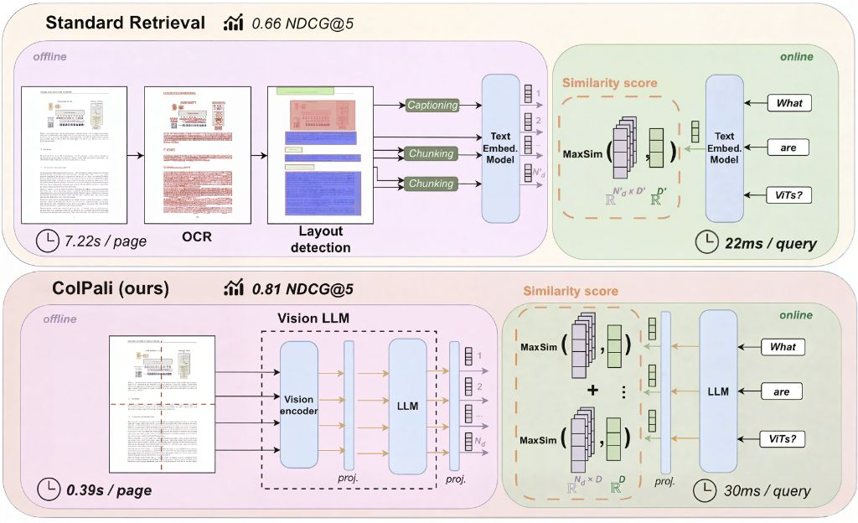



ColPali & ColQwen: Visual Document Retrieval
Multimodal RAG Architecture
HOW IT WORKS
Page → Image (skips fragile OCR/layout parsing pipeline)
VLM Encoding: Multi-vector embeddings • ColPali (Palidemma backbone) / ColQwen (Qwen2-VL backbone)
Query Processing: Convert to token embeddings
Late Interaction (MaxSim): Token-to-patch matching • Each query token matches best image patch → Aggregate scores
Result: Return top-k pages → optional reranker → LLM
Key Benefits
Trade-offs
Preserves visual context (tables, charts, fonts)
Higher storage (multi-vector per page)
Avoids fragile OCR + chunking errors
Why Visual Retrieval?
Strong performance on ViDoRe benchmark
Compute heavier than single-vector
Supports hybrid mode for text-heavy docs
PDFs often contain complex layouts, charts, tables → text-only pipelines lose context.
Visual-first retrieval preserves layout & visual cues, enabling accurate Q&A.

