Slide 1
Car Dealership
Daniil Mahad

Slide 2
Target Users & Stakeholders
Target Audience: Middle-class and upper-middle-class individuals looking to purchase cars.
Customers: People searching for new or used cars within a specific budget.
Dealership Admins: Manage car listings and customer inquiries.
Business Owners: Oversee platform performance and sales growth

Slide 3
Main Functionality:
Car Listings – Browse available cars with details and images.
Search & Filter – Find cars by model, price, and brand.
User Authentication – Secure login and account management.
Favorites – Save cars for later viewing.

Slide 4
Prototype
https://www.canva.com/design/DAGccu3sorg/yw4yJa9ZtlhY1x-u_oyWgg/edit?utm_content=DAGccu3sorg&utm_campaign=designshare&utm_medium=link2&utm_source=sharebutton

Slide 5
User stories
Login & Authentication – "As a user, I want to log in securely so I can access my account."
Car Listings – "As a customer, I want to browse available cars with details."
Search & Filter – "As a user, I want to search for cars by model, price, and brand."
Responsive Design – "As a user, I want a smooth experience on both mobile and desktop."
Add to Favorites – "As a customer, I want to save cars I’m interested in for later."

Slide 6
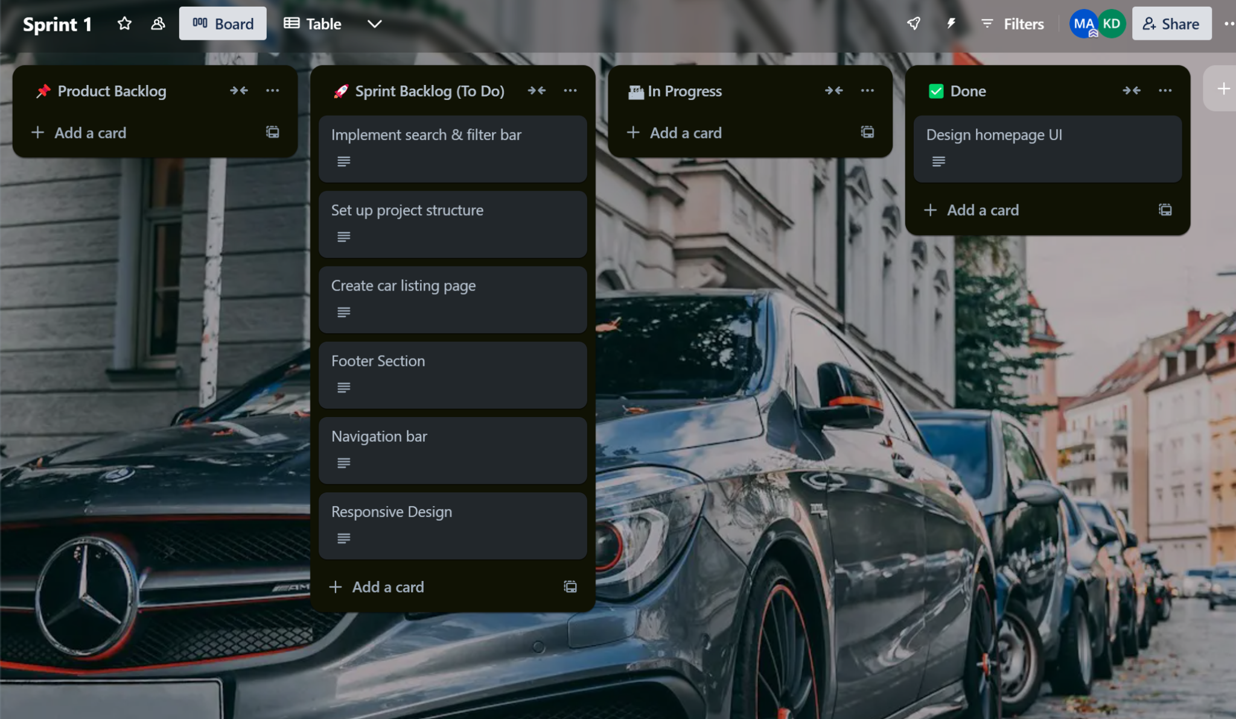
Backlog

Slide 7
Sprint ceremonies and insight
Daily Scrum
4 times a week:
  What was done?
  What will be done?
  Any blockers?
Sprint Planning
Select tasks from the Product Backlog

Slide 8
Team Contributions
Project Owner – Mahad
Defined the vision, prioritized tasks, and ensured the project met business goals.
Scrum Master – Daniil
Facilitated Scrum processes, removed blockers, ensured smooth collaboration, and helped the team stay productive.
Development Team – Sarujan and Joel
Sarujan – Took on major development tasks, solved key challenges, and optimized system performance.
Joel – Contributed to core feature development and actively participated in sprint discussions.
UI/UX Designer – Doni
Designed user-friendly interfaces, improved the platform's visual appeal, and enhanced the user experience.

Slide 9
Closing Remarks
Thank you for your time and attention! 🚗💻💥

