Slide 1
Chapter 8:Chalenges of Requirement Elicitation
Group 2: Andrew Denner

Slide 2
Overview
There are three main syndromes of software elicitation
“Yes, but…”
“Undiscovered ruins”
Users and Developers
Notes:
Requirements elicitation is plagued by 3 endemic syndromes… In this presentation I will cover what they are and potential methods to “cure” them.
“Yes, but…”… what I see is cool but could it do this also
“Undiscovered ruins” When is enough actually enough
Users and Developers… developers are from Mars Users are from Venus

Slide 3
“Yes, but…”
Two typical responses to software
“Cool”
“Yes but, wouldn’t it be neat if it could do…”
Why the “yes but”?
Human nature
User didn’t understand developer
Developer didn’t understand user

Slide 4
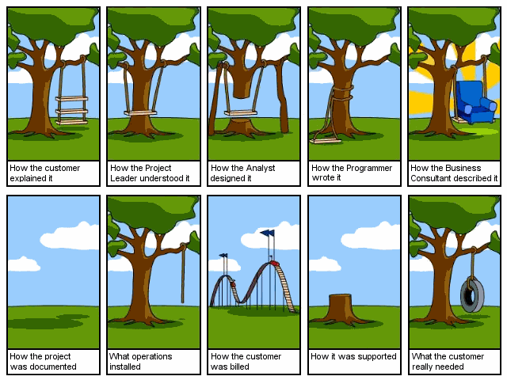
http://blog.dreamprojections.com/ Alex Gorbatchev March 05, 2005

Slide 5
“Yes, but…” cont.
Solution?
Software development compared to mechanical device development
Annoying, yes… but “Yes, but” can be a good thing
It leads to insights
It is human nature… expect it and plan for it
Get the buts out early

Slide 6
Undiscovered Ruins Syndrome
Requirements can be like looking for ruins, the more you find the more you know remain
Take time to identify all stakeholders. Especially non user stakeholders
You never will find them all… when is enough enough?

Slide 7
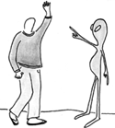
User & Developer Syndrome
Techniques have existed for 40 years
Communication problems exist due to different backgrounds motivations and objectives
How do we communicate?

Slide 8
User and Developer, solutions
Problem | Solution
Users do not know what they want, or they know what they want but cannot articulate it. | Recognize and appreciate the user as domain expert; try alternative communication and elicitation techniques.
Users think they know what they want until developers give them what they said they wanted. | Provide alternative elicitation techniques earlier: storyboarding, role playing, throwaway prototypes, and so on.
Analysts think they understand user problems better than users do. | Put the analyst in the user's place. Try role playing for an hour or a day.
Everybody believes everybody else is politically motivated. | Yes, its part of human nature, so let's get on with the program.
Notes:
The hope is that with a better understanding of both the nature of these problems and some approaches to mitigate them, developers will be better prepared for the interesting work ahead.

Slide 9
Conclusion
Understanding needs moves you out of comfort zone
We will be covering skills for problem analysis over the next few presentations
Interviews and questionnaires
Requirements Workshops
Brainstorming sessions and Idea Reduction
Story Boards

Slide 10
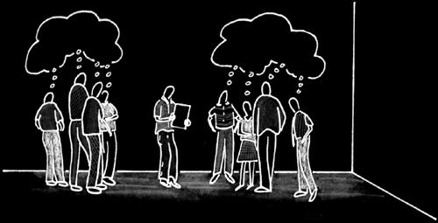
Chapter 9 THE FEATURES OF A PRODUCT OR SYSTEM
Group 2: Hojun Jaygarl

Slide 11
Key points
The development team → active role!! → in eliciting requirements for the system
Features : high level expression of desired system behavior
# of system features = 25-99 <= 50 preferred
Attributes: additional information about a feature

Slide 12
Active role
Problem
Specification
It is usually NOT a perfect or perhaps even reasonable understanding
The basis for system development
Why?
The dev team was passive

Slide 13
Active role
How to solve?
Go out and get them!
Play a much more active role!
To get better definition
To elicit better requirements
The majority of the responsibility
A senior lead, analyst, or product manager
BUT, in the end, the entire team

Slide 14
Stakeholder and User Needs
Obvious fact: the dev team understands the true needs of the stakeholder ➔ they will build a better system
That knowledge: the information to make better decision in the definition and implementation of the system.
Stakeholder or user needs
This set of input provides a crucial piece of puzzle.

Slide 15

Stakeholder and User Needs
Definition
Stakeholder need:
A reflection of the business, personal, or operational problem (or opportunity) that must be addressed in order to justify consideration purchase, or use of a new system

Slide 16
Features
If stakeholders need
“If I don’t increase productivity in this department. I won’t get my bonus this year”
“I want to be able to slow this vehicle down as quickly as possible without skidding”
“I must reduce sales order entry transaction processing time by 50 percent”
“The vehicle shall have a computer control system for each wheel”
Instead, they describe what seems to be an abstraction somewhere between
“I need a new GUI based order entry screen”
and
“I want a vehicle with ABS”
Real Needs
Actual Requirement for a system

Slide 17
Features
The high-level expression ➔ the features!!
Problem:
Often not well defined
May even be in conflict with one another
“I want increased order process rates”
Productivity
➔
What is their real needs????
“I want to provide a far more user friendly interface to help our new employees learn the system”
Safety

Slide 18
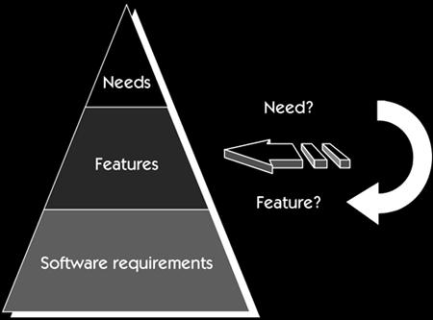
Features
What is happening?
The stakeholders have already translated the real needs into a system behavior in their mind.
They believe it will solve the real need:
This is not a bad thing!
➔ They are real expertise
➔ It is easy to discuss in natural
language
What
(I need)
How(“what I think the system should do to address this need”

Slide 19
Caveat of Features
If the dev team doesn’t understand the need behind the feature → real risk!
If the feature does not solve the real need → the system may fail to meet the objectives (even though the implementation delivered the feature)
You are right, but you still lose!

Slide 20
Definition of Features
Feature : a service that a system provides to fulfill one or more stakeholder needs
Features are a convenient way to describe functionality without getting bogged down in detail.
→ features cannot be too far removed from their needs
→ a handy way to define the system.

Slide 21
Understanding of Features
Understanding
User
Needs
On eliciting (organizing) the needs (features) of the proposed system
Focus
All Needs, No Features
No Needs, All Features
Be careful not to be confused of it.
Features
Early product scope management, the related negotiation, trade-off process
Help

Slide 22
Expression of Features
Feature Expression
natural language, consist of a short phrase
Application Domain | Example of a Feature
Elevator control system | Manual control of doors during fire emergency
Inventory control system | Provide up-to-date status of all inventoried items
Defect tracking system | Provide trend data to assess product quality
Payroll system | Report deductions-to-date by category
Home lighting automation system (HOLIS) | Vacation settings for extended away periods
Weapon control system | Minimum of two independent confirmations of attack authorization required
Shrink-wrap application | Windows XP compatibility

Slide 23
Managing Complexity
Pick the level of abstraction
A relatively small and manageable amount of information
➔a comprehensive and complete basis
➔ for product definition, communication, scope management, and project management.
Effectively pick the level of abstraction of the definition
22-99,
< 50 preferred
# of Features

Slide 24
Scoping after enumerating features
Start making such decision as
“defer to a later release”
“implement immediately”
“reject entirely”
“investigate further”
➔ Team Skill 4

Slide 25
Attributes of Features
Attributes
help better manage features, complexity of the information
make relation to other types of project information
No limited type
Use to
Track (name, unique id, sponsor, history data, allocated from, traced to
Prioritize(priority field)
Manage(status, progress)

Slide 26
Summary
Feature –
25-50 features describe simply and elegantly
→ what a system needs to do
→ how much time and effort may be required to do it
Simple, but Critical
Easy to elicit
Easy to document
Easy to maintain
User friendly

Slide 27
Interviewing
Chapter 10

Slide 28
Content
Key Points
Two types of questions
Compiling the Needs Data
Questionnaires

Slide 29
Key Points
A simple and direct technique
Can be used in most circumstances
Context-free questions for bias-free interviews
Solution-context questions for undiscovered requirements
Initiate a “requirements repository”
A questionnaire is no substitute for an interview

Slide 30
Context-Free Questions
Help us gain an understanding of the real problem without biasing the user’s input.
Force us to listen before attempting to offer solution.
Give us better understanding of the customer’s real problem.
Notes:
Ask questions about the nature of the user’s problem without context for potential problems.
For example:
Who is the user?
Who is the customer ?
Are their needs different ?
Find out any probs behind the problem.
As a part of technique called “solutions selling”
Where else can a solution to this problem found ?

Slide 31
Solutions-Context Questions
After context-free questions session.
Not only understanding but also providing appropriate solutions.
May give the user new insights and even a different view of the problem.

Slide 32
The generic, almost context-free interview
Part1: Establishing the customer/user profile
Name, company, industry, job title, etc
Key responsibilities, outputs, for whom, etc
Part2: Assessing the problem
Which problems do you lack a good solution ? What are they ? How they currently be solved ?
Part 3: Understanding the user environment
Who are the users? Their educational/computer background ? Which platforms are in use? etc

Slide 33
The generic, almost context-free interview
Part 4: Recap for understanding
List customer described problems in your own words
Check it whether adequately represent the current problems
Part 5: The analyst’s inputs on the customer’s problem
List any needs or additional problems you think should concern the customer/user
For each suggested problems check it is feasible and realistic enough.
Part 6: Assessing your solution
Summarize the key capabilities of your proposed solution and ask the customer/user to rank them.

Slide 34
The generic, almost context-free interview
Part 7: Assessing the Opportunity
Who needs this application ? How many types of users ?
Part 8: Assessing the reliability, performance, and support needs
What are your expectation for … ? What about maintenance/service access/installation/configuration ?

Slide 35
The generic, almost context-free interview
Part 9: Other requirements
Are there any legal, regulatory or environmental requirements or other standards that must be supported ?
Could you think any other requirements we should know about ?
Part 10: Wrap-up
Any other questions ? Will you participate in a requirements review?
Part 11: The analyst’s summary
Summarize three highest priority needs/problems identified by user/customer

Slide 36
Compiling the needs data
Record the three most important needs or problems uncovered in each interview.
After few interviews, these highest-priority needs will start to be repeated.
Ten interviews will often create only 10-15 different needs

Slide 37
Notes on the Interview
Prepare an appropriate context-free interview
Research the background of the stakeholder and the company to be interviewed.
Do not ask questions you are able answer but it is ok to verify the answers with the interviewee.

Slide 38
Notes on the Interview (cont)
Write down answers in your notebook during the interview.
It is ok to let the interviewee wander off course a bit, but the interviewer has to keeps the goal of interview in mind.

Slide 39
Questionnaires
Can be used effectively to gather a significant amount of focused data in a short period of time.
No substitute for an interview
Relevant questions cannot be decided in advance
The assumptions behind the questions bias the answer
Difficult to explore new domains
No Interaction
Difficult to follow up on unclear user responses.

Slide 40
Summary
One of easiest way to find out what a system needs.
Gathering requirements in a structured way (ask right person a right question in a right way).
Workshop can be helped to augment this fundamental process.

