Slide 1
Chapter 11: The requirements workshop
Group 2: Andrew Denner

Slide 2
Overview
The requirements workshop is one of the most powerful techniques for eliciting requirements
Gathers all stakeholders for a short period
The use of outside facilitator can help
Brainstorming is the most important part of the workshop

Slide 3
Why Requirements Workshop
There are many different methods for requirement elicitation
It is beneficial to use many different tools
Most versatile is Workshoping

Slide 4
Benefits
Assists building an effective team… one purpose, the success of the project
All stakeholders get their say
Forces agreement on what app must do
Expose and resolve potential political issues
Output of preliminary system definition at features level is available almost right away

Slide 5
Preparations
Proper preparation is critical
Expect resistance… but if you build it they will come
Take time to ensure participation of the right stakeholders
Attend to logistics
Proper invitations , lighting etc.
Expect Murphy’s Law
Appearance is everything

Slide 6
Warm-up Materials
Send out materials in advance, it will get the crowd in the right mental state
Push the idea “This is not just another meeting”
Two types of warm-up materials
Project Specific materials
Out of the box thinking material
Don’t send out materials too far in advance

Slide 7
Choosing the Facilitator
If possible have a specialist, not a team member—a non stakeholder
If it must be a team member they should have:
Received training in the process
Demonstrate strong consensus building skills
Be personable and well respected
Be strong enough to chair a challenging meeting
The facilitator must be objective

Slide 8
The facilitator’s Responsibility
Establish a professional and objective tone for the meeting.
Start and stop the meeting on time.
Establish and enforce the "rules" for the meeting.
Introduce the goals and agenda for the meeting.
Manage the meeting and keep the team "on track."

Slide 9
…The facilitator’s Responsibility
Facilitate a process of decision and consensus making, but avoid participating in the content.
Manage any facilities and logistics issues to ensure that the focus remains on the agenda.
Make certain that all stakeholders participate and have their input heard.
Control disruptive or unproductive behavior.

Slide 10
Setting an agenda
The agenda should be needs based, but structured
Most follow a standard form

Slide 11
Time | Agenda Item | Description
8:00 – 8:30 AM | Introduction | Review agenda, facilities, and rules
8:30 – 10:00 AM | Context | Present project status, market needs, results of user interviews, and so on
10:00-2:00 PM | Brainstorming | Brainstorm features of the application
12:00-1:00 PM | Lunch | Work through lunch to avoid loss of momentum
2:00-3:00 PM | Feature definition | Write out two- or three-sentence definitions for features
3:00-4:00 PM | Idea reduction and prioritization | Prioritize features
4:00-5:00 PM | Wrap-up | Summarize and assign action items, address "parking lot" items

Slide 12
After the Workshop
Follow-up
The facilitator is responsible for sending out minutes, records and outputs
After that the project leader must follow-up on open action items and organize info for output
Often is simple list of ideas or features

Slide 13
Review
Holding a workshop is powerful, and gets everyone under one roof and properly aligned
Allows a compression of many methods into one marathon event
Outside facilitators experience is helpful

Slide 14
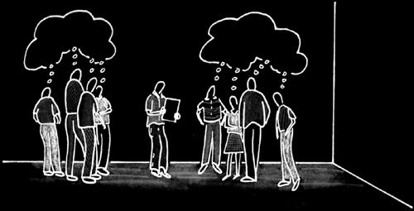
Chapter 12 Brainstorming and Idea Reduction
Group 2: Hojun Jaygarl

Slide 15
Key points
Brainstorming involves both idea generation idea reduction.
The most creative, innovative ideas often result from combining multiple, seemingly unrelated ideas.
Various voting techniques may be used to prioritize the ideas created.
Although live brainstorming is preferred, Web-based brainstorming may be a viable alternative in some situations.

Slide 16
Brainstorming!
When you are in the workshop
Whenever you found yourself needing new ideas or creative solutions to problems
→ Brainstorming is a very useful technique. It's simple, fun, and an easy way to get all stakeholders to contribute.

Slide 17
Finding undiscovered ruins
The workshop provides the opportunity to solicit new input and to mutate and combine these new features with those already under consideration.
This process will also help in the goal of "finding the undiscovered ruins" and thereby making sure that you have complete input and that all stakeholder needs are addressed.
Typically, a portion of the workshop is devoted to brainstorming new ideas and features for the application.

Slide 18
Benefits of Brainstorming
This elicitation technique has a number of benefits.
It encourages participation by all parties present.
It allows participants to "piggyback" on one another's ideas.
It has high bandwidth. Many ideas can be generated in a short period of time.
The results typically indicate a number of possible solutions to whatever problem is posed.
It encourages out-of-the-box thinking, that is, thinking unlimited by normal constraints.

Slide 19
Phases of Brainstorming
Brainstorming has two phases
Idea generation
Delineate as many ideas as possible
Focus on breadth of ideas, not necessarily depth.
Idea reduction
Analyze all the ideas generated.
Idea reduction includes pruning, organizing, ranking, expanding, grouping, refining, and so on.

Slide 20
Live Brainstorming
All the significant stakeholders gather in one room, and supplies are distributed.
The supplies given to each participant
A stack of large sticky notes and a thick black marker for writing on the notes.
3" x 5" (7 cm x 12 cm) - 5" x 7" (12 cm x 17 cm)
At least 25 sheets for each session.
Also need index cards, pushpins, and a soft wall, such as a large corkboard.

Slide 21
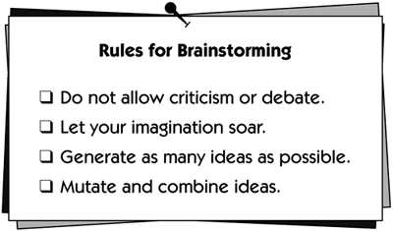
Live Brainstorming
3. Then the facilitator explains the rules.

Slide 22
Live Brainstorming
4. States clearly and concisely the objective of the process.
The way the objective is stated will affect the outcome of the session.
For example, the following questions are a few ways to state the objective.
What features would you like to see in the product?
What services should the product provide?
What opportunities are we missing in the product or the market?

Slide 23
Live Brainstorming
4. The facilitator asks participants to share their ideas aloud and to write them down, one per sheet.
This process is important
To make sure the idea is captured in that person's own words
To make sure ideas are not lost
To enable posting of ideas for later piggybacking
To prevent delays in the creative process that could be caused by a single scribe trying to capture all ideas on a flip chart or whiteboard in front of the room

Slide 24
Live Brainstorming
5. Collect and Post idea on a wall
Remember, no criticism or debate!
"That's a stupid idea“, "We already have that idea on the wall."
➔ the deleterious effect of suppressing further participation
"That's a Great Idea!“
➔ encourage further participation by all stakeholders.

Slide 25
Live Brainstorming
5. Collect and Post idea on a wall
Remember, no criticism or debate!
"That's a stupid idea“
"We already have that idea on the wall.“
The deleterious effect of suppressing further participation
"That's a Great Idea!“
encourage further participation by all stakeholders.

Slide 26
Live Brainstorming
Lulls
It is common for silence to occur during idea generation.
There are not times to stop
Longer nulls ➔ state the objective again and ask stimulation questions

Slide 27
Live Brainstorming
Time to stop
Most idea-generation sessions last around an hour(some last 2-3 hours).
It is common to generate 50–100 ideas.
The process tends to have a natural end; at some point, the stakeholders will simply run out of ideas.

Slide 28
Idea Reduction
After the idea generation, it is time to initiate idea reduction. Several steps are involved.
Pruning ideas
Grouping ideas
Defining Features
Prioritizing ideas

Slide 29
Idea Reduction – Pruning Idea
Visiting each idea briefly,
Asking for concurrence from the group that the idea is basically valid.
Is the idea worthy?
Agreement: No
Remove
Agreement: Yes
Stay
Disagreement

Slide 30
Idea Reduction – Grouping Idea
Related ideas are grouped together in regions of the walls. Name the groups of related ideas.
Idea generation can be reinitiated now for any one of these groups
E.g.:
New features
Performance issues
Enhancements to current features
User interface and ease-of-use issues
A freight and delivery service:
Package routing and tracking
Customer service
Marketing and sales
Web-based services
Billing
Transportation management

Slide 31
Idea Reduction – Defining Features
Writing a short description of what the idea meant to the person who submitted it.
Gives the opportunity to further describe the feature
helps ensure that the participants have a common understanding of the feature
Application Context | Brainstormed Feature | Feature Definition
Home lighting automation | "Automatic lighting settings" | Homeowner can create preset time-based schedules for certain lighting events to happen, based on time of day.
Sales order entry system | "Fast" | Response time will be fast enough not to interfere with typical operations.
Defect tracking system | "Automatic notification" | All registered parties will be notified via e-mail when something has changed.

Slide 32
Idea Reduction – Prioritizing Ideas
Once the groupings have stabilized and been agreed to, it is time to prioritize ideas.
Cumulative Voting: The Hundred-Dollar Test
Each person is given $100 to be spent on "purchasing ideas."
Limit the amount spends on one feature
Caveat : Work only once. Participants will bias in the next time.
Results of cumulative voting:
Idea 1 $380
Idea 2 $200
Idea 3 $180
Idea 4 $140
Idea 5 . . .
.
.
.
Idea 27 . . .

Slide 33
Idea Reduction – Prioritizing Ideas
2. "Critical, Important, Useful" Categorization
Good for small group
# of votes = # of ideas
Each vote must be categorized:
Critical (1/3), Important(1/3), Useful(1/3)
Critical (9pts): indispensable, Without the feature, the system does not fulfill its primary mission or meet the market need.
Important (3pts): There could be a significant loss. If the important items don't get implemented, some users would not like the product and would not buy it.
Useful (1 pt): Nice to have.
At lest useful → to avoid insult to other ideas

Slide 34
Web-Based Brainstorming
Sometimes live brainstorming is not possible → Internet or an intranet based brainstorming
It may be particularly suited for
developing advanced applications for which research is required
a long term view is critical
the concept is initially fuzzy, wide variety
significant number of users and other stakeholders inputs are involved

Slide 35
Web-Based Brainstorming
Records and comments on product features → it gives persistence.
Ideas and comments can be circulated over a long period time with full recording.
Ideas can grow and mature with the passage of time.

Slide 36
The Case Study: The HOLIS Requirements Workshop
The attendees
Name | Role | Title | Comments
Rick | Facilitator | Director of marketing
Alyssa | Participant | HOLIS product manager | Project champion
Marcy | Participant | Software development manager | Development responsibility for HOLIS
Lucy | Participant |  | Prospective homeowner
Elmer | Participant |  | Prospective homeowner
E.C. | Participant | CEO, Automation Equip | Lumenations' largest distributor
Raquel | Participant | GM, EuroControls | Lumenations' European distributor
Betty | Participant | President, Krystel Electric | Local electrical contractor
Rusty | Participant | President, Rosewind Construction | Custom homebuilder
Emily | Observer | VP and GM, Lumenations
Various members | Observer | Development team | All team members who were available

Slide 37
The Case Study: The HOLIS Requirements Workshop
The workshop
a warm up package
A few recent magazines articles highlighting the trends in home automation
Copies of selective interviews that had been conducted
A summarized list of the needs that had been identified to date

Slide 38
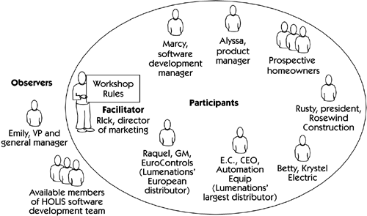
The Case Study: The HOLIS Requirements Workshop
HOLIS requirement workshop structure

Slide 39
The Case Study: The HOLIS Requirements Workshop
The Session
All participants were able to have their input heard.
Rick did a fine job of facilitating, but one awkward period occurred when Rick got into an argument with Alyssa about priorities for a couple of features. (The team members decided that for any future workshop, they would bring in an outside facilitator.)
Rick led a brainstorming session on potential features for HOLIS, and the team used cumulative voting to decide on relative priorities.

Slide 40
The Case Study: The HOLIS Requirements Workshop
The analysis of Results
The results of the process turned out as expected, except for two significant items.
"Built-in security“ It had low priority.
➔ After a quick offline review, decided to include this functionality and to position it as a unique, competitive differentiator in the marketplace.

Slide 41
Summary
Our management goal
Maximize the productivity and achievement
In harmony with the objectives
We need to propel team members to show
the unique and creative talents and individual skills
The workshop and brainstorming techniques
helps us meet this objective, at least within the requirements management context.

Slide 42
Chapter 13. Storyboarding
Group 2: Nam Pham

Slide 43
Content
Overview
Types of storyboards
What storyboards do
Tools
Conclusions

Slide 44
Storyboarding
Extremely inexpensive
User friendly, informal and interactive
Provides an early review of the user interfaces of the system
Easy to create and easy to modify

Slide 45
Types of storyboards
Passive:
Tell a story to the user
Active storyboards:
Try to make the user see “a movie that hasn’t actually been produced yet”
Interactive storyboards:
Let user experience the system is as realistic a manner as practical.

Slide 46
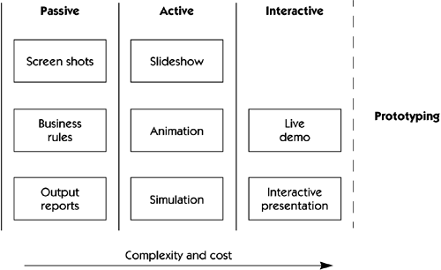
Types of storyboards

Slide 47
What storyboards do
To work through the details of the human-to-machine interface.
For used-based systems
Who the players are (users, other systems, devices, etc)
What happens to them (behavior of the users and systems)
How it happens (showing events, states, state transition).

Slide 48

An example of storyboards
The WHO represented the guests who ride on the roller coaster (going to die)
The WHAT represented the behavior of the roller coaster (falls out and kills everyone).
The HOW provided further description of how this interaction happens (the roller coaster smashes into the camera, all of the harnesses rise back up, the front eight cars depart from the tracks, etc and people are scared to death)

Slide 49
Tools
Passive-storyboarding: paper, pencil or post-it notes.
Active-storyboarding: Power Point, pdf files
Interactive-storyboarding: software package for interactive prototyping such as Macromedia’s Director and Cinemation.

Slide 50
Some notes
Do not invest to much on a storyboard.
Make the storyboard easy to modify.
Do not make the storyboard too functional.
Make the storyboard interactive whenever possible.

Slide 51
Conclusions
Provide an early review of the user interfaces of the system.
To elicit early “Yes, But” syndrome (possible “blank-page” syndrome).
Passive, active, or interactive
Identify the players, explain what happens, and describe how it happens to them
Sketchy, user friendly, interactive and easy to modify
Do early and often with new or innovative content

