Slide 1
Setting the scene: Why ongoing HIV service delivery prioritization matters now
HIV service delivery prioritization in resource-constrained settings
Anna Grimsrud, IAS
18 August 2026

Slide 2

What if this isn’t the storm…
…what if it’s the climate?
Notes:
For the last few years, we've talked about responding to crisis.
As though the funding shock we're experiencing is temporary.
But what if it isn't?
What if this isn't a storm that will pass...
...but a new climate in which HIV programmes will need to operate?
If that's true, then the challenge changes.
It is no longer simply about finding more money.
It becomes about making deliberate choices about where every dollar can have the greatest impact.
And that's what today is about.

Slide 3
Supporting countries to prioritize
Many interventions
Limited resources
Countries need to decide
TIER (2025)
Tool for Intervention Evaluation and Ranking
Notes:
We developed TIER to support countries through exactly these conversations.
Not to prescribe priorities...
but to provide a transparent process for making difficult decisions.
It combines programme data, evidence and country expertise to answer one question:
Given our context, which interventions matter most?

Slide 4

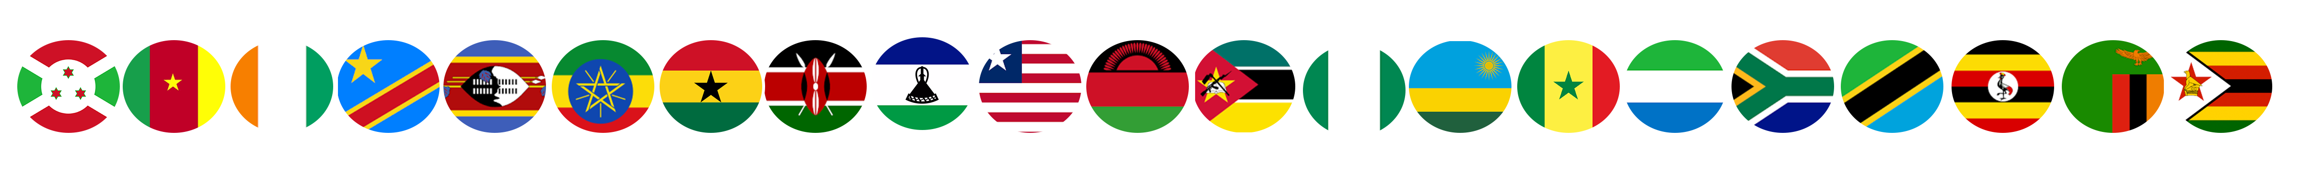
Countries – and communities – used TIER
Versions of the TIER were used by at least 21 countries
COMPASS partners adapted the TIER tool to develop a, “TIER-Community Prioritization Tool” for HIV, TB, Malaria, NCDs and pandemics
For example, in Tanzania, circulated draft to community service organizations to determine the prioritization of the interventions and used their TIER to engage regarding prioritization with the Global Fund, PEPFAR and national government
Prioritization became a shared conversation rather than a technical exercise.
Notes:
One of the things we found most encouraging...
was that this wasn't simply a Ministry of Health exercise.
Community organizations adapted the framework as well.
Suddenly governments, civil society and partners were discussing priorities using a common language.
That fundamentally changed the conversation.

Slide 5
“SHOW US THE IMPACT”
TIER could identify priorities......but not quantify their impact.
Notes:
And then something interesting happened.
Countries kept asking us the same question.
"You've helped us prioritize."
"Now tell us..."
Which intervention saves the most lives?
Which delivers the greatest return?
What happens if we invest here instead of there?
They weren't looking for another ranking.
They wanted evidence about the consequences of their decisions.

Slide 6
Enter TIER-Plus
From prioritization to potential impact
Compare scenarios
Estimate outcomes
Understand trade-offs
Designed to be openly available – not just for select stakeholders.
Notes:
TIER-Plus wasn't developed because TIER failed.
It was developed because countries asked the next question.
If TIER helps us decide...
can you also estimate what happens after we decide?
Can you estimate costs?
Can you estimate outcomes?
Can you compare scenarios?
That's exactly what you'll see in Dr Nichols’ presentation later today.

Slide 7
Thank you

