Slide 1


Slide 2
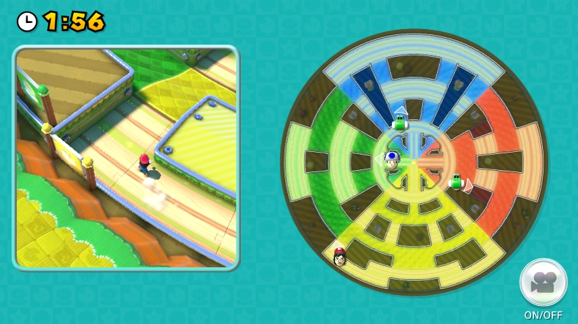

Slide 3
Rules
4 Toads coordinate to capture Mario within X seconds
Closed Arena
Toads know distance from Mario, but do not know in which direction
Mario knows the exact location of all Toads

Slide 4
Our Methods
Model a simplified game version in Python
Develop algorithms for Toads (Capturing)
Develop algorithms for Mario (Evasion)
Measure algorithms against one another

Slide 5
Mario’s Evade Algorithm
M1: Random Movement
Mario moves randomly, avoids walls
M2: Basic Evasion
Mario moves away from closest toads
M3: Advanced Evasion
Mario pathfinding to safe locations

Slide 6
Toad’s Chase Algorithm
T1: Random Movement
Each toad moves in random direction
T2: Basic Toad Movement (No Collaboration)
Each toad measures distance to Mario
If the distance is decreasing, toad maintains direction
If the distance is increasing, toad changes direction
T3: Advanced Toad Movement (Collaboration)
Toads share locations and distances with one another
Toads move toward closest toad

Slide 7
Analysis 1000 Trials Each
Toad Win% | M1 | M2 | M3
T1
T2 | 99.6% | 99.5% | 97.4%
T3 | 99.9% | 99.9 | 71.3%
AVG Game Length(sec) | M1 | M2 | M3
T1
T2 | 38.425 | 33.155 | 45.283
T3 | 32.749 | 42.563 | 92.294

