Slide 1



AppointmentAnalysis_Makus&Obasanya
View in Power BI
Last data refresh:
4/10/2020 2:42:39 PM Eastern Standard Time
Downloaded at:
4/10/2020 2:53:46 PM Eastern Standard Time

Slide 2
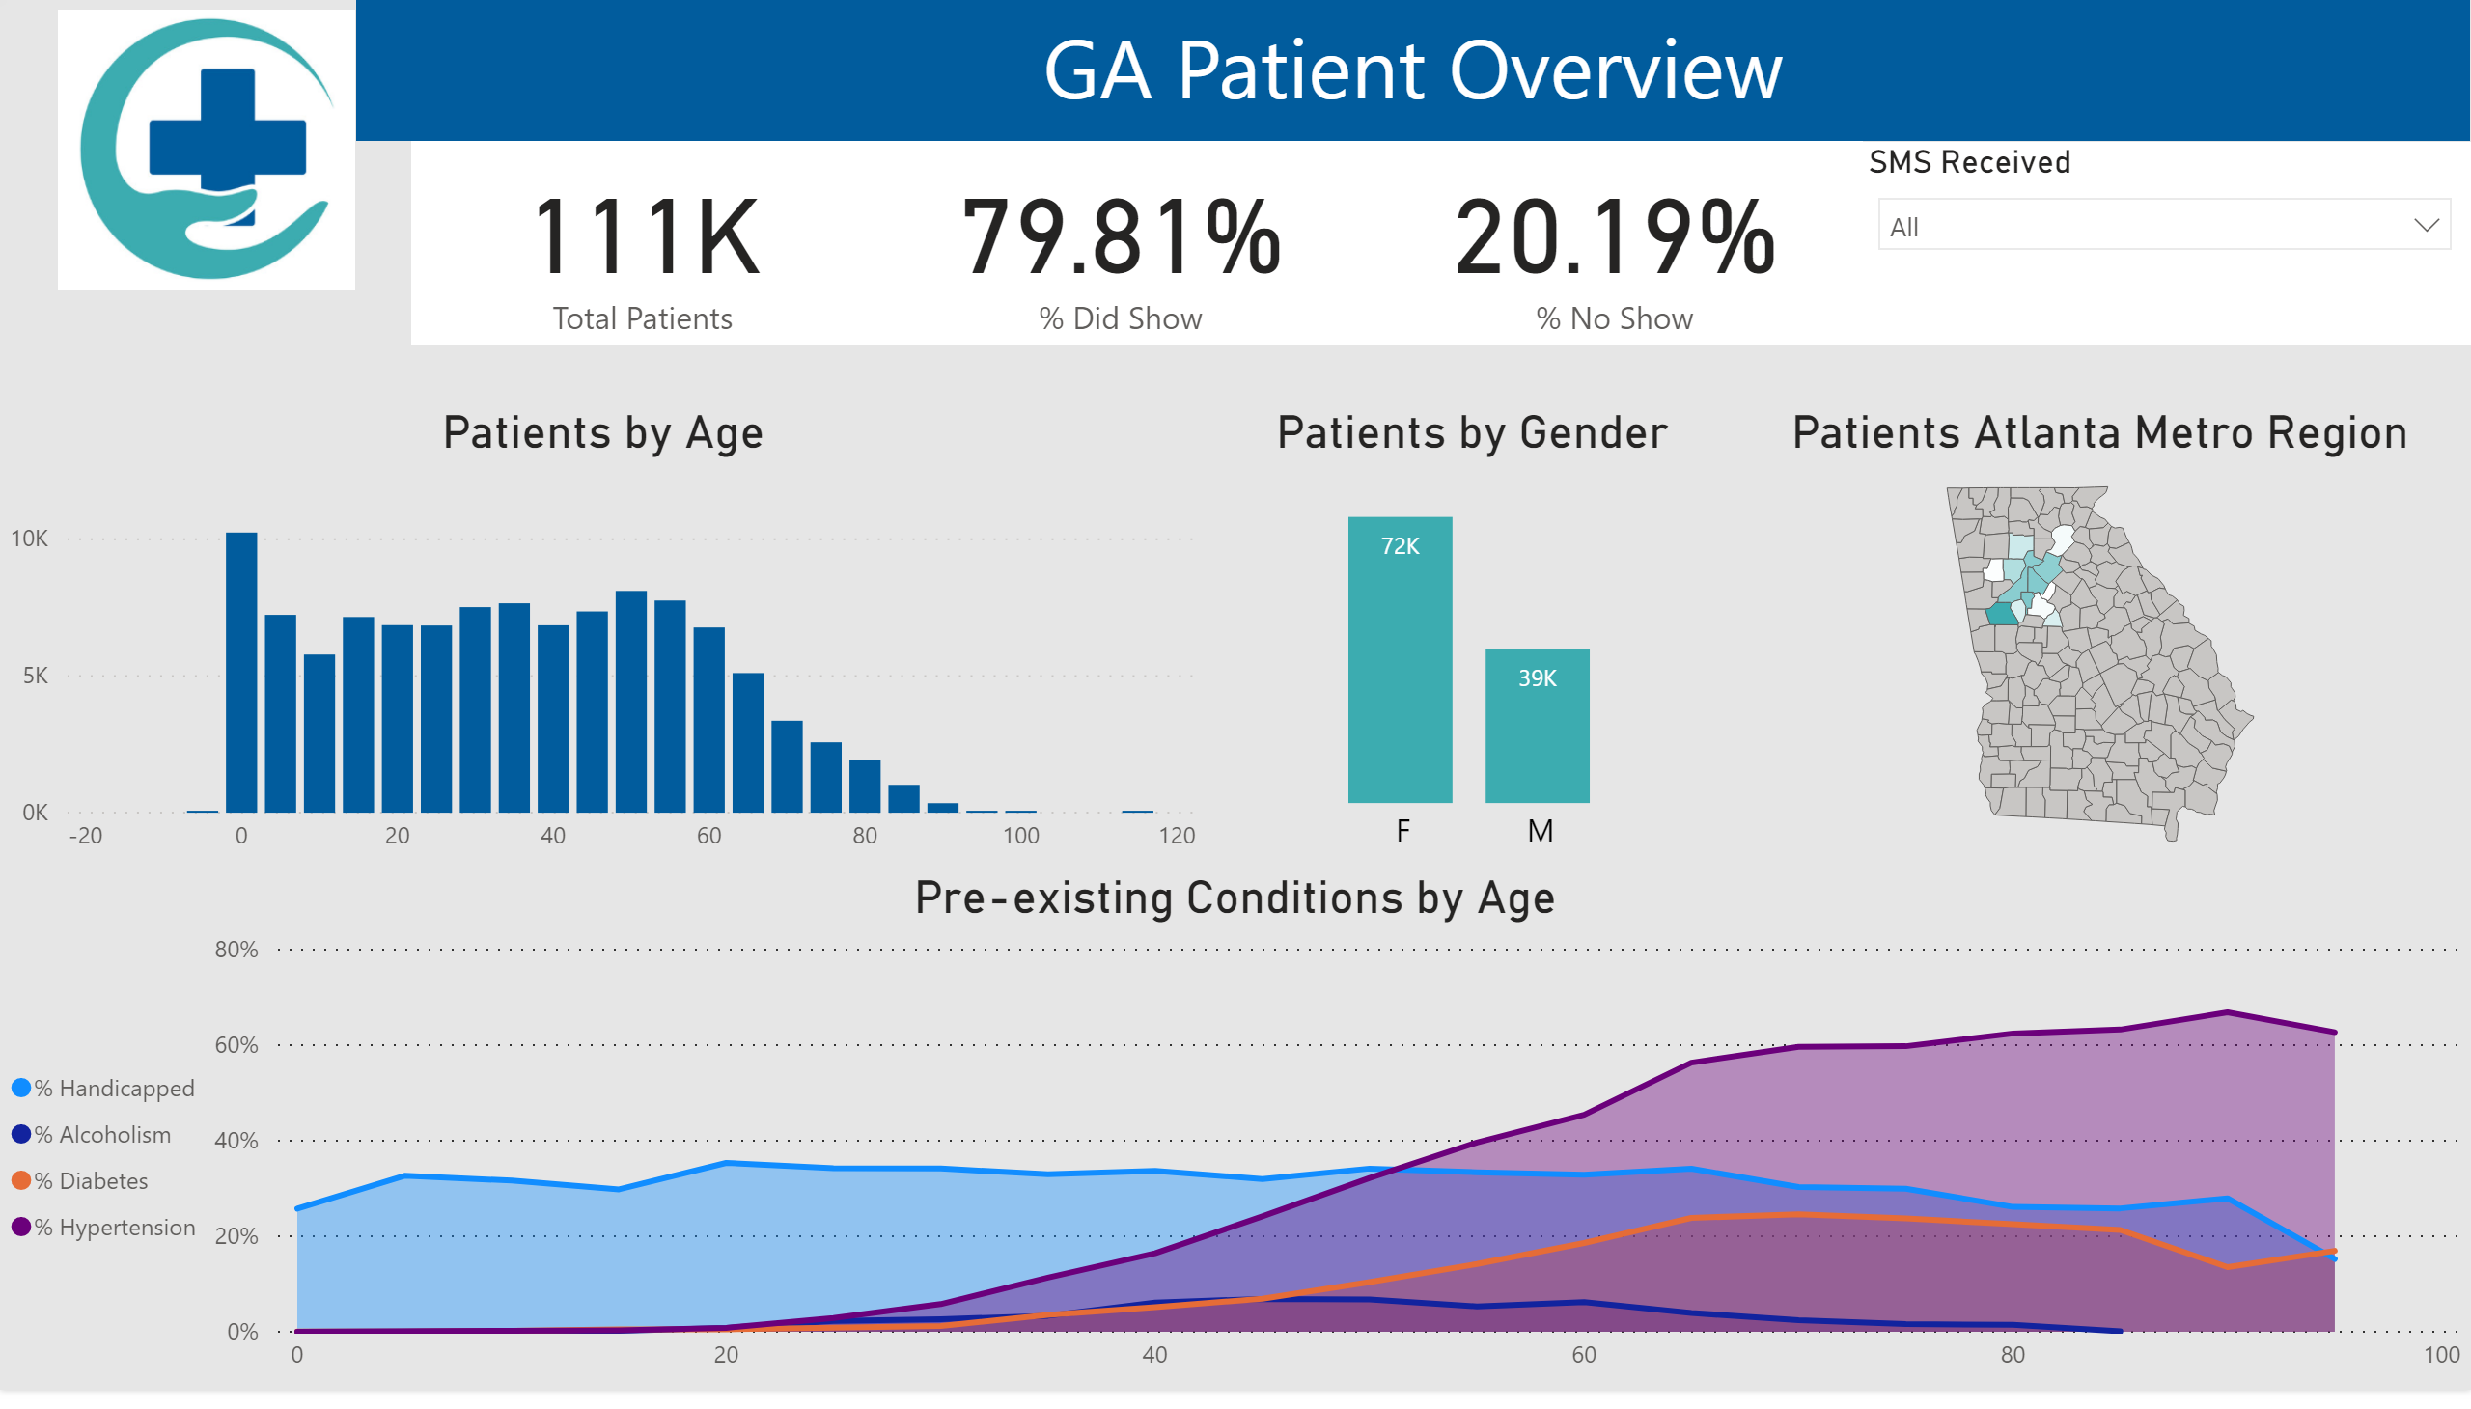

Slide 3
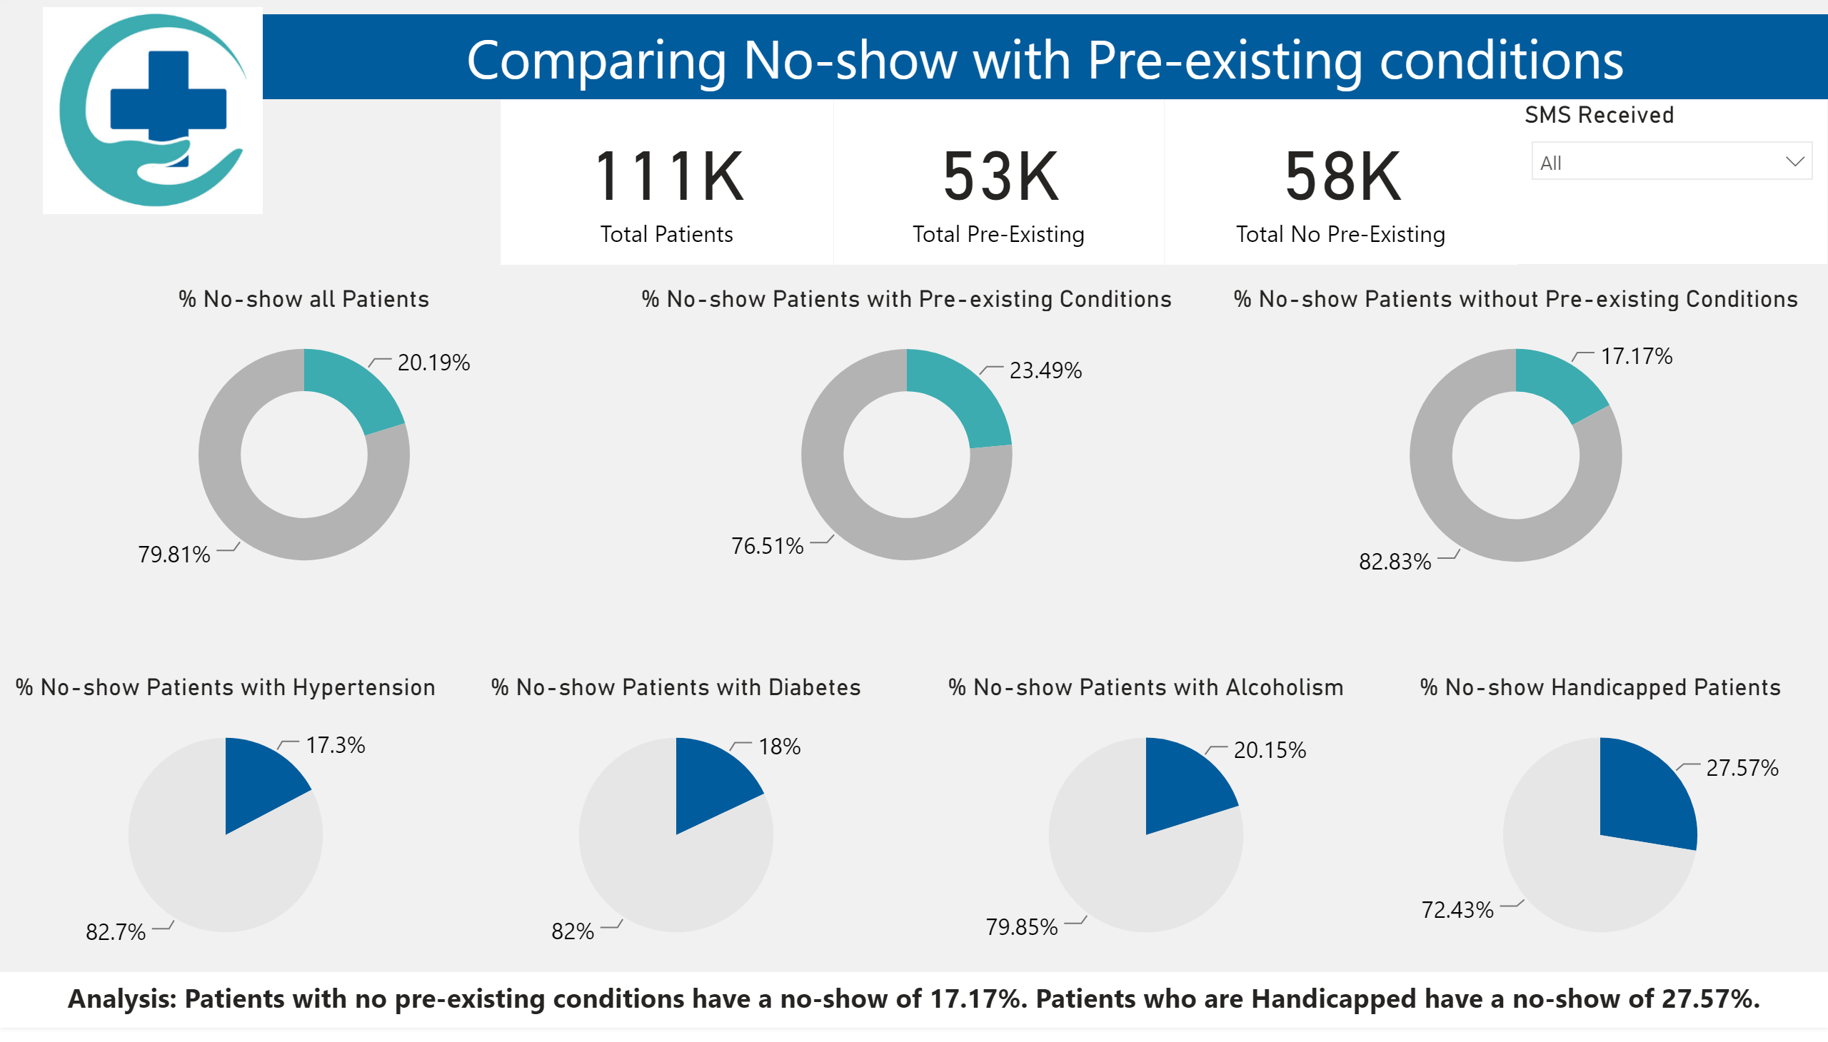

Slide 4
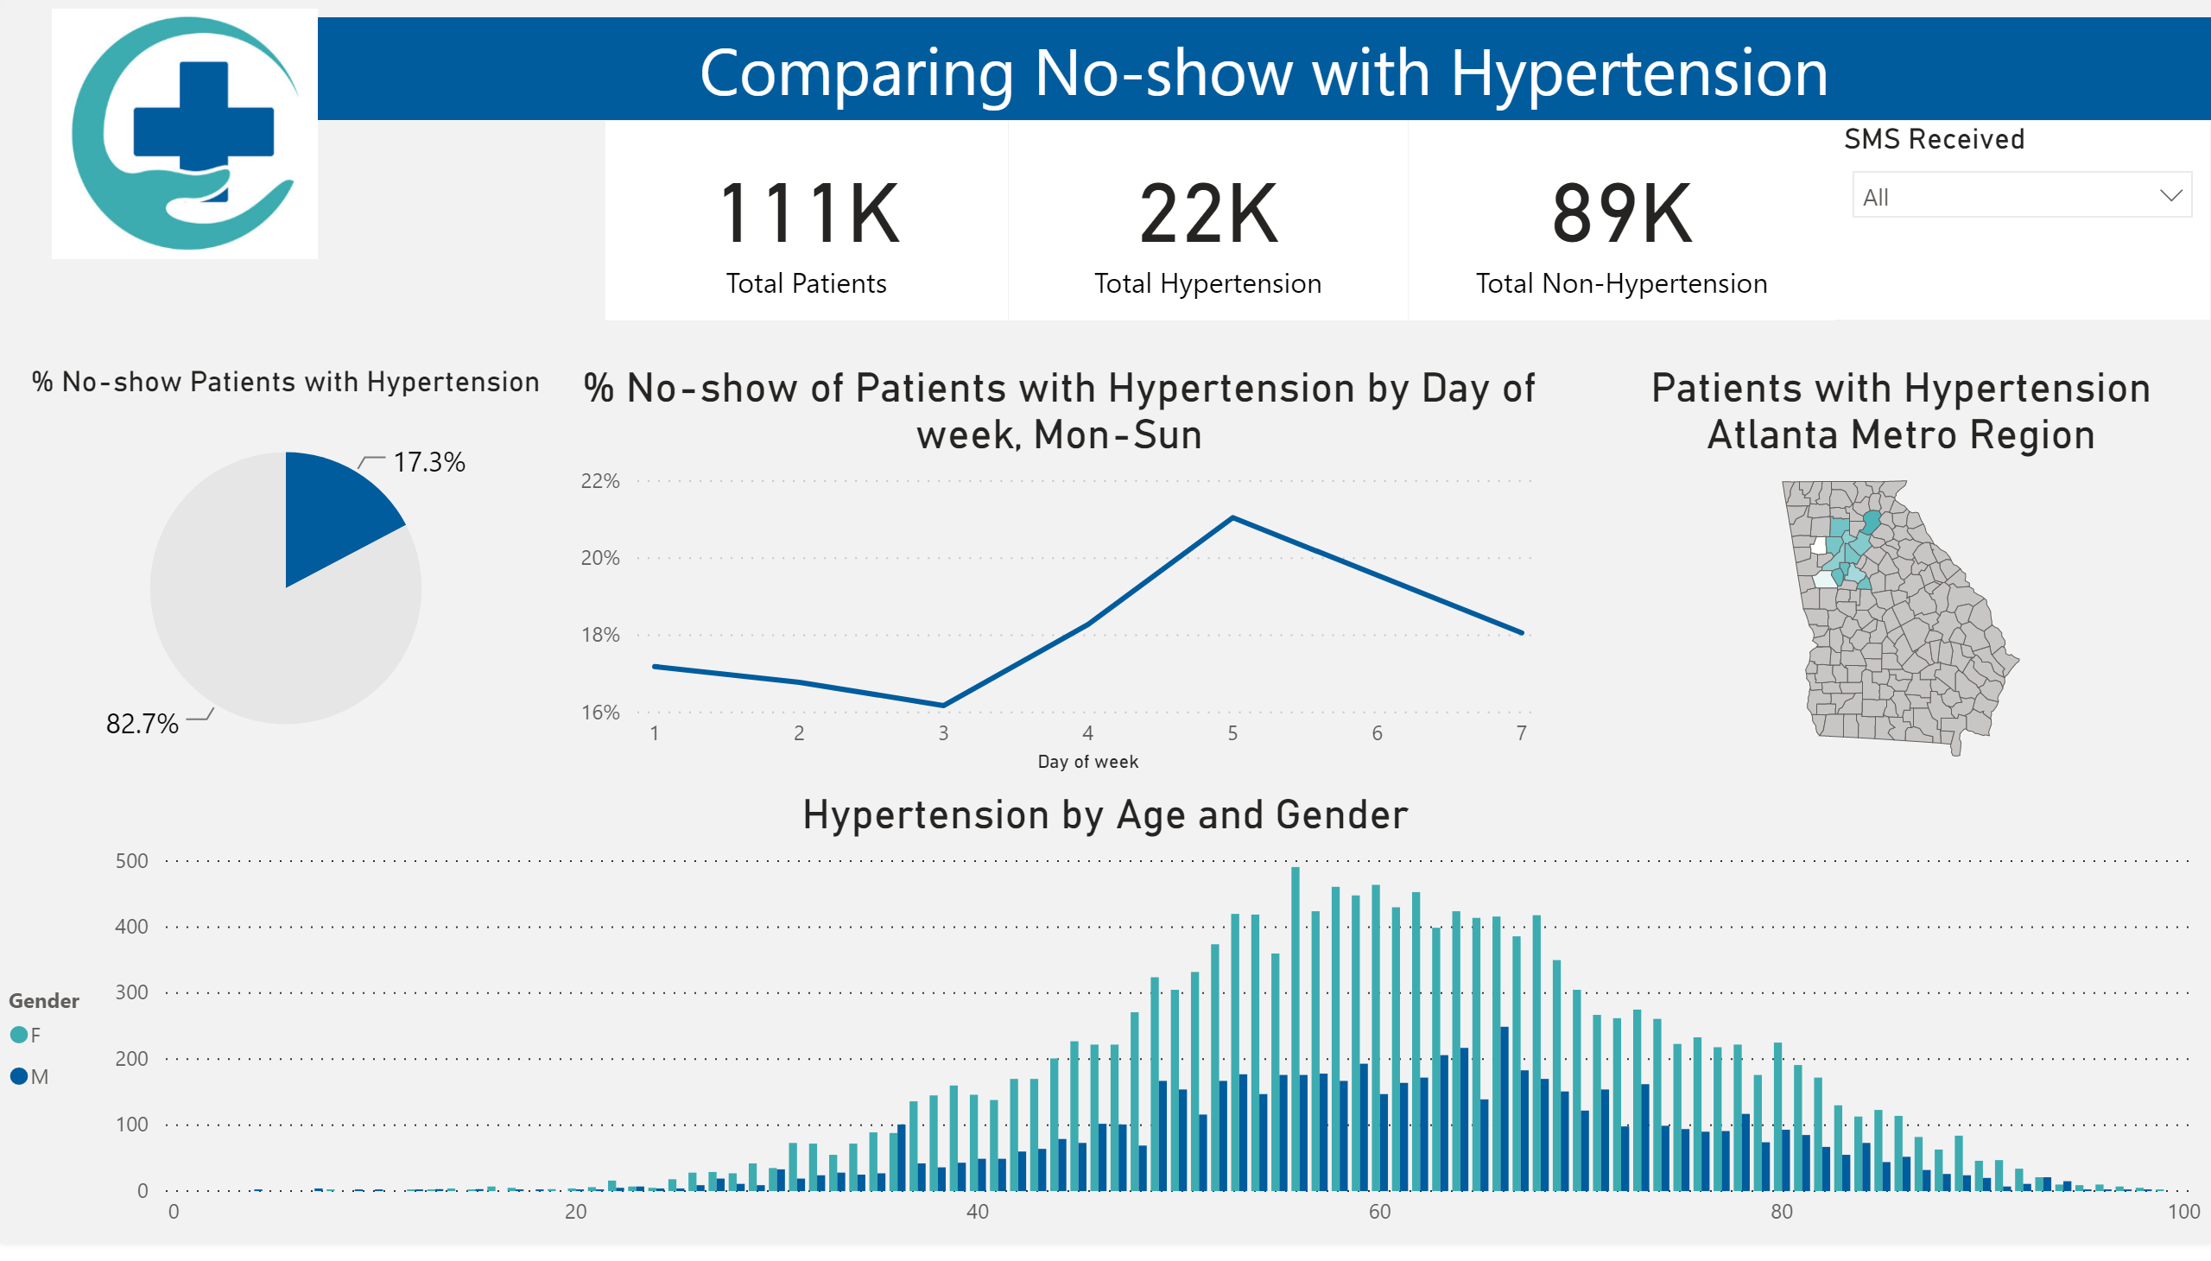

Slide 5
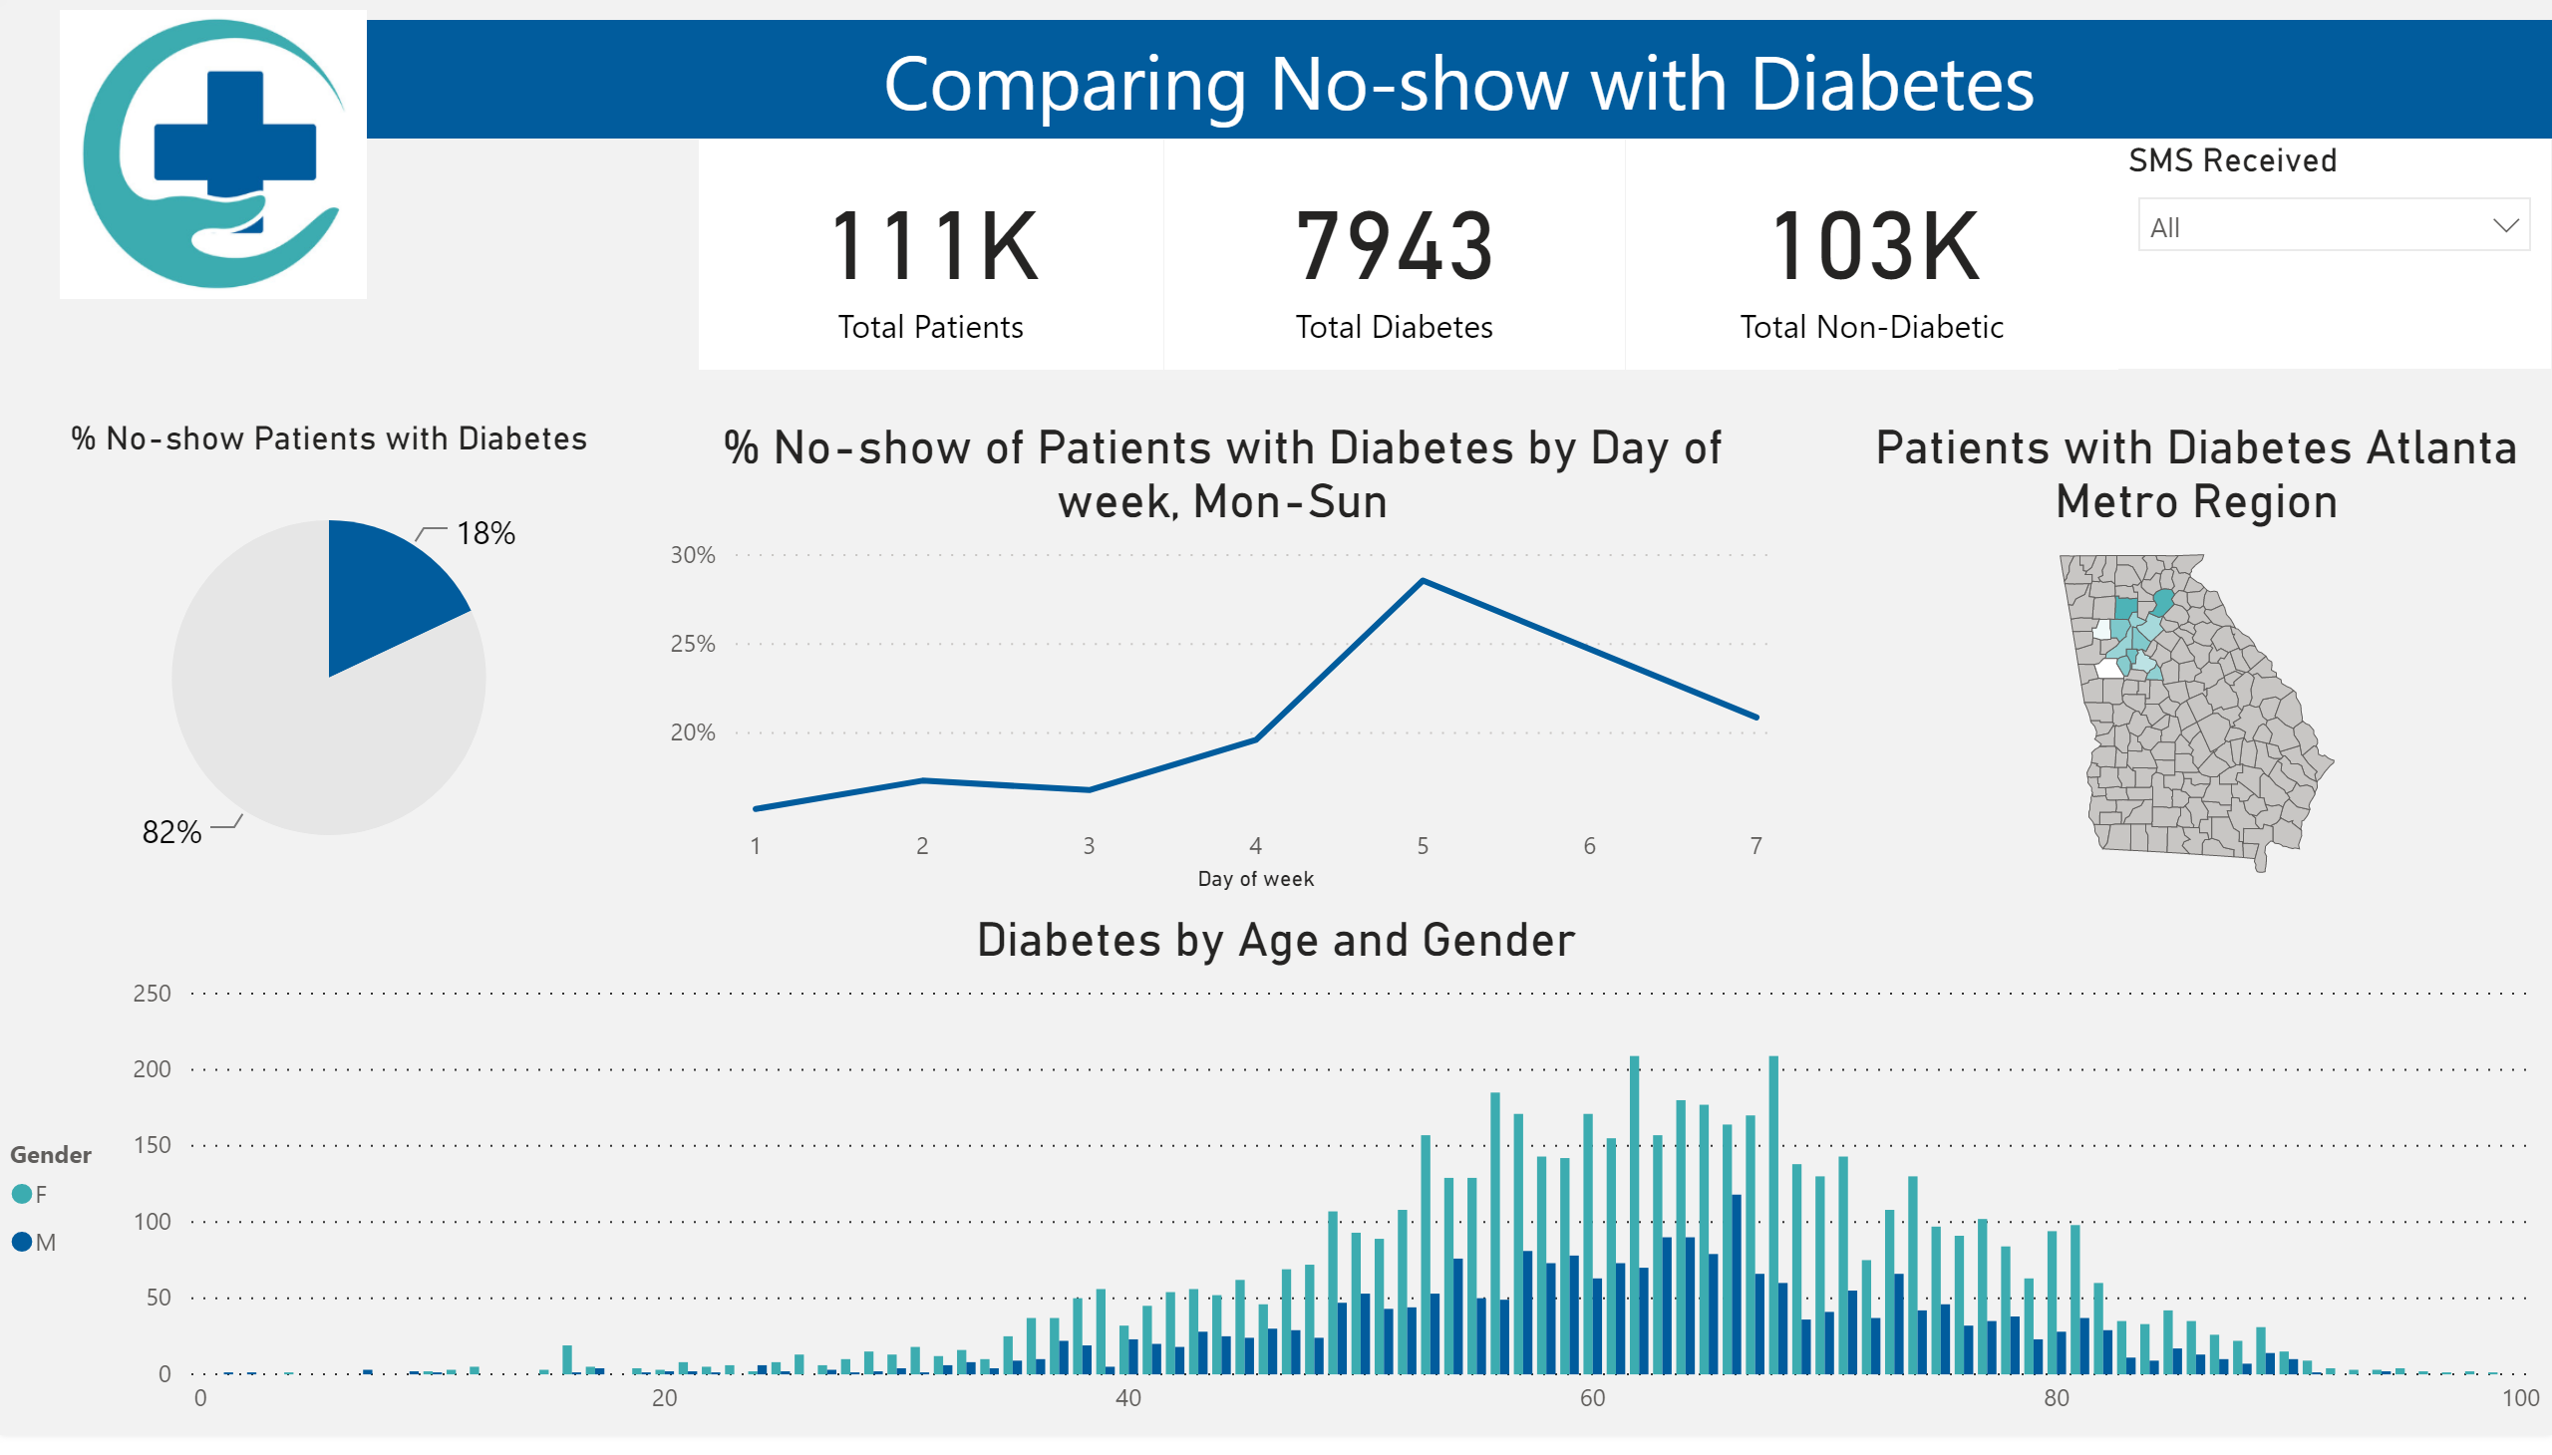

Slide 6
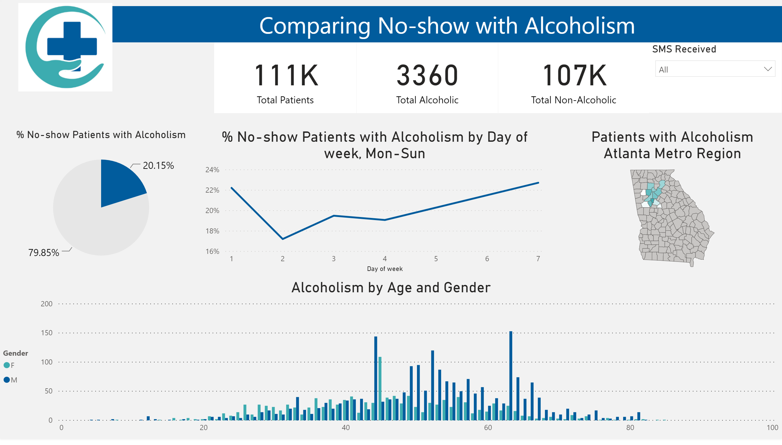

Slide 7
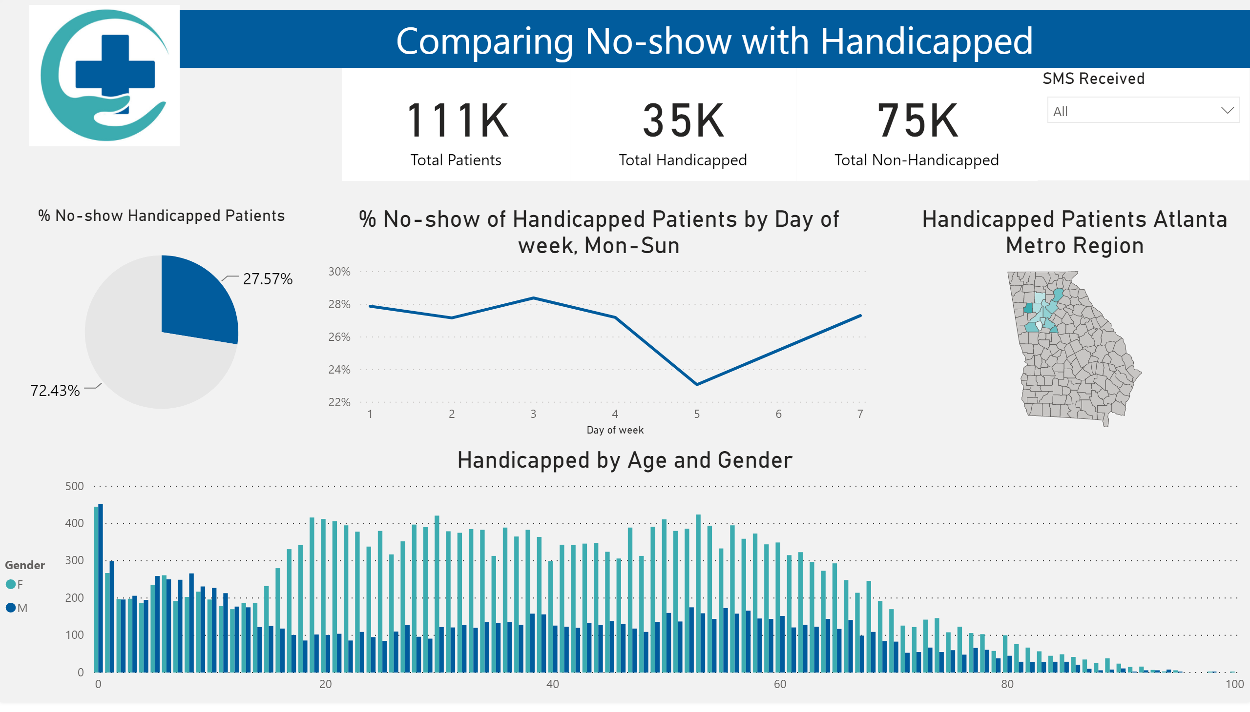

Slide 8
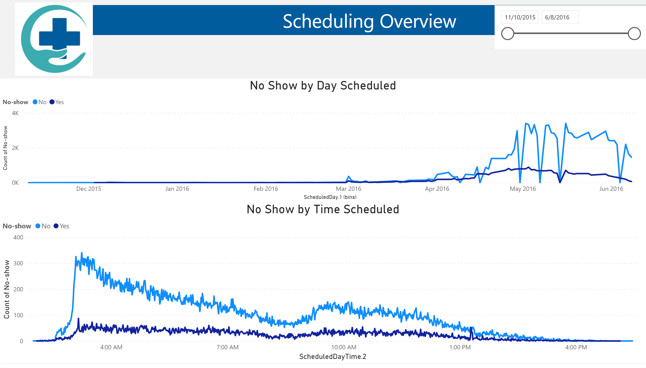

Slide 9
