Slide 1


Part 1
Introduction

Slide 2

Let’s fire up things.. gonna take a little while…

Slide 3
Welcome
Part 1 - 14 Feb 2017 : Introduction to Postgres
Part 2 - 7 Maret 2017 : Configurations, Query Optimizer, Performance, Data Types
Part 3 - 4 April 2017 : Data Integrity; Provisioning using Azure & Ansible
Part 4: - May 2017: Reserved
Let’s do it with our pace…

Slide 4
Speaker
Name: Nur Agus Suryoko
Occupation: Infrastructure Architect
Company: Virkea

Slide 5





Past…

Slide 6
Current

Slide 7
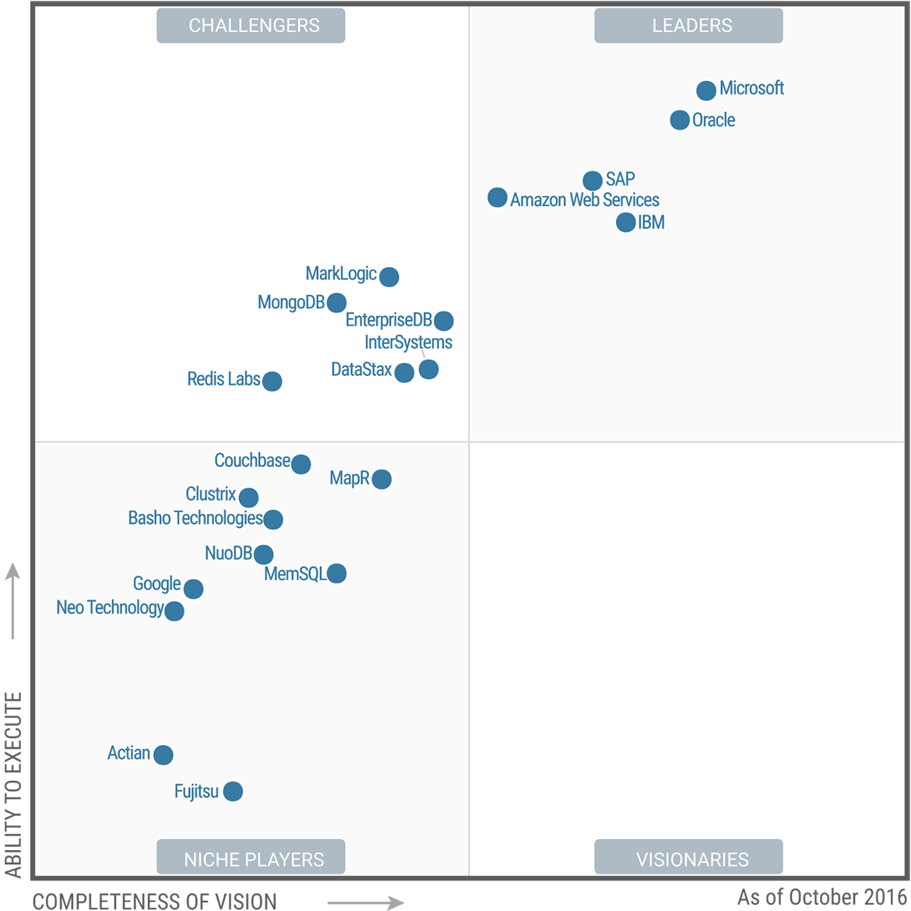
Why Postgres? - Gartner Magic Quadrant

Slide 8
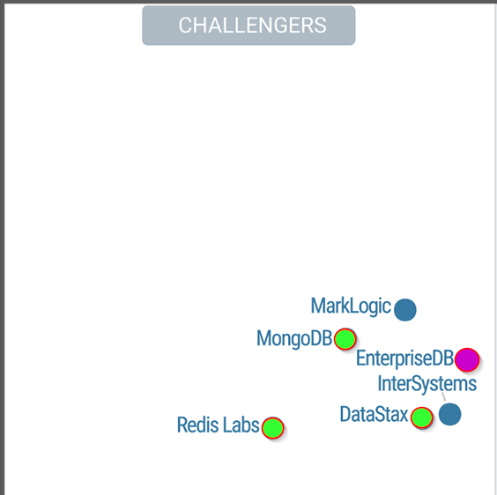
Why Postgres? – Gartner Magic Quadrant
4 open-source:
3 nosql
1 rdbms

Slide 9

OOT: VoltDB

Slide 10
Why Postgres? Personal Opinion
Open source (postgresql license ~ BSD / MIT license)
Postgres is fast – enough
Very simple to use, fire and forget
PL/psql
JSONB datatypes
Columnar datastore

Slide 11
Characteristics
No “storage engine”: remember MyISAM vs InnoDB?
Different “kind of” storage engine, e.g.columnar
Less optimization knobs on configuration
So much more on compile flags
Designed to be “fire and forget”
No “rampant layering violation” (2007 kids, remember zfs?)
No datafile mirror (should be handled by raid)
Using a lot of operating system buffers

Slide 12
Characteristics
Extensions:
Contrib: uuid-ossp, hstore, ltree, cube, etc
External modules: pgbouncer, columnar_store, foreign-data-wrappers
ACID by default:
Undo is always active; log rotate though
Near-Zero maintenance:
33 GB database and growing, no maintenance other than backup

Slide 13
“Enough talking, show me the terminal already!”

Slide 14



Slide 15
https://github.com/nuragus/jlp_aux

Slide 16
Installation

Slide 17
Installation 1: Distro Package
On Ubuntu:
sudo apt install postgresql postgresql-common
sudo su – postgres
psql
Quickest way to get postgresql running
Scattered installation location (distro based)
Contrib modules added by installing another package
Not so easy to compile extra modules

Slide 18
Installation 2: EnterpriseDB PostgreSQL
On All Distros:
sudo apt update && sudo apt install –y wget
wget https://get.enterprisedb.com/postgresql/postgresql-9.6.2-1-linux-x64.run
chmod +x postgresql-9.6.2-1-linux-x64.run
sudo ./postgresql-9.6.2-1-linux-x64.run
mkdir /home/postgres && chown –R postgres:postgres /home/postgres
vim /etc/passwd
echo pg_env.sh > ~/.bash_profile
Not the quickest way to get postgresql running
Centralized location (we can choose)
Will be consistent in all linux distro
Most contrib modules are added already
Not so easy to compile extra modules

Slide 19
Installation 3: Compile
On All Distros:
mkdir source_postgres
cd source_postgres
sudo apt update && apt install –y git
git clone https://github.com/nuragus/jlp_aux.git
chmod +x ./jlp_aux/postgres_compile.sh
./jlp_aux/postgres_compile.sh
Not that scary, maybe even very easy
Enable flags (if necessary)
Centralized location (we can choose)
Consistent in all linux-distros
Prepared for compile extra modules
Comes with aliases

Slide 20

Installation 4: Ansible
Next 2 meetup :P

Slide 21
Clients

Slide 22
pgAdmin 4
Stock GUI for postgresql
Installation on windows with EnterpriseDB PostgreSQL

Slide 23
psql
command line client
Ubuntu: sudo apt install postgresql-common
fast and highly configurable
Password: Initial1

Slide 24
The Database

Slide 25
postgres = cluster
cluster = data-directory
1 installation can have multiple cluster
1 cluster can have multiple database
using all previous installation method, 1 cluster is created

Slide 26
Creating another cluster
sudo mkdir /mnt/pgdata
sudo chown –R postgres:postgres /mnt/data
sudo su – postgres
initdb –D /mnt/data
pg_ctl –D /mnt/data start

Slide 27
Extensions: uuid-ossp
uuid toolsets
more information: https://www.postgresql.org/docs/9.6/static/uuid-ossp.html
cd ./postgresql-9.6.1/contrib/uuid-ossp
make && sudo make install
sudo cp uuid-ossp.so /usr/local/pgsql/lib/
sudo su – postgres
psql
create extension “uuid-ossp”;

Slide 28
Extensions: ltree

Slide 29
Create database & fill the data
create database regions;
create user regions;
alter database regions owner to regions;
\c regions;
create extension “uuid-ossp”;
pg_restore -F custom -d regions regions.custom

Slide 30
Cool Stuff

Slide 31
Cool Stuff 1: Column Store

Slide 32
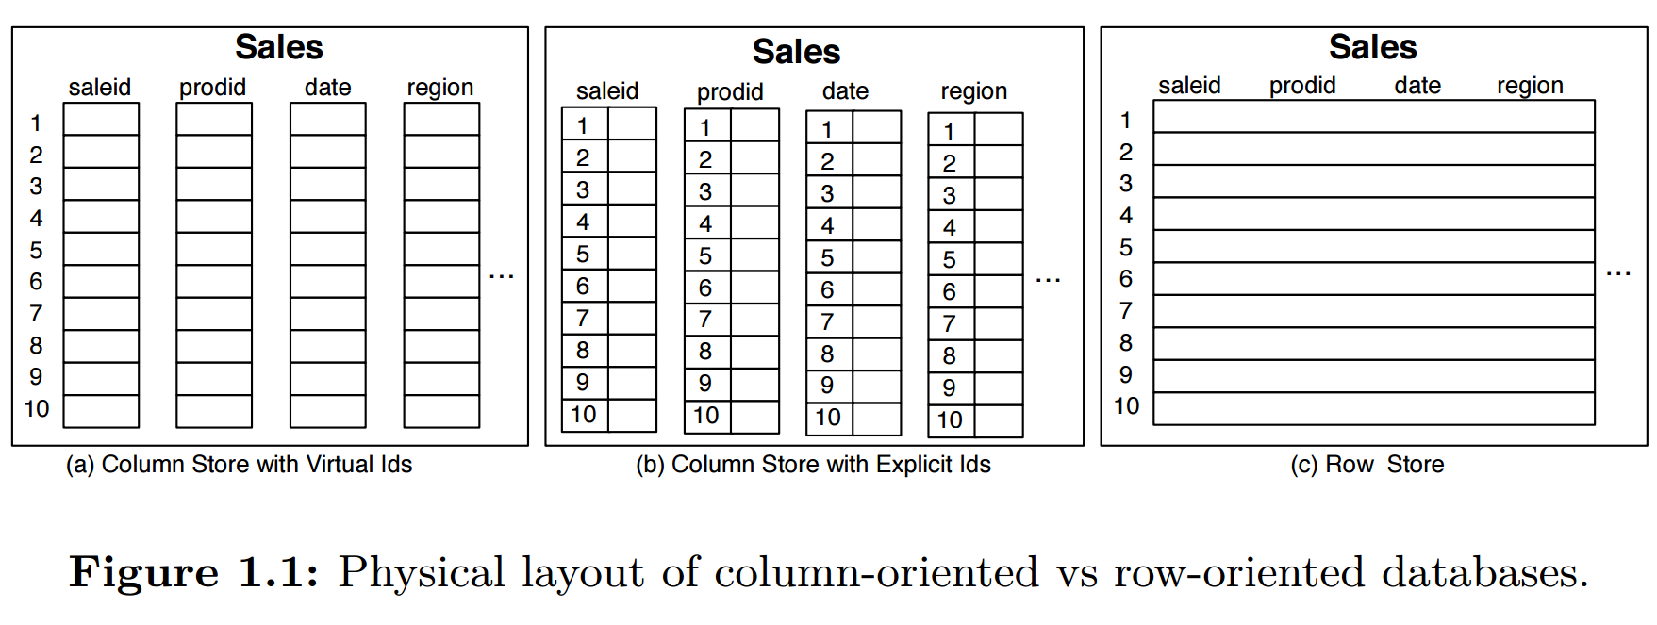
Column store
source: http://db.csail.mit.edu/pubs/abadi-column-stores.pdf

Slide 33
Our Example
MGD (Mouse Genetic Database)
Database size: 40GB
table: seq_sequence (dna sequence information of mice)
number of rows: 13237065
Find average length of dna_sequence
select avg(length) from seq_sequence; -- row based
select avg(length) from seq_sequence_column; --column based
Let’s play a little bit and compare

Slide 34
Column Store
Very useful for any aggregation such as average, count, sum, min, max
Faster analytics

Slide 35
Cool Stuff 2: JSONB
Big data, anyone?

Slide 36
Our Example
San Francisco city lots information
Database size: 177 MB
json data
Let’s play with json

Slide 37
Cool Stuff 3: Openresty
Service JSON rest-api without coding

Slide 38
Openresty
openresty = nginx + lua + so many modules
https://openresty.org/en/

Slide 39
Openresty
openresty = nginx + lua + so many modules
https://openresty.org/en/
example:
https://pg_demo.virkea.com/get_data

Slide 40
Openresty
nginx.conf
upstream database {
postgres_server 127.0.0.1 dbname=mgd user=mgd password=Initial1;
}
sites-enabled
location /get_data {
postgres_pass database;
escape $seq_type;
rds_json on;
postgres_query HEAD GET "select avg(length) avg_dna_seq_length from seq_sequence_column where type = $seq_type;";
}
}

Slide 41
Openresty
more information
http://www.slideshare.net/nursuryoko/building-rest-api-without-coding

Slide 42
Backup & Restore

Slide 43
Part 1: ACID & MVCC
Atomicity
Consistency
Isolation
Durability
Multi Version
Concurrency
Control
Write-ahead-logs
Point-in-time recovery

Slide 44


Slide 45
Backup Simplified: DUMP
Standard simple syntax:
pg_dump –F <file type> -f <file name> <db_name>
Specific hosts:
pg_dump –F <file type> -f <file name> -h <remote host> <db_name>
Specific hosts & users:
pg_dump –F <file type> -f <file name> -h <remote host> -U <db useraname> <db_name>

Slide 46
Backup Simplified: Various Case
Dumping DB:
pg_dump -F custom -f dump_json_sample_14022017.custom -h postgres.virkea.com -U postgres json_sample
Extract table content to sql:
pg_dump -F plain -f dumpsql_progeny_14022017 -t crs_progeny -h postgres.virkea.com -U mgd mgd

Slide 47
Backup Simplified: Various Case
Extract DDL statament:
pg_dump -F plain -f dumpddl_progeny_14022017 -t crs_progeny -s -h postgres.virkea.com -U mgd mgd
Extract table content to sql:
pg_dump -F plain -f dumpsql_progeny_14022017 -t crs_progeny -h postgres.virkea.com -U mgd mgd

Slide 48
pg_dump parameters
More information:
https://www.postgresql.org/docs/9.6/static/app-pgdump.html

Slide 49
Restore
create the database
create the user (optional)
restore:
pg_restore –F custom –d json_sample dump_json_sample_14022017.custom
chown dumpfile as postgres:postgres
run locally

Slide 50
Tips
Shutdown app servers during dump (not doable in production)
User PITR (taking advantage of wal) if possible
Recommended format: custom (binary, compressed)
Only one way to ensure your backup is valid:
test restore

Slide 51
FREE Postgres Account SSL Encrypted Traffic Huge storage (400GB)
Contact me: Slack: jlpcommunity.slack.com Twitter: @berandajiwa

Slide 52
FREE (NO SLA) help on postgres
Contact me: Slack: jlpcommunity.slack.com Twitter: @berandajiwa

Slide 53
NEXT

Slide 54
MAKE POSTGRES PERFORMANCE FLY!

