Slide 1
WORKSHOP
Build Your AI Project Manager
An agentic assistant with CrewAI and local open models — hands-on, from first agent to a virtual office
Felix Yustian Setiono · Senior AI / Computer Vision Engineer
A hands-on MurzEdu session · ~2 hours · Python + a laptop that can run Ollama

Slide 2

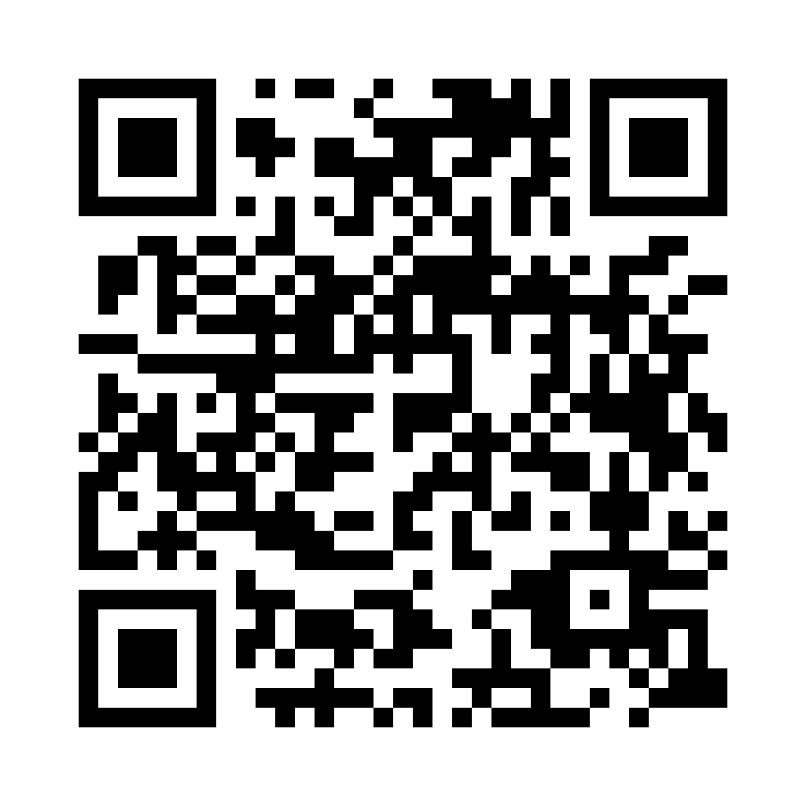
PROFILE
10+ years turning AI into working business systems — from computer vision and predictive models to LLM-powered, agentic automation. Bridges real engineering with the Indonesian market: regulation, language, and SME operations.
CORE SKILLS
▸ LLM & Agentic Systems: CrewAI, LangChain / LangGraph, MCP, multi-agent
▸ Computer Vision & Edge AI: YOLO, TensorRT, NVIDIA Jetson, DeepStream
▸ Machine Learning & MLOps: Python, PyTorch, forecasting, FastAPI, Docker
▸ Document AI: OCR, KTP / ID extraction, governed LLM extraction
Felix Yustian Setiono
Senior AI / Computer Vision (CV) Engineer
AI / ML Systems Architect
SELECTED HIGHLIGHTS
Semarang, Central Java, Indonesia
felixyustian@gmail.com
linkedin.com/in/felixsetiono
• 5-agent business assistant for Indonesia's 65M SMEs (OpenClaw Agenthon 2026 winner)
• Predictive maintenance for industry — flag failures before they happen (MachineGuard)
• Governed AI for OJK-regulated decisions — auditable and deployable (PRANATA)
• Document / KYC automation — IDs & invoices read automatically, PII-safe
CURRENTLY
Sigmawave AI Singapore — Senior AI/ML & CV Engineer & CV Team Lead
V-TEKI Indonesia — AI Architect & Technical Lead
CREDENTIALS & RECOGNITION
M.Eng., ITB · Professional Engineer (Ir.) · Google Cloud GenAI Leader · Published researcher (Scholar h-index 4) · IEEE / PII / KORIKA member

Slide 3
What we'll build today
1
The goal — an agent crew that helps run your projects
2
How agents actually work: LLM + tools + a loop
3
Set up CrewAI on local open models (Ollama)
4
Build the PM assistant — step by step, in code
5
Intermezzo — a virtual office of agents
6
Make it reliable, observable, and safe
Build Your AI Project Manager · CrewAI + Ollama · MurzEdu Program

Slide 4
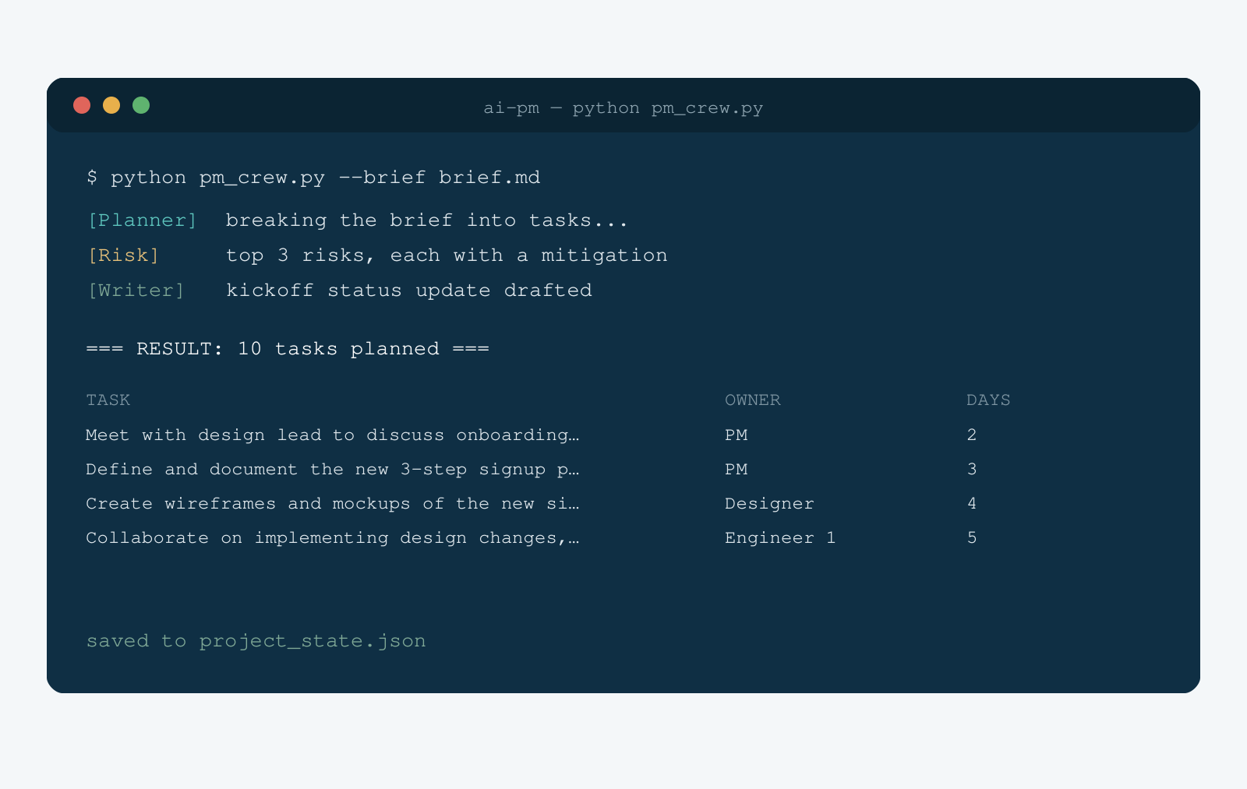
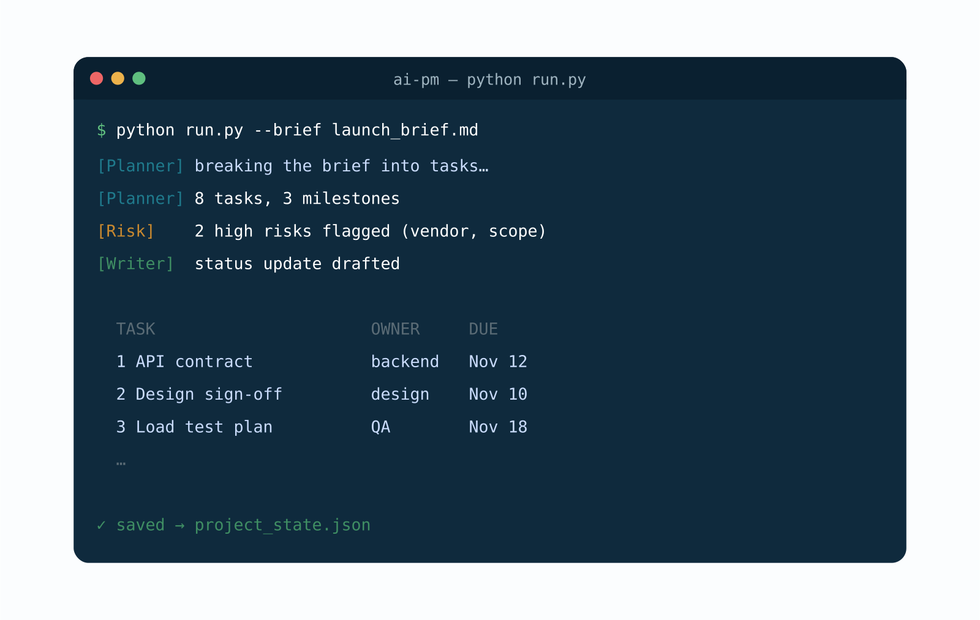
What we're building: your AI PM
WHAT IT DOES
— Turns a project brief into tasks, owners, and estimates
— Flags risks and drafts a status update
— Runs locally — your data never leaves the machine
And you'll build it in code, today.
Build Your AI Project Manager · CrewAI + Ollama · MurzEdu Program

Slide 5
01
How Agents Work
LLM + tools + a loop — the moving parts

Slide 6
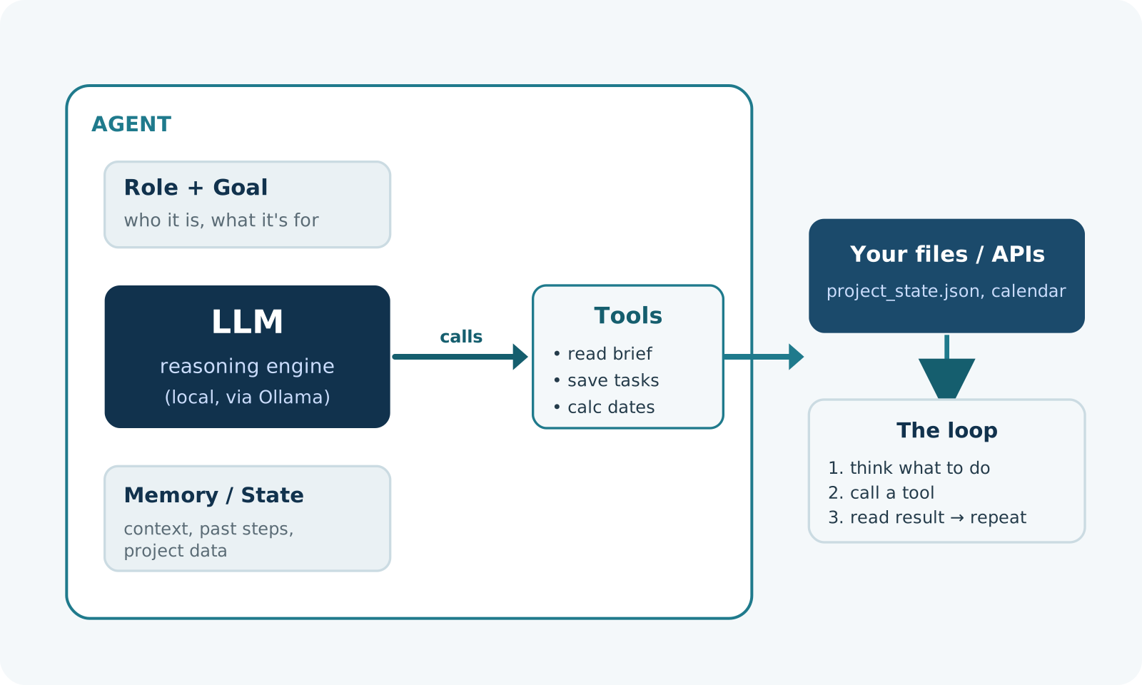
Anatomy of an agent
FOUR PARTS
— An LLM that reasons
— Tools it can call (plain functions)
— Memory / state it carries
— A loop that ties them together
Strip the hype: an agent is a loop around a model.
Build Your AI Project Manager · CrewAI + Ollama · MurzEdu Program

Slide 7
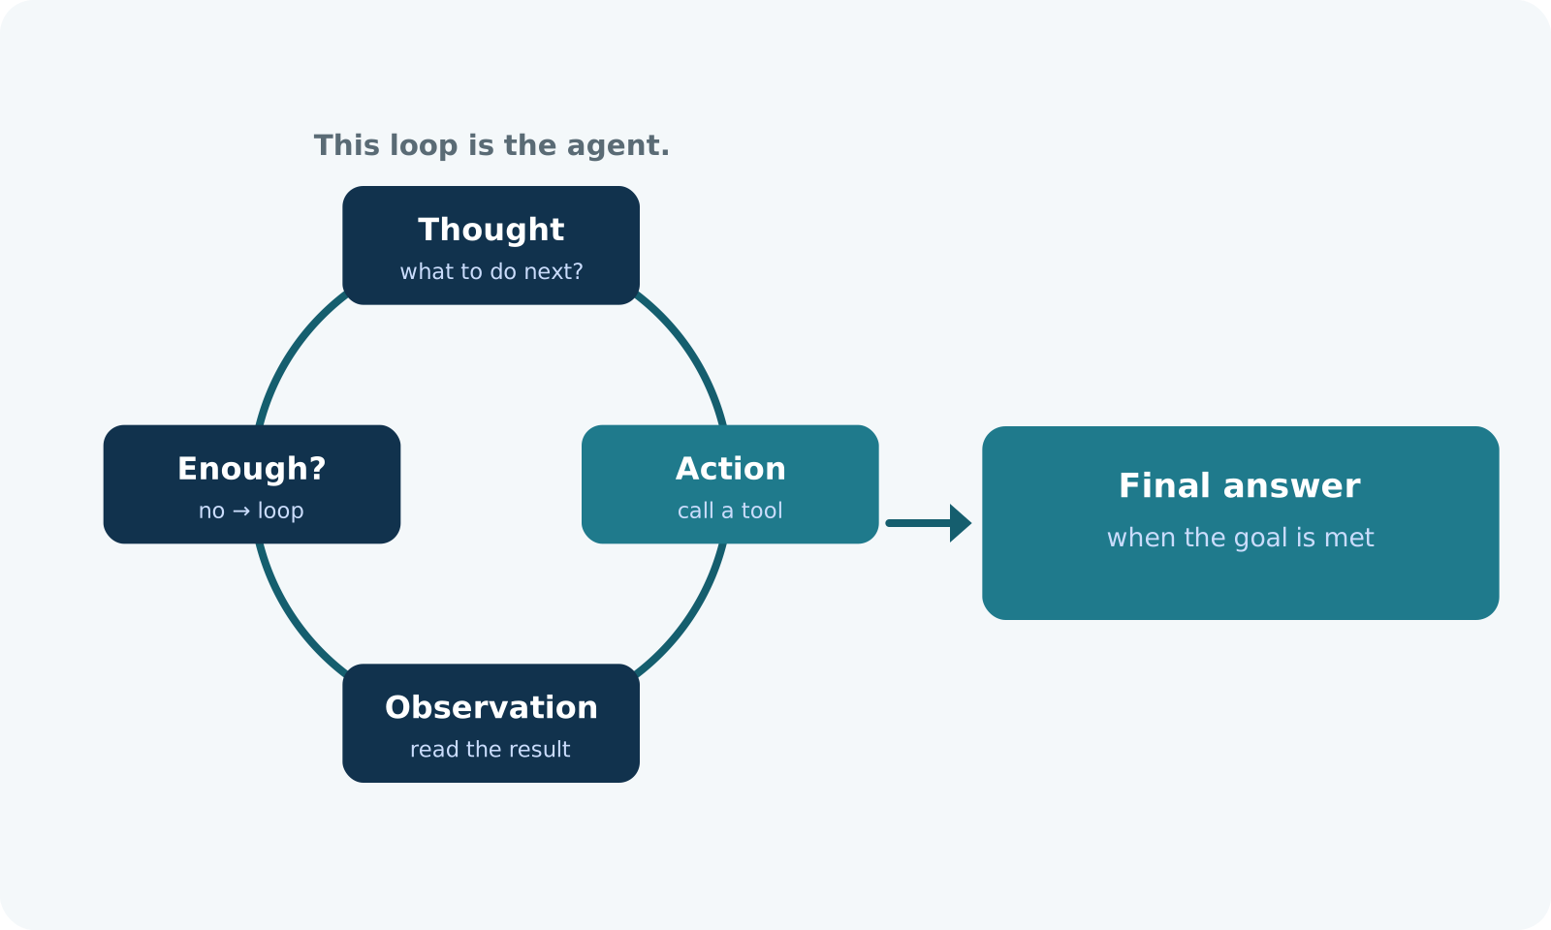
The loop: Reason → Act → Observe (ReAct)
EACH TURN
— Think about the next step
— Act — call a tool
— Observe the result
— Repeat until the goal is met
CrewAI runs this loop for you.
Build Your AI Project Manager · CrewAI + Ollama · MurzEdu Program

Slide 8
One agent, or a crew?
• One agent is enough for a single, focused job.
• Hard jobs split better across specialists — a planner, a researcher, a writer.
• A crew coordinates them: sequential (a pipeline) or hierarchical (a manager delegates).
• More agents = more capability, but more cost, latency, and nondeterminism.
RULE OF THUMB
Start with one agent. Add roles only when one agent clearly struggles.
Build Your AI Project Manager · CrewAI + Ollama · MurzEdu Program

Slide 9
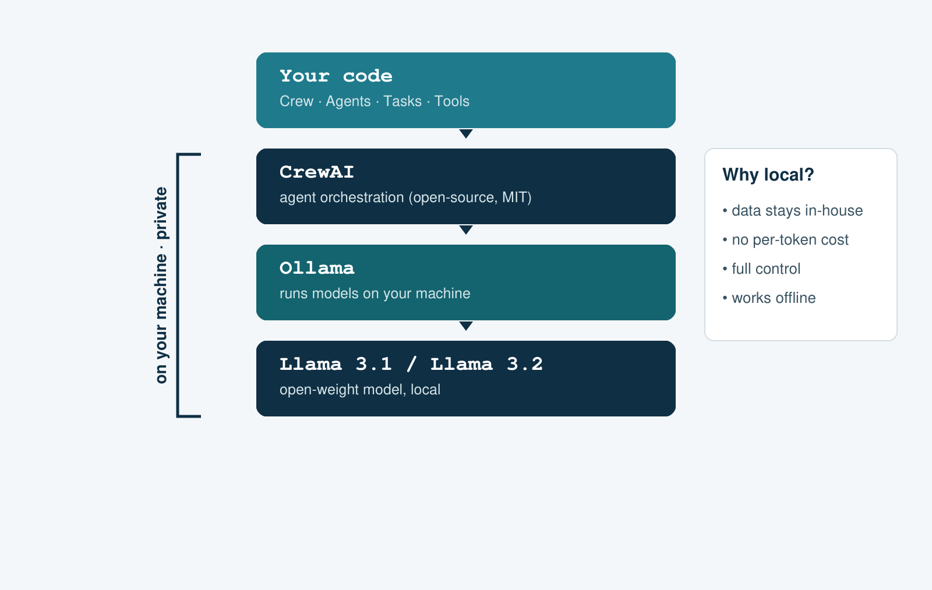
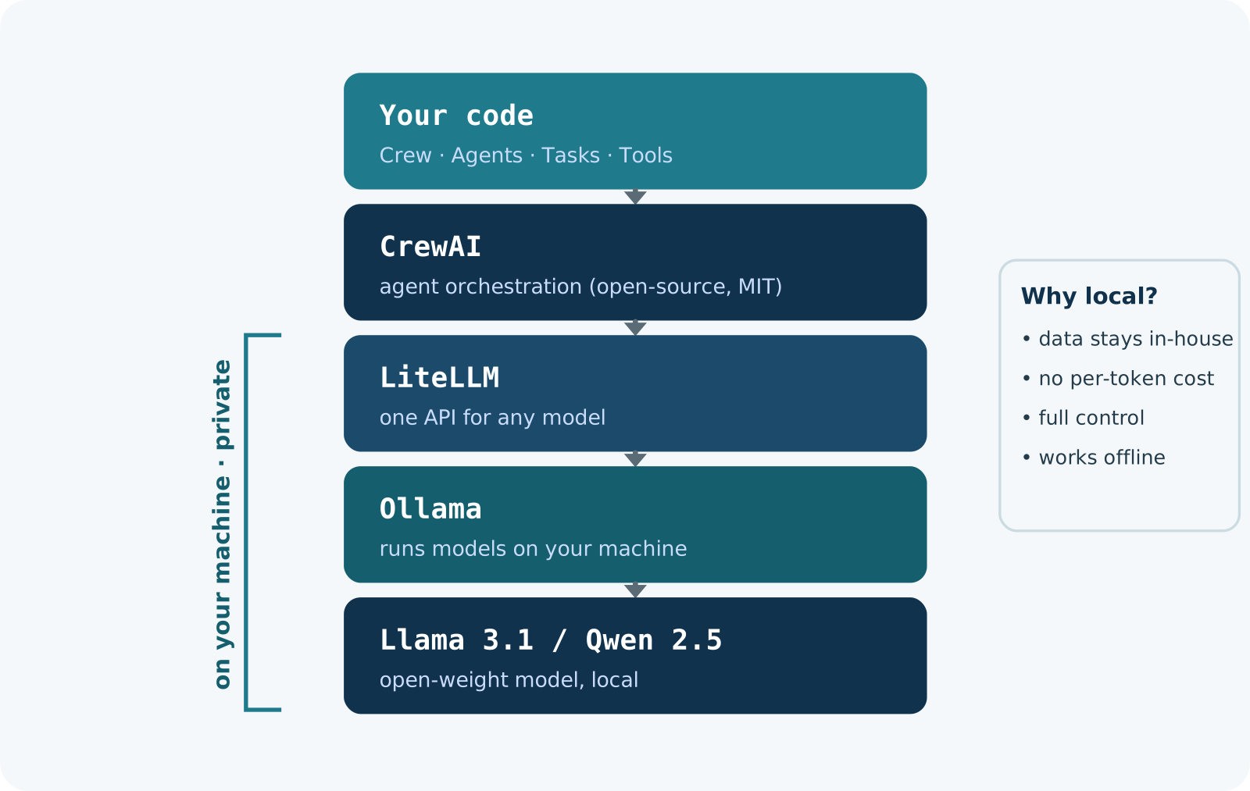
Open-source, and running on your machine
THE STACK
— CrewAI orchestrates the agents
— CrewAI talks to Ollama directly
— Ollama runs open models locally
— Llama 3.1 / Llama 3.2 — open weights
No API keys. No data leaving your laptop.
Build Your AI Project Manager · CrewAI + Ollama · MurzEdu Program

Slide 10
02
Build the PM Assistant
A brief goes in; a plan comes out

Slide 11
Setup — Ollama + CrewAI
Install once, pull a model, add the framework. Windows: .venv\Scripts\activate
# 1. install Ollama (ollama.com), then pull open models
ollama pull llama3.1 # ~4.7 GB, runs fully local
ollama pull llama3.2:3b # ~2 GB, for weaker laptops
# 2. a clean Python 3.10-3.13 environment + the framework
python -m venv .venv && source .venv/bin/activate
pip install -r requirements.txt
# 3. sanity check: is everything ready?
python check_setup.py
→ Pinned to crewai==1.15.35 so the session is reproducible across laptops.
Build Your AI Project Manager · CrewAI + Ollama · MurzEdu Program

Slide 12
Your first agent
Agent + Task + Crew, pointed at the local model.
from crewai import Agent, Task, Crew, Process, LLM
# point CrewAI at the LOCAL model served by Ollama
llm = LLM(model="ollama/llama3.1",
base_url="http://localhost:11434")
planner = Agent(
role="Project Planner",
goal="Turn a project brief into a clear task list",
backstory="A sharp PM who makes vague briefs actionable.",
llm=llm, verbose=True,
)
task = Task(
description="Break down this brief into tasks:\n{brief}",
expected_output="A numbered task list with an owner each",
agent=planner,
)
crew = Crew(agents=[planner], tasks=[task], process=Process.sequential)
print(crew.kickoff(inputs={"brief": open("brief.md").read()}))
→ One agent, one task, a crew to run it — a working agent in ~20 lines.
Build Your AI Project Manager · CrewAI + Ollama · MurzEdu Program

Slide 13
Give it a tool
Tools are just Python functions the agent may choose to call.
from crewai.tools import tool
import json
@tool("save_tasks", max_usage_count=1)
def save_tasks(tasks_json: str) -> str:
"Save a JSON list of task titles to tasks.json."
data = json.loads(tasks_json)
with open("tasks.json", "w") as f:
json.dump(data, f, indent=2)
return f"saved {len(data)} tasks"
# the agent may now decide to call this tool
planner.tools = [save_tasks]
→ The model decides whether to call it. Run tool_demo.py a few times: sometimes it won't.
Build Your AI Project Manager · CrewAI + Ollama · MurzEdu Program

Slide 14
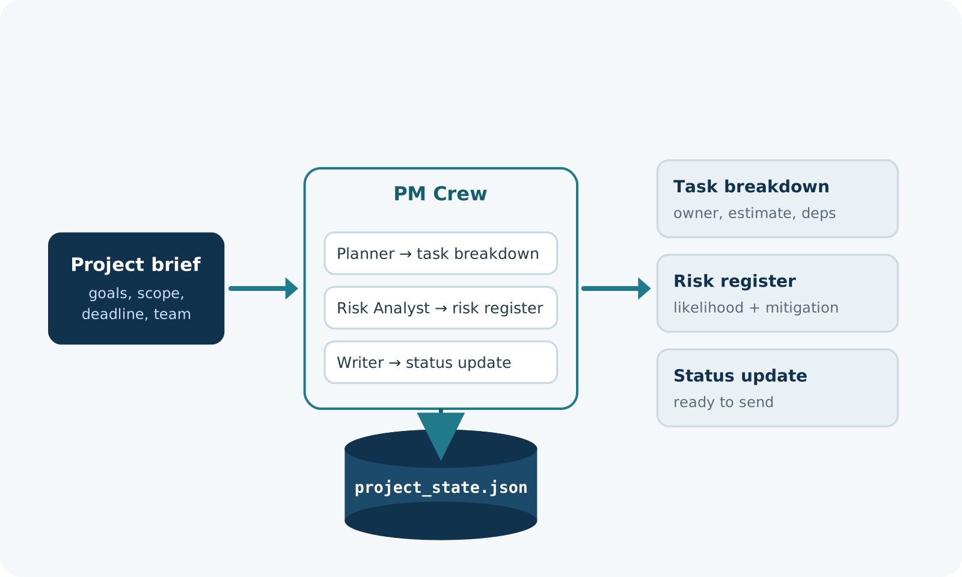
The PM assistant: the shape
THE FLOW
— Brief in → the PM crew
— Planner, Risk Analyst, Writer
— Out: tasks, risks, a status update
— Shared state in project_state.json
Three specialists, one shared state file.
Build Your AI Project Manager · CrewAI + Ollama · MurzEdu Program

Slide 15
Typed output, not prose
Make the planner return structured data the next step can trust.
from pydantic import BaseModel
from typing import List
class TaskItem(BaseModel):
title: str
owner: str
estimate_days: int
class Plan(BaseModel):
tasks: List[TaskItem]
plan_task = Task(
description="Break the brief into tasks:\n{brief}",
expected_output="A Plan object",
agent=planner,
output_pydantic=Plan, # validated, typed output
)
→ A Pydantic schema means no regex-parsing of prose — the output is validated and typed.
Build Your AI Project Manager · CrewAI + Ollama · MurzEdu Program

Slide 16
Add two specialists
A risk analyst and a status writer, each with one job.
risk = Agent(
role="Risk Analyst",
goal="Flag the top risks, with one mitigation each",
backstory="A cautious PM who has watched projects slip.",
llm=llm)
writer = Agent(
role="Status Writer",
goal="Draft a short status update for stakeholders",
backstory="Writes clear, calm updates and never invents facts.",
llm=llm)
risk_task = Task(description="Review the plan. List the top risks.",
expected_output="A risk register", agent=risk,
context=[plan_task])
status_task = Task(description="Write a kickoff update. Work has NOT started: claim no progress.",
expected_output="At most 5 lines", agent=writer,
context=[plan_task, risk_task])
→ One agent = one responsibility. Keep roles narrow and goals sharp.
Build Your AI Project Manager · CrewAI + Ollama · MurzEdu Program

Slide 17
Run the PM crew
Wire the three agents into one sequential crew and run it.
from pathlib import Path
crew = Crew(
agents=[planner, risk, writer],
tasks=[plan_task, risk_task, status_task],
process=Process.sequential, # planner -> risk -> writer
verbose=True,
)
result = crew.kickoff(inputs={"brief": open("brief.md").read()})
print(result) # the final task's output: the status update
# save shared state from Python, so it can't depend on the model's choice
plan = result.tasks_output[0].pydantic
Path("project_state.json").write_text(plan.model_dump_json(indent=2))
→ Run it on a real brief. That's your AI project manager — in about 40 lines.
Build Your AI Project Manager · CrewAI + Ollama · MurzEdu Program

Slide 18
♪
Intermezzo · The Virtual Office
When one assistant becomes a team

Slide 19
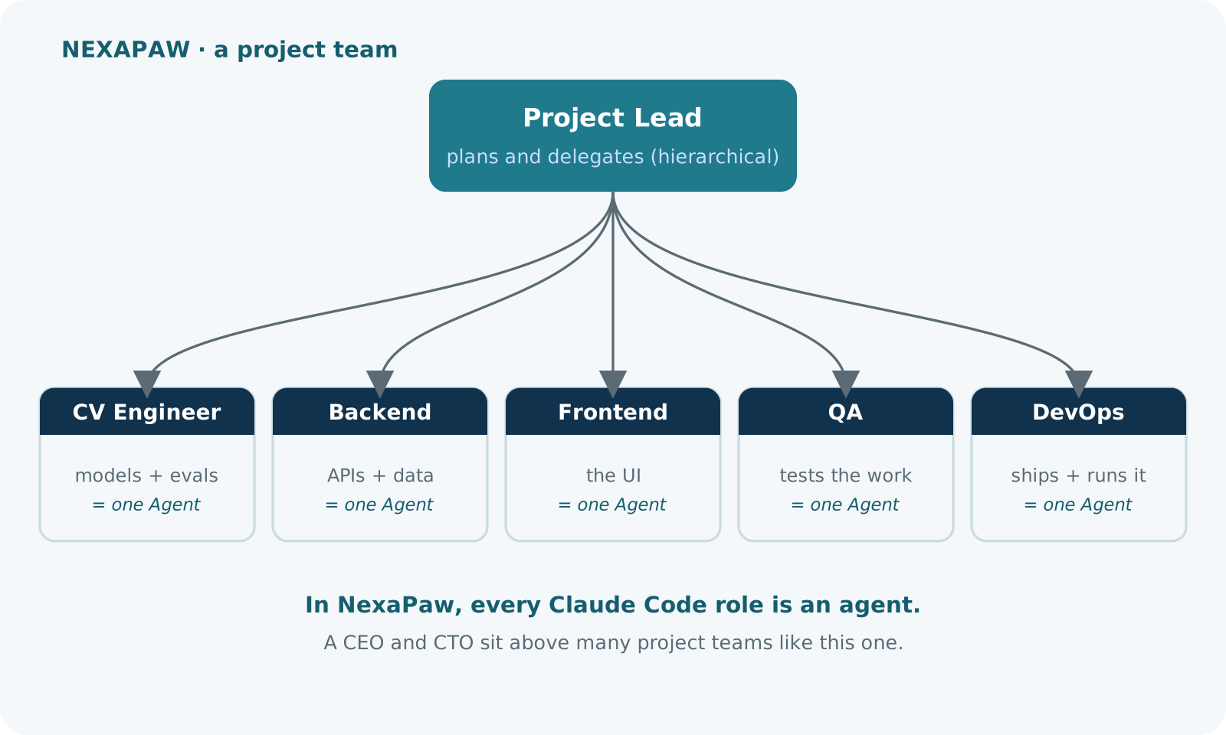
NexaPaw: a real agentic office
THE IDEA
— Each Claude Code role is an agent — a job, a project, tasks
— A CEO & CTO sit above project leads, who lead specialist teams
— A lead delegates; the team hands work between each other
— This is my NexaPaw office — 65 agents, live in a 3D HQ
A company of agents — running on your machine.
Build Your AI Project Manager · CrewAI + Ollama · MurzEdu Program

Slide 20
From crew to office: a Lead delegates
The Lead returns a typed plan; Python dispatches it. You define the staff, not the steps.
class Assignment(BaseModel): # a role must name a real staff member
role: Literal["CV Engineer", "Backend Engineer", "Frontend Engineer", "QA Engineer"]
work: str
class WorkPlan(BaseModel):
assignments: List[Assignment]
# 1. the Lead decides who does what
planning = Task(description=f"Assign this goal to your team ({', '.join(team)}): {brief}",
expected_output="A WorkPlan with at most 3 assignments", agent=lead,
output_pydantic=WorkPlan)
plan = Crew(agents=[lead], tasks=[planning]).kickoff().pydantic
# 2. Python dispatches the Lead's decisions to the specialists
tasks = [Task(description=f"{a.work}. Use at most 4 bullet points.", agent=team[a.role],
expected_output="At most 4 bullet points") for a in plan.assignments]
result = Crew(agents=list(team.values()), tasks=tasks).kickoff()
print(result)
→ Like a NexaPaw project team: the Lead decides who does what; an invalid role fails validation.
Build Your AI Project Manager · CrewAI + Ollama · MurzEdu Program

Slide 21
What the office buys you — and costs
• Specialists beat one generalist on complex, multi-part work.
• The manager handles coordination you'd otherwise hard-code.
• But more agents = more model calls = more time and nondeterminism.
• Local models are slower than hosted — size the crew to your hardware.
• In my tests, Process.hierarchical never reached a specialist on Llama 3.1 or 3.2. Check who actually ran.
HONEST TRADE-OFF
A virtual office is powerful and harder to control. Reach for it only when a single agent plateaus.
Build Your AI Project Manager · CrewAI + Ollama · MurzEdu Program

Slide 22
03
Make It Real
From a script to something you can trust

Slide 23
Reliability: guardrails + a human in the loop
Validate outputs; keep consequential actions behind a person.
# guardrail: Python validates the output; failures go back to the agent
def short_update(output: TaskOutput) -> tuple[bool, Any]:
if len(output.raw.split()) > 120:
return (False, "Too long. Keep it under 120 words.")
return (True, output.raw)
status_task = Task(description="...", expected_output="...", agent=writer,
guardrail=short_update, guardrail_max_retries=2)
# gate risky actions behind a human — draft, never send
@tool("send_email")
def send_email(to: str, body: str) -> str:
"Save a draft for human approval; does NOT send."
Path("outbox.md").write_text(body)
return "DRAFT saved to outbox.md — needs approval"
# stop a stuck agent from looping forever
planner = Agent(role="Project Planner", goal="...", backstory="...",
llm=llm, max_iter=8, max_retry_limit=2)
→ Agents can act. Keep irreversible actions — send, pay, delete — behind human approval.
Build Your AI Project Manager · CrewAI + Ollama · MurzEdu Program

Slide 24
Observe it, and control cost
• Turn on verbose / logging to see each thought, tool call, and result.
• Trace tokens and latency — local models are free but slower.
• Cache repeated calls; keep prompts and passed context tight.
• Evaluate on a fixed set of briefs with known-good outputs before you trust it.
BEFORE PRODUCTION
If you can't measure it on a test set, you can't trust it in front of a stakeholder.
Build Your AI Project Manager · CrewAI + Ollama · MurzEdu Program

Slide 25
Responsible & safe agents
• Least privilege — give an agent only the tools it truly needs.
• Local-first keeps customer data off third-party servers (helps with PDP Law).
• Watch for prompt injection when agents read external text, email, or web pages.
• Keep a human on any decision about people — hiring, credit, performance.
SIMPLE RULE
An agent should propose; a person should dispose — for anything that matters.
Build Your AI Project Manager · CrewAI + Ollama · MurzEdu Program

Slide 26
The whole build, in seven lines
An agent is an LLM plus tools, memory, and a loop (ReAct).
CrewAI runs that loop; Ollama runs the model locally.
1
2
Agent + Task + Crew is a working assistant in ~40 lines.
Tools are plain Python functions the agent may call.
3
4
Typed (Pydantic) outputs make agents composable.
A Lead + specialists = a virtual office (typed delegation).
5
6
Guardrails, a human in the loop, and evals make it trustworthy.
7
Build Your AI Project Manager · CrewAI + Ollama · MurzEdu Program

Slide 27
Questions & build ideas
Q&A
What project chore would you hand an agent crew first?
• Which of your tools would it need — calendar, repo, tracker?
• Where must a human stay in the loop?
Build Your AI Project Manager · CrewAI + Ollama · MurzEdu Program

Slide 28
Thank you
Questions & Build Ideas
Felix Yustian Setiono · https://linktr.ee/felixyustian · felixyustian@gmail.com
Build Your AI Project Manager — a hands-on MurzEdu session

