Slide 1
Probability
Chapter 6

Slide 2
P(E) means “the probability of event E”.
This is relative to an “experiment”.

Slide 3
Example Experiment:
A fair coin is tossed and the outcome is recorded as “heads” or “tails”. Since the coin is “fair”, each of the outcomes is equally likely.

Slide 4
Outcomes are unique.
Outcomes are mutually exclusive.
The set of all possible outcomes for an experiment is referred to as the Sample Space and is often denoted with the Greek letter Omega: Ω.

Slide 5
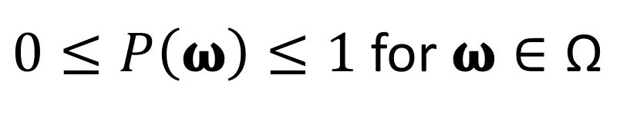
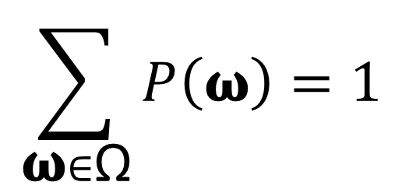
For an experiment with Sample Space Ω, we have the following properties:
$0≤P\left(\text{ω}\right)≤1$ for $\text{ω}∈\text{Ω}$
$$\sum_{\text{ω}∈\text{Ω}}{P\left(\text{ω}\right)=1}$$

Slide 6
For our experiment we have Ω={“heads”, “tails”}.
P(“heads”)=0.5 and P(“tails”)=0.5.
The probabilities of the outcomes in the sample space form the probability distribution.

Slide 7
An event is a subset of the sample space.
For our first experiment, the distinction between outcomes and events is subtle, so we will define a more interesting experiment.

Slide 8
Experiment 2:
A fair coin is tossed twice and the outcome of each toss is recorded in order.
What is the sample space?

Slide 9
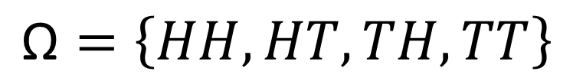
$$\text{Ω}=\left\{HH,HT,TH,TT\right\}$$
What are the probabilities of the outcomes?

Slide 10
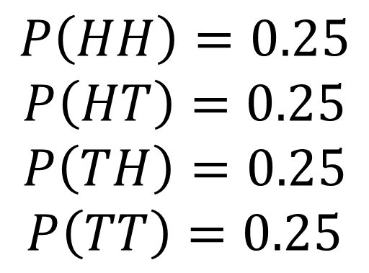
$$\text{Ω}=\left\{HH,HT,TH,TT\right\}$$
$$P\left(HH\right)=0.25$$
$$P\left(HT\right)=0.25$$
$$P\left(TH\right)=0.25$$
$$P\left(TT\right)=0.25$$

Slide 11
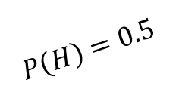

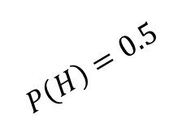
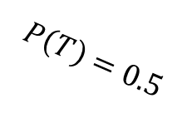


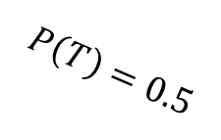

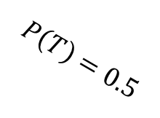

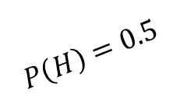
Our experiment consists of independent trials.
$$H$$
$$P\left(HH\right)=P\left(H\right)P\left(H\right)=0.5\left(0.5\right)=0.25$$
$$P\left(H\right)=0.5$$
$$H$$
$$P\left(T\right)=0.5$$
$$P\left(H\right)=0.5$$
$$T$$
$$P\left(HT\right)=P\left(H\right)P\left(T\right)=0.5\left(0.5\right)=0.25$$
$$P\left(T\right)=0.5$$
$$H$$
$$P\left(TH\right)=P\left(T\right)P\left(H\right)=0.5\left(0.5\right)=0.25$$
$$P\left(H\right)=0.5$$
$$T$$
$$P\left(T\right)=0.5$$
$$T$$
$$P\left(TT\right)=P\left(T\right)P\left(T\right)=0.5\left(0.5\right)=0.25$$

Slide 12

An event is a subset of the sample space.
$$\text{E}⊆\text{Ω}$$
What are some events that correspond to Experiment 2?

Slide 13
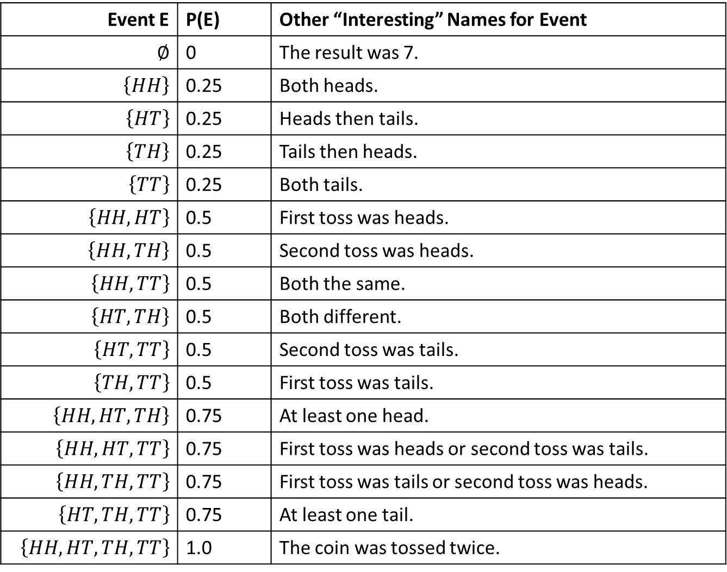
Event E | P(E) | Other “Interesting” Names for Event
$$∅$$ | 0 | The result was 7.
$$\left\{HH\right\}$$ | 0.25 | Both heads.
$$\left\{HT\right\}$$ | 0.25 | Heads then tails.
$$\left\{TH\right\}$$ | 0.25 | Tails then heads.
$$\left\{TT\right\}$$ | 0.25 | Both tails.
$$\left\{HH,HT\right\}$$ | 0.5 | First toss was heads.
$$\left\{HH,TH\right\}$$ | 0.5 | Second toss was heads.
$$\left\{HH,TT\right\}$$ | 0.5 | Both the same.
$$\left\{HT,TH\right\}$$ | 0.5 | Both different.
$$\left\{HT,TT\right\}$$ | 0.5 | Second toss was tails.
$$\left\{TH,TT\right\}$$ | 0.5 | First toss was tails.
$$\left\{HH,HT,TH\right\}$$ | 0.75 | At least one head.
$$\left\{HH,HT,TT\right\}$$ | 0.75 | First toss was heads or second toss was tails.
$$\left\{HH,TH,TT\right\}$$ | 0.75 | First toss was tails or second toss was heads.
$$\left\{HT,TH,TT\right\}$$ | 0.75 | At least one tail.
$$\left\{HH,HT,TH,TT\right\}$$ | 1.0 | The coin was tossed twice.

Slide 14
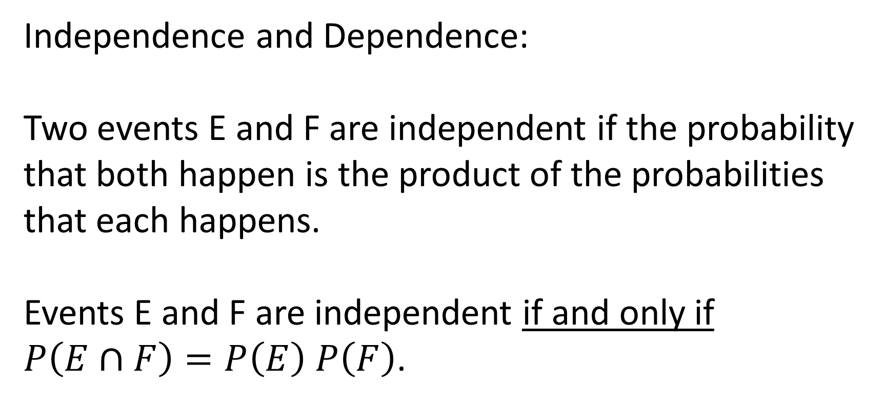
Independence and Dependence:
Two events E and F are independent if the probability that both happen is the product of the probabilities that each happens.
Events E and F are independent if and only if $P\left(E∩F\right)=P\left(E\right)$ $P\left(F\right)$.

Slide 15
Independ or Dependent?
E = “first flip heads”
F = “both flips tails”

Slide 16
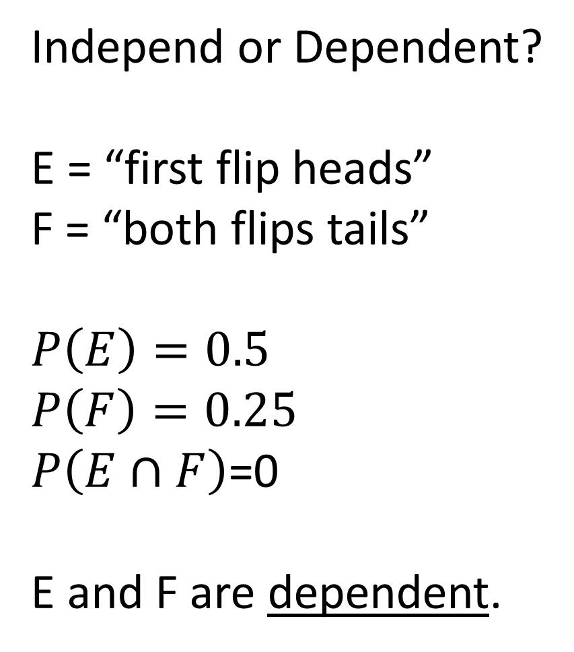
Independ or Dependent?
E = “first flip heads”
F = “both flips tails”
$$P\left(E\right)=0.5$$
$$P\left(F\right)=0.25$$
$P\left(E∩F\right)$=0
E and F are dependent.

Slide 17
Independ or Dependent?
E = “first flip heads”
F = “both flips different”

Slide 18
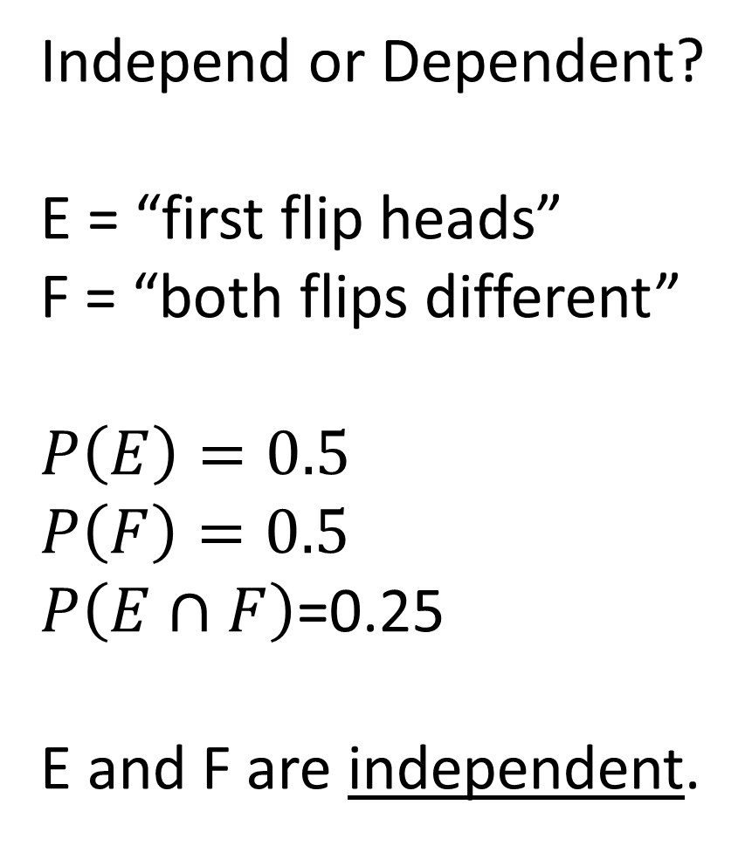
Independ or Dependent?
E = “first flip heads”
F = “both flips different”
$$P\left(E\right)=0.5$$
$$P\left(F\right)=0.5$$
$P\left(E∩F\right)$=0.25
E and F are independent.

Slide 19
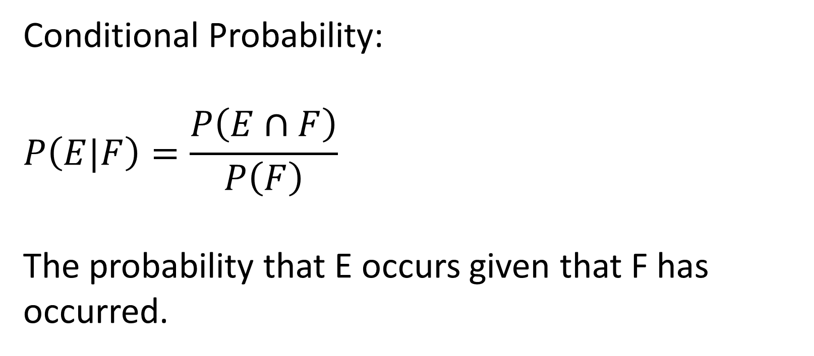
Conditional Probability:
$$P\left(E|F\right)=\frac{P\left(E∩F\right)}{P\left(F\right)}$$
The probability that E occurs given that F has occurred.

Slide 20
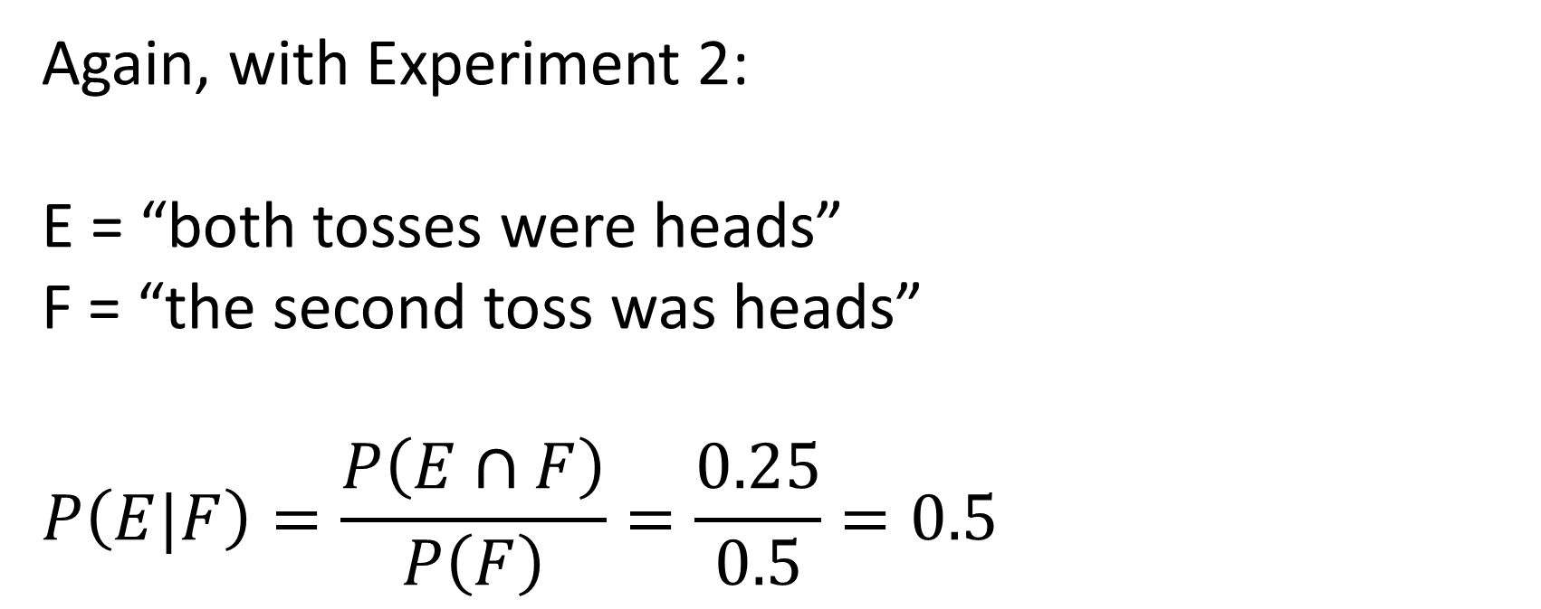
Again, with Experiment 2:
E = “both tosses were heads”
F = “the second toss was heads”
$$P\left(E|F\right)=\frac{P\left(E∩F\right)}{P\left(F\right)}=\frac{0.25}{0.5}=0.5$$

Slide 21
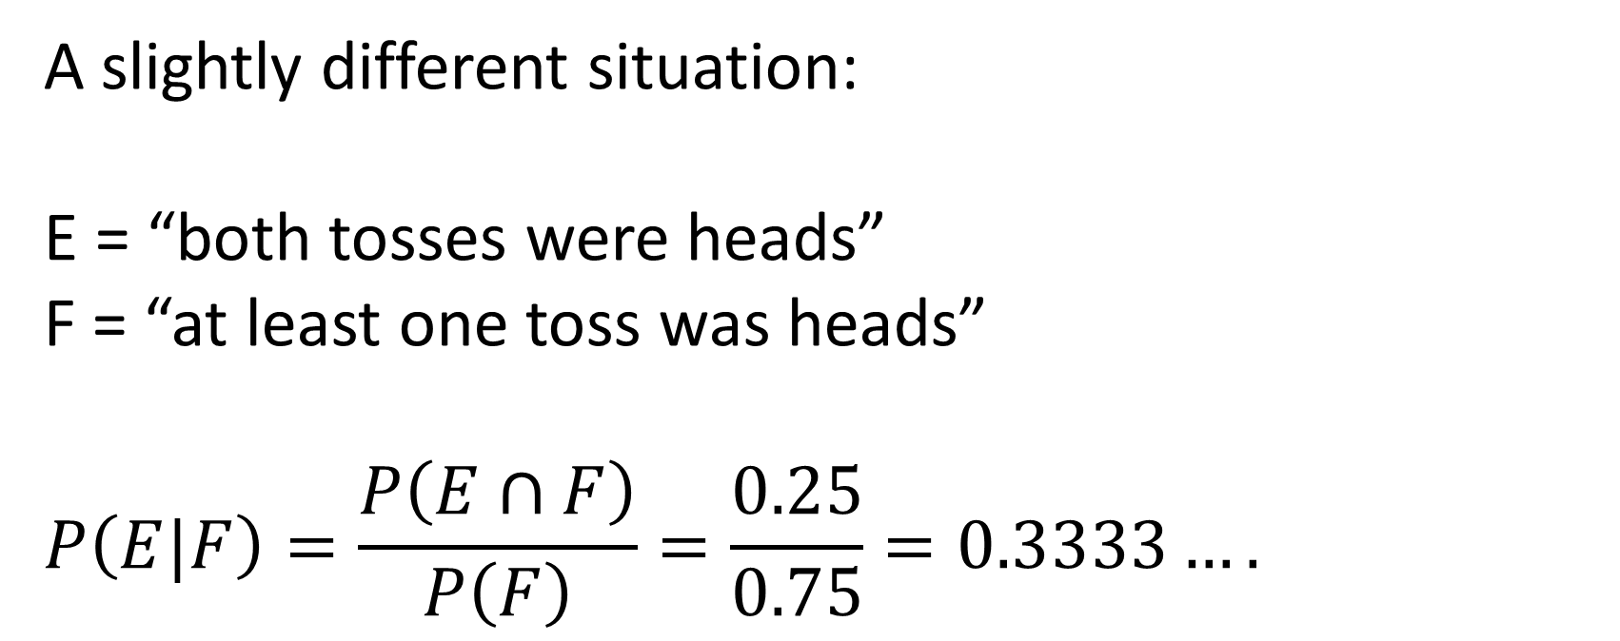
A slightly different situation:
E = “both tosses were heads”
F = “at least one toss was heads”
$$P\left(E|F\right)=\frac{P\left(E∩F\right)}{P\left(F\right)}=\frac{0.25}{0.75}=0.3333….$$

Slide 22
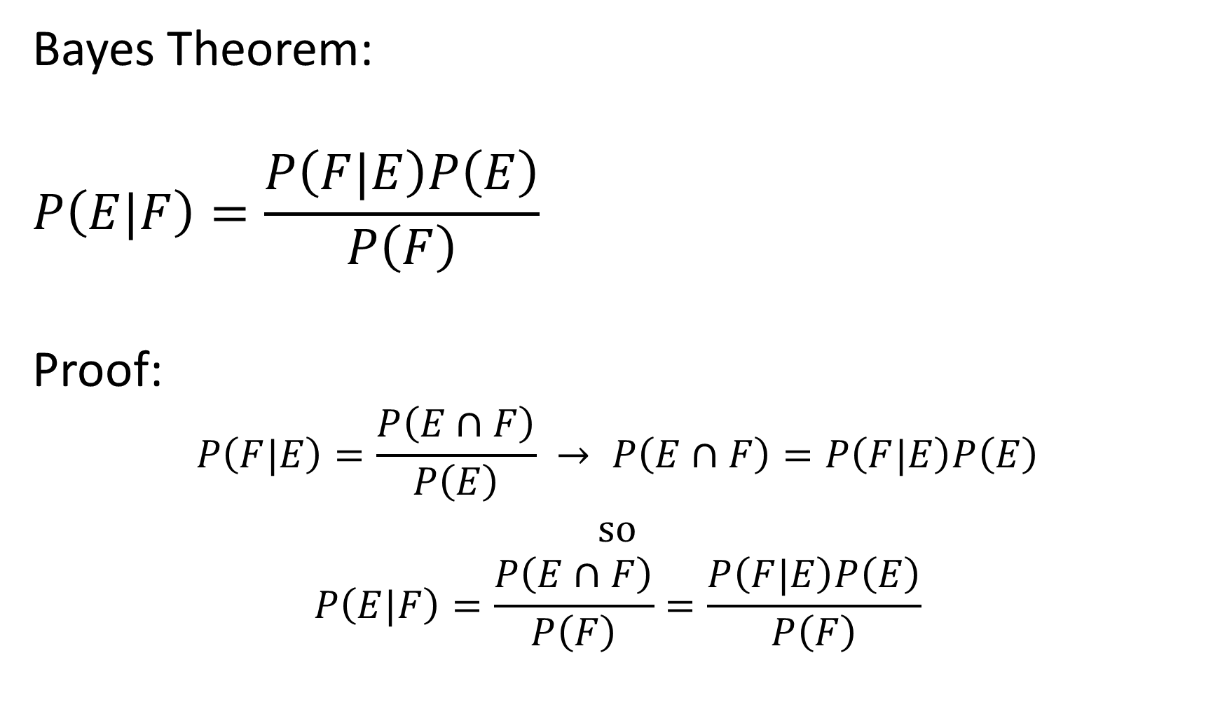
Bayes Theorem:
$$P\left(E|F\right)=\frac{P\left(F|E\right)P\left(E\right)}{P\left(F\right)}$$
Proof:
$$P\left(F|E\right)=\frac{P\left(E∩F\right)}{P\left(E\right)} → P\left(E∩F\right)=P\left(F|E\right)P\left(E\right)$$
so
$$P\left(E|F\right)=\frac{P\left(E∩F\right)}{P\left(F\right)}=\frac{P\left(F|E\right)P\left(E\right)}{P\left(F\right)}$$

Slide 23
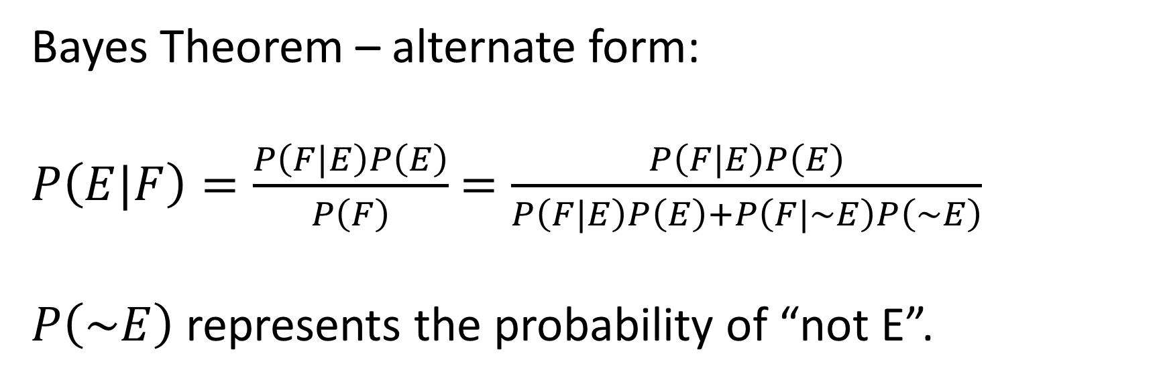
Bayes Theorem – alternate form:
$P\left(E|F\right)=\frac{P\left(F|E\right)P\left(E\right)}{P\left(F\right)}$ $=\frac{P\left(F|E\right)P\left(E\right)}{P\left(F|E\right)P\left(E\right)+P\left(F|\sim E\right)P\left(\sim E\right)}$
$P\left(\sim E\right)$ represents the probability of “not E”.

Slide 24
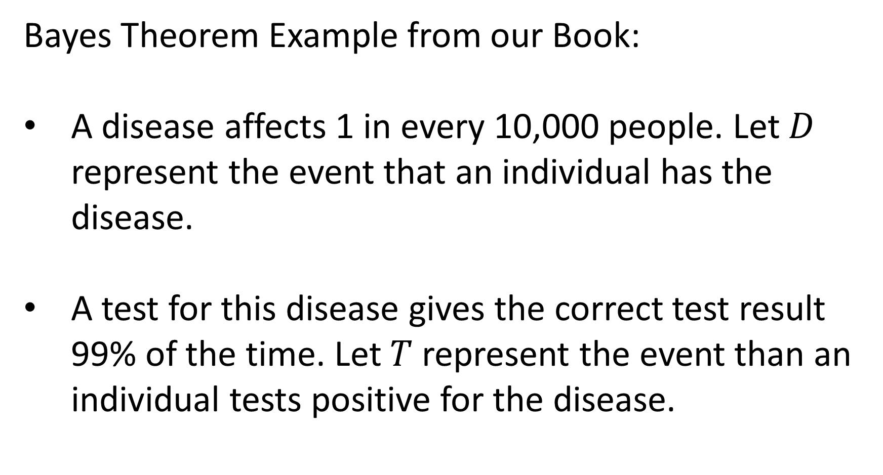
Bayes Theorem Example from our Book:
A disease affects 1 in every 10,000 people. Let $D$ represent the event that an individual has the disease.
A test for this disease gives the correct test result 99% of the time. Let $T$ represent the event than an individual tests positive for the disease.

Slide 25
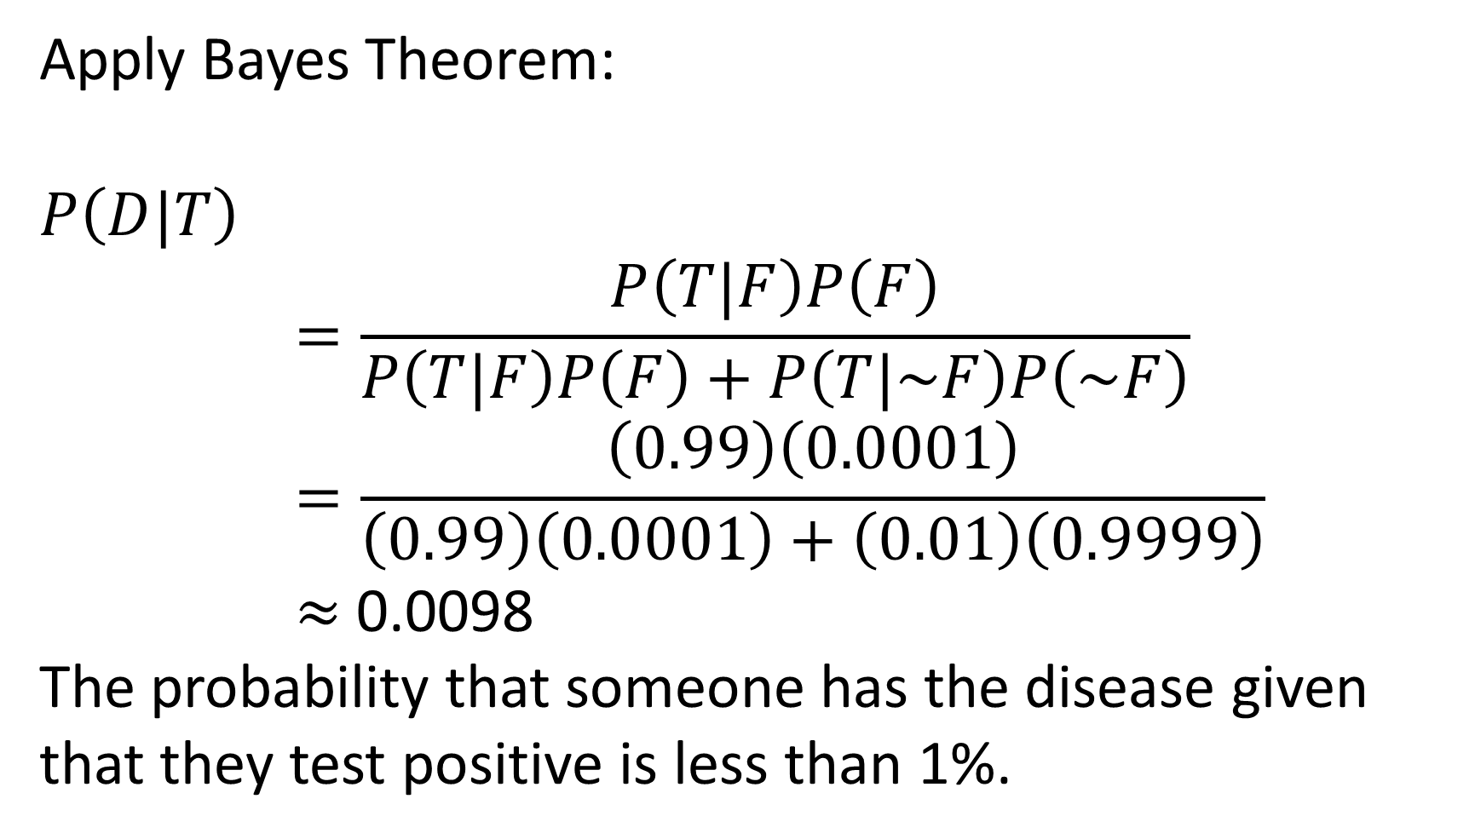
Apply Bayes Theorem:
$$P\left(D|T\right)$$
$$=\frac{P\left(T|F\right)P\left(F\right)}{P\left(T|F\right)P\left(F\right)+P\left(T|\sim F\right)P\left(\sim F\right)}$$
$$=\frac{\left(0.99\right)\left(0.0001\right)}{\left(0.99\right)\left(0.0001\right)+\left(0.01\right)\left(0.9999\right)}$$
$≈$ 0.0098
The probability that someone has the disease given that they test positive is less than 1%.

Slide 26
Random Variables:
A random variable is a numeric function of the outcomes in the sample space.
By definition, a random variable has an associated probability distribution.
Statistics (expected value, variance, etc.) can be computed on random variables.

Slide 27
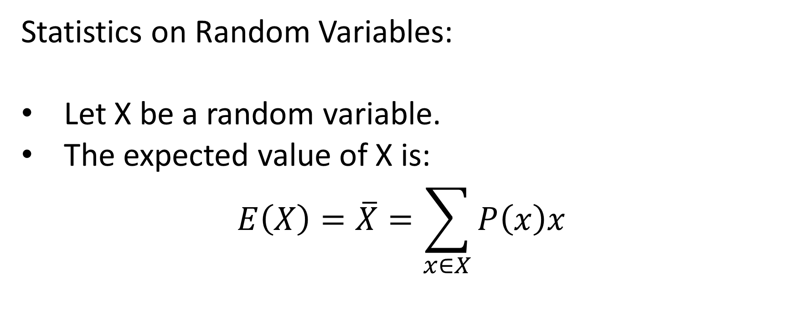
Statistics on Random Variables:
Let X be a random variable.
The expected value of X is:
$$E\left(X\right)=\overline{X}=\sum_{x∈X}{P\left(x\right)x}$$

Slide 28
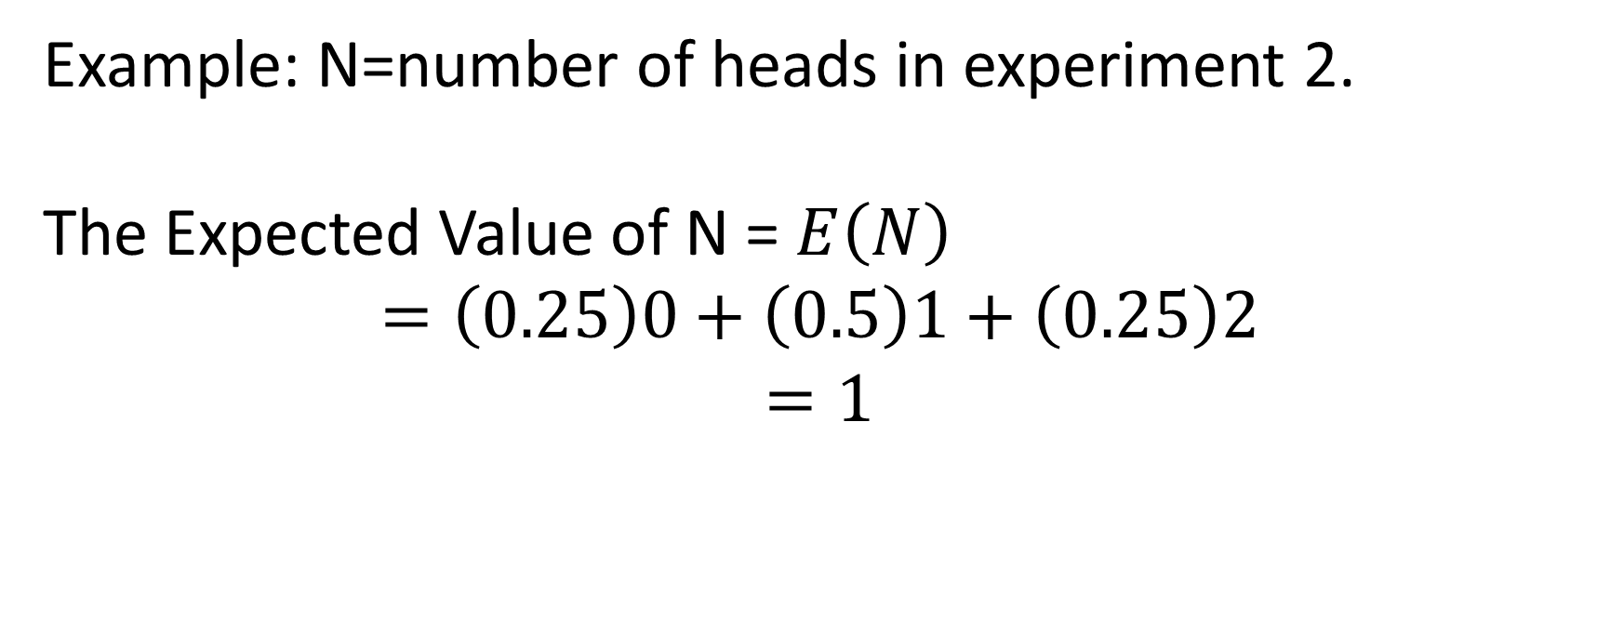
Example: N=number of heads in experiment 2.
The Expected Value of N = $E\left(N\right)$
$$=\left(0.25\right)0+\left(0.5\right)1+\left(0.25\right)2$$
$$=1$$

Slide 29
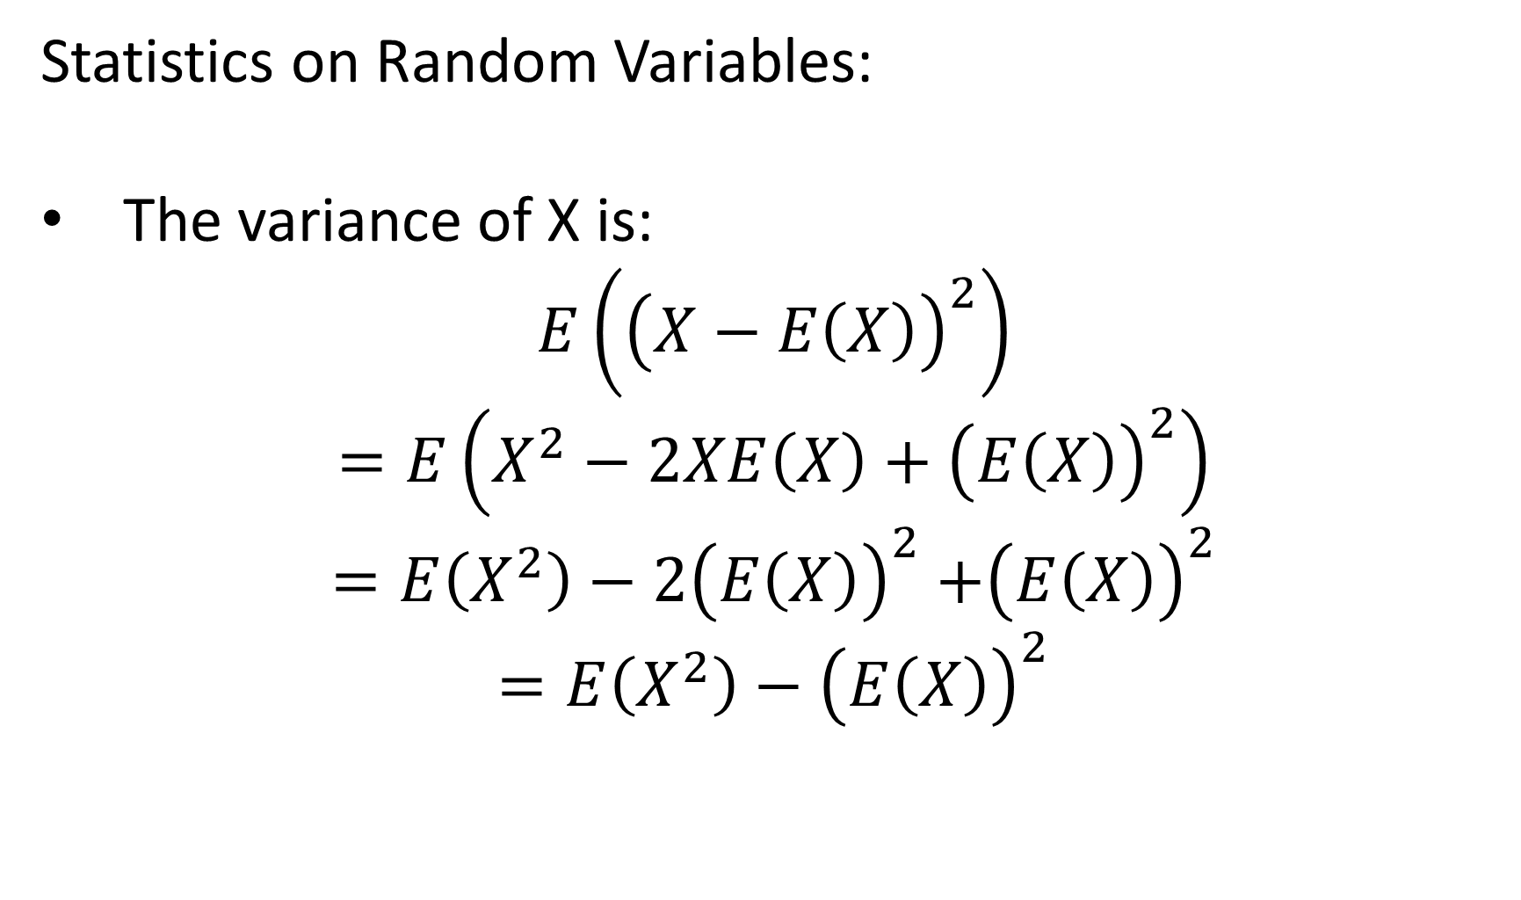
Statistics on Random Variables:
The variance of X is:
$$E\left({\left(X−E\left(X\right)\right)}^{2}\right)$$
$$=E\left(X^{2}−2XE\left(X\right)+{\left(E\left(X\right)\right)}^{2}\right)$$
$=E\left(X^{2}\right)−$ $2{\left(E\left(X\right)\right)}^{2}$ $+{\left(E\left(X\right)\right)}^{2}$
$=E\left(X^{2}\right)−$ ${\left(E\left(X\right)\right)}^{2}$

Slide 30
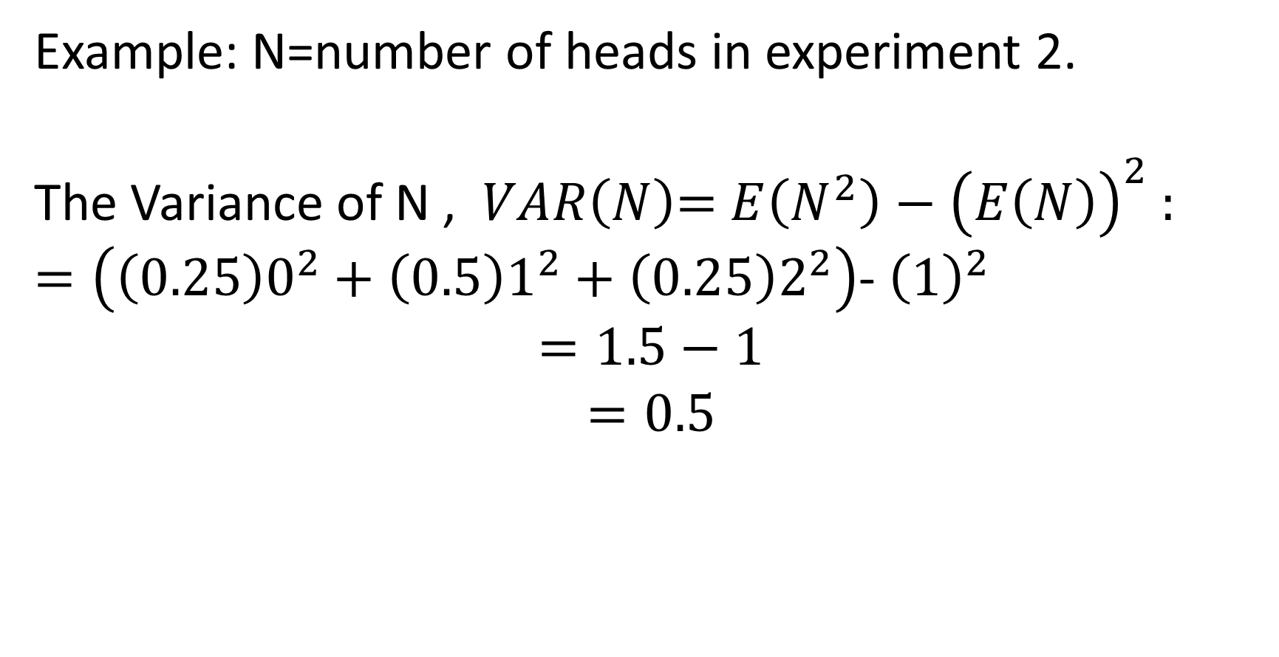
Example: N=number of heads in experiment 2.
The Variance of N , $VAR\left(N\right)$= $E\left(N^{2}\right)−{\left(E\left(N\right)\right)}^{2}$ :
$=\left(\left(0.25\right)0^{2}+\left(0.5\right)1^{2}+\left(0.25\right)2^{2}\right)$- ${\left(1\right)}^{2}$
$$=1.5−1$$
$$=0.5$$

Slide 31
So far, we have discussed discrete probability distributions. Specifically, we have discussed situations related to the Bernoulli Distribution and the Binomial Distribution.

Slide 32

Bernoulli Distribution:
$$P\left(X=1\right)=p$$
$$P\left(X=0\right)=1−p$$

Slide 33
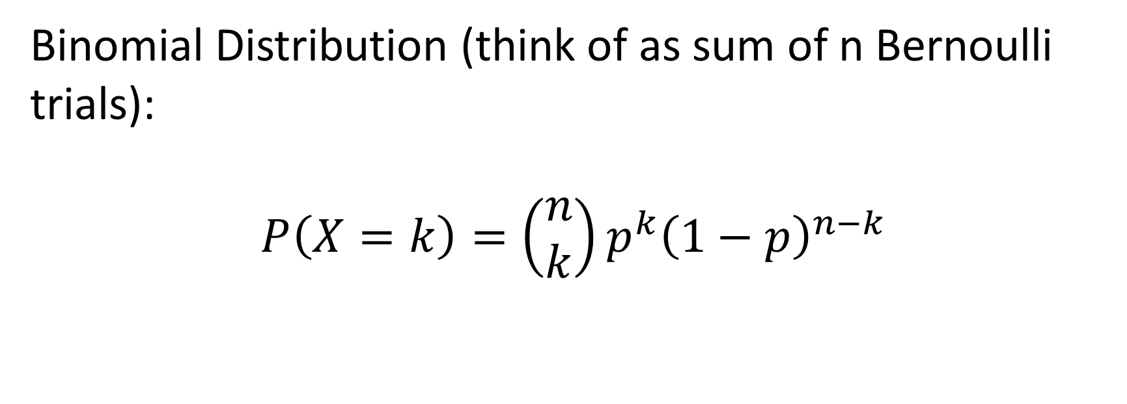
Binomial Distribution (think of as sum of n Bernoulli trials):
$$P\left(X=k\right)=\left(\begin{matrix}n \\ k\end{matrix}\right)p^{k}{\left(1−p\right)}^{n−k}$$

Slide 34
Several continuous distributions:
Uniform Distribution
Normal Distribution

Slide 35
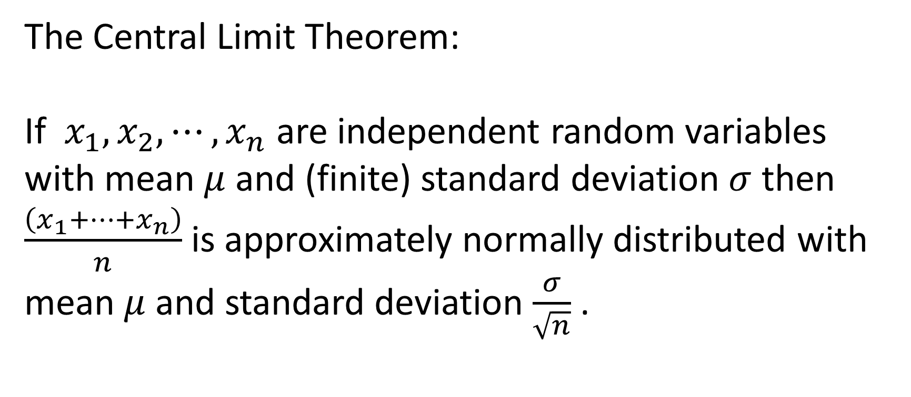
The Central Limit Theorem:
If $x_{1},x_{2},⋯,x_{n}$ are independent random variables with mean $μ$ and (finite) standard deviation $σ$ then $\frac{\left(x_{1}+⋯+x_{n}\right)}{n}$ is approximately normally distributed with mean $μ$ and standard deviation $\frac{σ}{\sqrt{n}}$ .

