Slide 1
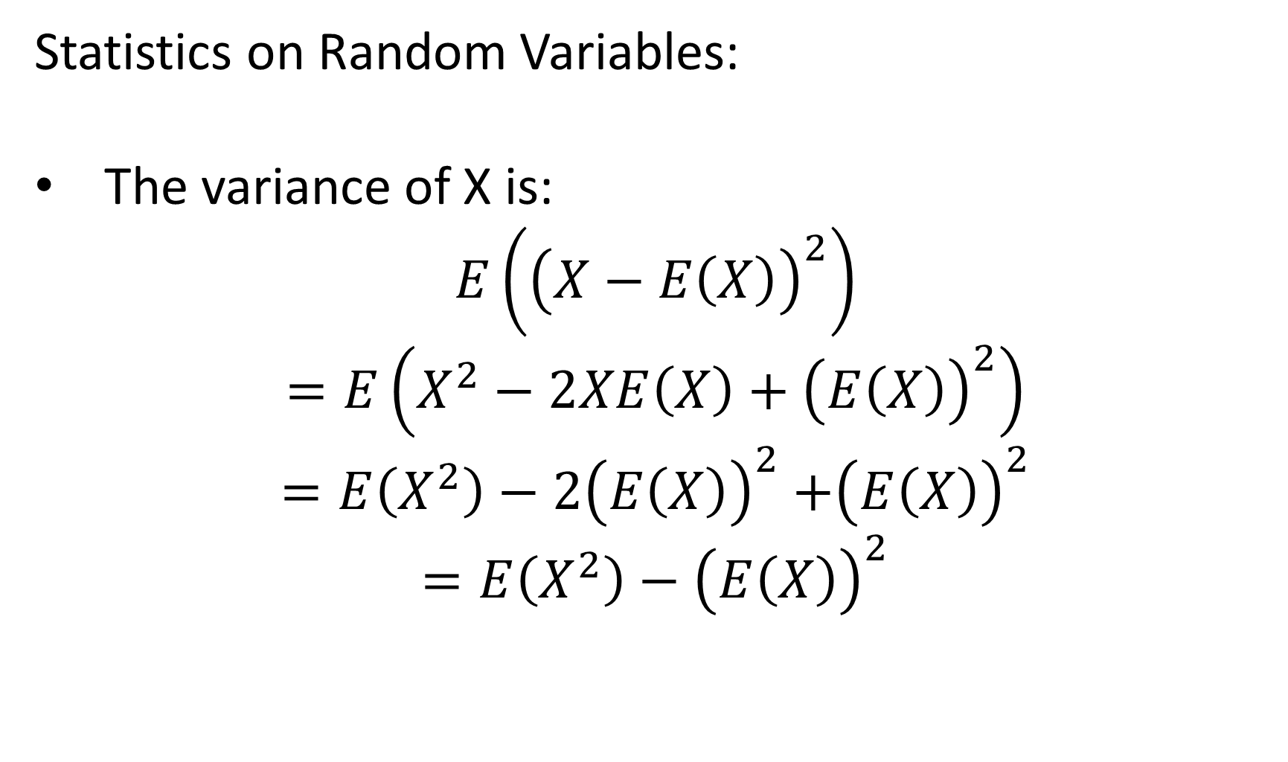
Statistics on Random Variables:
The variance of X is:
$$E\left({\left(X−E\left(X\right)\right)}^{2}\right)$$
$$=E\left(X^{2}−2XE\left(X\right)+{\left(E\left(X\right)\right)}^{2}\right)$$
$=E\left(X^{2}\right)−$ $2{\left(E\left(X\right)\right)}^{2}$ $+{\left(E\left(X\right)\right)}^{2}$
$=E\left(X^{2}\right)−$ ${\left(E\left(X\right)\right)}^{2}$

