Slide 1
Poisonous Defense: Circumventing BGP Level Censorship Team: Pretty Good BGP (PGBGP)
Kirtus Leyba
Ryan Schmidt
Austin Derbique

Slide 2
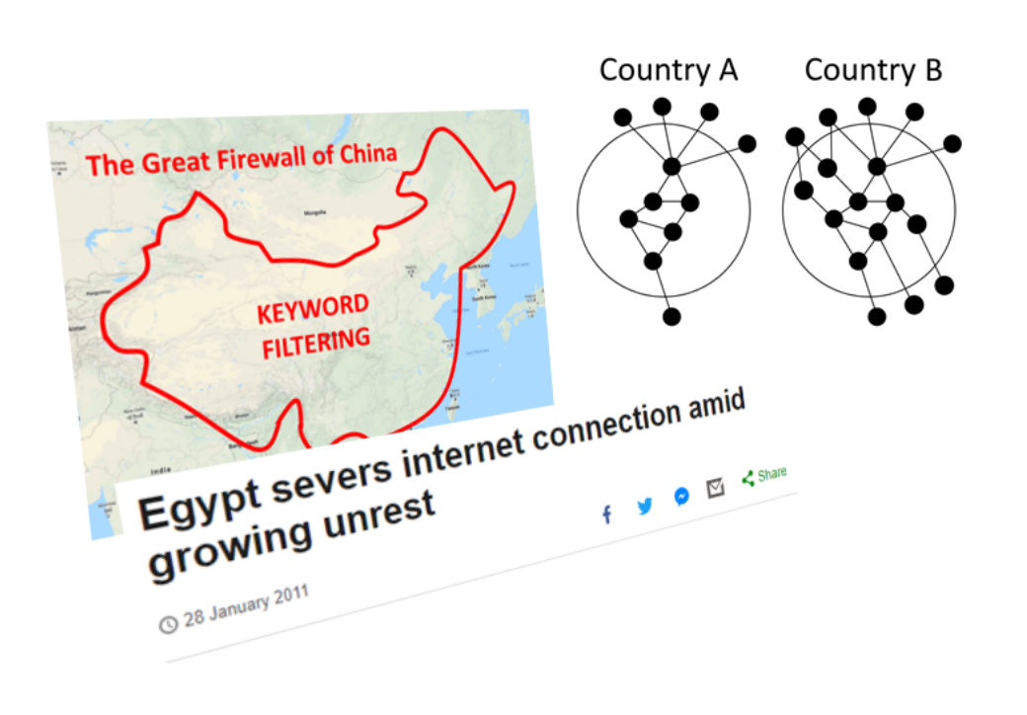
Motivation
Censorship is bad
Want to circumvent censoring/spying nodes
Project based on existing research of DDoS mitigation
Real World Examples: China, Myanmar

Slide 3
Group project Description
Provision Network Resources
Lead: Ryan Schmidt
Create Test Network
Lead: Austin Derbique
Run Services on Test Network
Lead: Kirtus Leyba
Create Path Poisoning Utility
Lead: Kirtus Leyba
Test Path Poisoning Utility
Lead: Ryan Schmidt
Enhance Path Poisoning Utility
Lead: Austin Derbique

Slide 4
Technical Details
15 VMs for the test network
Ubuntu Server 20.04, 2 cores, 3 GB RAM, 16 GB disk
VMWare vSphere/ESXi used for virtualization
Ansible
VM Provisioning
FRRouting
Open Source BGP daemon implementation
Nginx
Web server for network connectivity testing
Python
To run poisoning attack and collect experiment results

Slide 5
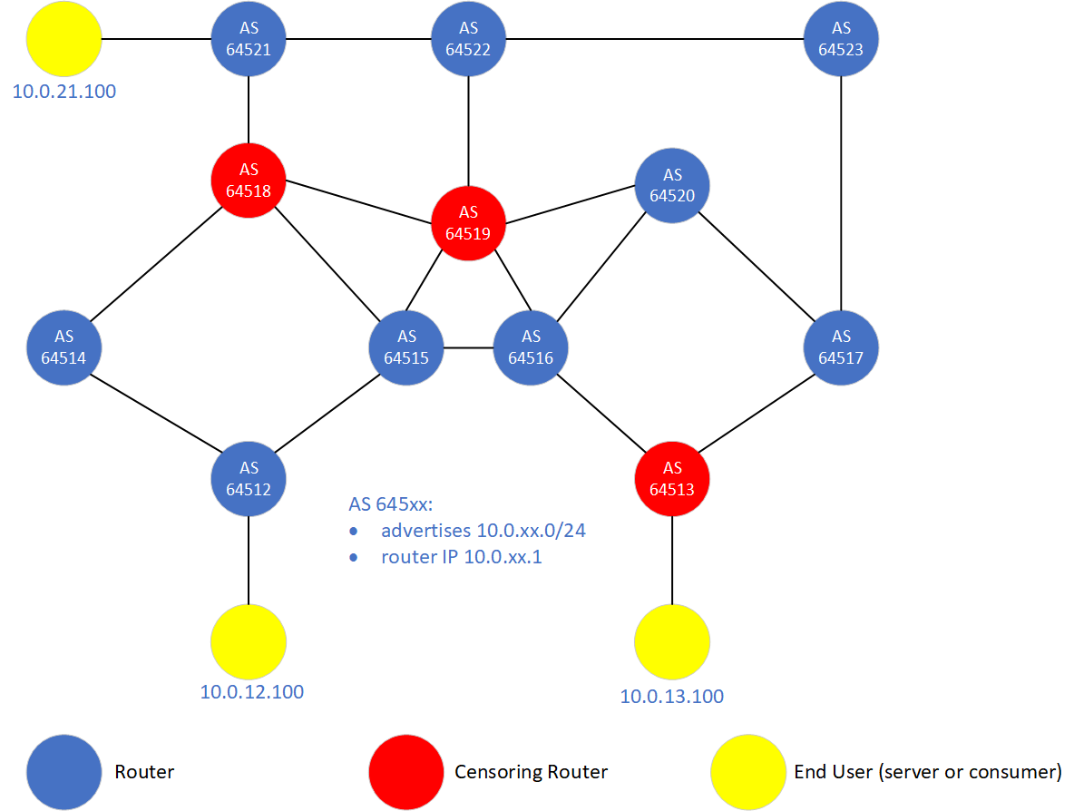
Technical Details

Slide 6
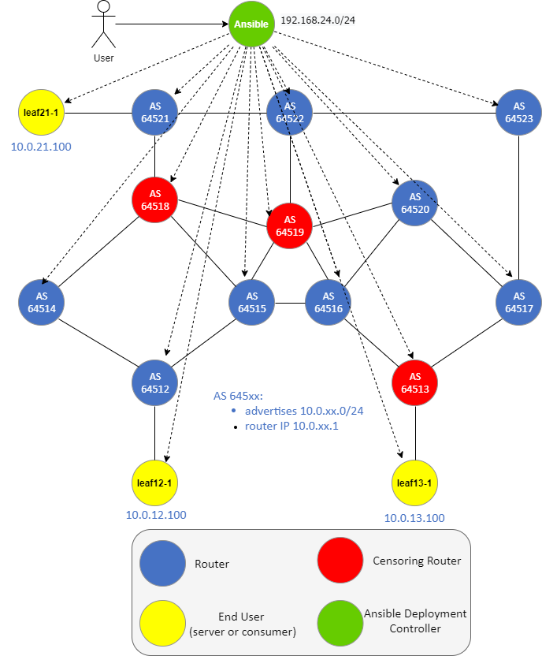
Technical Details

Slide 7
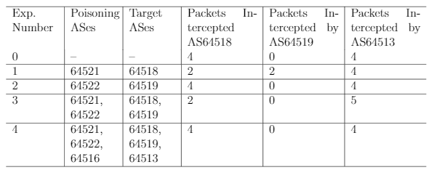
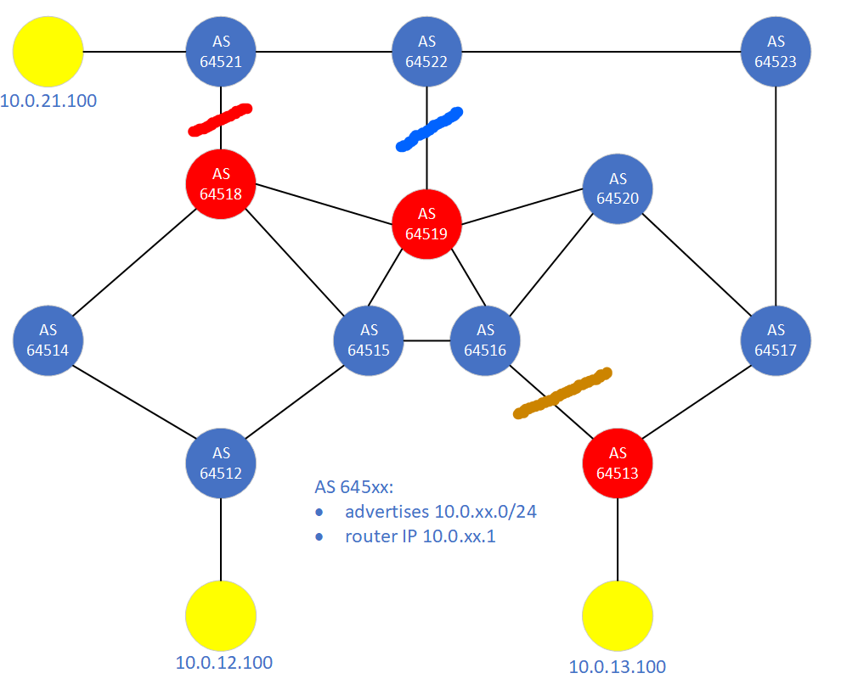
Path Poisoning Results
Path poisoning succeeds in selectively circumventing nodes.
The network topology can prevent censorship circumvention.

Slide 8
Risks and Benefits
Novel aspects of this project:
Using BGP Poisoning as a defensive measure instead of an attack
Risks/challenges:
Network provisioning
Collecting test results
May isolate leaf node if no other routes available
Potential applications & benefits:
Evading censorship and surveillance
Notes:
Just to reiterat...
-> novel: Path Poisoning originally used as an attack or DDoS defense
-> risk: Experimenting on realistic networks and experimenting on bigger networks
-> benefits: Finding the way out <censored border>

Slide 9
Tasks Accomplished by Now
Provision Network Resources
Create Test Network
Run Services on Test Network
Create Path Poisoning Utility
Test Path Poisoning Utility
Enhance Path Poisoning Utility

Slide 10
Conclusion
Alternate routes are used as a result of BGP path poisoning
Using our poisoning utility successfully avoids censors
Future work
Distributed path poisoning
Impacts on internet freedom
Counter measures

Slide 11
Demo

