Slide 1
Intro | Opening
Self Introduction
Why App | Android
Build The Thing, Right
Ade Rifaldi

Slide 2
Self Introduction

Slide 3
Why App | Android

Slide 4
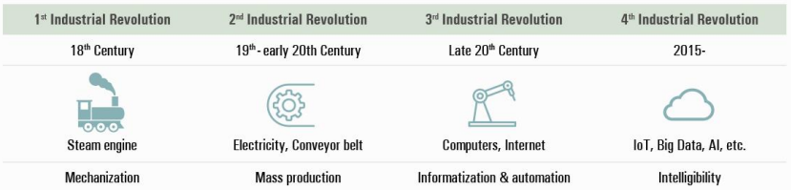
Digital Transformation
Free

Slide 5
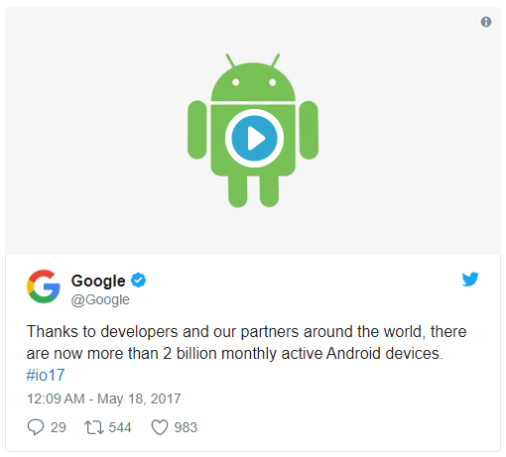
It now has more than 2 billion monthly active devices.
https://www.theverge.com/2017/5/17/15654454/android-reaches-2-billion-monthly-active-users

Slide 6
Build The Thing, Right

Slide 7
Quality Software | App
Reliability
Security
Efficiency
Maintainable
Size

Slide 8
