Slide 1


A dedicated workplace benefit for substance use disorder.
Finally.
24/7 peer recovery navigation for employees and their families — activated company by company, alongside the EAP and behavioral health benefits you already offer.
PREPARED FOR NEWS CORP · HR LEADERSHIP BRIEFING · FRIDAY, SEPTEMBER 18, 2026
Choosing to be sober today · for self, at home, and at work.
© sobrynth.com · 2026
Notes:
Jess
I want to start with the word on this slide that matters most, and it isn't 'finally.' It's alongside.
I know what this room is managing. Across these businesses you have EAP coverage. You have behavioral health coverage. Some of your companies have a digital mental health app, a musculoskeletal vendor, a fertility benefit, a navigation layer on top of all of it — and somebody above you asking why the stack keeps growing.
So I'm not here to add a fourteenth vendor. I'm here about one condition that every single thing in your stack technically covers and functionally does not reach.
I'm Jess Ferretti, VP of Sales at Sobrynth, and before anything else you should know I'm in recovery myself. I say that in rooms like this because the reason this condition doesn't show up in your utilization reports is that people like me learned very early not to raise our hand at work. That's not a benefits design problem. It's a disclosure problem.
Two framing notes before I start.
First, scope. I'm here about your US entities. Everything I'm proposing today is US-only, so nothing I say depends on how News UK or News Corp Australia are set up.
Second — and this is a genuine question, not a setup. You are not one workforce. You are a newsroom, a book publisher, a digital real estate business, a print and distribution operation, and a corporate center. I don't know from the outside whether that sits on one US EAP contract or several, and I'd rather ask than assume: how many EAP contracts are in this room?
[Jess: ASK THIS OUT LOUD. Do not assert it. At minimum the Dow Jones IAPE population is collectively bargained, so 'one contract' may well not be true — and being corrected on their own benefits stack in the first ten minutes costs you the room.]
Whatever the answer, it points the same way, which is why I'm asking for one company and ninety days rather than a group-wide rollout.

Slide 2
SUD MISCONCEPTIONS
3 Common Misconceptions about SUD in the Workplace
1
2
3
“You can tell when someone has a substance use problem.”
“If someone really wanted help, they’d just get treatment.”
“Our EAP already handles substance use.”
Often, you can't. Many people with SUD are employed and high-performing — filing on deadline, hitting their numbers — and it stays invisible until an absence, a safety incident, a workers' comp claim, or a crisis.
Fear of stigma, job consequences, cost, confidentiality concerns, and not being ready for formal treatment are huge barriers. Support often needs to start before someone is willing to enter treatment.
An EAP may technically cover SUD, but that doesn't mean employees will use it for SUD — or use it early. Whether these businesses sit on one EAP contract or several, the reporting comes back blended across all conditions. Substance use needs an engagement strategy built for each culture, and a number of its own.
Notes:
Jess
There are three things I hear constantly, and I'd love a show of hands — or put it in the chat — for who has heard these before.
One — 'you can tell when someone has a substance use problem.' If you met me with my two kids, my SUV and my very quintessential house in the suburbs, would you know I spent the vast majority of my life struggling with drug use? Probably not. The picture people carry is somebody visibly falling apart. The actual population is functioning, employed, filing on deadline, hitting most of their numbers, and completely invisible until there's an absence, an incident, a claim, or a crisis. By the time it's visible on your dashboard, you're years in.
Two — 'if they really wanted help, they'd get it.' This is the one that sounds like common sense and isn't. Fear of stigma, fear of job consequences, cost, confidentiality — and the big one nobody designs for: they're not ready for formal treatment yet. Support has to exist before someone is ready, or it doesn't get used.
Three — and this is the one I'd flag hardest for this group — 'our EAP already handles substance use.'
Here I want to ask rather than tell, because I genuinely cannot know it from outside: how is EAP structured across your US businesses? One contract, or several?
If it's one, it lands in a newsroom, a book publisher, a digital real estate sales floor and a print plant — four completely different disclosure cultures — and it will underperform in at least three of them.
If it's several, then nobody in this room holds a single comparable number, and the variation between your businesses is invisible.
Either answer lands in the same place: the reporting you get is blended across every condition, so the substance use line has never been broken out on its own. That's ask number two at the end.

Slide 3
THE MEDIA WORKFORCE
What the Data Says About People Who Work in Media
SAMHSA · BY INDUSTRY
SAMHSA · BY INDUSTRY
TRAUMA EXPOSURE
3rd
13.7%
86–100%
Arts, entertainment and recreation ranks 3rd of 19 industries for substance use disorder — 12.9% against 9.5% across all full-time workers
Past-month illicit drug use in arts and entertainment — second highest of any industry, against an 8.6% all-industry average
Of journalists report witnessing a traumatic event on the job. PTSD runs 4–13%, and 28.6% lifetime among war correspondents
BURNOUT
IRREGULAR HOURS
JOB INSECURITY
8 in 10
25%
17,163
US journalists report burnout or chronic stress in the past year. 38% say their mental health declined; half considered leaving
More alcohol consumed by night-shift workers than day-schedule workers. Rotating and night work is linked to binge drinking
Media job cuts announced in 2025, up 15% year over year. Sustained job insecurity is a documented driver of substance use
Sources: SAMHSA NSDUH, Substance Use and Substance Use Disorder by Industry · Feinstein et al. 2002 · Dart Center for Journalism and Trauma · Muck Rack State of Journalism 2025 · Media Resilience Network 2026 · European Addiction Research, shiftwork systematic review · Challenger, Gray & Christmas 2025
Notes:
Jess
This is the slide I added for this room, because the first question I always get is 'sure, but is that our people?'
Two things about the industry data. The top row is measured prevalence. SAMHSA breaks substance use disorder out by industry, and arts, entertainment and recreation comes in third of nineteen — 12.9% against a 9.5% average. Illicit drug use is second highest of any industry in the country. That's the entertainment-adjacent side of media, and it is a real signal, but I want to be straight with you: it is not a clean proxy for a newsroom or a book publisher. Take it as directional.
The bottom row is why I think the exposure is broader than the industry code suggests. It's three mechanisms, and every one of them is present somewhere in this company.
Trauma exposure. Between 86 and 100% of journalists report witnessing a traumatic event on the job. Not covering one. Witnessing one. PTSD runs four to thirteen percent, and among war correspondents it's 28.6% lifetime — four to five times the general population. Feinstein also found war journalists self-report drinking more than other journalists. If you have foreign desks, crime desks, or anyone who handles graphic user-generated content for a living, that's your population.
Burnout. Eight in ten US journalists report burnout or chronic stress in the past year. Thirty-eight percent say their mental health declined. Half have considered leaving.
Irregular hours. Night-shift workers consume about 25% more alcohol than day-schedule workers, and rotating shifts are independently associated with binge drinking. News does not keep business hours. Neither do print plants or distribution.
And then job insecurity underneath all of it — 17,163 media job cuts announced in 2025, up fifteen percent.
I'm not telling you News Corp has a drinking problem. I'm telling you that you employ, at scale, almost every occupational risk factor the literature identifies for this condition. And the one benefit you have pointed at it is the one your people are least likely to call.

Slide 4
GALLUP STUDY MAY 2026
What Americans Know About Substance Use Disorder
GALLUP FINDING
GALLUP FINDING
GALLUP FINDING
30%
Knowledge Reduces Stigma
56%
Most employers have no mechanism to address stigma
Americans who don't know where to find accurate SUD information
Would help a struggling colleague. 31% simply don't know what to do
GALLUP FINDING
GALLUP FINDING
GALLUP FINDING
Fear Stops People
No Policy Infrastructure
Families Carry Stigma
Stigma and employment fears are documented barriers to seeking help
Exists for most employers, recovery-friendly intent stays unscalable
They're often first to recognize SUD, but face their own shame and knowledge gaps
Sources: Addiction Policy Forum & Gallup - Addiction Stigma in America, May 2026 · SAMHSA NSDUH
Notes:
Jess
There's some very new data from Gallup from May of this year with three findings I'd pull out specifically for this group.
The first - 56% of Americans would help a struggling colleague, but 31% don't know what to do. The willingness is already inside your buildings. The competence isn't. That's a training problem, and training problems are solvable — which is a much better position than a culture problem.
Second - Most employers have no policy infrastructure for this. So even a leader who wants to do the right thing has no procedure. Recovery-friendly intent stays a value statement instead of becoming an operating standard.
And then lastly - families carry their own stigma. They're usually the first people to recognize what's happening — and the last to have anywhere to go with it. They see it before any manager does, before any claim does, before anything shows up in your data. And they're carrying their own shame about it at the same time.

Slide 5


SUD IMPACT IN THE WORKPLACE
1 in 10
4 in 5
EMPLOYEES WITH UNTREATED SUD
IMPACTED ARE NEVER TREATED
$8,817
30%
ANNUAL COST PER IMPACTED EMPLOYEE
INCREASED SUD COST IN 3 YEARS
Per 1,000 employees: 100 untreated. 80 getting nothing.
Sources: SAMHSA NSDUH, NSC/NORC 2025, U.S. Department of Labor
Notes:
Jess
Run this against your own census while we talk through it.
70% of adults with a substance use disorder hold active jobs. They're on your headcount. They enrolled during open enrollment.
1 in 10 of your employees has untreated SUD right now. I'm putting this per thousand rather than quoting you a headcount, because the public News Corp figure is a worldwide number and we are only talking about your US entities today. So take it at whatever scale is yours: per 1,000 employees, 100 people. And here's the number I want you to hold — 4 in 5 of them are never treated. That's 80 of those 100, with nothing in place.
Now — 4 in 5 never treated. Not 4 in 5 uncovered. Every one of those people has coverage. They have your medical plan. They have your EAP. Coverage was never the problem. Reach is.
Over $8,800 per affected employee per year, up 30% in three years. On a thousand people that's about $880,000 a year. I'm not going to multiply it across your whole US census and put one headline number on the screen, because your operating companies sit on different plans and a blended figure would be fiction. Run it per company. That's ask number one at the end.
And it isn't a projection — it's already in your numbers. It's spread across absence, turnover, disability, medical and pharmacy, and never once coded to substance use.

Slide 6





THE CHAIN OF UNTREATED SUD
STAGE 1
STAGE 2
STAGE 3
STAGE 4
STAGE 5
A missed deadline
A relationship, quietly strained
A resignation no one probed
An incident in the plant or the field
A body that's had enough
$15,000+
$20,000+
$30K–$45K
$47,316
$485,320
in lost output, per year
per leave event
to replace one employee
average claim cost
average claim cost
≈8 hrs/week of reduced output × avg. U.S. hourly wage (BLS, 2026), annualized
12-week FMLA leave: continued health premium (KFF, 2025) + backfill coverage (BLS, 2026)
6–9 months of salary: recruiting, onboarding, ramp-up to full productivity (SHRM)
Average lost-time workers' comp claim (NCCI, via National Safety Council, 2025)
Average cost of a single cancer diagnosis to a self-funded health plan (Voya Stop-Loss Analysis, 2025)
Someone just had to catch stage one.
Every stage has a price tag. Sobrynth is built to interrupt the chain before it starts.
Sobrynth®
Notes:
Jess
This is the slide to photograph.
This is not five employees. It's one person, moving left to right, over about three to five years. Every stage has a price tag, and every price tag lands somewhere in your world.
Stage one, a missed deadline. $15,000 in lost output. Nobody does anything — because a missed deadline isn't a crisis, it's a bad quarter. That's the whole problem: stage one never generates a ticket.
Stage two, a relationship quietly strains. $20,000 per leave event — continued premium plus backfill. That one is already crossing your desk as a leave request, and nobody codes it to substance use.
Stage three — and I re-cut this one for your workforce. In a plant it's a failed screening. In a newsroom or a publishing house it's a resignation nobody probed. Someone good leaves, the exit interview says 'pursuing other opportunities,' and it costs you $30,000 to $45,000 to replace them. Notice this is usually where employers finally act, and acting means losing them. You didn't resolve the exposure. You transferred it to another employer and paid replacement cost for the privilege.
Stage four, an incident. $47,316, average lost-time workers' comp claim. And I want to be specific with this room, because most people hear 'media' and picture a desk. You run print plants. You run distribution fleets. You put camera and field crews in unpredictable places. That is a safety-sensitive population inside a company that doesn't usually think of itself as a safety-sensitive employer.
And stage five, a body that's had enough — $485,320, the average cost of a single cancer diagnosis to a self-funded plan.
Someone just had to catch stage one.

Slide 7
CURRENT STATE
We’re only Solving for Stage 4 & 5 Today
Of 48.5M Americans with SUD, only 20% sought treatment last year. Support pathways are limited today.
Inpatient / Residential Treatment
Medication for SUD / MAT
>10%
All other pathways — Unreached
90% who need support cannot find the pathway they seek today.
Source: SAMHSA NSDUH 2024 | ©Sobrynth · Choosing to be sober today.
Notes:
Jess
Everything we've built in our healthcare system sits at the far right of that chain.
Inpatient. Residential. Medication-assisted treatment. Those are stage four and stage five interventions. They're excellent — and they are designed for people already in crisis.
48.5 million Americans have a substance use disorder. 20% sought treatment last year and only half qualified for inpatient or medication. That means 90% of people who need support cannot find a pathway that matches where they actually are.
Now put that in plan-design terms, because this is the part that should bother you. Every dollar you currently spend on this condition activates at the moment of highest cost and lowest probability of a good outcome.
There is nothing in your benefits stack a person can use at 'I think I'm drinking too much on weeknights.' And that's stage one — the moment where the intervention costs almost nothing and works best.
So it isn't that nobody catches stage one because they don't care. It's that we never built anything that lives at stage one

Slide 8
SOBRYNTH SUPPORTS ALL PATHWAYS OF CARE.
Housing & Transitional
Recovery Support
Sober Housing ·
· Peer Recovery Coaching
Sub-Clinical Support:
Peer Coaching
Transitional Housing ·
· Sober Curious Exploration
Peer Recovery Housing ·
· Family Support
Recovery Community Centers ·
· 24/7 Phone / Email / SOBRPath™
Reintegration Programs ·
SOBRIETY
· AA / Al-Anon / Recovery Orgs
IS PERSONAL
No one pathway or combination of care
Partial Hospitalization ·
· Outpatient Treatment (OP)
Inpatient Treatment ·
· Intensive Outpatient (IOP)
Residential Treatment ·
· Day Treatment
Intensive Clinical Care:
Higher Levels of Care
Outpatient Care:
Lower Levels of Care
Detox / Medical Stabilization ·
· Telehealth Counseling
Clinical Pathway Programs ·
· Behavioral Health Therapy
Sobrynth®
Notes:
Jess
So, what does genuine, live-experience substance us support actually look like then? This.
We don't push people down one path — we meet them where they are and walk with them through whatever makes sense for them. All of these are valid ways to get sober. Not just therapy. Not just inpatient. Not just an EAP referral.
For some people it starts with getting sober-curious. Peer coaching. Family support. A community group. Somebody to talk to at two in the morning when it's about to spiral. That's stage one. For others it's outpatient, IOP, or intensive clinical care. The problem today is that no single system helps someone navigate across all of it — so people get pushed into the wrong level of care, or they fall through entirely.
And now the part I want this room specifically to hear, because it's the part that surprises benefits leaders. We are not insurance-based.
No claim. No network. No deductible. No prior authorization. Nothing hits your plan.
Which means we can support people you currently cannot reach no matter how good your plan design is. Your part-time and hourly workforce. Employees who waived coverage. Someone on a spouse's plan. And — going back to that families number — family members who have never been on your plan at all.
That's a coverage gap most of you already know you have and have never had a tool for. It's also a big part of why our engagement numbers look the way they do. And it's why health plans have started paying attention — because people who get the right support at stage 1 don't turn into the $485,000 claim on the right edge of the last one.

Slide 9
THE SOBRYNTH DIFFERENCE
Before, during, and after, Sobrynth is here for it all.
LOWER ACUITY · NON-CLINICAL
HIGHER ACUITY · CLINICAL
SOBRYNTH: BEFORE, DURING & AFTER
EMPLOYEE
FAMILY
MANAGER
ALL OTHER WORKPLACE SUD BENEFITS: ONLY DURING TREATMENT
EMPLOYEE ONLY
$0
$0
$0
$$
$$$
$$$$
Sober Curious
Exploration
Peer Recovery
Coaching
Family Support &
Community Orgs
Outpatient / IOP
Treatment
Residential / Day
Treatment
Detox & Inpatient
Stabilization
©2026 Sobrynth · Choosing to be sober today.
Notes:
Marin
Two differences on this slide.
First, the timeline. Every other workplace SUD benefit switches on during treatment and switches off after. But before and after are where this condition actually lives — the slow slide in, and the relapse risk on the way out. Recovery isn't an episode of care. Your benefits stack is built almost entirely out of episodes of care.
Second, look at who's covered. Employee. Family. Manager.
Family — and this is the third time families have come up in twenty minutes, which is deliberate. Gallup says they see it first. Two in three American families are living with it. And the spouse knows roughly two years before the employer does. So they are simultaneously your earliest possible detection point and, in many cases, your own plan members. Give them somewhere to call and you have moved detection years upstream on a person you are already insuring.
Manager, because your people leaders are the ones who'll see stage one. Right now they have exactly two options: ignore it, or send it to HR. And everyone in the building knows what it means when something goes to HR. So they pick option one, every time, and I don't blame them — nobody ever taught them a third option.
And the left three columns are zero dollars. No cost, no claim, no clinical trigger, no eligibility check. Which means the interruption happens where it's cheapest — in every sense of that word.

Slide 10



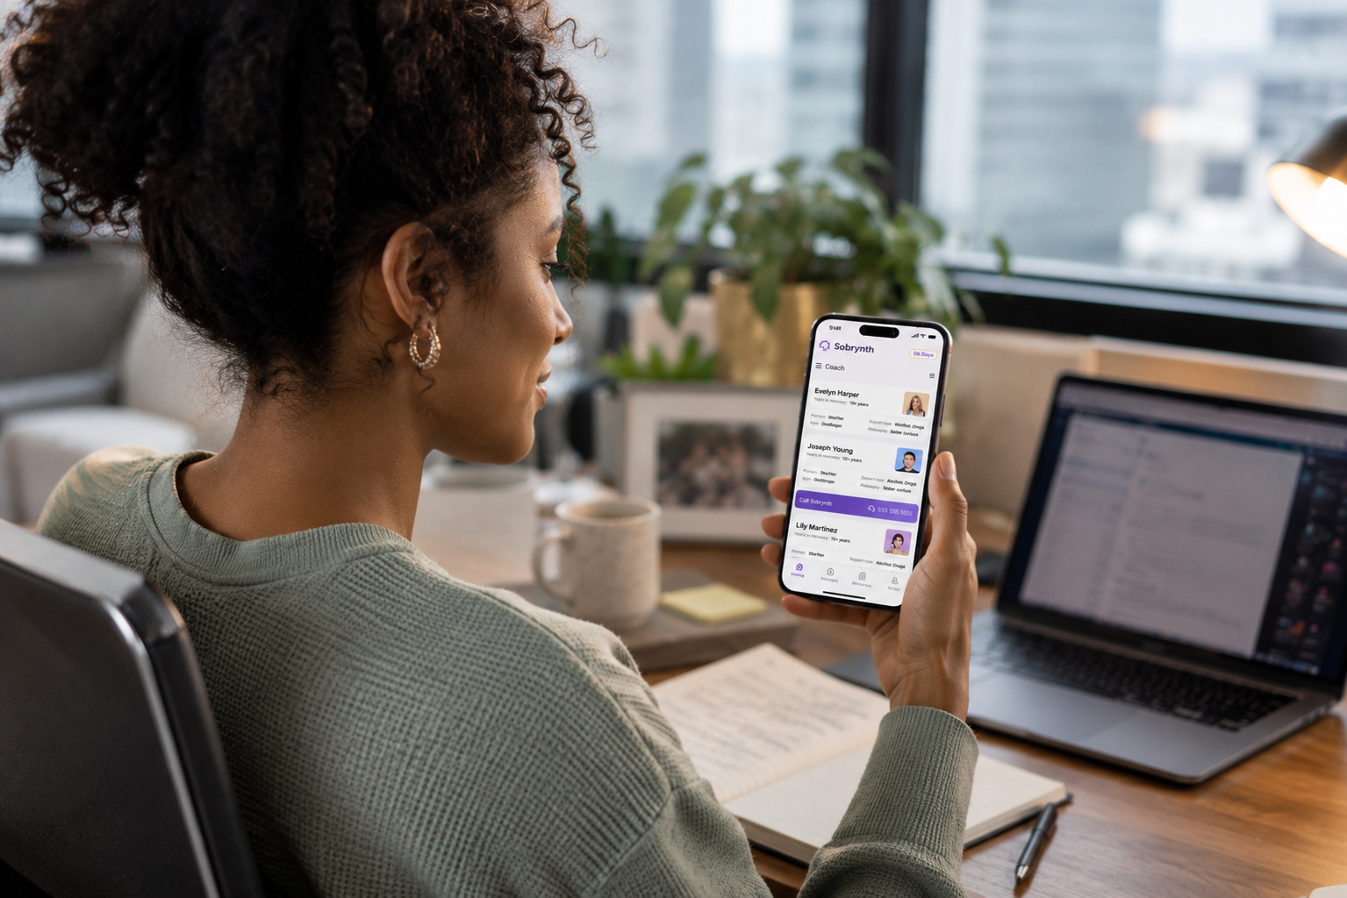
SOBRYNTH SOLUTION
Recovery-Friendly
Workplace Activation
24/7 Care
Navigation
Unlimited Peer Coaching
SOBRPath™ Platform
2
3
4
Customized Communications
Training for People Leaders
Sober ERG Framework
Personalized Marketing
Dedicated line and unique code for each operating company
Concierge support
Free + community resources through to clinical care
Employees + families
Certified Peer Recovery Coaches with lived experience.
Every acuity level
Uncapped sessions
Sobriety is personal, so is plan
Confidential, self-service platform
Browse coaches + book time
Track sober days, find resources, and more
2025 Stevie Award winner
Early intervention. Education at scale. Anonymous + uncapped.
©2026 Sobrynth · Choosing to be sober today.
Notes:
Marin
Four things working together.
A 90-day Recovery-Friendly Workplace activation — customized communications, training for people leaders, a sober ERG framework. This is the part that makes it culturally safe to ask before there's a crisis. It's also the part that most benefits programs skip, which is why most benefits programs sit at two percent utilization.
24/7 care navigation. Dedicated line, employer-specific code, concierge support — a person, not a portal. Anonymous. No names shared with HR. No claims filed. Employees and families.
Certified peer recovery coaches, every one in recovery themselves, at every acuity level, with uncapped sessions. And I want to be precise about uncapped: no session limit, no additional cost. Compare that to three to six EAP sessions — which is exactly enough time to build trust and then take it away.
And the SOBRPath platform for confidential self-service, whenever someone's ready.
Underneath all four is a tiered engagement model, and this is the part your CFO will care about: the roughly 80% with lower-acuity needs get served through peer coaching and navigation at low cost. The 20% with higher-acuity needs get routed to the right level of clinical care — not the most expensive one, the right one. One benefit, matched to need, instead of one-size-fits-all.
And the key word, again — alongside. We sit next to your EAP and your behavioral health vendor. We don't replace them, and I'd be suspicious of anyone who told you they could.

Slide 11
RFW ACTIVATION
Live in 90 Days
A guided path from kickoff to launch, run company by company — so each masthead and business gets an activation built for its own culture, not a group-wide template.
DAYS 1–30
DAYS 31–60
DAYS 61–90
Foundation
Readiness
Activation
We learn your culture, agree on success metrics, and shape the plan with your team.
Leaders and peer champions are trained. Materials, digital access, and your support line are ready.
Employees and families gain 24/7 anonymous support. You see engagement and impact in quarterly reporting.
Go Live in Month 3
24/7
Done for you
1 in 10
Anonymous peer support for employees and families, at their own pace.
Trainings, templates, and communications are prepared and delivered by our team.
Employees are impacted by substance use disorder (SUD). Most never ask for help at work.
Beyond Day 90: Ongoing access to the Employer Hub, with a monthly communication toolkit and a library of resources and engagement opportunities to keep awareness strong.
Notes:
Marin
Ninety days, kickoff to live, and it's done for you. First thirty we learn your culture and agree on success metrics with your team. Thirty-one to sixty we train leaders and peer champions, build the materials, stand up the line. Sixty-one to ninety, employees and families have 24/7 access and you start seeing engagement in quarterly reporting.
Let me say the quiet part, because I've watched it kill good programs. The number one reason a benefit like this dies isn't budget. It's that your team doesn't have the bandwidth to launch it. You're running open enrollment, you're mid-renewal, you're short a person, and the new thing needs eight hours of internal comms nobody has.
So we write the trainings. We build the templates. We deliver the communications. Your team's job is to show up and give us your leaders for a session.
And after day 90 there's an Employer Hub with a monthly communications toolkit — because awareness that isn't refreshed decays inside one quarter. That's the difference between 100% awareness and a program everyone forgets by March.
Before we keep going, I want to throw a question out to the group: What percentage of your employees used your EAP last year – for any reason?

Slide 12

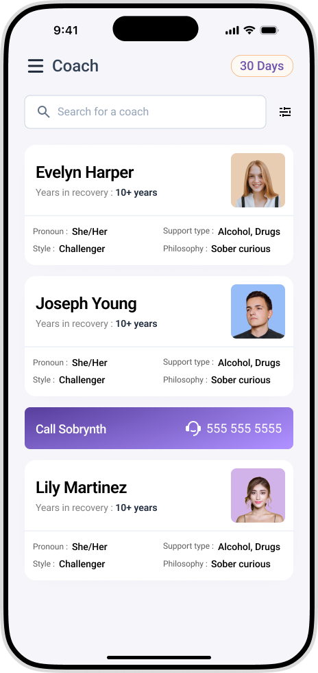
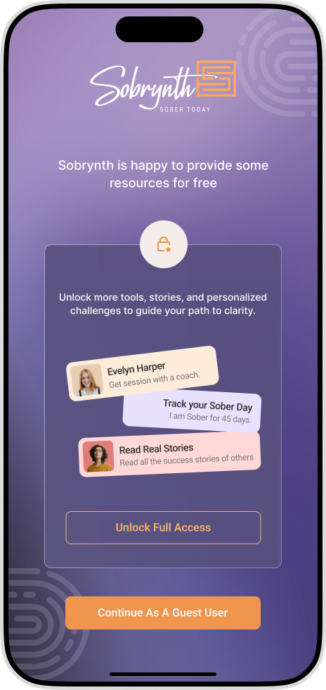
THE PLATFORM
SOBRPath™ Platform
1
Resources for 50 States, All Care Pathways
Find the care you seek in our comprehensive resource directory - for yourself or a loved one. Clinical to free community resources and everything in between.
2
Track Sober Days, Read Stories + More
SOBRPath™ has a journey for everyone. Lived recovery stories, FAQs and conversation guides, and personalized sober goals - all self-serve, anytime.
3
Personalized Coach Connection
Employees choose their own coach for personalized guidance tailored to their unique needs and goals. Every coach is in recovery themselves.
©2026 Sobrynth · Choosing to be sober today.
Notes:
Show SOBRPath as the self-serve layer alongside human coaching.
SOBRPath is the self-serve layer underneath all of this, and it won a Stevie Award in 2025. It gives employees and families a resource directory covering every care pathway, in all fifty states. It gives them a place to track sober days, read real recovery stories, and find answers without having to ask a single person first.
And when someone is ready to talk to a human, they choose their own peer coach, someone who is in recovery themselves, matched to their specific needs. Self-service when you want privacy, real human connection the moment you want it. That choice is the point.

Slide 13
SOBRYNTH RESULTS
Awareness leads to utilization. Utilization leads to retention.
100%
6%
33%
Employee Awareness
Utilization in 45 Days
Webinar to Platform
Achieved full employee awareness of SUD resources following our 90-day activation program.
Versus the 2–5% EAP benchmark across all conditions. Concentrated entirely on SUD.
Of employees who attended a single optional webinar created an account on SOBRPath™.
© Sobrynth · Choosing to be sober today.
Notes:
Marin
Two to five percent. For everything — mental health, financial, legal, marital, substance, all of it. And nobody's angry about it, because it costs almost nothing per employee. Which is exactly why nobody has ever asked why it doesn't work.
Here's ours. 100% employee awareness after the 90-day activation. 6% unique utilization inside 45 days — on one condition. Not blended. Not all-conditions. Substance use alone.
So it isn't 'a bit better than your EAP.' It's an order of magnitude more concentrated, on the condition your EAP reaches least.
And I'd point out what that number is for you. Most of you have to defend a benefits budget with utilization data. This is a number you can put in front of a CFO without a caveat attached.
The third one is the one I find most telling. 33% of employees who attended a single optional webinar went and created an account. One in three. Nobody recruited them. Nobody referred them. The demand was already sitting in the building — it had just never been given a door that felt safe to walk through.

Slide 14
PROOF IT WORKS
Gardner Builders. 8x EAP Utilization.
250 employees. Minnesota commercial construction. The hardest room we have ever walked into.
100%
6%
EMPLOYEE AWARENESS AT 45 DAYS
UNIQUE EMPLOYEE UTILIZATION WITHIN 45 DAYS
Our goal is to be a place where people feel valued, challenged, and love coming to work. You can’t love your work if you don’t feel safe asking for help.
8x
3X
UTILIZATION COMPARED TO AVERAGE EAP
UTILIZATION OF
TRADITIONAL EAPS
Kathryn Wegler, Employee Engagement Director, Gardner Builders
Notes:
Marin
I want to show you this one specifically because it's the hardest case, not the easiest.
Two hundred fifty employees. Minnesota commercial construction. A workforce that is largely male, largely trades, and culturally the least likely population in America to raise a hand and say they need help with a substance. If you were designing a test to make a program like this fail, you'd design this one.
100% awareness at forty-five days. 6% unique utilization inside forty-five days. Eight times the utilization of their traditional EAP.
Fifteen people out of two hundred fifty asked for help in six weeks, in the environment where asking is hardest.
Which is why I'd argue the number travels. If it works there, the question at a professional-services employer or a health system isn't whether people will use it. It's why you'd assume your people are somehow less affected.
And listen to what Kathryn says: 'You can't love your work if you don't feel safe asking for help.' She's an Employee Engagement Director. That is an engagement statement, and it's the same psychological safety you're already measuring in your survey — just pointed at the one topic your survey will never ask about.

Slide 15
PROOF IT WORKS
Olympia Hospitality. 3x Treatment for SUD. Flat $ YoY.
2,000+ employees. 42 locations. The closest analogue to a multi-company, multi-site footprint.
3x
91%
TREATMENT-SEEKING RATE, NO INCREASE IN HEALTH SPEND
AWARENESS AT 90 DAYS
“It's about creating a culture where an employee is seen as a whole person, not just who they are when they walk through the door.”
57+
100%
PEER COACH CONTACTS
WORKFORCE REACHED
Abby Flynn, Senior HR Manager, Olympia Hospitality
Notes:
Jess
Olympia is the case study I'd anchor on for News Corp, because the shape of the workforce is the closest analogue we have. Two thousand employees, forty-two locations, distributed, multiple operating cultures, one program.
Treatment-seeking tripled. And this is the number I want you to sit with: their health spend on this did not go up. Flat dollars year over year, while three times as many people got help. That's an independent three-year retrospective claims analysis run by a top-five health plan, not our own number.
Ninety-one percent workforce awareness within ninety days. Fifty-seven-plus peer coach contacts. And that's the floor, not the ceiling, because the claims data only covers employees actually on the health plan. The rest of the workforce has the same access and isn't counted here.
The reason I show you Gardner and Olympia together: Gardner proves it works where asking is hardest, Olympia proves it scales across sites without the spend following it.

Slide 16
ROI ILLUSTRATION
Sobrynth delivers 10x+ ROI for every customer.
Modeled for one US operating company on Sobrynth's per-employee economics. The multiplier will vary by workforce, the pattern will not.
10x
returned for every dollar invested in Sobrynth
2,000-employee operating company · $100,000 investment
THE INVESTMENT
THE ENGAGEMENT
THE SAVINGS
THE POWER OF RECOVERY
$100K
6%
$864K
$204K
Annual Sobrynth investment for one 2,000-person operating company
Employee utilization, 3x the typical EAP benchmark
Avoided treatment cost and retained talent
Productivity gained from employees who get, and stay, sober
$1.07M in impact. $968K net of the investment.
Scaled from Sobrynth's per-employee model using its own utilization data and independent peer-support research. Illustrative, not a quote.
Sources: NSC/NORC 2025 · SAMHSA NSDUH 2024 · Olympia Hospitality health plan claims analysis 2023–2025 · Sobrynth utilization data · NIDA · Recovery Research Institute 2024 · SHRM
©2026 Sobrynth · Choosing to be sober today.
Notes:
Jess
Same model Sobrynth uses everywhere, sized to one of your US operating companies so nobody has to do arithmetic in their head.
A two-thousand-person operating company invests a hundred thousand dollars a year. Engagement lands at six percent, three times the typical EAP benchmark, matched to what we actually see across our customer base. That avoids treatment cost and retains talent worth $864,000, and recovers $204,000 in productivity from employees who get, and stay, sober. Call it $1.07 million in impact against a hundred thousand dollar investment. $968,000 net.
One caveat I'd rather say than have someone catch: the savings side is modeled, not billed. The number I'd actually defend to a CFO is Olympia's — three times the treatment-seeking, flat dollars year over year, verified by a health plan's own claims analysis.
[Jess: do NOT extrapolate this to a group-wide number on your feet. The public News Corp headcount is worldwide, your scope is US, and a number you can't source is the one thing that will get picked apart in this room. If someone asks 'what would this be across all of us?', the answer is: give me your US census per company and I'll model it properly.]

Slide 17
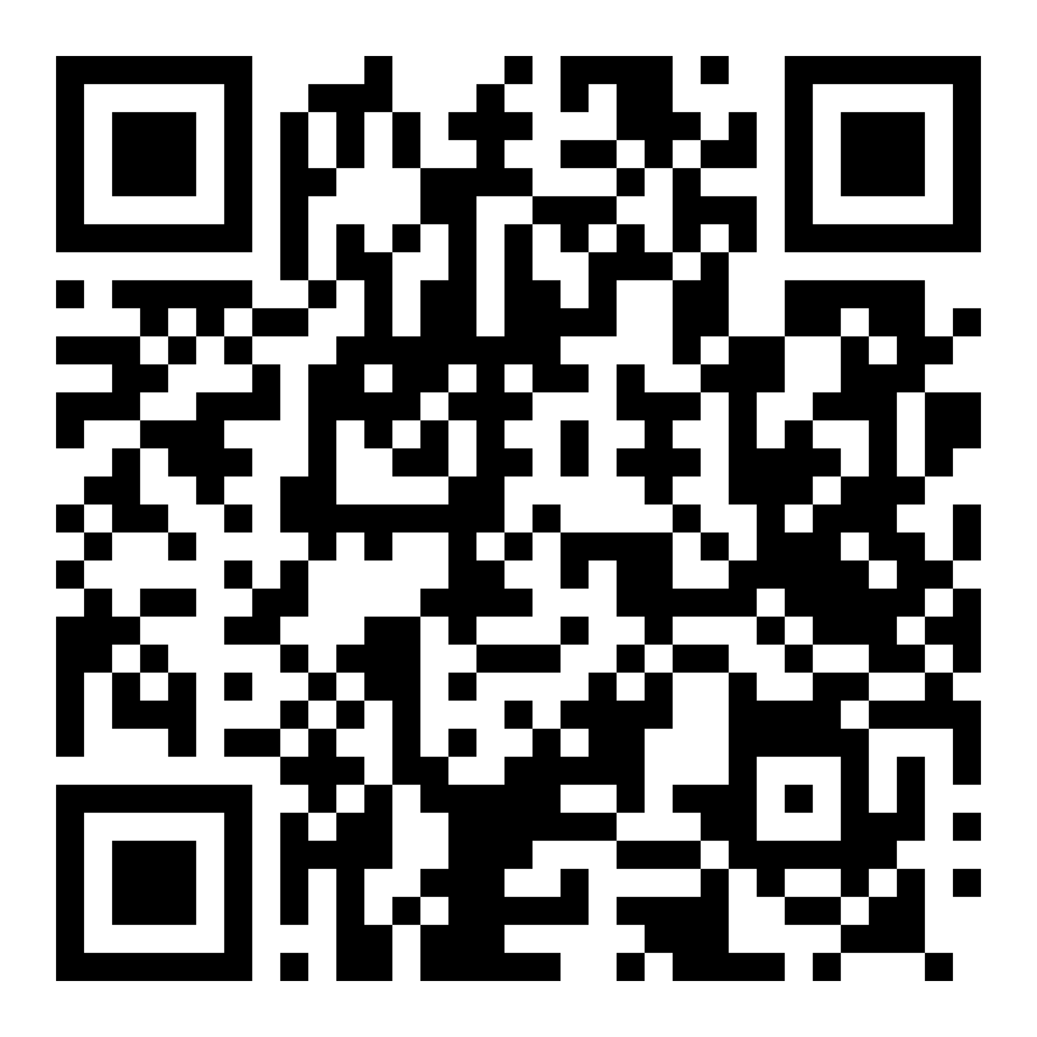
NEXT STEPS
Three things you can do this week.
1
Run your workforce numbers through Sobrynth's Substance Use Cost Calculator
before your next benefits review — one number per operating company, not one blended number for the group.
2
Ask each EAP vendor for SUD-specific utilization, not blended.
However many contracts you have across these businesses, ask for all of them side by side. The variation is the business case.
3
Start one internal conversation about recovery-friendly practices.
Leadership, HR, or Safety. RFW certification starts with a decision, not a budget.
“It’s time for recovery-friendly workplaces to become the norm, not the outlier.”
Notes:
Jess
Three things, and none of them cost anything or require a decision.
One — run your workforce through the Substance Use Cost Calculator before your next benefits review. Ten minutes. But do it per operating company, not once for News Corp. A blended number across a newsroom, a publisher and a print operation is a number you can't act on.
Two — and this is the one I'd actually do first. Go back to your EAP vendor, or vendors, and ask for SUD-specific utilization. Not blended. Not all-conditions. Substance use, broken out, in writing.
However many contracts sit across these businesses, ask for all of them side by side. Two things will happen. Either they can't produce it at that granularity, which tells you something — or they can, and the number will be well under one percent in most of your businesses. Either way, the gap between what gets reported to you and what's actually in your workforce is the whole business case, and you don't need me to make it.
Three — start one internal conversation about recovery-friendly practices. Leadership, HR, or Safety. It starts with a decision, not a budget.

Slide 18
WHAT WE'RE PROPOSING
Start with one operating company. 90 days.
1
Pick the one US company where the case is clearest.
Highest-risk workforce, or simply the HR leader with the most appetite. One masthead, one business, one market.
2
We run the full 90-day activation. Done for you.
Communications, people-leader training, peer champions, the dedicated line and company code — built for that culture.
3
You judge it on awareness and utilization at day 90.
If it tracks Gardner and Olympia, we scale to the next company. If it doesn't, you have spent a quarter and learned something.
The fastest way to know if this works in your workforce is to run it in one of them.
Notes:
Jess
Here's what I'm actually asking for, and it is deliberately small.
Not a group-wide rollout. One operating company, ninety days.
Pick the one US business where the case is clearest to you — the highest-risk workforce, or honestly just whichever HR leader in this room has the most appetite. One masthead, one business, one market.
We run the whole activation. Communications, people-leader training, peer champions, the dedicated line with a code specific to that company. Your team's job is to give us your leaders for one session.
Then you judge it on two numbers at day ninety: awareness and utilization. If it tracks what Gardner and Olympia saw, we have a conversation about the next company. If it doesn't, you have spent a quarter and learned something real about your own workforce.
I'd rather earn the second company than be handed all of them.

Slide 19
Questions?
Marin Nelson
Jess Ferretti
marin@sobrynth.com · sobrynth.com · 651-425-1153
jess@sobrynth.com · sobrynth.com · 516-385-0411
Notes:
Jess
Questions. And the two I expect, so let me pre-empt them.
Coverage — we're scoped to your US entities, and SOBRPath's resource directory is built out for all fifty states, so that lines up cleanly. If anyone asks about extending to News UK or News Corp Australia later, say honestly that non-US resource coverage is work we would scope before committing to a date. [Jess: don't volunteer international. If asked, that's the answer.]
Privacy — anonymous by design. No names shared with HR, no claims filed, nothing hits the plan. That's also why utilization reporting comes back aggregated at the company level.

