Slide 1
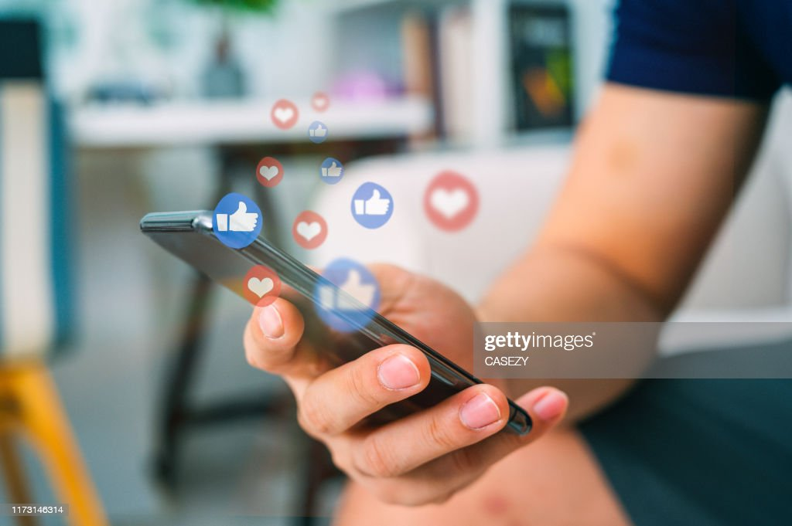
CHANGING BEHAVIOUR DUE TO SOCIAL MEDIA

Slide 2
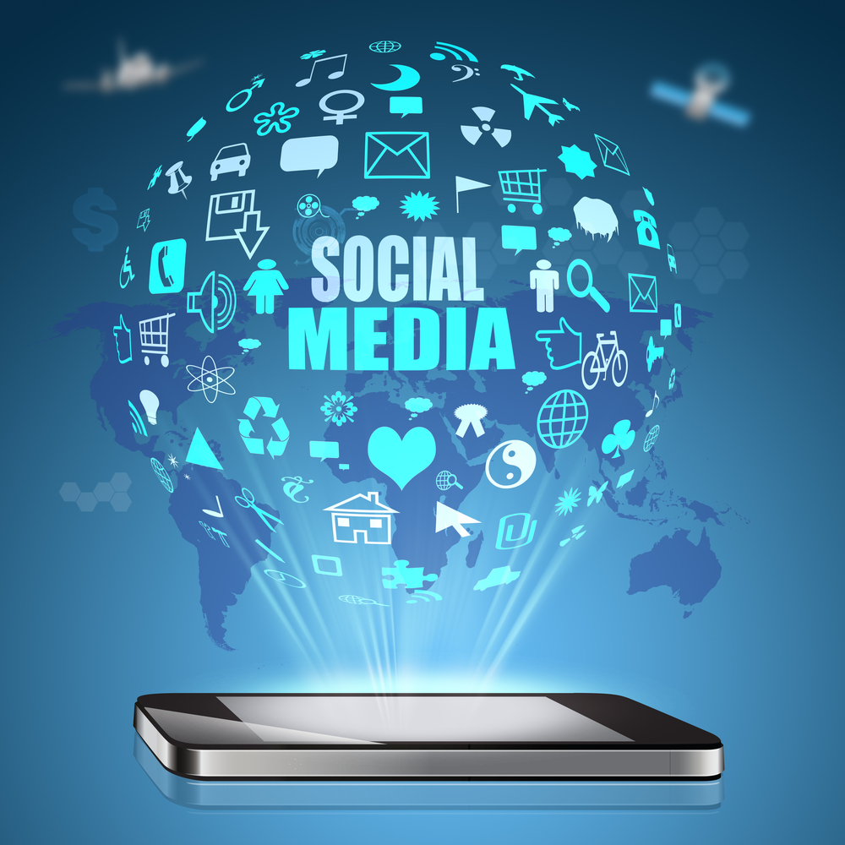
Social media has changed not only our powers of thinking, but today governs our behavior and social conducts as well.
Human behavior changes more when we dabble with technology especially with social media. The daily use of social media by people has increased so much that it is slowly injecting an inflection into our behaviors.

Slide 3

Some pros of social media
Social media can add creativity to our thinking as people can share their views and work with others.
It allows people to explore and become actively involved without the fear of rejection.
While no one advocates spending hours after hours gaming, social media games can build social connections, improve a person’s self-efficiency, boost their cognitive flexibility and self-control. They can teach students how to deal with successes and failures in real life.
Social media connectivity with families, friends and some government safety organizations, has resulted in people feeling safe while moving out.
LinkedIn is one of the greatest example of how networking over social media has helped people in finding the jobs in domain of their interests.

Slide 4
Cons of social media
Face-to-face interactions which are necessary for development of personalities, learning social skills and communication skills, have been removed from the lives of people, especially younger generations. Children are having a difficult time interacting with others, which might lead to unsociable behaviors.
Comparison with other lives has been made easy by social media. People become unhappy with their current circumstances, leading to problems with self-esteem and depression.
Social media use has also been associated with cyber bullying and cyber abuse by anonymous users online, which leads to problems of self-esteem, privacy ,etc.
Most studies have shown that, social media’s violent games result in increase in violent tendencies and behavior in children.
Social media has also been used as tool to spread negativity and rumors online which has leads to increase in the instances of violence in the society. For instance - Recently, the rumour of kidnappers over WhatsApp have led to deaths of innocent people in various parts of India.

Slide 5
Social media stats
There are 5.31 billion unique mobile phone users in the world.
4.95 billion people are using the internet.
But when it comes to social, a huge 99 percent of users connect via mobile, and just 1 in 5 use a laptop or computer.
In 2022, there are 4.60 billion active social media users worldwide, a 10.1% increase from last year.
47% of internet users worldwide use video calling services on mobile
5.3 billion QR code coupons will be redeemed by smartphones, and 1 billion smartphones will access QR codes
45 percent of internet users now say they use voice search and voice commands each month, compared to the 43 percent reported in January 2020.
33 percent of internet users worldwide have concerns around how companies are using their personal data.
42 percent of internet users worldwide report that they use ad blockers.
And how are we searching? 98% of us use a conventional search engine, 45.3% use voice search or voice commands, 44.8% use social media and 32.9% use image recognition tools on mobile. We’re choosing online shopping over bricks and mortar more every day too, with 90.4% of global internet users visiting an online retail site or store, 81.5% searching online for a product or service, 76.8% purchasing a product online, 69.4% using shopping apps on mobile or tablet and 55.4% purchasing a product online from their mobile.
2021 predicted average time spent on mobile devices: 4 hours, 6 minutes

Slide 6
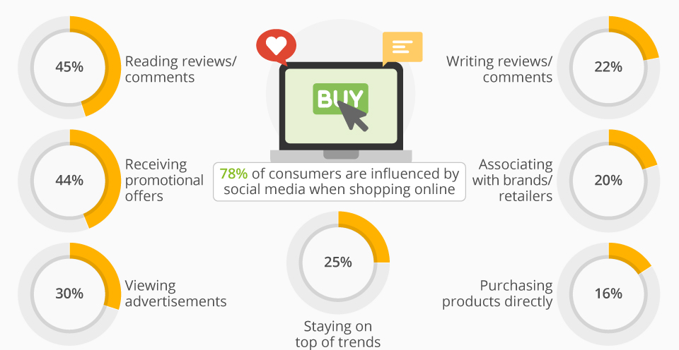

Slide 7
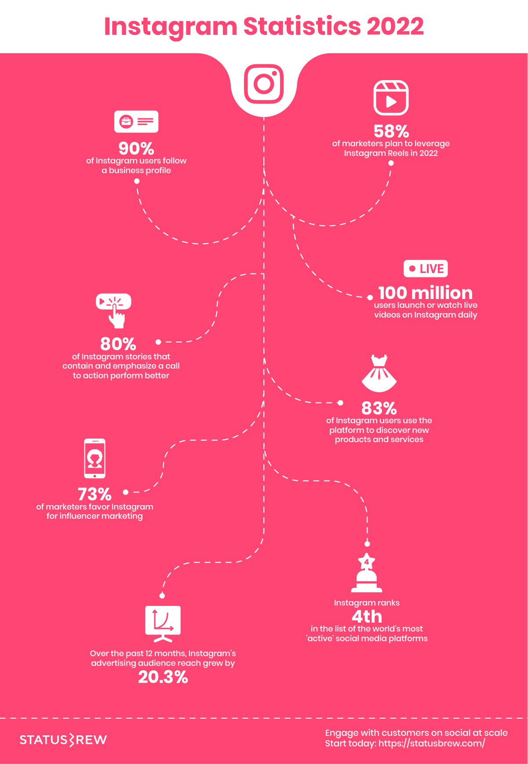
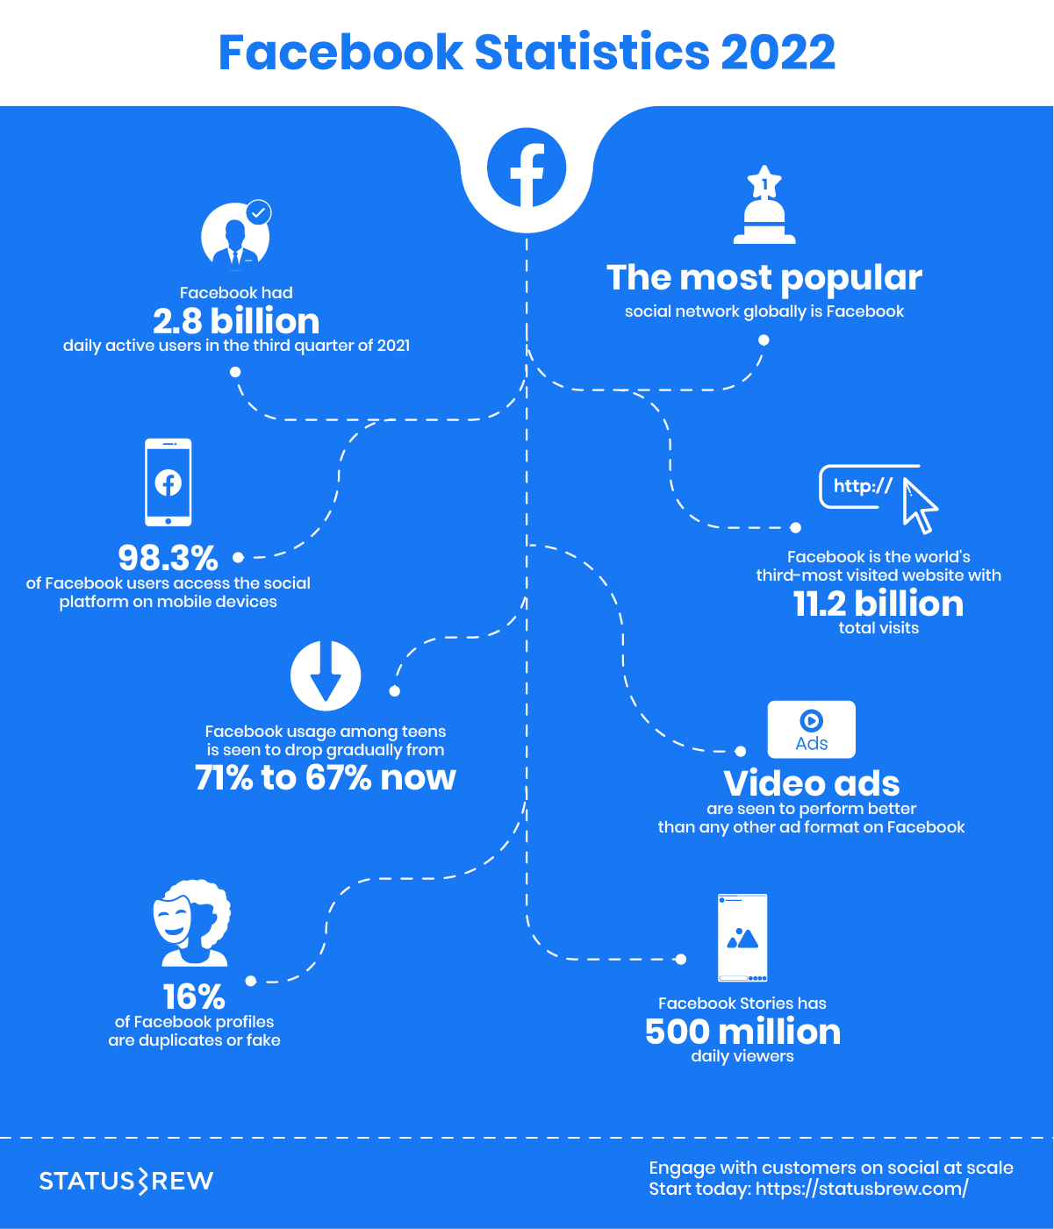
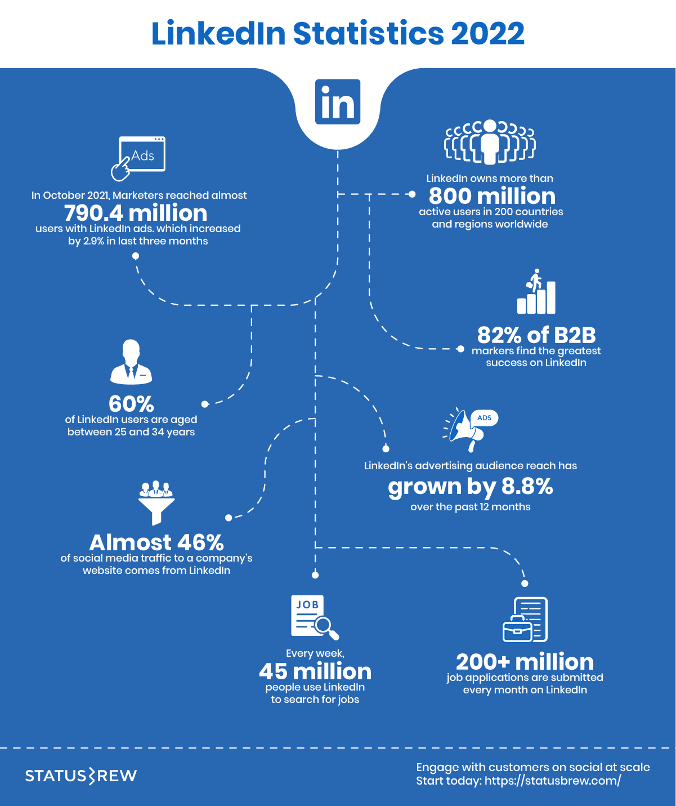

Slide 8
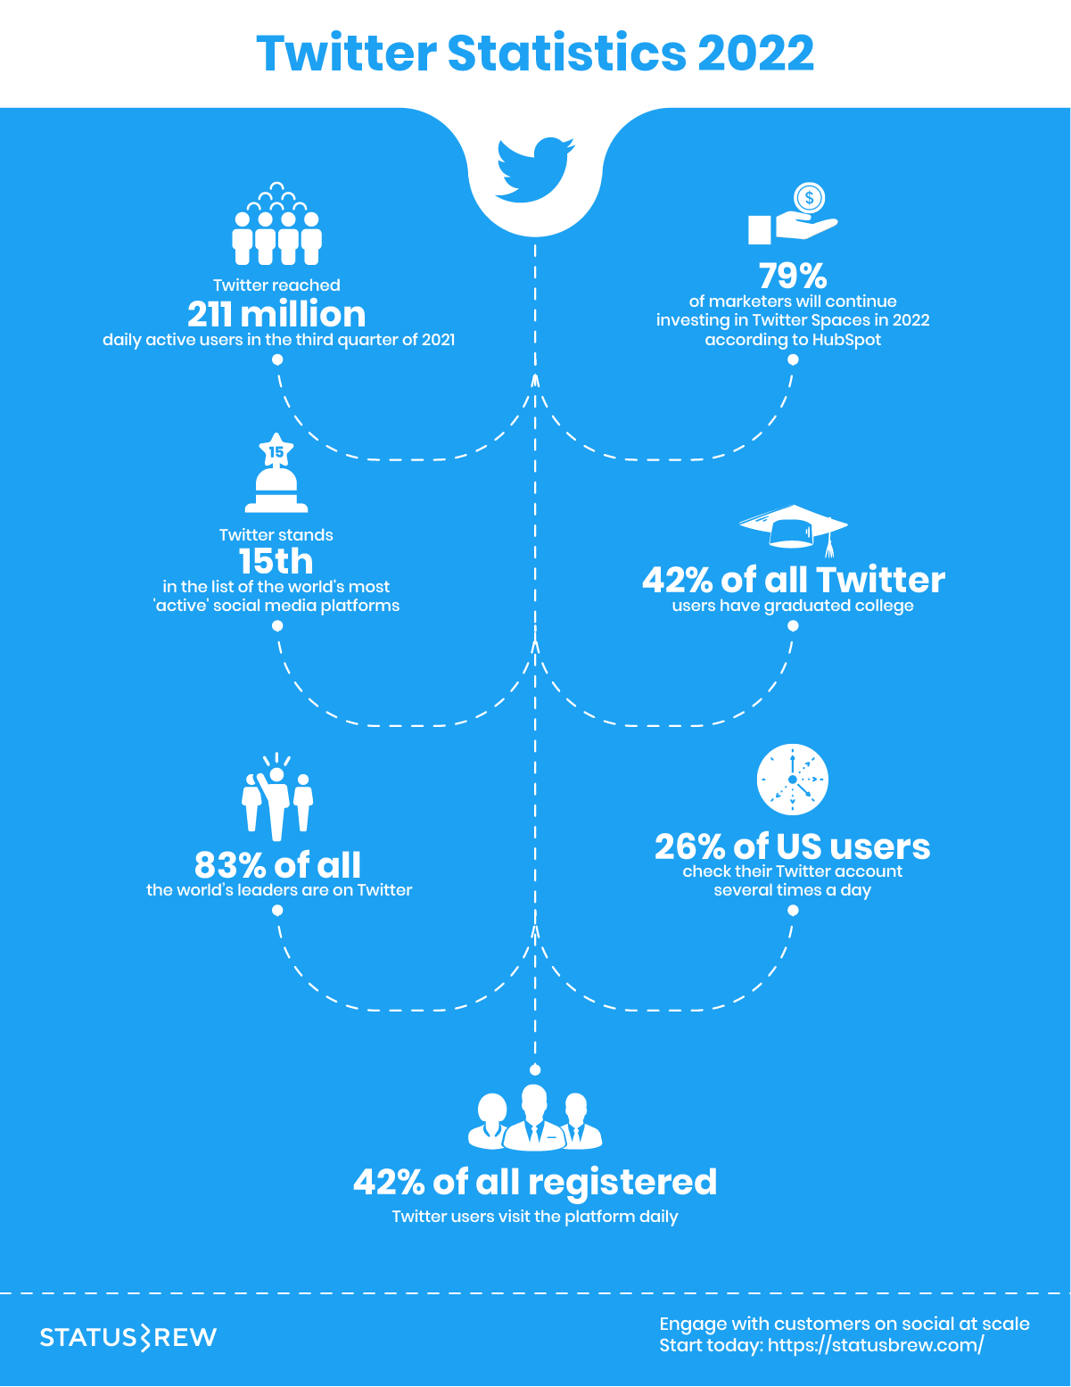
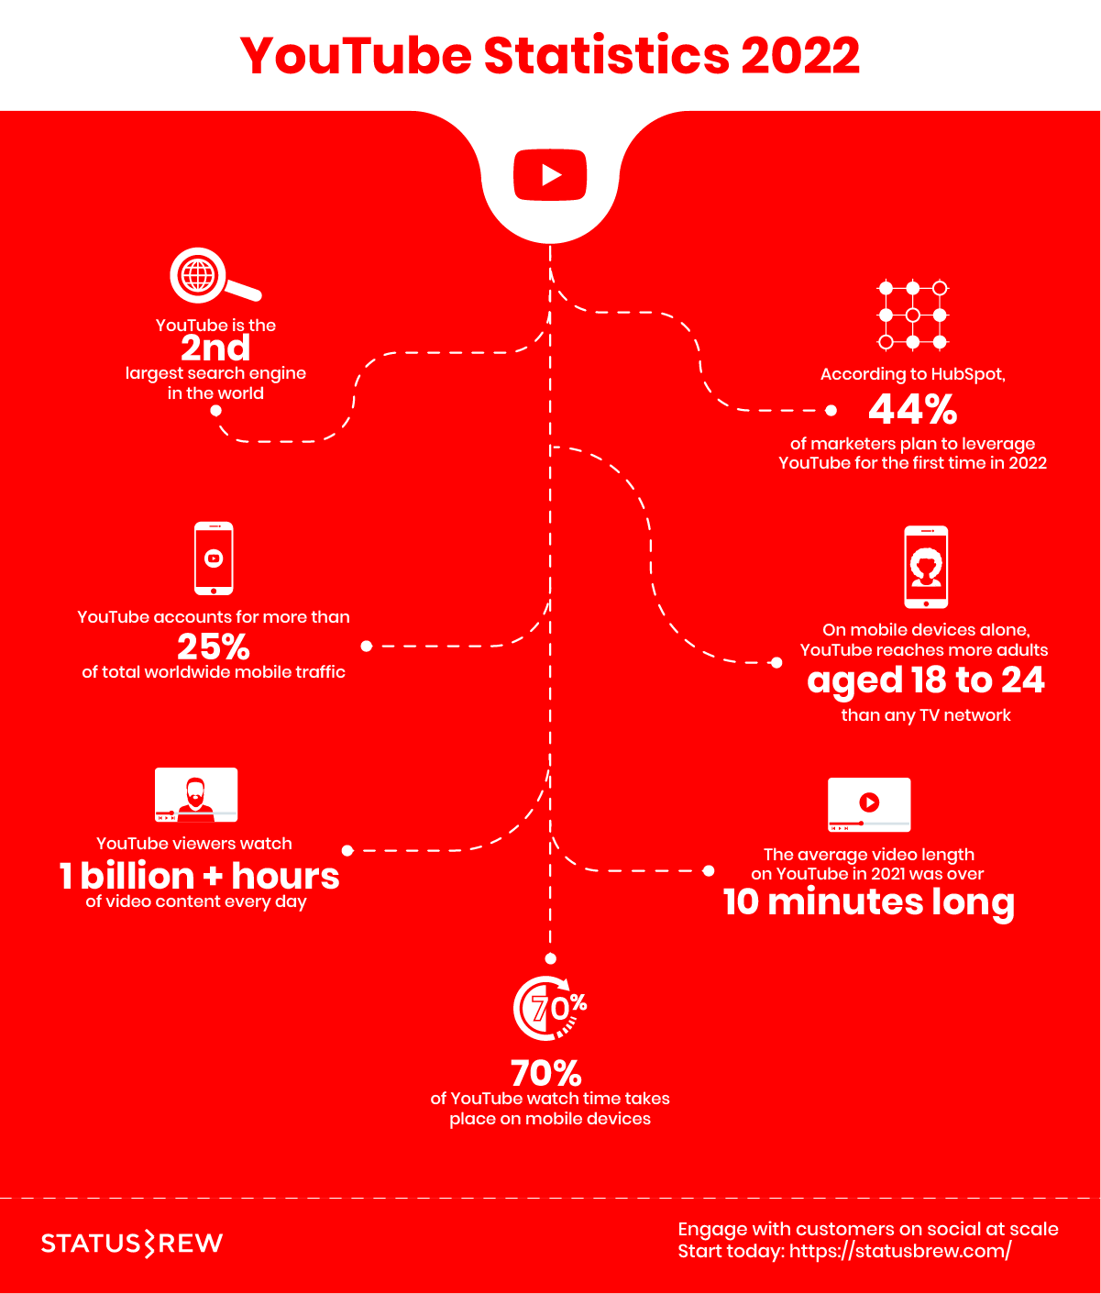

Slide 9
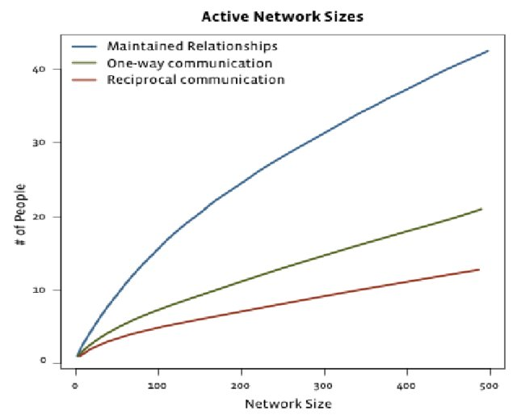

Slide 10


