Slide 1


MindSpark’17: Hackathon 2.0
MIT-Pune
Ronish Zadode, Adesh Tajane

Slide 2
Problem Statement
Localities from CoEP need pick-ups to get to college .Hectic Pune traffic takes a heavy toll on students. Find a way for students in a particular locality to come to college together without having hassle. Consider all possible factors.

Slide 3
Our Solution
Back End: Python ( for data manipulation and result making .)
Database and Result format : JSON .
Front End: Android.

Slide 4
Front END:
Use android APP to interect with user .
For New user: user inputs name , address and mode of transport and email.
Then he receives User id on his mail.
User with ID: logins by entering the user id.
Application checks if ID exists on the online database. If ID exists it displays the group information and optimized mode of transport with accurate time to reach (Calculated at backEND.)
Then user can get other group members location and track realtime journey of the group through the android app(Used Google's MAP API.)

Slide 5
Grouping
Take Input in JSON format . Apply Algorithm and calculate distance and time .
Input: username , address , mode of transport.
Step1: find accurate latitude ,longitude , distance from college and time to reach.
Step2: group the students based on distance from college.
Step3: then divide this groups further based on direction .
Step4: apply algorithm to optimize mode of transport and give group id and final mode.
Give group information and time as output in json file on URL to be accesed in the android app.

Slide 6
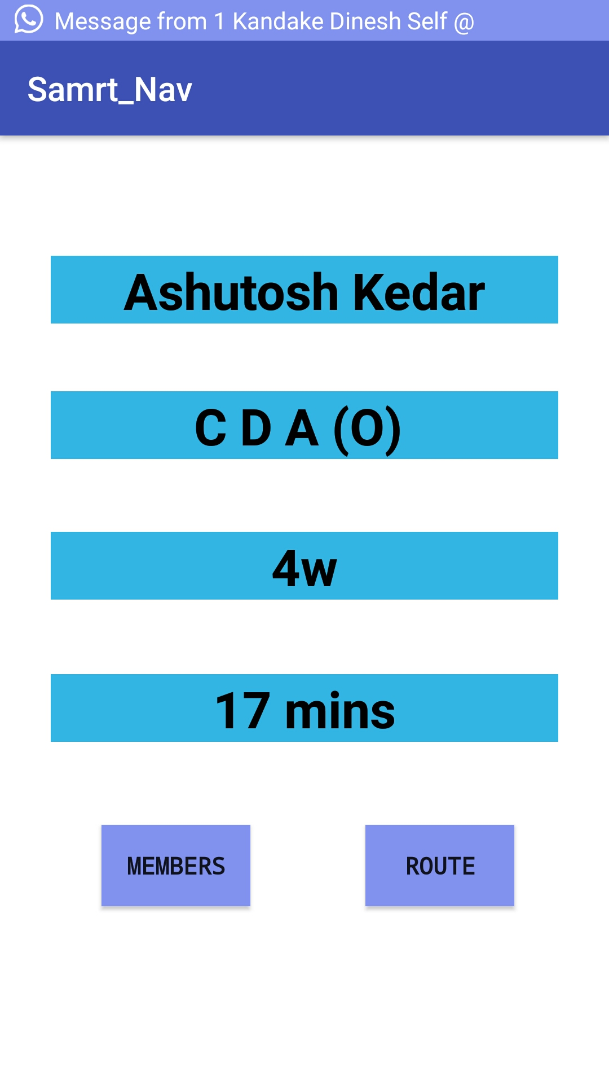
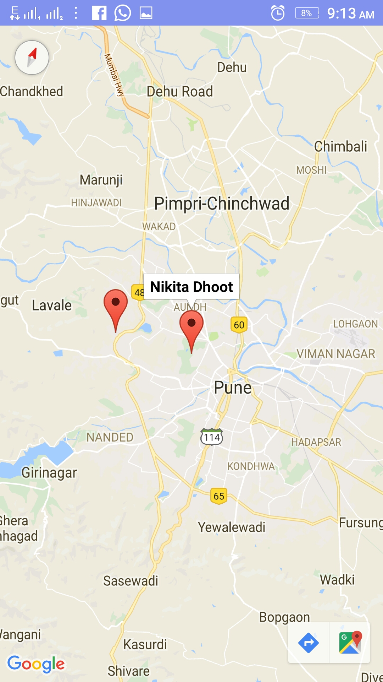
Result: Route and Time
User gets his Info and time .
Other group members and route on google map's API with real time tracking.
Get member location and real time route

Slide 7
Real Time Application
Real time replanning and re-scheduling.User is able to modify or search for other route options in case of failure.(e.g. puncture of vehicle.)
Mode switch.
Encouraging sharing and public transport and Integration of Public transport.
Generic database.
Chat function for group members.
Journey planner for trips and other purposes.

