Slide 1
Keval Adeshara
Microsoft Certified Trainer
Speaker :
TechEd : Europe , USA , Gulf
Dev Summit : NA MCT Summit,GIDS

Slide 2
What is Exactly database?
Database are computer files that store data in structured way
The organization of the files helps to ensure that the data is accurate .
The database files usually are managed by Software to
To make it accessible to application and users
Manage and maintain the data

Slide 3
Why not just use Text Files ? Spread sheet
Data integrity? Redudant data? Outdated Data?
Data size?
Retrieval ?Filtering? Searching?
Protecting data from malicious or unauthorized use?
Protecting data from becoming corrupt?

Slide 4
What is Table
It consists of fields (columns), and rows. In relational databases and a table is a set of data elements (values) using columns (identifiable by name) and horizontal rows, the cell being the unit where a row and column intersect.

Slide 5
SQL Server
Microsoft SQL Server is a Relational Database Management System(RDBMS) developed by Microsoft.
It is designed to run on a central server, so that multiple users can access the same data simultaneously.

Slide 6
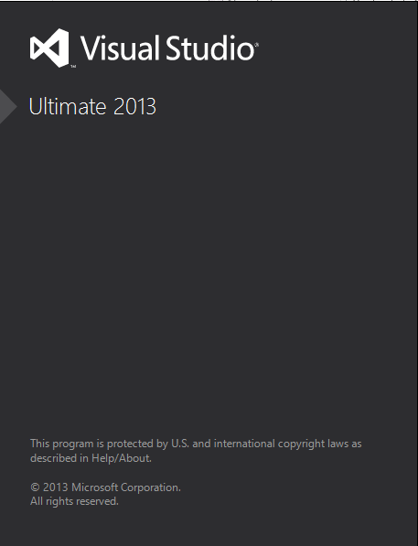
Lets ,Dirty Hands with SQL Server Express
Open Visual Studio

Slide 7
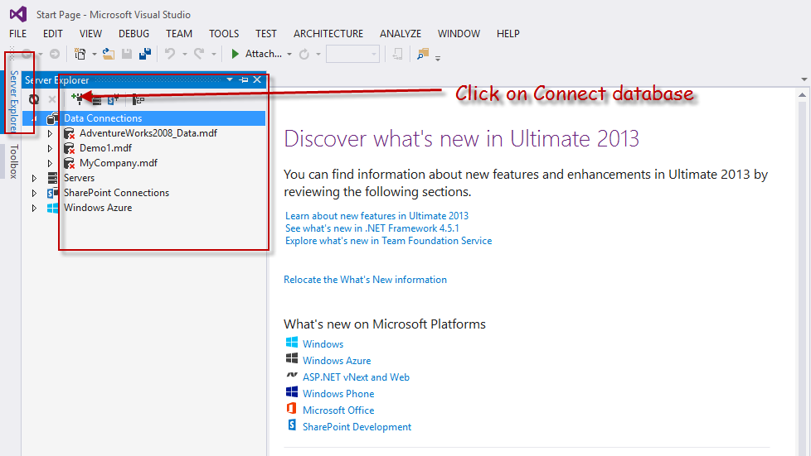
Create New Database

Slide 8
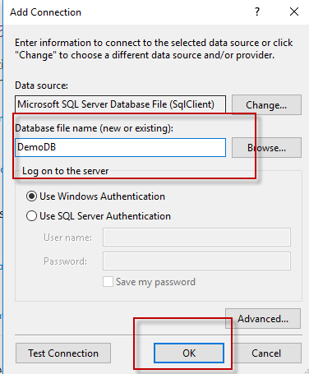
Create DemoDB Database

Slide 9
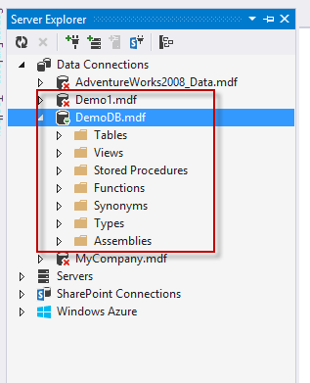

Slide 10
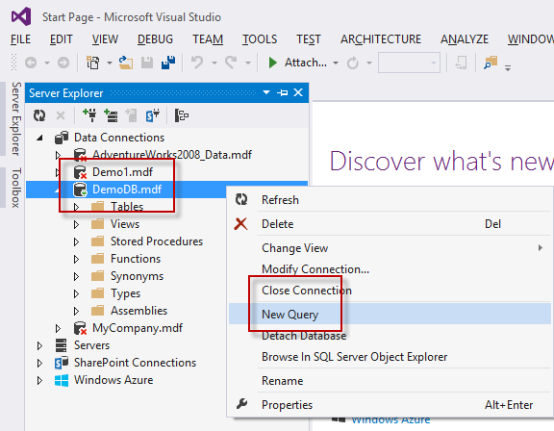

Slide 11
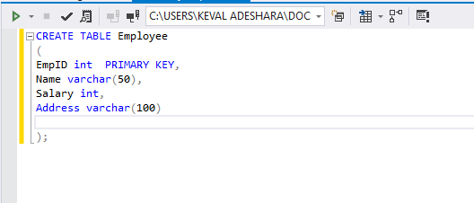
How to Create Table?
CREATE TABLE TABLE_NAME
(
COL1 VARCHAR(10),
COL2 VARCHAR(20),
);
DDL (Data Definition Language)
SQL commands used to create, modify, and drop the structure of database objects like table, view, procedure, indexes etc.
CREATE,
ALTER,
DROP and
TRUNCATE commands.

Slide 12
Lets Understand Constraints
Primary Key
CREATE TABLE table_name
(
col1 datatype [CONSTRAINT constraint_name] PRIMARY KEY,
col2 datatype
);
Unique
Not Null
Auto Increment [preferably]
Always Integer [Recommended but not RULE]

Slide 13
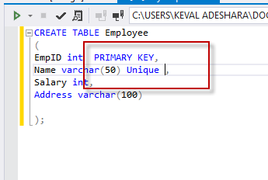
2.Unique Key
Unique key is a set of one or more fields/columns of a table that uniquely identify each record/row in database table.
It is like Primary key but it can accept only one null value and it can not have duplicate values.

Slide 14
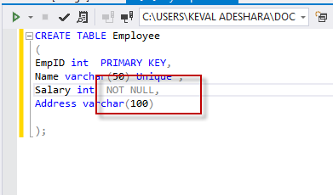
3.Not Null
This constraint ensures that all rows in the database table must contain value for the column.
Empty or Null value not allowed.

Slide 15
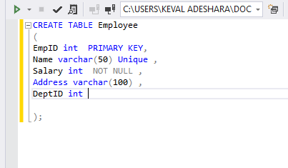
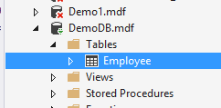
Execute it

Slide 16
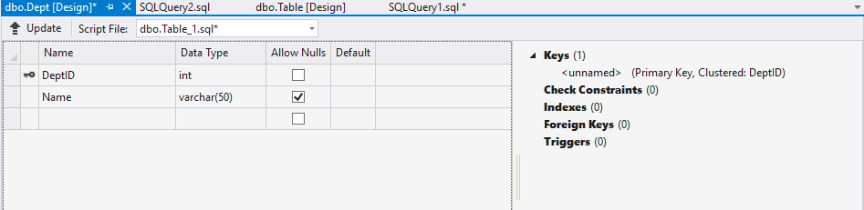
4.Foreign Key
Create another table with Dept name

Slide 17
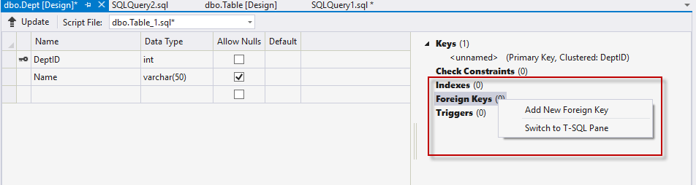
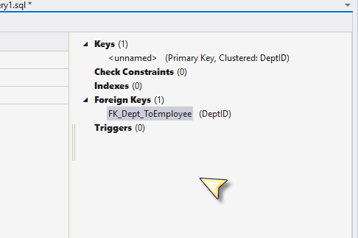
How to Add Foreign key

Slide 18
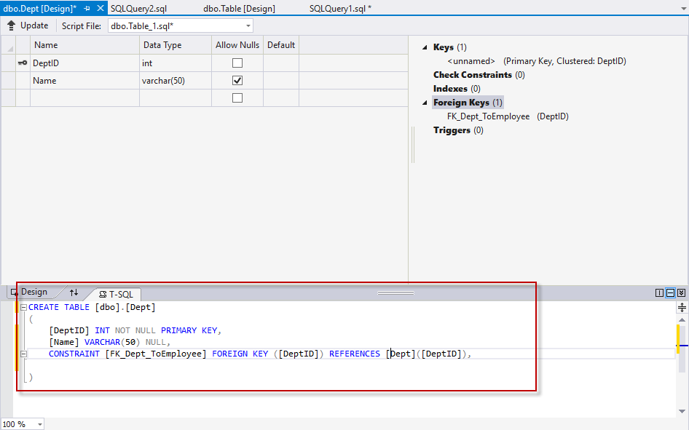
After That Update it

Slide 19
Now , we will learn Data Manipulation Commands : Must Learn By Heart this syntax.
INSERT : INSERT into table_name values (val1,val2,val3)
UPDATE :Update table_name SET col1= val1 , col2=val2 where some_col=some_val
DELETE : Delete from table_name Where some_col = some_val

Slide 20
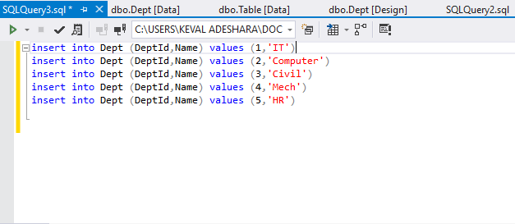
Now Enter Data with Query – THIS IS What we are doing Data Manipulation. Insert , Update , Delete
DML (Data Manipulation Language)
These SQL commands are used to store, modify, and delete data from database tables.
we have INSERT, UPDATE, and DELETE commands.

Slide 21
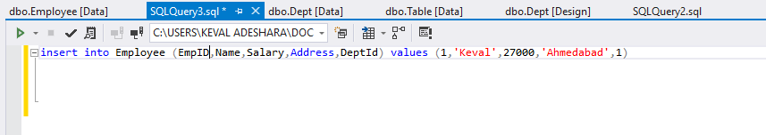
Enter Some Data In Employee Table

Slide 22
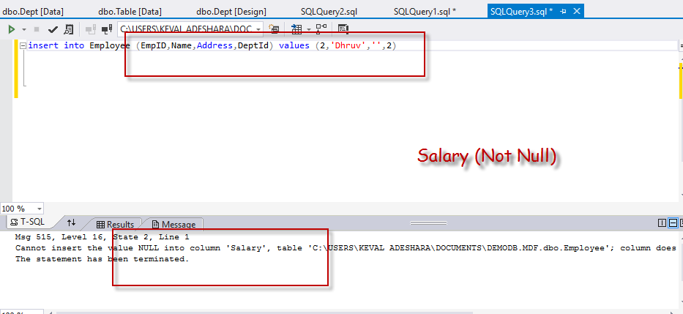
Enter Value in Employee Table

Slide 23
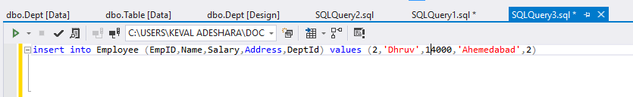
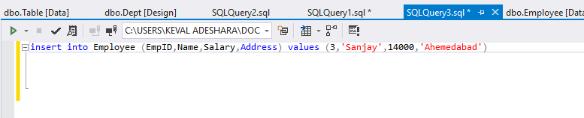
In this Query I have not mention any Dept Relation

Slide 24
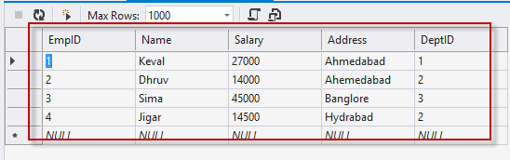
Update Query
update Employee set Address = 'Pune' where EmpID = 4

Slide 25
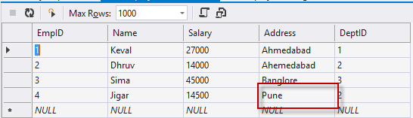
Execute Query

Slide 26
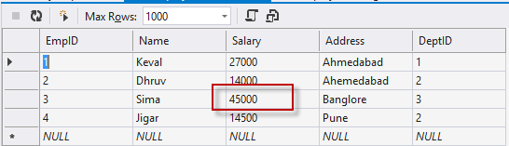
Update Query

Slide 27
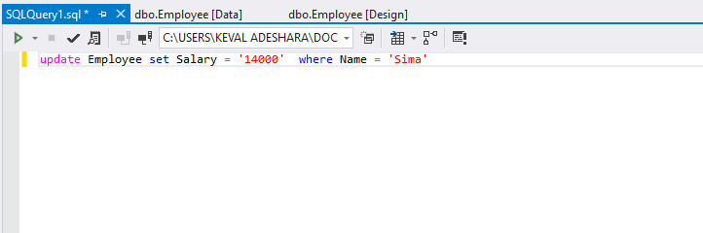
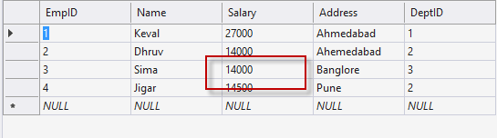
Write Update Query

Slide 28
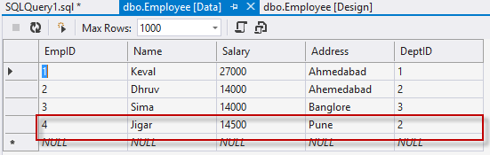
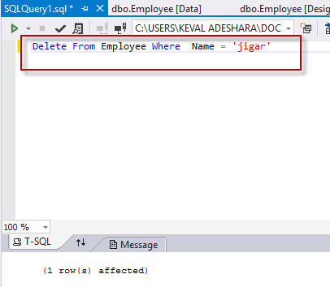
Delete Query
Delete

Slide 29
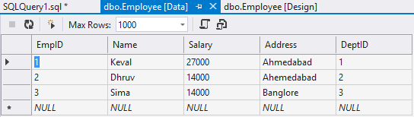
Successfully Deleted Record !!

Slide 30
Thank You. Email : kevaladeshara@gmail.com Tweet :kevaladeshara Contact No : 7405478312 FB:- keval.adeshra

