Slide 1

Components

Slide 2


Button
Progress Bar
Badge
Pagination
Alerts
Dropdown

Slide 3
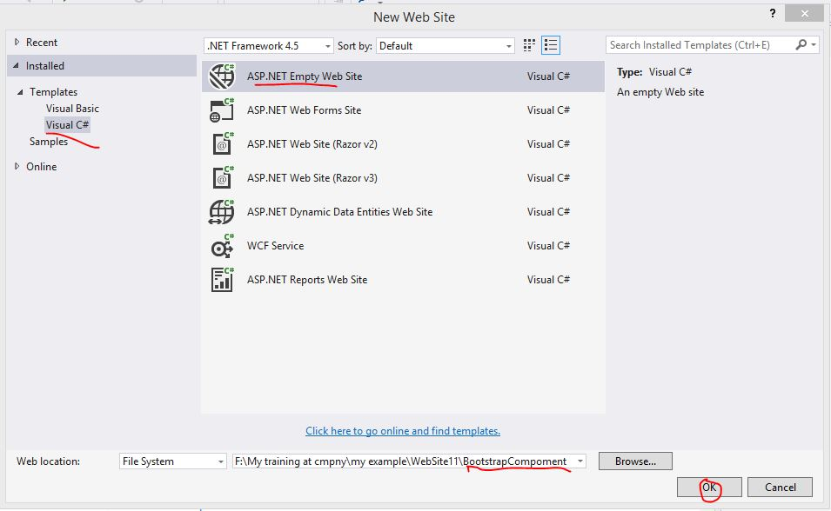
Create new ASP.NET Empty Website and give as above.

Slide 4
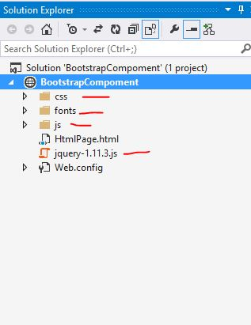
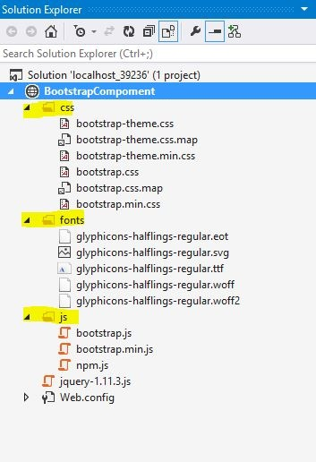
Copy past bootstrap and jquery file which is you have downloaded.

Slide 5
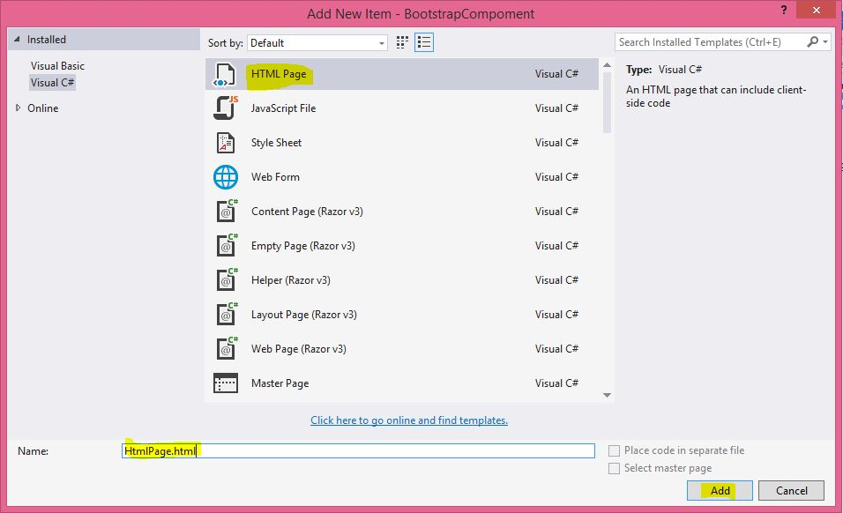
Add one html page.

Slide 6
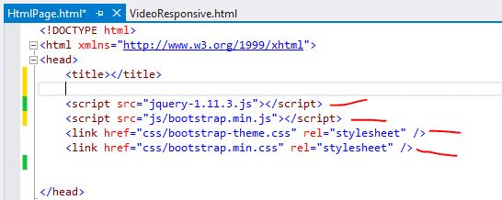
Add reference of bootstrap and jquery file in html page in head tag.

Slide 7
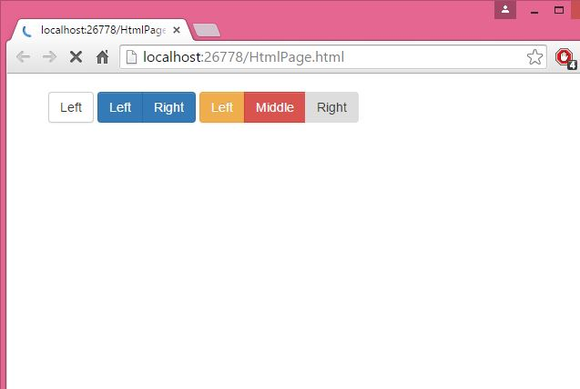
I want to make button group as above.

Slide 8
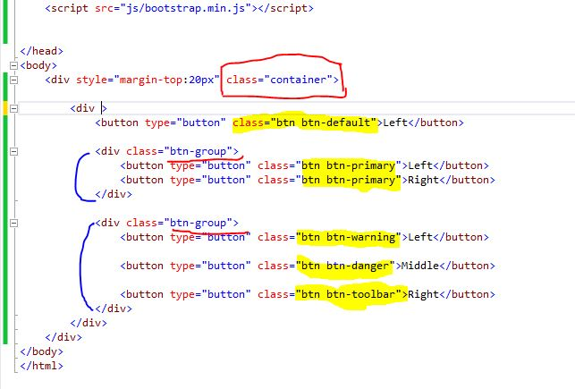
Button
In body tag add one div tag with class “Container” and add button as above with
different classes.
Here “btn-group” class create the group of button.

Slide 9
Single button
Two button in group
Three button in group.

Slide 10
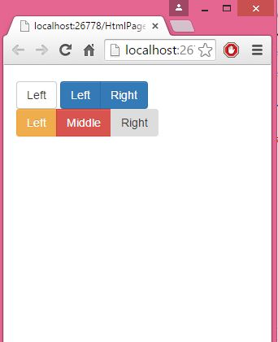
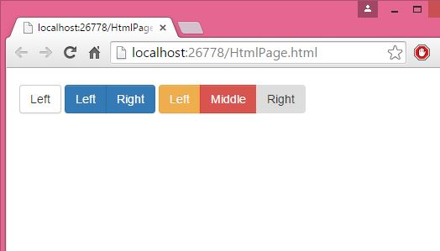

Slide 11
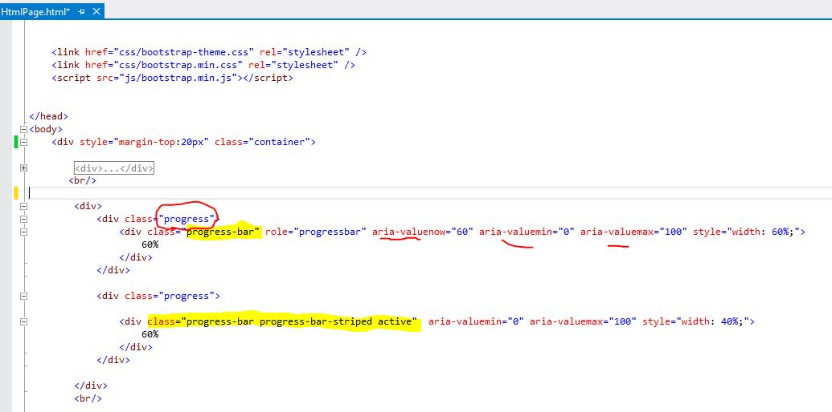
Progress-bar
Now add one div for progress bar component as above. here class is “progress-bar” and
second div with class “progress-bar progress-bar-striped active”.
Area-valuemin shows initial value of progress-bar and area-valuemax shows maximum
value Of progress-bar.

Slide 12
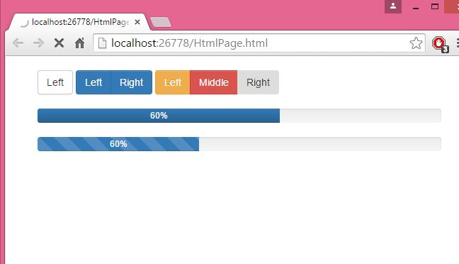
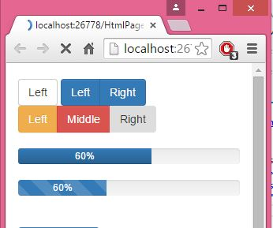
progress-bar is looked as above.

Slide 13
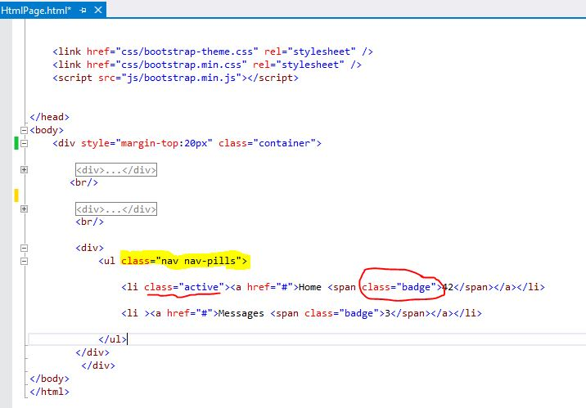
Badge
Badge is used to indicate new or unread items by adding a <span class="badge">

Slide 14
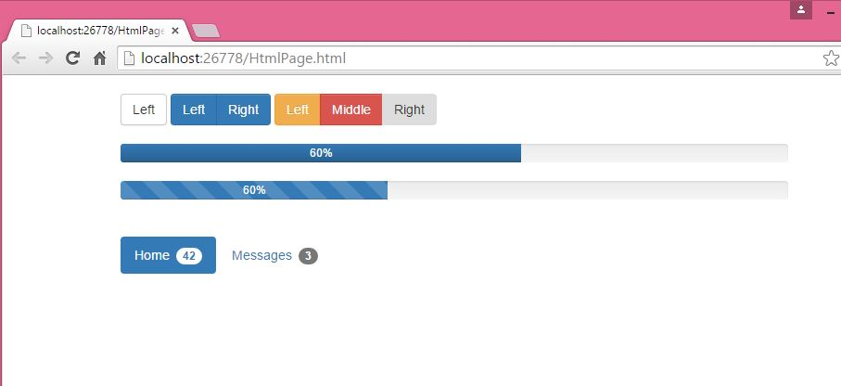

Slide 15
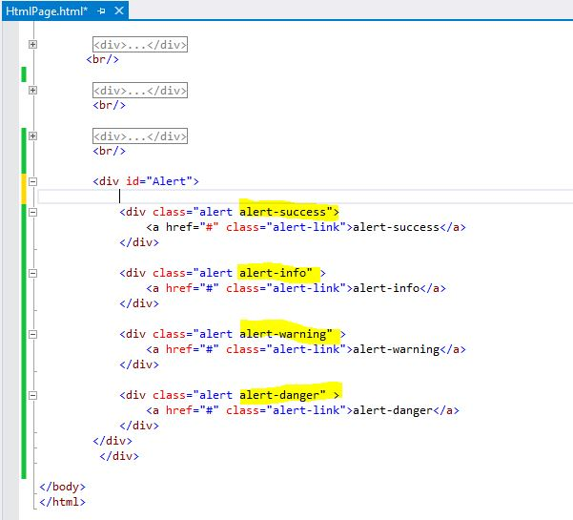
Alert
Alert used to shows alert messages for user actions .

Slide 16
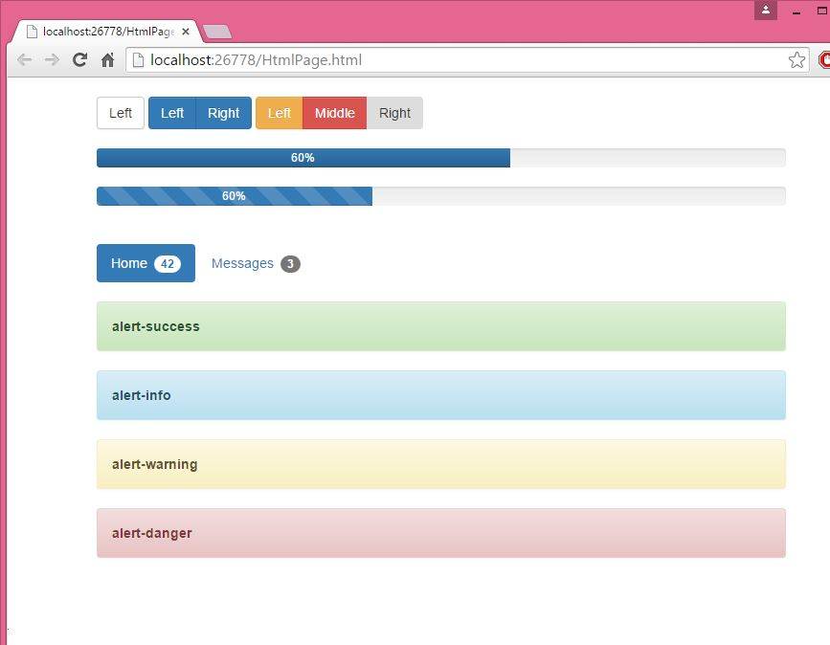
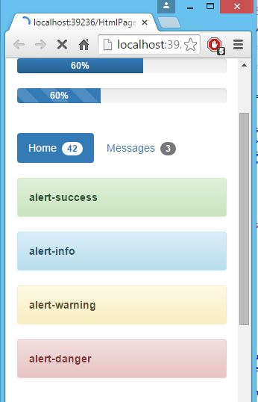

Slide 17
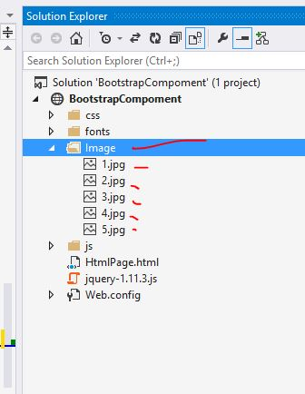
Now create new folder with name Image and add five images in that.

Slide 18
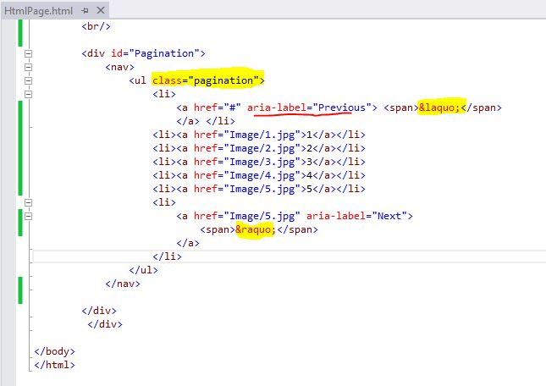
Pagination
Add one div for pagination in this div.After that in ul tag add class “pagination” aria-lable show the text on link.

Slide 19
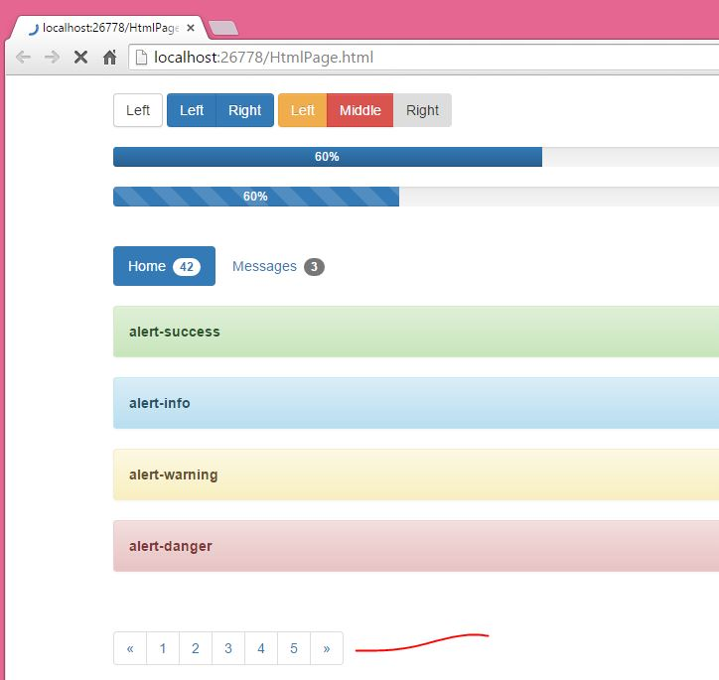

Slide 20
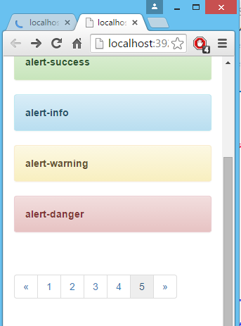
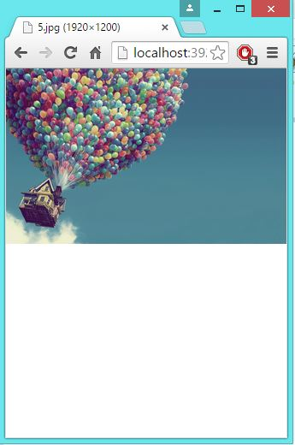
When I clinked on 5 it will navigate you on 5.jpg image

Slide 21
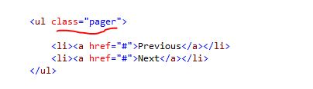
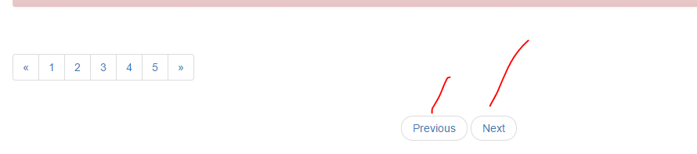
When you add pager class in ul tag By default, the pager centers links

Slide 22
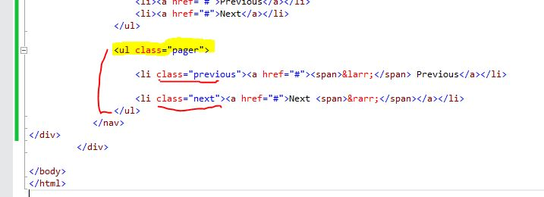
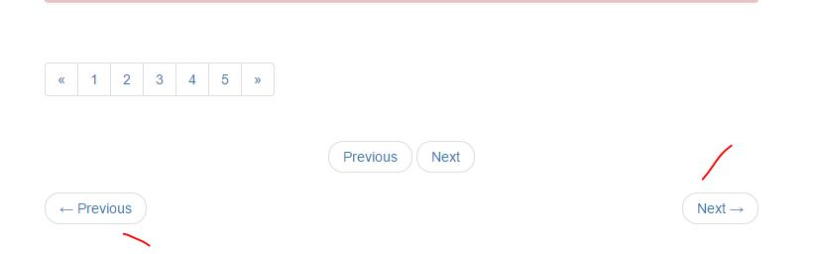
When you add previous and next class in li tag its shows as below

Slide 23
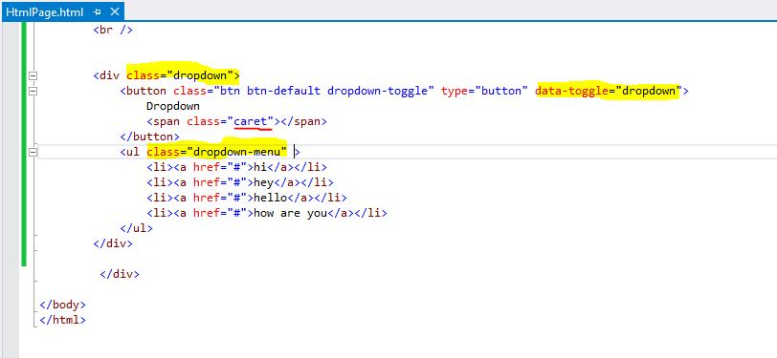
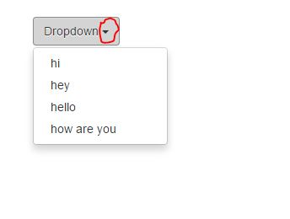
Drop-Down
Here class caret indicate triangle shape on
Button.

Slide 24
