Slide 1
Normalization
Name
Title
Organization

Slide 2
What is Normalization
Normalization is step by step process of organizing data in to tabular format.
without normalization a database system may slow, inefficient and may not produce the expected result.
Normalization reduces the data redundancy and inconsistent data dependency.

Slide 3
6 Types of Normal Form
1.First Normal Form
2.Second Normal Form
3.Third Normal Form

Slide 4
What is Data Redundancy??
Duplication Data
Disk Space Wastage
Data inconsistent
DML Query Problems
EmpName | Gender | Salary | DeptName | DeptHead | Dept.Location
Ajay | Male | 4500 | IT | John | London
Sima | Female | 5500 | HR | Mike | Sydney
Vijay | Male | 1456 | IT | John | London
Keval | Male | 6698 | HR | Mike | Sydney
Pooja | Female | 1236 | IT | John | London

Slide 5
Normalized Table
DeptId | DeptName | DeptHead | DeptLocation
1. | IT | John | London
2. | HR | Mike | Sydeny
EmpID
1
2
3
4
5
EmpName | Gender | Salary | DeptId
Ajay | Male | 4500 | 1
Sima | Female | 5500 | 2
Vijay | Male | 1456 | 1
Keval | Male | 6698 | 2
Pooja | Female | 1236 | 1

Slide 6
First Normal Form
Rules for 1NF (First Normal Form)
1.The Data in each column should be Atomic ,No multiple Values ,Separated by Commas.
2.The Table doesn’t Contain any Repeating Columns.

Slide 7
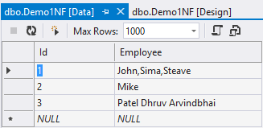
No Atomic Employee Columns
Create Table like This→
1. Retrieve of Particular Employee?
2.Insert only FirstName of Employee?

Slide 8
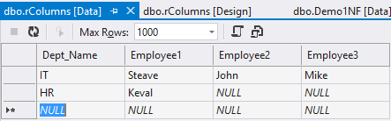
No Repeating Columns
Create Table like this →
How to Add one More Employee???
What about less then 3 Employee??? Disk Wastage

Slide 9
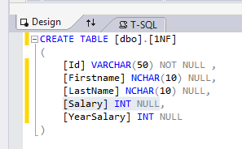
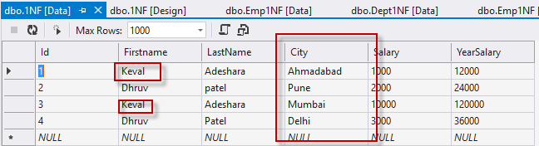
Step: Create Table 1NF
Apply the first normal form, Emp City will come in one
column and Emp Name will break in two fiels:

Slide 10
Second Normal Form
The Table meets all the Condition of 1NF
Move Redundant data to Separate Table.
Create Relationship between these tables using Foreign key
EmpName | Gender | DeptName | DeptHead | Dept.Location
Ajay | Male | IT | John | London
Sima | Female | HR | Mike | Sydney
Vijay | Male | IT | John | London
Keval | Male | HR | Mike | Sydney
Pooja | Female | IT | John | London

Slide 11
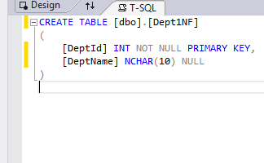
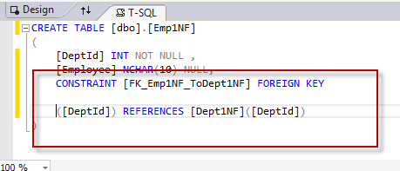
Step:Create Two Tables

Slide 12
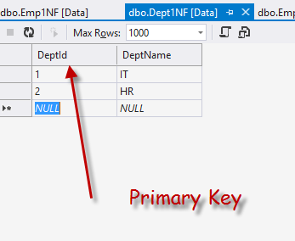
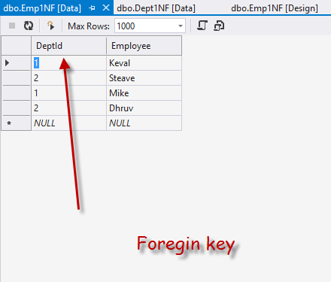
Second Normal Form
Add Some Data

Slide 13
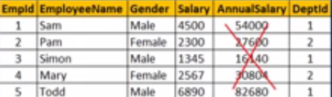
Third Normal Form
Meet all the Condition of 1NF,2NF
Does not Contain columns that are not fully dependent upon the Primary Key.

Slide 14
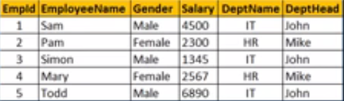
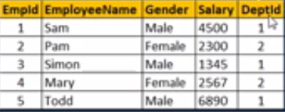

DeptID
Reletion with Primary key and Foreign key

