Slide 1
Every thing about the Table
Name
Title
Organization

Slide 2
What is Views
Views are virtual tables that are compiled at run time.
The data associated with views are not physically stored in the view, but it is stored in the base tables of the view.
A view can be made over one or more database tables. Generally we put those columns in view that we need to retrieve/query again and again.
Once you have created the view, you can query view like as table. We can make index, trigger on view.

Slide 3
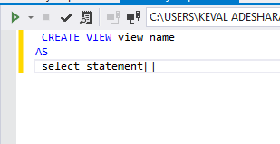
Advantages of Views
Views show only those columns that are present in the query which is used to make view.
One more advantage of Views is, data abstraction since the end user is not aware of all the data present in database table.
Syntax of View

Slide 4
1.System Defined Views
System defined Views are predefined Views that already exist in the Master database of Sql Server.
These are also used as template Views for all newly created databases. These system Views will be automatically attached to any user defined database.
1.Information Schema View
2.Catalog View
3.Dynamic Management View

Slide 5
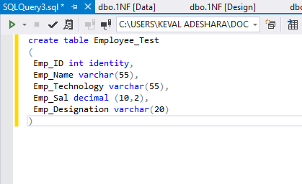
1.Information Schema View
These View is used to display information of a database, like as tables and columns. This type of view starts with INFORMATION_SCHEMA and after this view name.
Step: Create Table

Slide 6
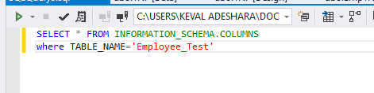
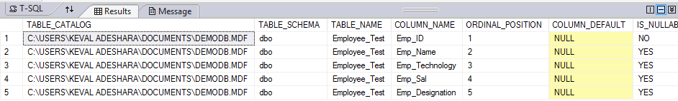
Create a View
Step: Execute it

Slide 7
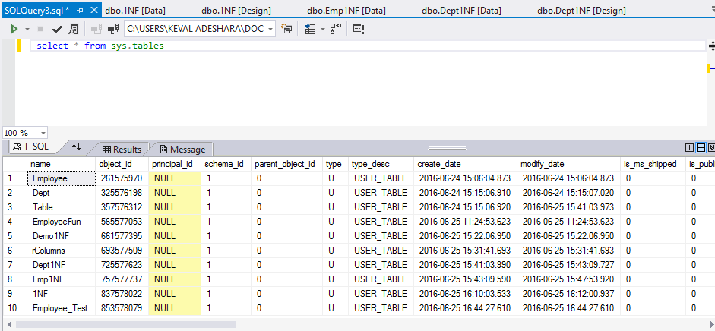
2.Catalog View
Catalog Views were introduced with SQL Server 2005. These are used to show database self describing information.

Slide 8
3.Dynamic View Management
Dynamic Management Views were introduced in SQL Server 2005.
These Views give the administrator information of the database about the current state of the SQL Server machine.
These values help the administrator to analyse problems and tune the server for optimal performance.
These are of two types
1.Server-Scoped Dynamic management View
2.Database-scoped Dynamic Management View

Slide 9
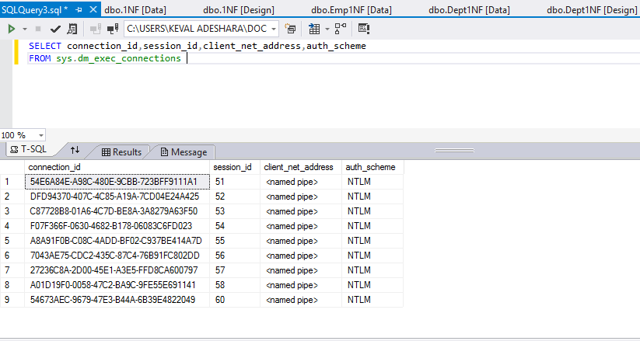
1.Server-Scoped Dynamic Management View
It is stored only in Master Table View.
2.Database-scoped Dynamic Management View
They Stored in Each Database.

Slide 10
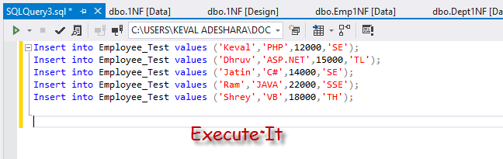
2.User Defined Views
There are Two types of Views Defined by Users.
1.Simple View
Step: Enter Some data in Employee_Test

Slide 11
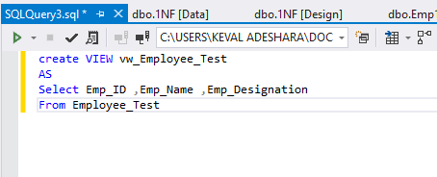
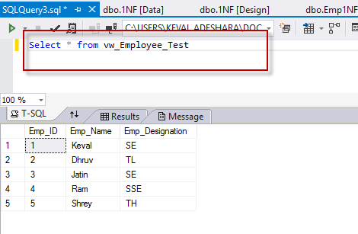
Step:Create View
Step:Query View as Table

Slide 12
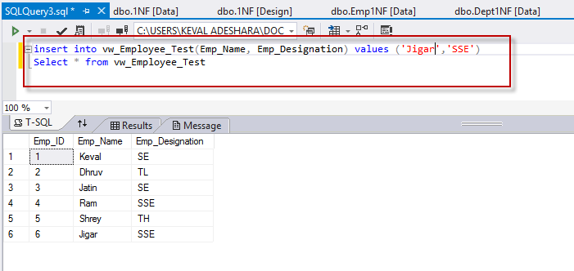
In simple view we can insert, update, delete data. We can only insert data in simple view if we have primary key and all not null fields in the view.

Slide 13
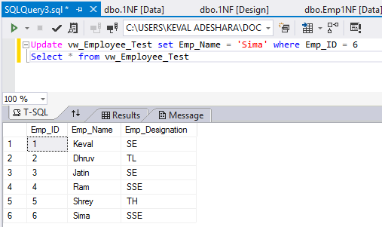
Update View

Slide 14
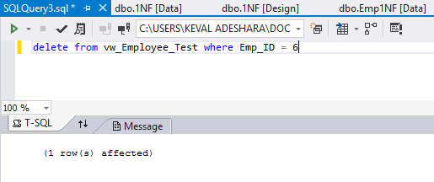
Delete View

