Slide 1

Restaurant Success Prediction based on YELP dataset
CMPE 255 - Group 3
Yogesh Luckshetty (016522883)
Madhuri Ghattamaneni (016566342)
Pragnesh Bagary (016650179)
Adesh Landge (016190486)

Slide 2
Objective
Our primary objective is to perform extensive analysis on the Yelp dataset to predict the success of the restaurants based on various factors.
We chose Yelp dataset because, it is currently the most widely used business information software across the United States.
To predict the success of a restaurant, we analyzed the data considering multiple parameters and divided into multiple use cases.

Slide 3
Initial Steps.
We had to perform some data pre-processing on the YELP dataset:
Conversion of YELP’s .json files to .csv files.
Fixed some incorrect data.
Performed data transformation and data reduction to fit our model that we were aspiring to build.

Slide 4
Use Case 1
If I open a mexican restaurant in Pacifica, would it turn out to be a successful business?

Slide 5
Our Approach
Yelp attributes used - Stars, Categories, Postal Code, Latitude, Longitude, Review Count, Users.
Feature extraction -
Clustered nearby restaurants within a specific radius using Latitude and Longitude attributes.
Then, extracted nearby restaurants which fall under similar categories.
Extracted nearby restaurants which had similar ratings provided by the users.
Extracted nearby restaurants visited by the users.

Slide 6
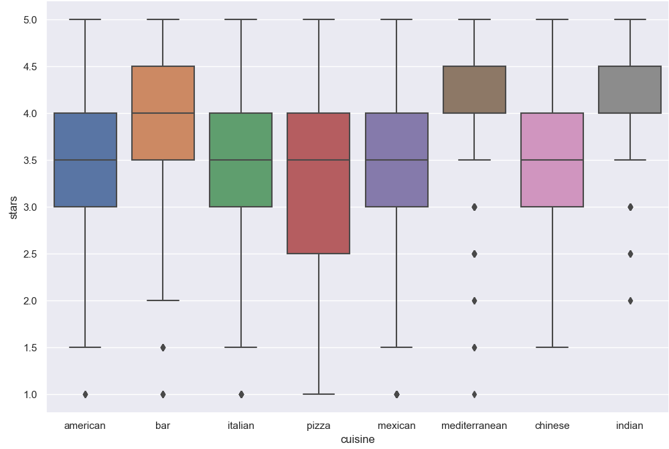
Plot for Cuisine Vs Ratings

Slide 7
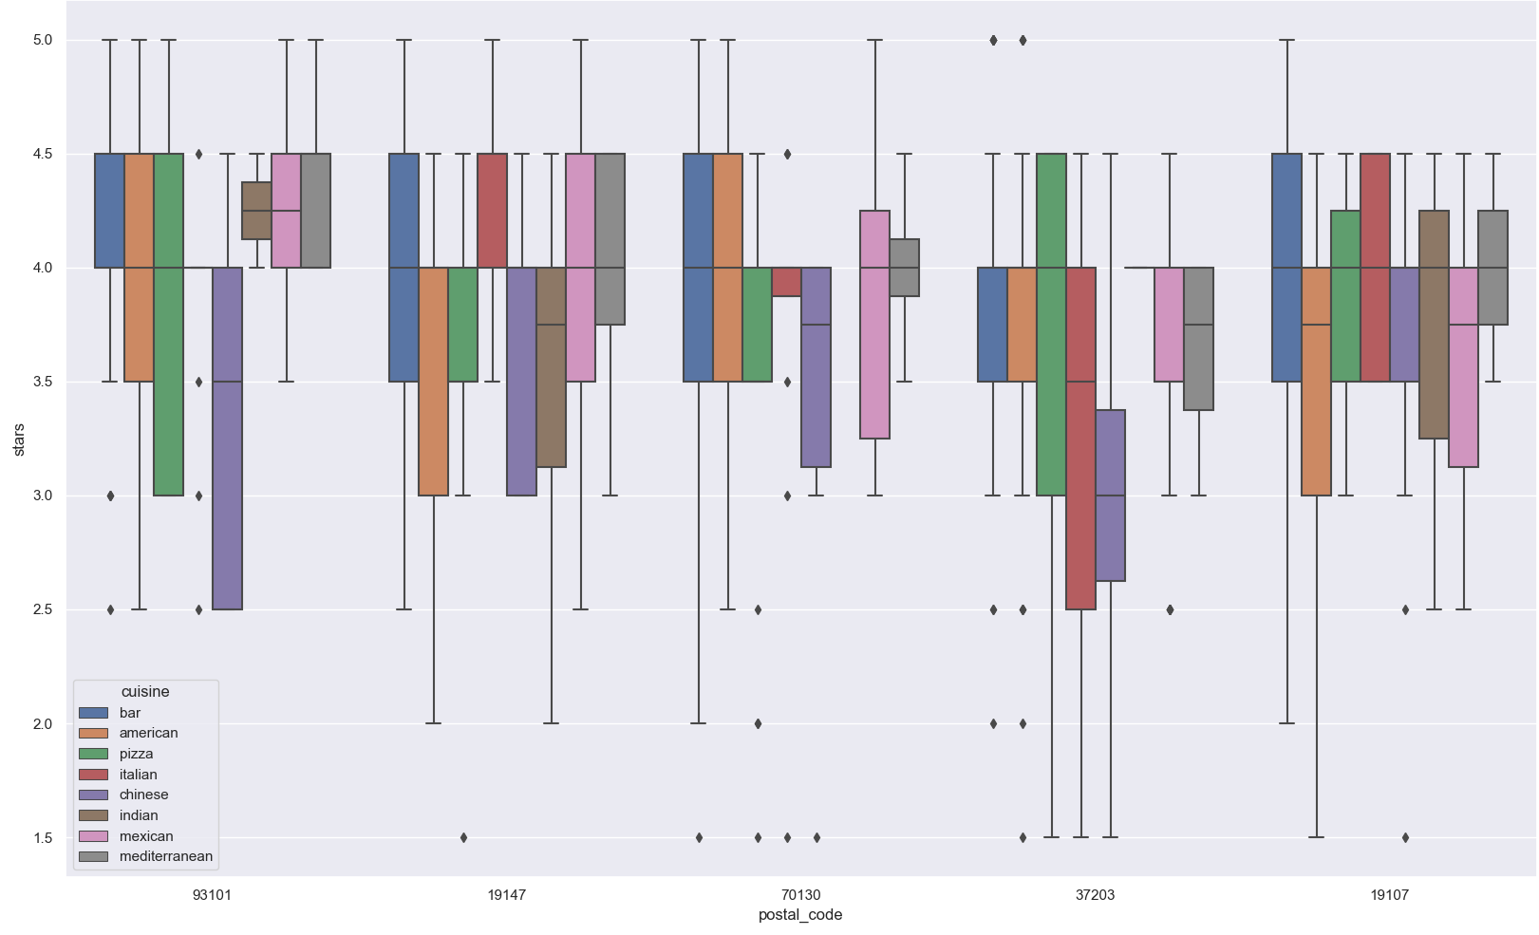
Plot for Location Vs Ratings

Slide 8
Classification Models Used for Use Case 1
Cuisine - Stars Analysis
Location-Cuisine-Stars Analysis
Model | Accuracy Score
Random Forest Classifier | 0.7893
Support Vector Classifier | 0.788
Decision Tree Classifier | 0.7804
Gradient Boosted Tree | 0.7969
Model | Accuracy Score
Random Forest Classifier | 0.7168
Support Vector Classifier | 0.6845
Decision Tree Classifier | 0.7207
Gradient Boosted Tree | 0.7422

Slide 9
Use Case 2: Analysis based on Business Closure, Checkin, Noise & Gender
Using only the review count and star rating when we tried to predict if a restaurant close or no, the accuracy was only 55%.
To increase the accuracy we merged the review data and the checkin data, as for any successful business the number of customers is high, which means the checkin data should be high.
Split the data into test data and train data with test size 0.3.
Got an improved accuracy of 76%.

Slide 10
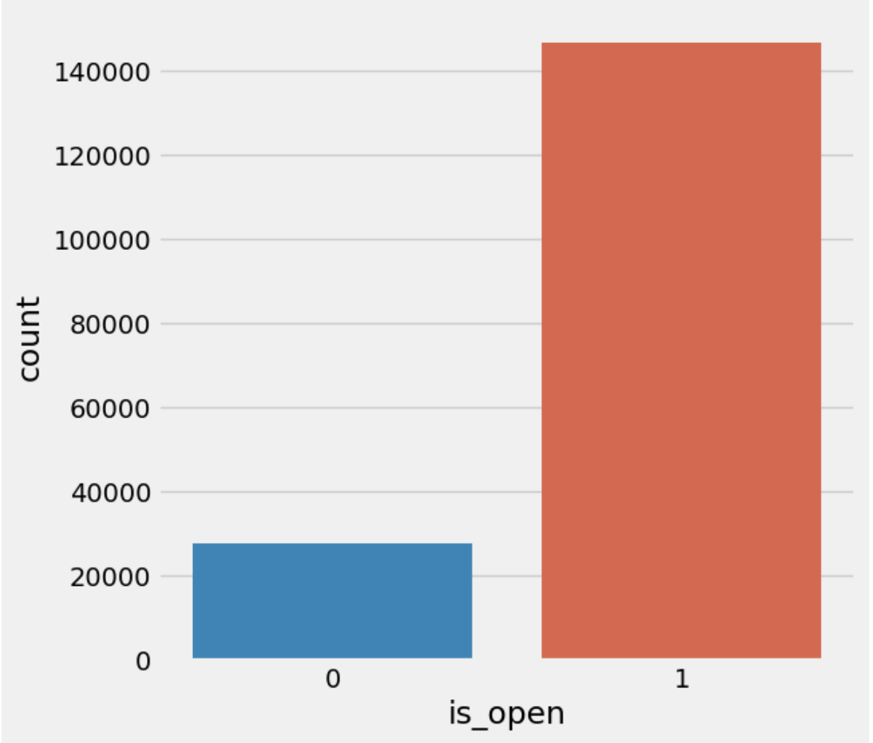
Imbalanced data
As the data is imbalanced, the model will try to predict everything to be of the majority class, which increases accuracy but is meaningless, hence we used SMOTE to resolve this issue.

Slide 11
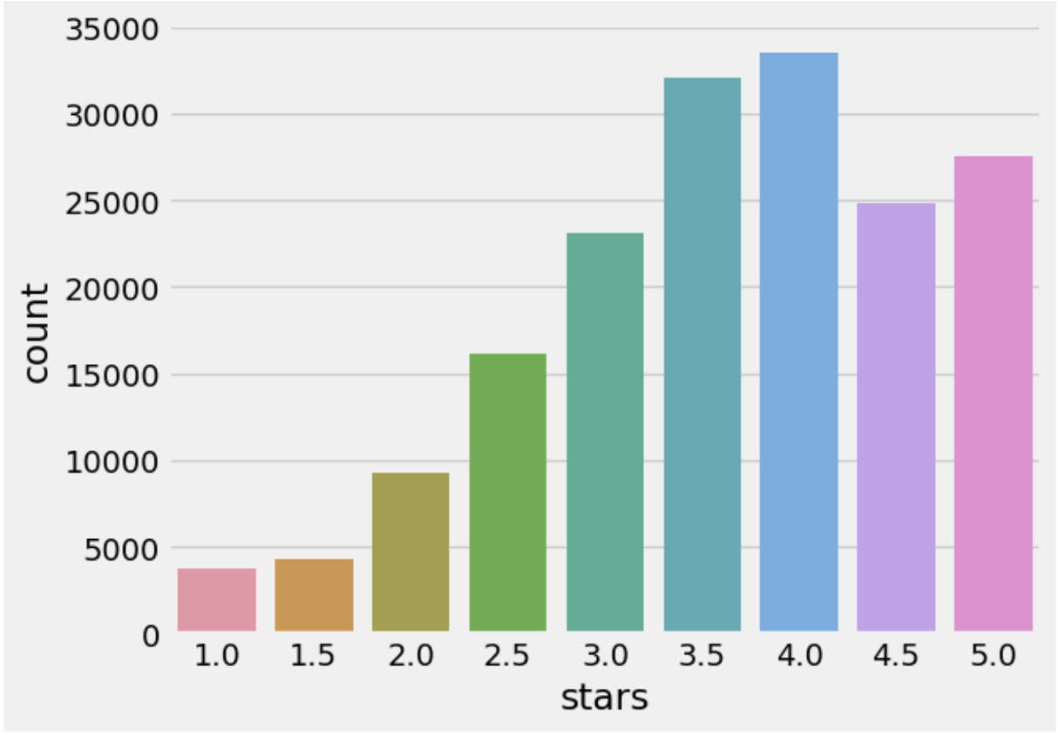
User ratings
Most of the users have given a rating > 3.5

Slide 12
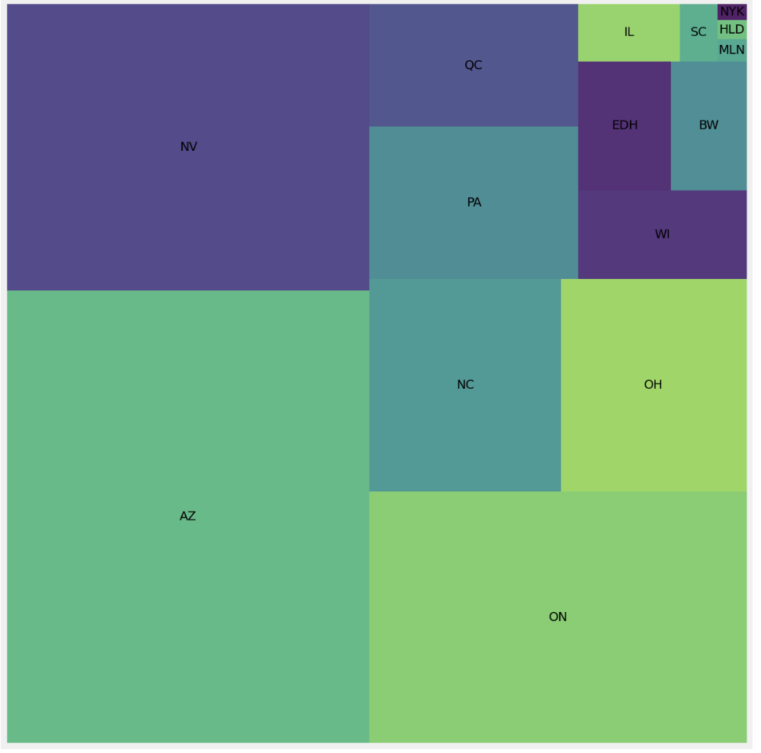
Tree Map showing Restaurants in Different Areas

Slide 13
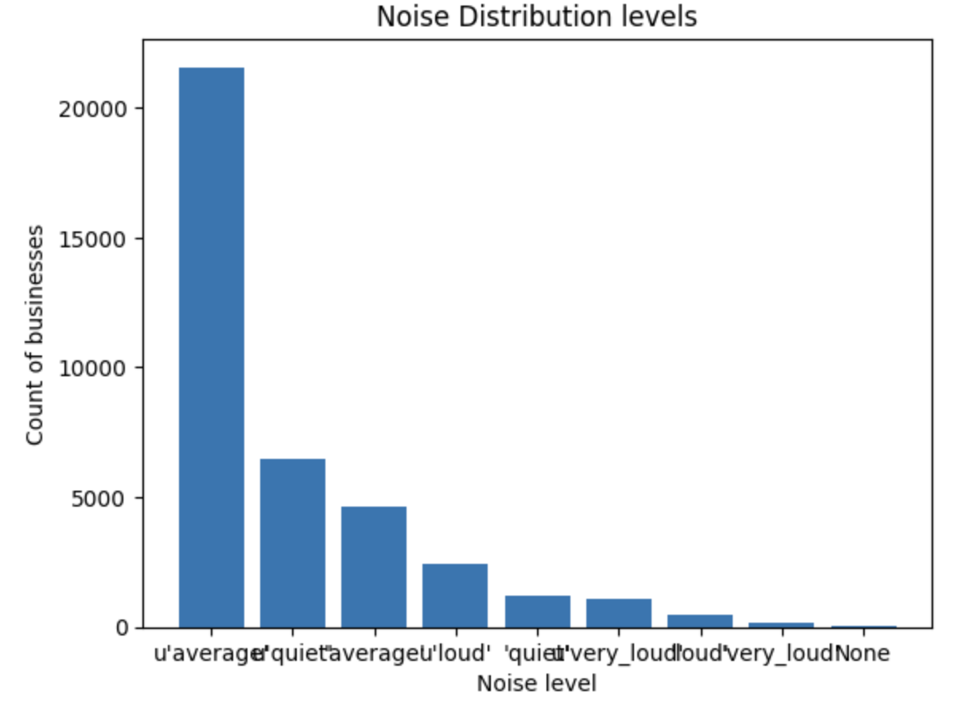
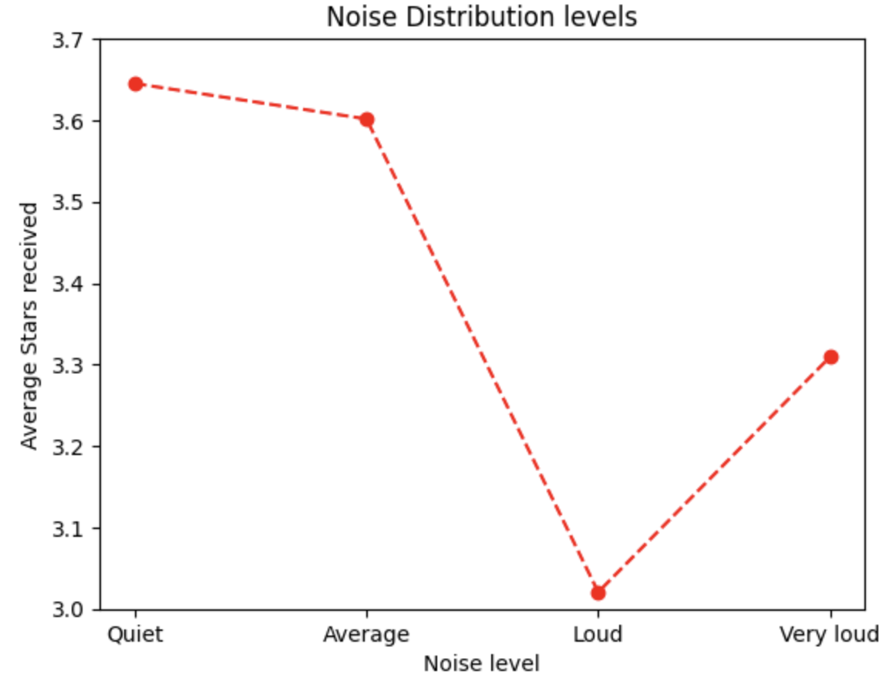
Effect of noise levels on the success of a restaurant
It is clear that customers prefer quiet places. The restaurants with loud noises have low average star rating.

Slide 14
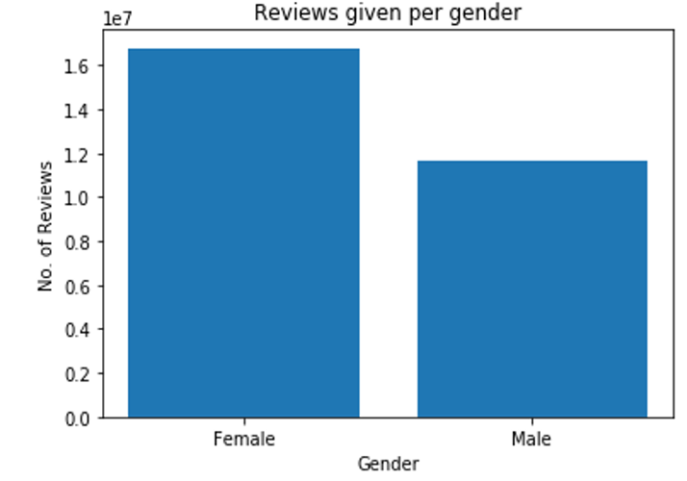
Who tends to give more rating, male or female?
Females tend to give more number of reviews compared to males.

Slide 15
Classification Models Used for Use Case 2
Stars and Checkin Analysis
Model | Accuracy Score
Logistic Regression | 0.546
Random forest | 0.65
XGBoost Model | 0.764

Slide 16
Conclusion
If someone wishes to start a restaurant business and thinks of having a glance on the Yelp data, our prediction model would help them by providing relevant insights and aid them with making wise decisions for opening a restaurant.

Slide 17
Thank you.
Source:
https://www.yelp.com/dataset

