Slide 1
BIT-MECHANIX · HARDWARE PROJECT
ALU-FORGE '26
Design and Implementation of an 8-bit Arithmetic Logic Unit
Using Registers, a Common Bus, Clock Timing and Discrete Digital ICs
TEAM MEMBERS
Mukesh S
Harikrishnan R
Deshni A
01 / 06

Slide 2
Abstract & Objectives
WHAT WE SET OUT TO BUILD
Objectives
i
Abstract
1
Design & Arithmetic Processing
This project implements an 8-bit Arithmetic Logic Unit using discrete digital logic ICs and a shared 8-bit bus architecture.
Construct an 8-bit ALU to perform addition and subtraction.
Operands set via DIP switches are sequentially loaded into Registers A and B using push-button controls and a 1 Hz clock source.
2
Storage & Data Transfer
Dedicated A/B registers and a common 8-bit bus with 74HC245 transceiver control for bidirectional routing.
The operands are processed through an 8-bit adder/subtractor circuit — addition or subtraction is determined by the carry-in control of the first adder stage.
3
Control & Input Interface
DIP switches for operand input, push buttons for register/bus control, and a 1 Hz clock for step-by-step observation.
Team: Bit-Mechanix | Track: Digital Logic Hardware
4
Hardware Demonstration
Verify continuous arithmetic and register-transfer operations at the hardware level.
02 / 06

Slide 3
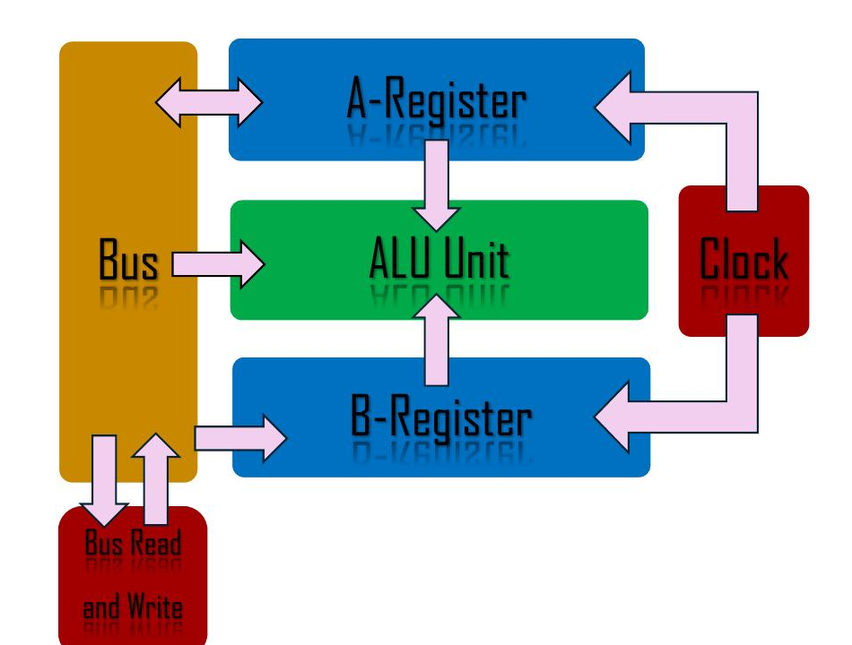
System Overview
REGISTER · BUS · ARITHMETIC ARCHITECTURE
How data moves through the system
BLOCK DIAGRAM
1
An 8-bit value selected on the DIP switches is placed on the common bus.
2
When the A-register enable signal fires, the bus value is captured by Register A on the next clock event — Register B loads the same way.
3
Both register outputs feed the arithmetic section, which adds or subtracts based on the selected control condition.
4
The A-register output and 74HC245 transceiver give controlled access back onto the bus, so results can be transferred through the shared data path.
03 / 06

Slide 4
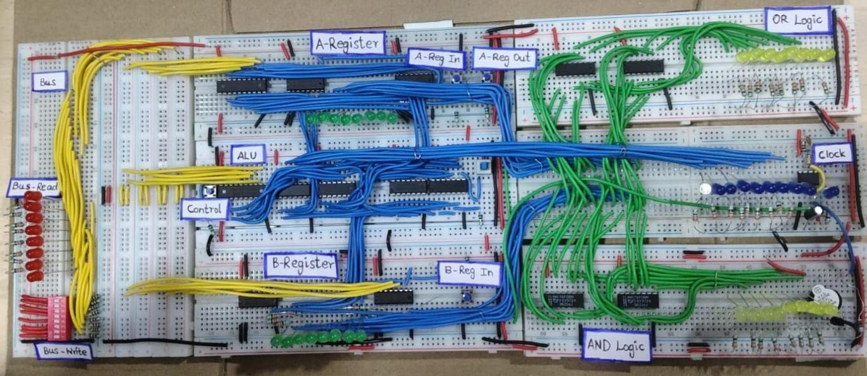
The Designed Circuit
FULL BREADBOARD BUILD — END-TO-END SIGNAL PATH
Working Procedure
1
Load A — Set the DIP switches, place value on bus, enable A-Register, clock it in.
2
Store A — Register A captures the bus value and retains it after switches change.
3
Load & Store B — Change DIP switches to operand 2, place on bus, enable B-Register.
4
Select Operation — Apply the operation-control / carry-in for addition or subtraction.
5
Generate Result — Cascaded adder stages process both operands into an 8-bit result.
6
Transfer Result — Bus/transceiver and register controls reuse or move the result.
Six interlinked breadboards: DIP-switch input, A/B registers, ALU core, bus transceiver, clock, and AND/OR logic blocks.
04 / 06

Slide 5
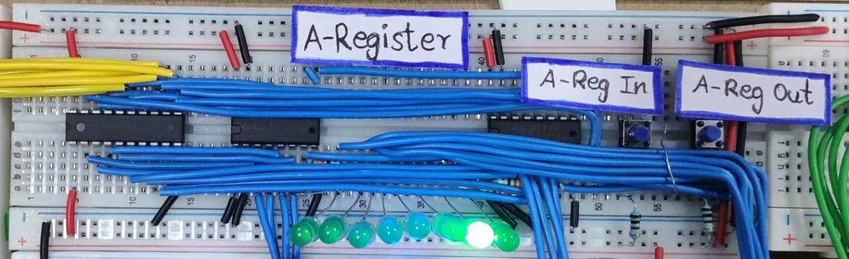
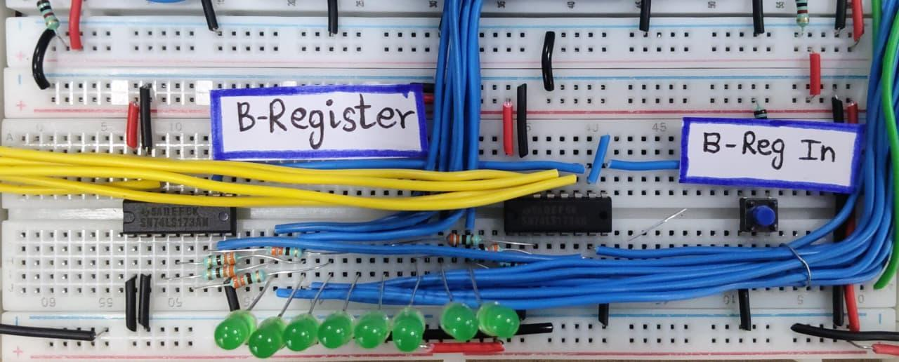
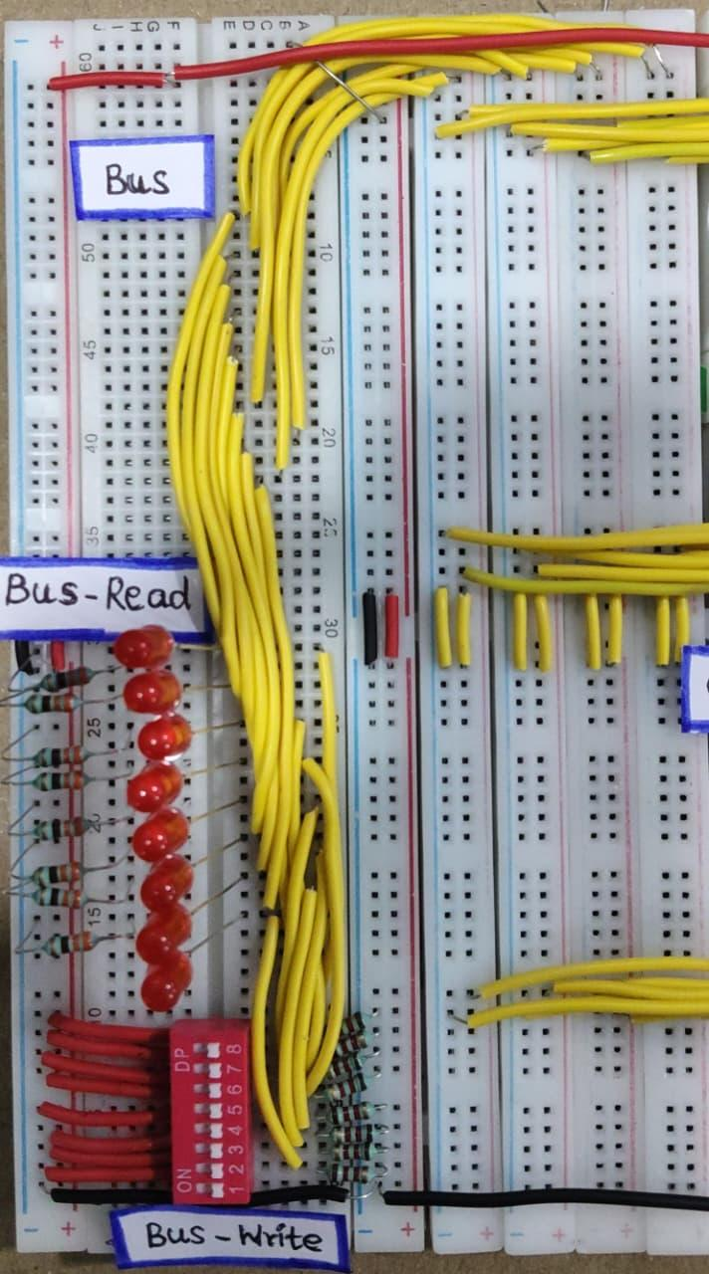
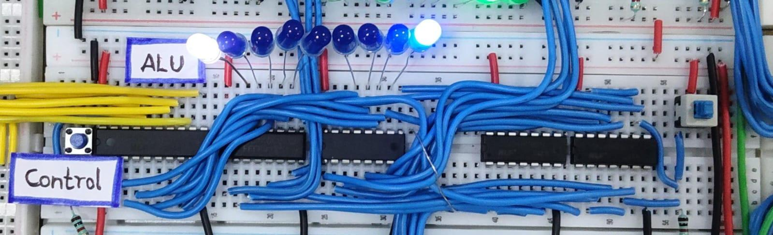
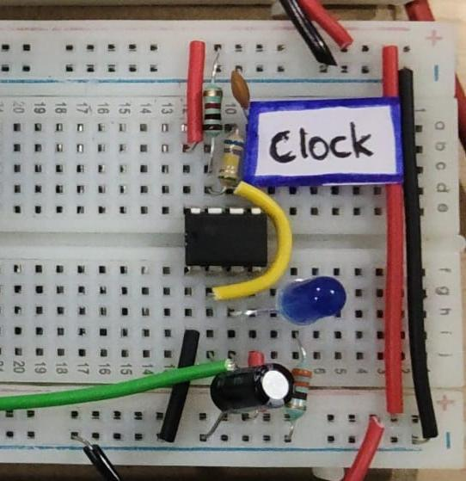
Core Modules
REGISTERS · COMMON BUS · ALU · CLOCK
A-Register
B-Register
Common 8-bit Bus
IC 74173 ×2 · stores operand 1, doubles as the accumulator for results.
IC 74173 ×2 · stores operand 2 from the same shared bus, own enable line.
DIP switches write; 74HC245 controls read/write — avoids bus contention.
Addition / Subtraction
Cin = 0 → Result = A + B
Cin = 1 → Result = A − B
ALU Unit
1 Hz Clock
IC 74008 & 74286 · Cin=0 → A+B addition, Cin=1 → A−B via 2's complement.
IC 555 timer · paces register loads so data movement is visible step-by-step.
One control line sets the B-input XOR bank and the adder's carry-in together.
05 / 06

Slide 6
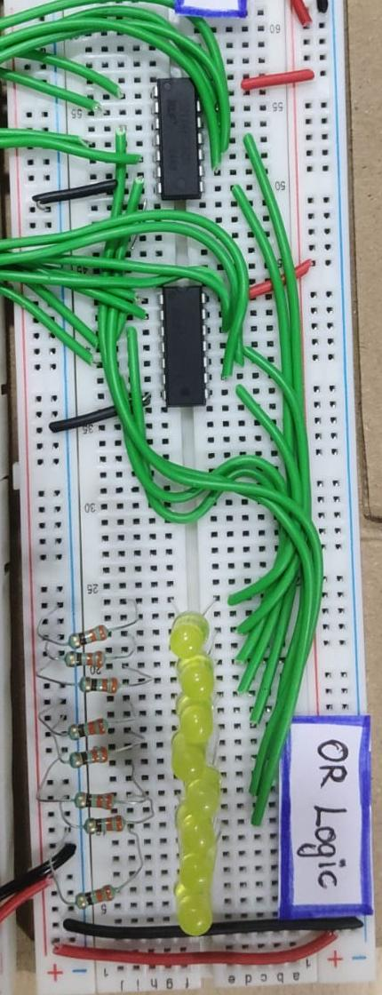
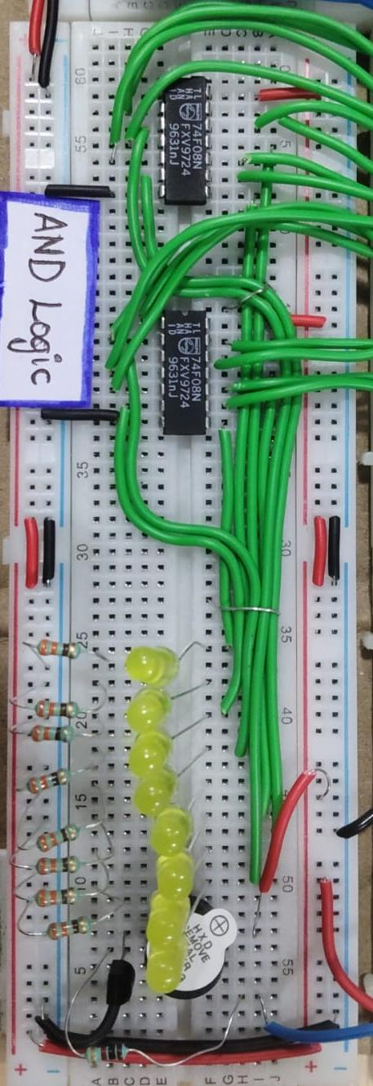
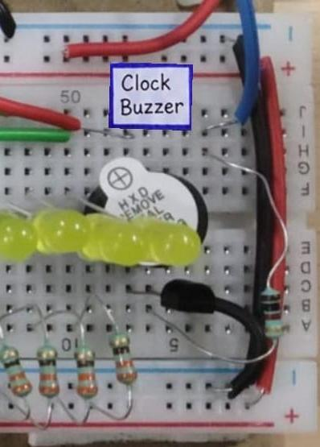
Additional Designs & References
BONUS LOGIC BLOCKS BUILT ALONGSIDE THE CORE ALU
References
Website
eater.net/8bit/alu
YouTube Reference
youtu.be/CiMaWbz_6E8
Clock Buzzer
Team Bit-Mechanix
Audible tick on every clock pulse, for demo feedback.
Mukesh S · Harikrishnan R · Deshni A
OR Logic
AND Logic
Bit-wise logical OR of the two register outputs.
Bit-wise logical AND of the two register outputs.
06 / 06

