Slide 1
SEGMENTING CONSUMERS OF BATH SOAP
Amruta Deshpande

Slide 2
Problem and Objective
The market survey data has sets of variables as :
Purchase behavior
Basis of purchase
Segmenting data on basis of Purchase Behavior, Basis of Purchase and both; Purchase Behavior and Basis of Purchase and Demographics.
The objective is to allocate the cost-effective promotions to different market segments. This can be achieved by targeting direct-mail promotions based on the segmented data.

Slide 3


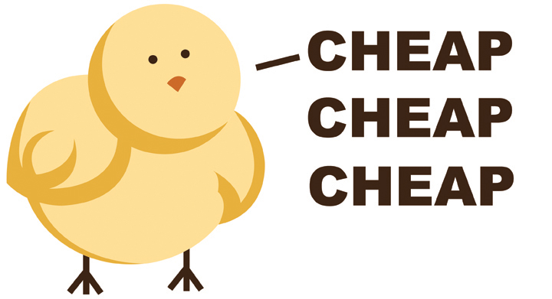

PURCHASE BEHAVIOR
When data is segmented based on Purchase Behavior ; it can be divided in two groups of loyalty towards brand.
Cluster 1 : Brand Loyal
Cluster 2 : Brand Disloyal
BASIS OF PURCHASE
When data is segmented based on Basis of Purchase ; it can be divided in four groups of different price categories.
Cluster 1 : Premium
Cluster 2 : Skimming (initially price is set to high)
Cluster 3 : Economy
Cluster 4 : Penetration (initially price is set to low)

Slide 4
Purchase behavior and basis of purchase
Cluster 1 : Finest Segment
Leading in most of the categories such as Number of Transactions, Brand, etc.
Cluster 2 : Price Point
Purchase in Price category is maximum.
Cluster 3 : Brand Loyal
Topmost purchase in Brand Loyal.
Cluster 4 : No Promotions
Highest purchase under no promotions.

Slide 5
Summary and conclusion
Different Segments can be targeted for the direct mail promotions based on the categories.
For instance, Offers on Brand- Brand Loyal
Price Discount- Price Point and No promotions.
To select customers which may generate high revenue, then we can target the Finest segment.

Slide 6
THANK YOU

