Slide 1
Application of Data Mining in Underwriting Department
Group Project: MIS-64037- Advanced Data Mining and Analytics
Group 4:
Gujja Rithin Rao
Padade Srushti
Deshpande Amruta Shrikant
Chujun Huang

Slide 2
Table of Content :
Project Goal and Objective
Scenario 1
Scenario 2
Scenario 3
Conclusion

Slide 3
Project Goal & Objective:
The goal of the project is to design an appropriate asset-management strategy to optimize the economic capital utilization and minimizing the risk to financial investors.
The primary objective of this project is to make on decision on allocation of loan money to the applications received by underwriting department of the bank based on the evaluation of three different scenarios described in the provided information.

Slide 4
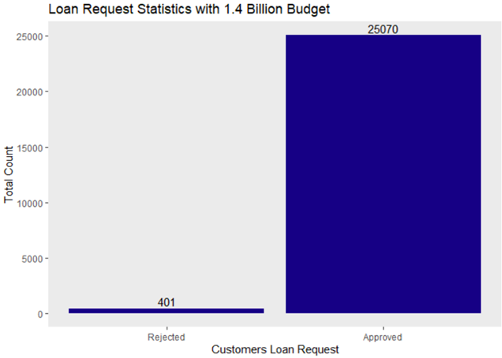
SCENARIO 1:
Total capital: $1.4 Billion
Fixed Term: 5 Years
Annual Interest Rate: 4.32%
Total Applicant: 25471
Approved Applications: 25070
Budget Spent: $1.25 Billion

Slide 5
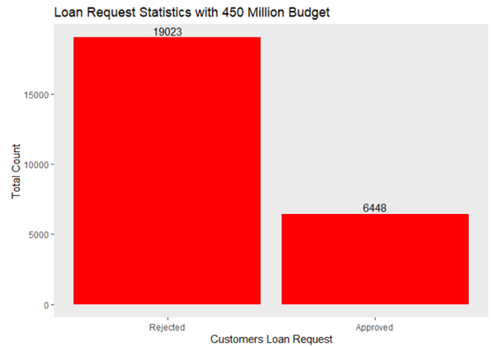
SCENARIO 2:
Total capital: $450 Million
Fixed Term: 5 Years
Annual Interest Rate: 4.32%
Total Applicant: 25471
Approved Applications: 6448
Budget Spent: $449 Million

Slide 6
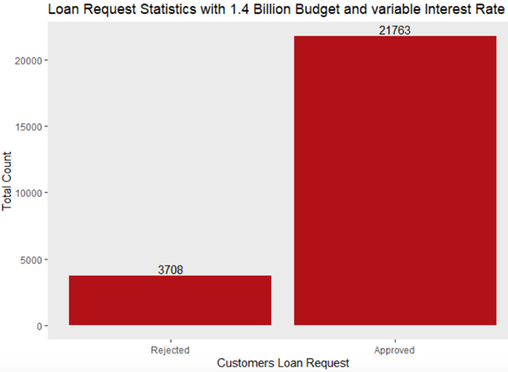
SCENARIO 3:
Total capital: $1.4 Billion
Fixed Term: 5 Years
Annual Interest Rate: Varying
Total Applicant: 25471
Approved Applications: 21763
Rejected Applications: 3708

Slide 7
Conclusion :
As an underwriting department employee, the decision of loan approval decision is simplified using data mining.
So, this application of data mining acts as a bridge between traditional and modern banking technique.

Slide 8
THANK YOU

