Slide 1

Add Collateral to a Loan Account

Slide 2
How to Add Collateral to a Loan Account?
This guide will show you how to add Collateral to a Loan Account with Mifos X System

Slide 3
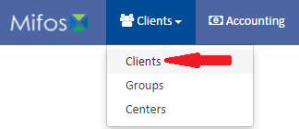
Go to Clients
Click on Clients in the Clients’ tab.

Slide 4
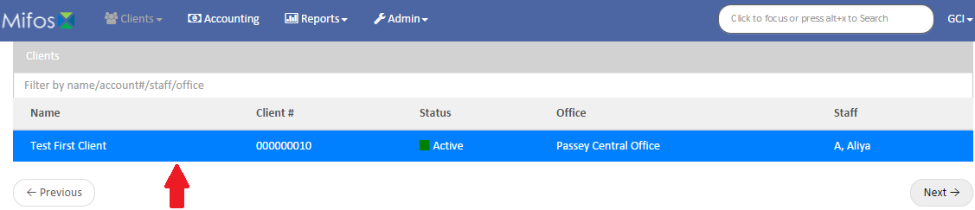
Select a Client
Select a client by clicking on him

Slide 5
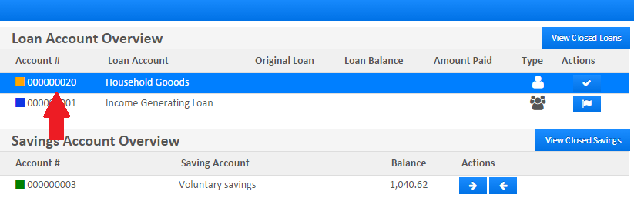
Selecting a Loan
Select a Loan by clicking on it, but keep in mind that the square must be orange

Slide 6
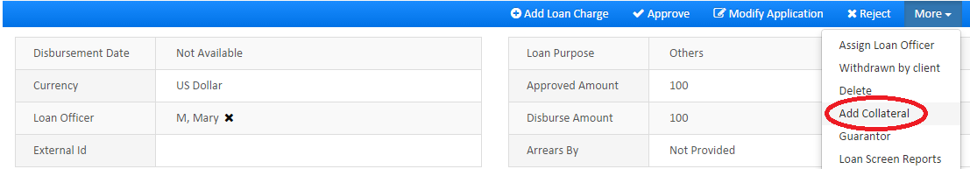
Selection Option
Click on button, which is situated within the More section in the blue action bar

Slide 7
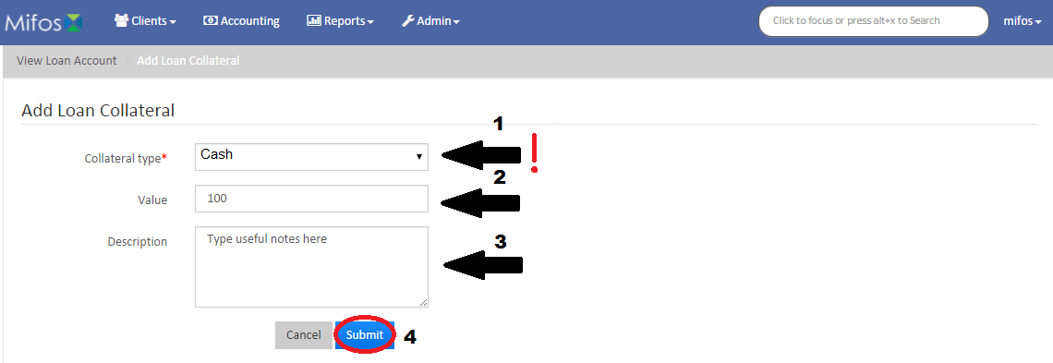
Adding Loan Collateral
Choose Collateral type, this is a mandatory field
Fill the Value text box with the amount you want
Put some useful notes in the Note box, like why you add Loan Collateral
Click button

