Slide 1

New client setup

Slide 2
How to add new Client?
This guide will show you how to add a new Client with Mifos X System

Slide 3
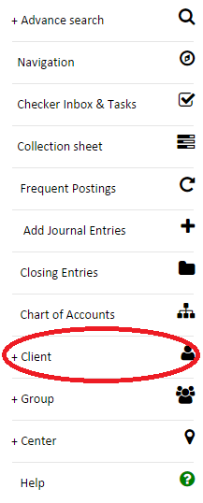

Step One: Open Client Creation
First access the Quick navigation tab by going to the left side of the screen.
After that click on and you will get to client creation screen.

Slide 4

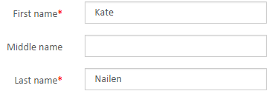

Step Two: Creating Client
1. Assign Client’s Office from the drop-down menu. This is mandatory.
2. Assign the names the Client. First name and Last name are mandatory
3. Assigning Staff is a good idea, but it’s not mandatory.

Slide 5


Step Two Continued
4. The following fields are not mandatory, but they provide very useful information about the Client so if you know the info fill them.
5. The following fields are not mandatory, but they specify the Client a lot more strictly and provide filter information, which will help in finding the Client faster.
Also you can give the Client External id
6. You can make the Client Active after checking the box by clicking on it, which will add an additional Activation field mandatory field.

Slide 6

Step Two Continued
7.This field is set by default on the current date.
It shows when the Client is Submitted.
8. You can give the Client Savings Account by checking the box and selecting Savings Product from the drop-down menu. Not mandatory.
9. Click the Submit button.

Slide 7
Questions?

Slide 8
Thank you for your attention!

