Slide 1
CACTS WEBSITE ANALYSIS

Slide 2
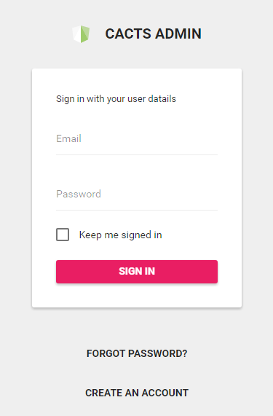
SUPER ADMIN SECTION.
SUPER ADMIN LOGIN PAGE
FUNCTIONALITY
The super admin logins into the system using his/her registered email address.
A link to retrieve user password if forgotten. The user can retrieve his/her password using the email used during the user registration.

Slide 3
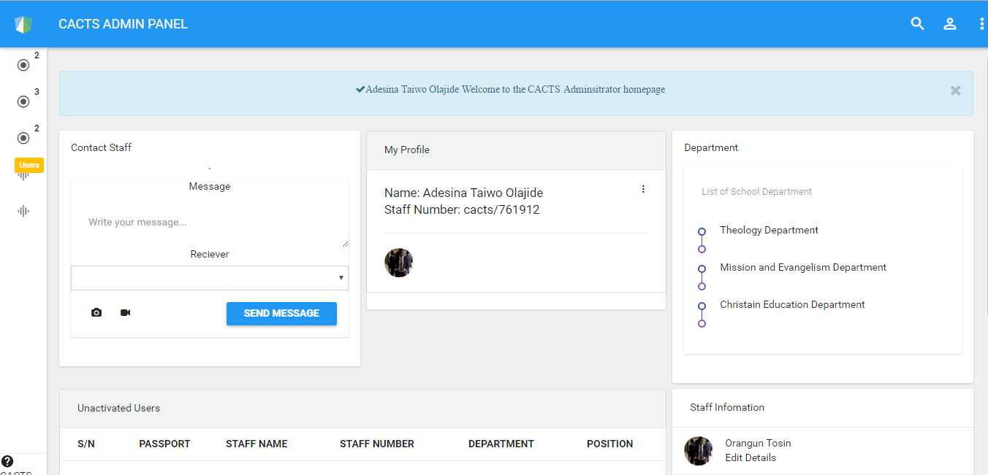
SUPER ADMIN PANEL

Slide 4
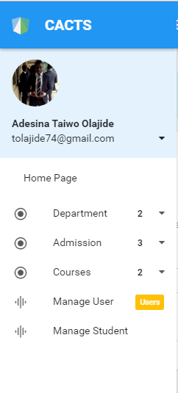
ADMIN PANEL SIDE BAR NAVIGATION
The side bar consist of
Department (A drop down that has a link to add, edit, delete and view department).
Admission (A drop down that has a link to admit new students, cancel admission, and view admission list).
Courses(A drop down that has a link to Add, edit, delete and view school courses).
Manage Users(This handles the user lists, list of staff, staff bio data and user activation).
Manage Student (Shows a panel to add, editing, viewing and deleting student bio data

Slide 5
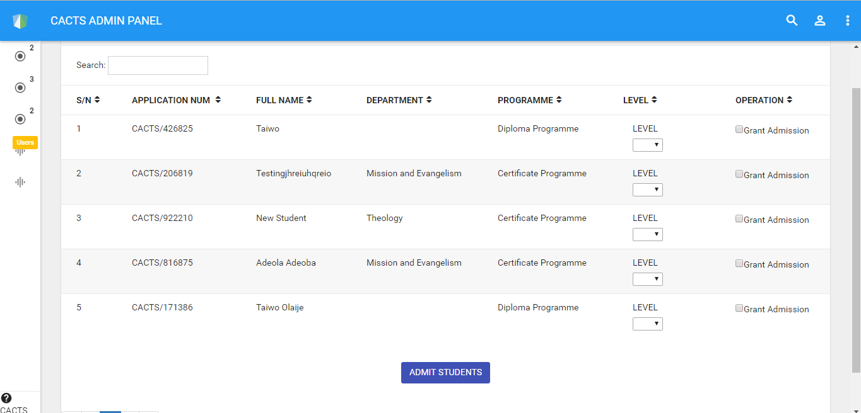
ADMITTING STUDENTS
A table that shows the list of all the students that obtained the school form. Which shows their department of choise, pintrested programme and full names.
The admin can grant admission by clicking on the grant check box, select the student level and many students can be admitted at the same time.

Slide 6
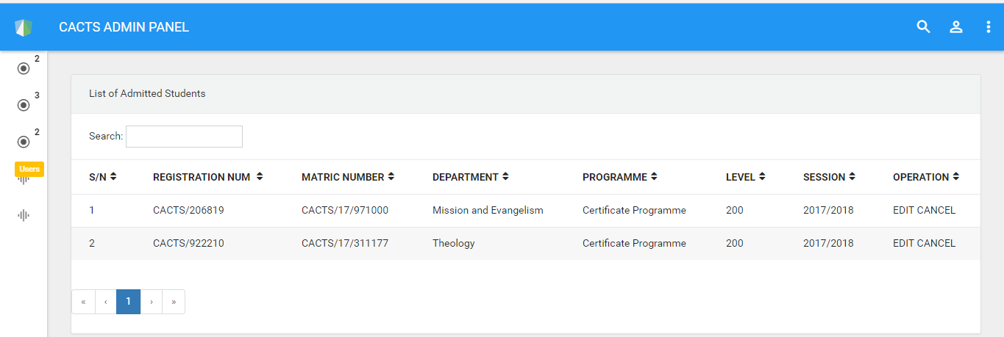
Admission list
List of admitted students showing the student registration number, the matric number generated for each student when admitted, their programmes, dept , level and a link to edit or cancel students admission.

