Slide 1

Marcus Kaseder
Distributed Systems & Messaging

Slide 2
Why Distributed Systems
Scalability Serve millions of users without a hitch.
Fault Tolerance System remains operational even if part of it fails.
Geographic Distribution Serve users from nearby locations.
Resource Sharing Maximizing efficiency by sharing resources.

Slide 3
Traditional vs. Distributed Development
Traditional Development
Centralized system
Single point of failure
Limited scalability
Tightly coupled components
Distributed Development
Multiple nodes working together
Fault tolerance through replication
Scalability across nodes
Loosely coupled with messaging

Slide 4
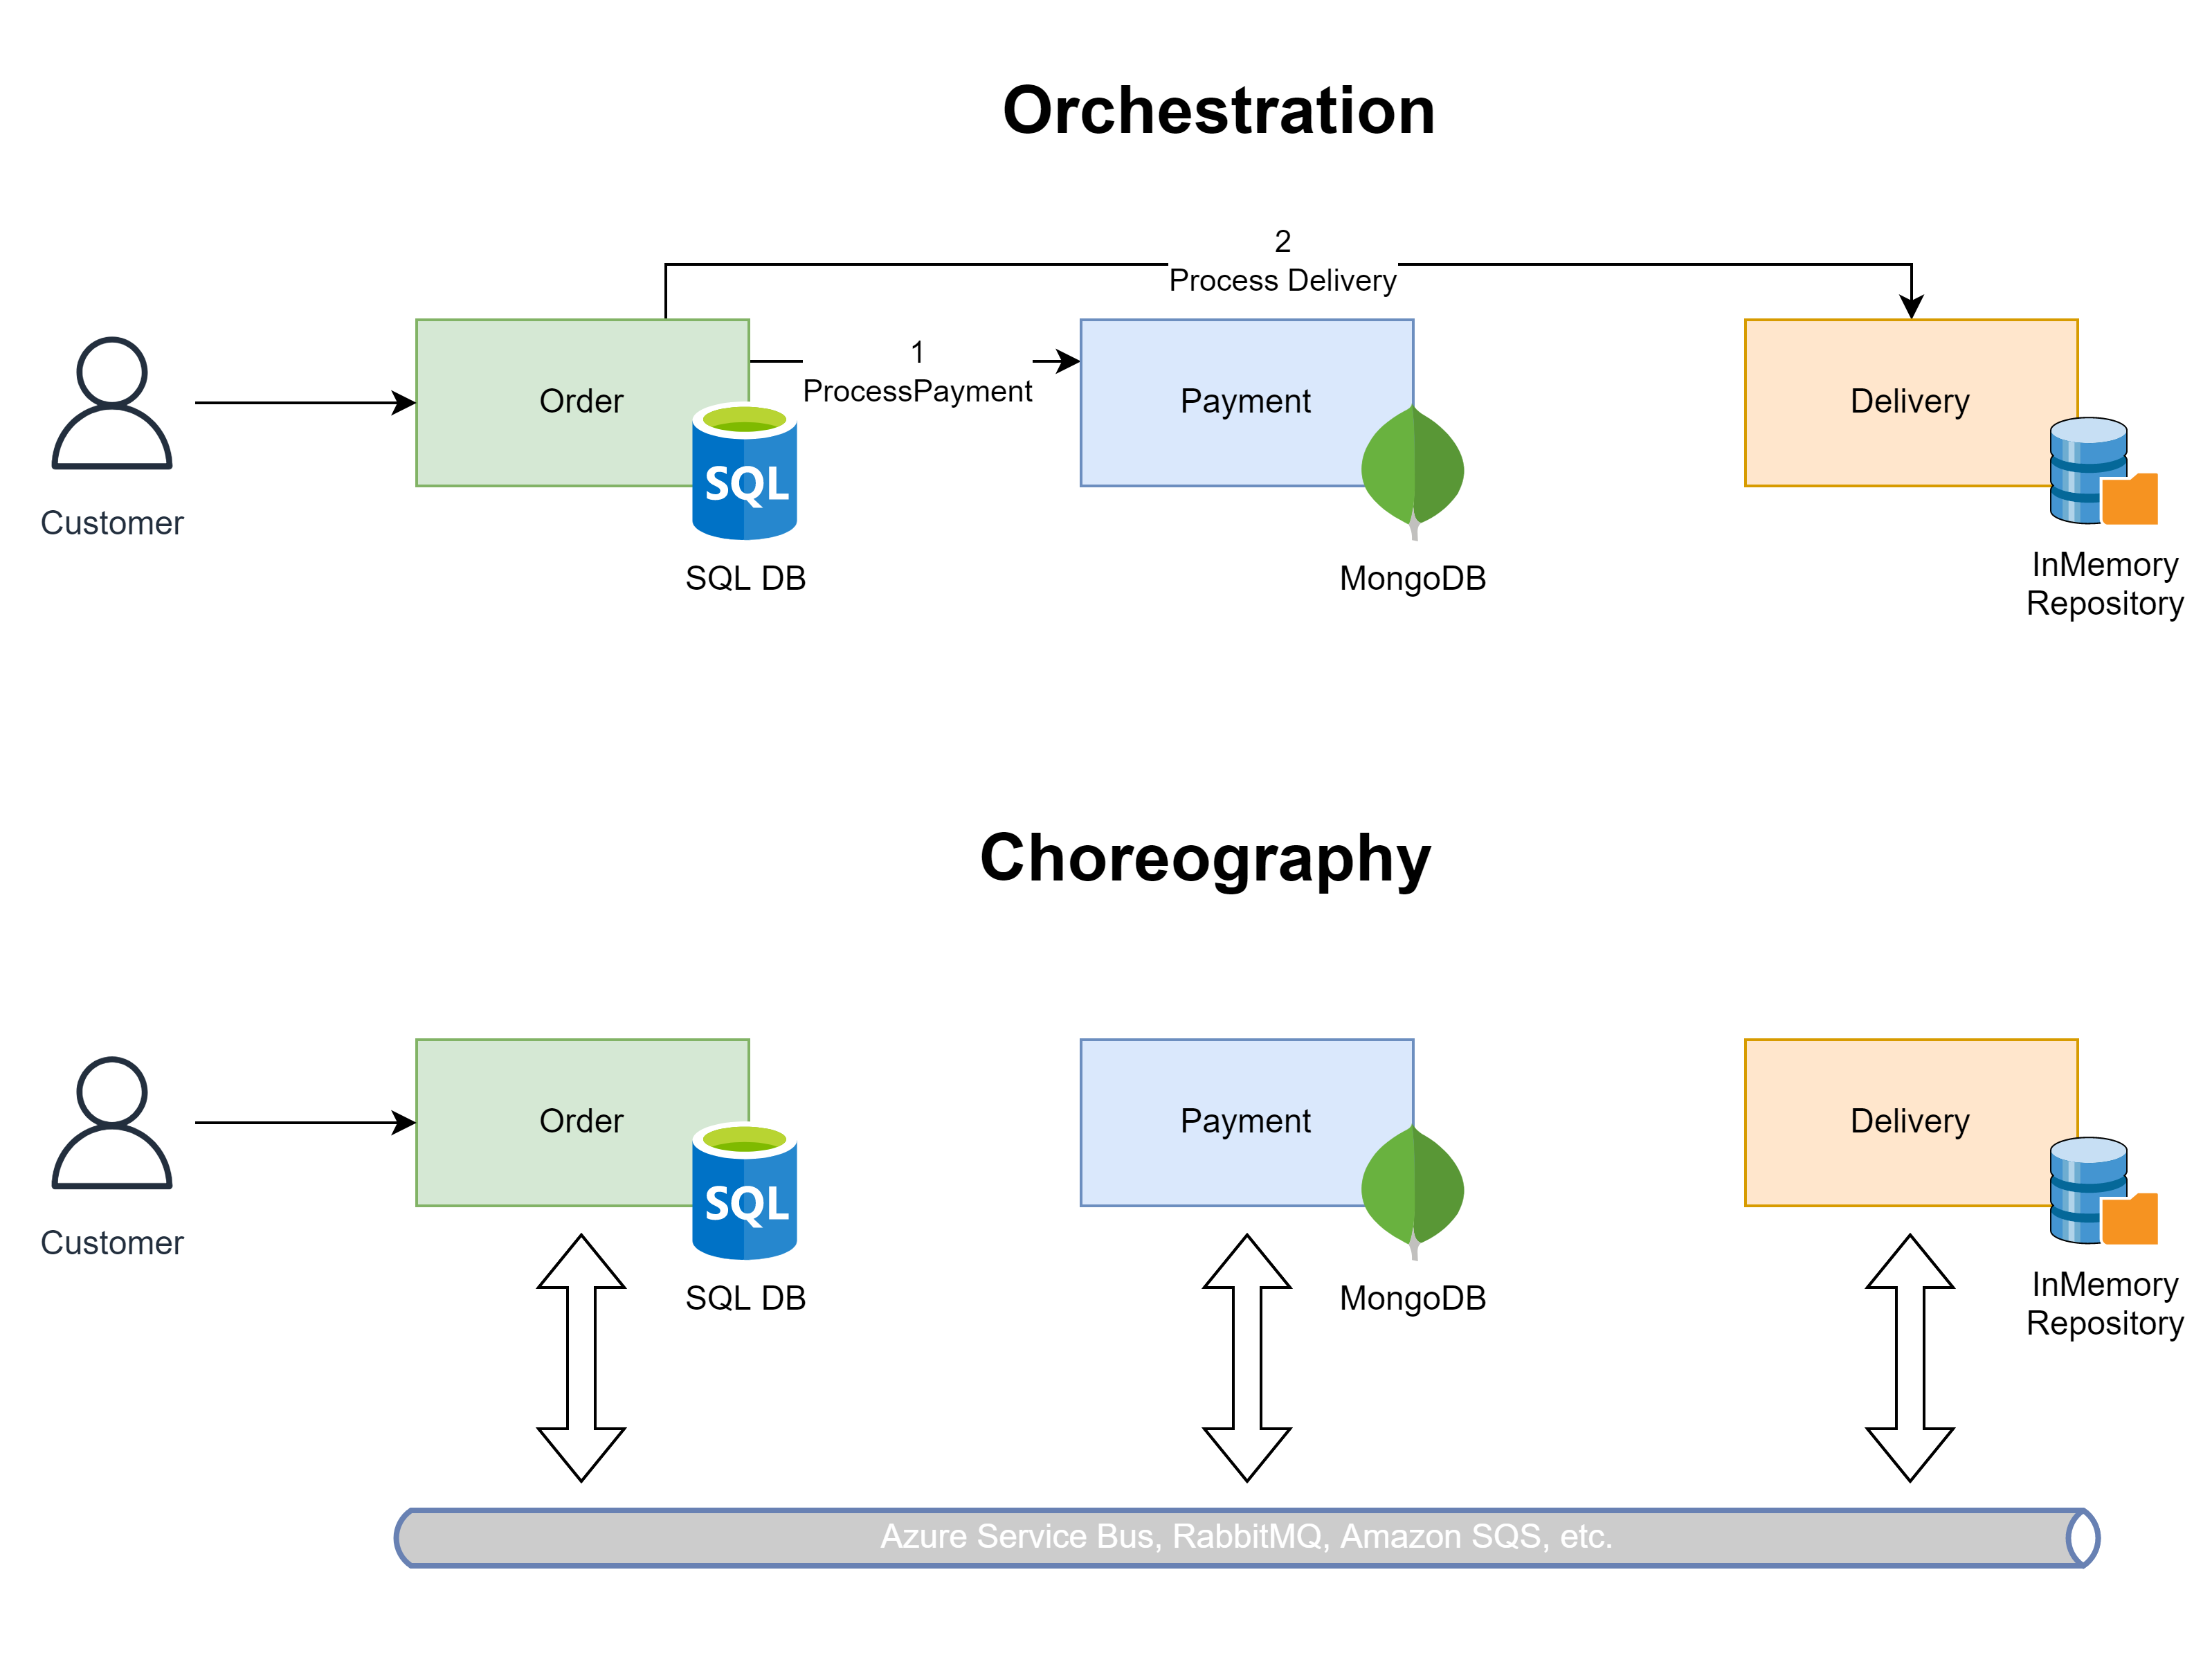
Orchestration vs. Choreography

Slide 5
Orchestration vs. Choreography
Feature | Orchestration | Choreography
Control Flow | Centralized | Decentralized
Service Knowledge | Orchestrator knows all services | Services are autonomous
Complexity | Can become a bottleneck | Distributed, but can be harder to track
Fault Tolerance | If orchestrator fails, flow stops | Failure doesn‘t halt the entire process
Scalability | Limited by orchestrator | High, as services scale independently

Slide 6

Marcus Kaseder
Many thanks!
adesso SE
Adessoplatz 1
44269 Dortmund
Germany
T +49 231 7000-7000
F +49 231 7000-1000
www.adesso.de/en

