Slide 1
The Big Green (Dashboard)
Philip Wirth
Michael Dowlin
Lourdes Milano

Slide 2
Motivation

Slide 3








Workflow
Web visualization
SQL database in
Postgres server
Data manipulation,
cleaning and mining.
Statistical analysis
Database connection
csv files:
EPA website
Json API reader, JQuery, D3,
leaflet
Web application framework
JSON API

Slide 4
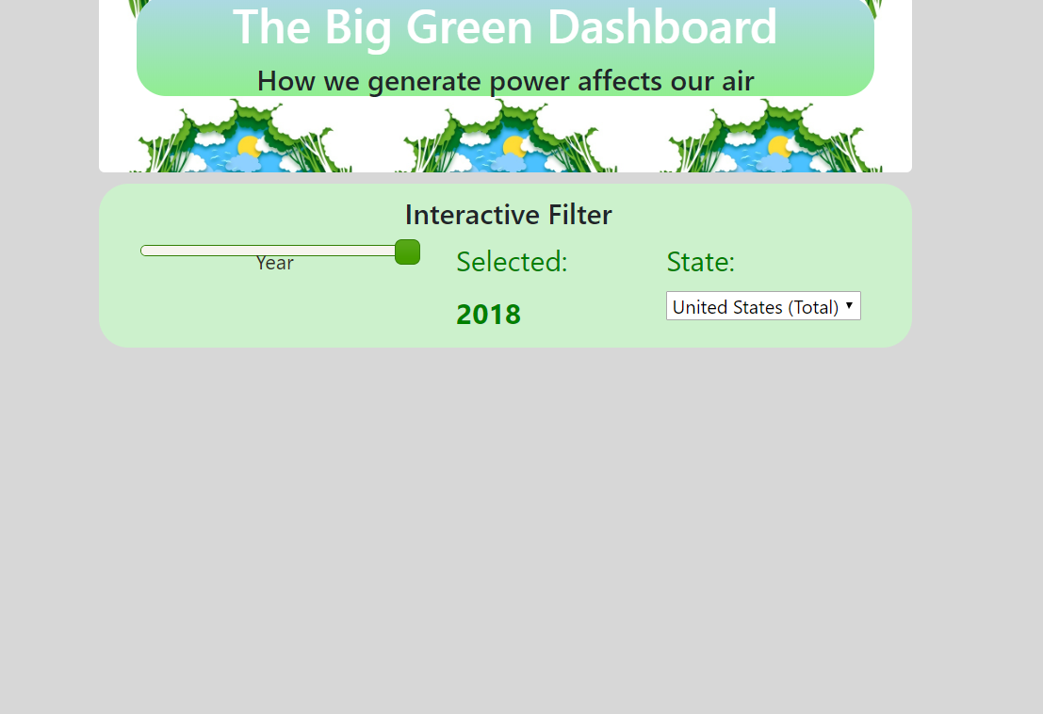
Desktop demo
Place your screenshot here

Slide 5
Future steps

Slide 6

Thanks!

