Slide 1
COLLEGE MANAGEMENT SYSTEM
PRESENTS
BY
OLADELE PETER GBENGA
MATRIC NUMBER: SUPERVISOR IN-CHARGE:
22010211160 MR. AINA
Notes:
1

Slide 2
INDEX
Introduction
Scope
Aims and Objective
Related work
Methodology
Expected Results
Future work
Conclusion
Contribution to knowledge
References

Slide 3
INTRO.
College Management System may be a software system developed for a university or a college for maintaining or Managing the data.
Information associated to varied daily activities within the college. The CMS is utilized to keep data
Details of various departments in the university or college, varied courses offered by the school
Student admission details, faculty details, day-to-day attendance details

Slide 4
MODULES AND ITS SHORT DESCRIPTION
Main objective of this system or project is to design or develop a software portal for colleges for maintaining lectures details, student’s attendance information, and student’s internal and external marks managing system.
MODULES OF A THE SYSTEM
Attendance
Data of a Faculty
Data of a Student
Data of a Exam
Fees Payment

Slide 5
USERS AND THEIR ROLE DESCRIPTION
Admin/Faculty
1. Changes the Data Of a Student
2. Add the Faculty/Student
3. Upload the Result of a Student
4. Add the Attendance of a Student
User/Student
1. Add the complaint
2. Upload the Document If Faculty Want
3. Pay the Fees of Hostel/College

Slide 6
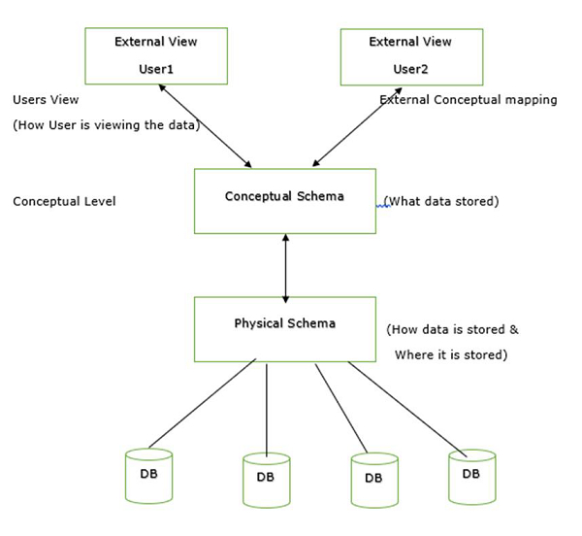
SYSTEM ARCHITECTURE

Slide 7
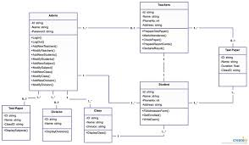
UML Diagrams
Class Diagram: This diagram shows the classes (entities) in the system and their relationships.

Slide 8
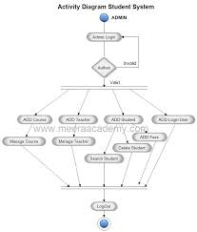
ACTIVITIES DIAGRAM

Slide 9
LIMITATIONS
There Are Some Limitations For Both Student and as Follows:-
Admin:- The Admin can changes the things in the system if he/she wants to change the information of student or faculty they can.
Student:- The user cannot changes anything in the website they all see the website and there details and pay their school fees.

Slide 10
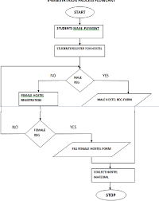
FLOAT CHAT

Slide 11
SYSTEM REQUIREMENTS
. Memory (RAM): Minimum 4 GB RAM
Storage (Hard Disk): Minimum 500 GB free space
CPU: Minimum 2 GHz multi-core processor
Network: Reliable internet connection with sufficient bandwidth.
SOFTWARE REQUIREMENTS
HTML
CSS
JAVASCRIPTS
JQUERY
PHP
MYSQL

Slide 12
EXPECTED RESULTS
The CMS is designed to streamline administrative tasks, enhance communication, and improve overall efficiency. By outlining the expected results, we can establish a clear vision for the implementation process and measure its success.
Increased Efficiency & Productivity
Enhanced Collaboration & Communication
Improved Data Security & Decision Making
Potential Cost Savings & Better Outcomes

Slide 13
RELATED WORKS
A Secure College Management System" by S.R. Roy, S. Das, and A. K. Pal (2023)
Impact of College Management System Implementation on Student Retention Rates by J. Lee and A. Brown (2023) (explores the potential benefits of CMS on student retention).
Optimizing Faculty Workload through College Management System Automation by M. Garcia and S. Jones (2022) (investigates how CMS can streamline tasks and reduce faculty workload).

Slide 14
FUTURE WORK
Continued development of new features based on:
1. User feedback Integration
2. Additional systems like learning management platforms Implementation of mobile applications for students, faculty, and staff Regular system maintenance and updates

Slide 15
CONCLUSION
A college management system offers a multitude of benefits for our institution. This slide summarizes the key expected outcomes, emphasizing improved efficiency, communication, data management, decision-making, and ultimately, a better student experience. The implementation of a CMS has the potential to transform the college into a more streamlined and effective learning environment.

Slide 16

CONTRIBUTION TO KNOWLEDGE

Slide 17
REFERENCE
www.studymafia.org
www.google.com
www.wikipedia.com

Slide 18


