Slide 1

    A WEB-BASED LEGAL CASE MANAGEMENT SYSTEM
PRESENTS
BY
BADRU LATEEF OLAYINWONUOLA
MATRIC NUMBER: SUPERVISOR IN-CHARGE:
22010211036 Mr. Onalaja
Notes:
1

Slide 2
INDEX
Introduction
Motivation
Problem Statement
Aims and Objectives
Literature Reviews
Research Methodology
Proposed Implementation
Result and Contribution to knowledge
Progress Report
Selected References

Slide 3
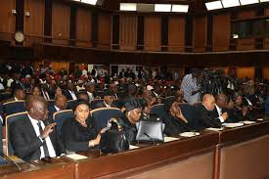
INTRODUCTION
A web-based CMS is a software application that help organizations manage their cases from start to finish. It provides a centralized platform for tracking cases, storing data, and collaborating with team members.

Slide 4

MOTIVATION
A web-based CMS can help organizations streamline
their case management process by automating tasks and
improving visibility into cases. This can lead to
significant improvements in efficiency and productivity
such as.
Increased Efficiency
Improved Collaboration
Cost Savings
Scalability

Slide 5
Problem Statement
Recently, Prosecuting Attorney’s current case management system is a desktop base application where cases that are registered are printed out and pasted on the notice board to enhance public access. The courts print out the cases that will be held in that particular week and keeps the outdated cases that have already been held in excel on the desktop. Due to this clients need to come back to the court to confirm the day its case will be held and sometimes leads to frustrations. (Rooze, 2021).

Slide 6
Aims and Objectives
The project aims to develop an Electronic Court Case Management System (eCCMS) for efficient registration, management, and reporting of court cases.
OBJECTIVE
Implement an Electronic Court Case Management System (eCCMS) for court case registration and updates via a user interface.
Enable user data entry.
Include event and scheduling features for case arrivals, session appointments, deadlines, courtroom reservations, and assigned judges.

Slide 7
Literature Reviews
As the Judiciary is the system of courts of justice in a country, the arm of government charged with the responsibility to administer justice. Nigeria's legal system was built on a foundation of received Anglo-Saxon common law, statutory law, and other documents. (The Judicial Secretary, 2021).

Slide 8
RESEARCH METHODOLOGY
Create Cases: Users can create new cases by entering basic information, such as the case name, type, and client information..
Assign Cases: Cases can be assigned to specific team members based on their expertise or workload.
Track Case Progress: The system can be used to track the progress of cases through different stages. This can help to ensure that cases are completed on time and within budget.
Manage Documents: The system can be used to store and manage all of the documents associated with a case. This can help to improve organization and ensure that everyone has access to the latest information.

Slide 9
Proposed implimentation
* // Data Collection as input
FUNCTION collect_various_cases():
data = [
/* implementation*/
];
RETURN data;
// Preprocessing data (Offline)
FUNCTION preprocess_the_case(data);
* // Output model
FUNCTION generate_output(return_data, validation_data, epochs);

Slide 10
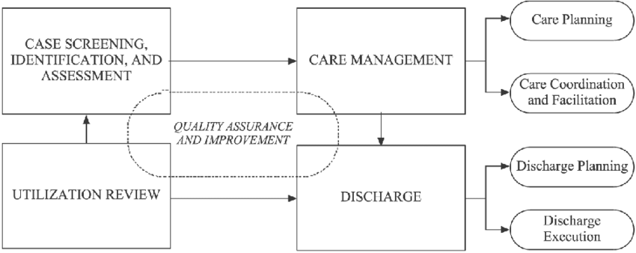
SYSTEM ARCHITECTURE

Slide 11
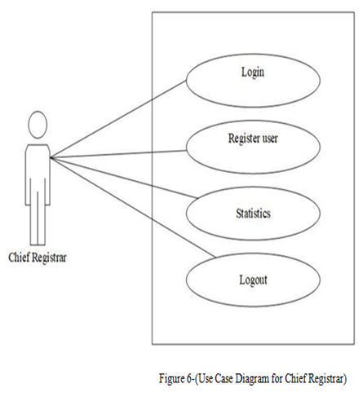
uML Diagrams

Slide 12
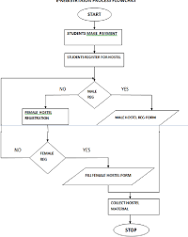
Flowchart

Slide 13
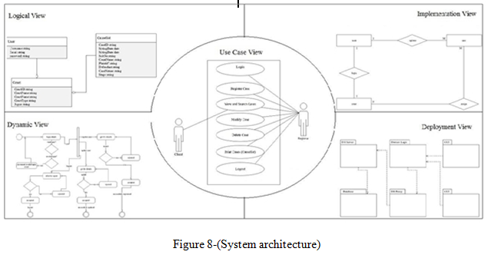
System ARCHITECTURE

Slide 14
System requirement
. Memory (RAM): Minimum 4 GB RAM
Storage (Hard Disk): Minimum 500 GB free space
CPU: Minimum 2 GHz multi-core processor
Network: Reliable internet connection with sufficient bandwidth.
SOFTWARE REQUIREMENTS
JAVASCRIPT
PHP
MYSQL
BOOTSTAP

Slide 15
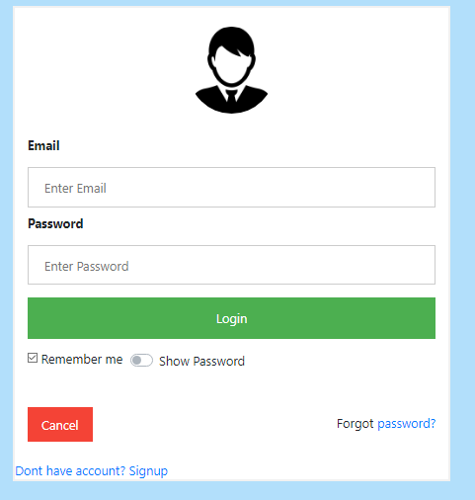
RESULTS
Showing login page

Slide 16
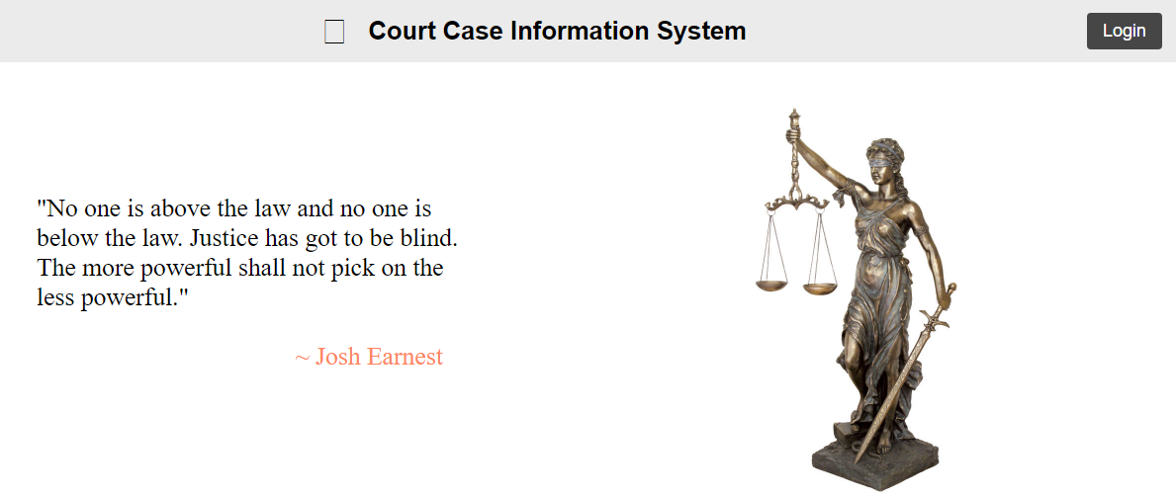
Index page

Slide 17
CONTRIBUTION TO KNOWLEDGE
Enhanced Personalization: Advances case management by automating processes for improved user experience.
Event Scheduling Innovation: Introduces features for optimizing case scheduling and deadlines.
Deep Learning Application: Applies deep neural networks (DNNs) to improve case recommendations and management accuracy.
Improved Case Outcomes: Aims to enhance efficiency and effectiveness through personalized management tools.

Slide 18
FUTURE WORK
integration with other systems: Integrate the web-based CMS with other business systems, such as accounting software or CRM systems.
Advanced reporting and analytics: Develop more advanced reporting and analytics capabilities to provide users with deeper insights into their cases
Artificial intelligence (AI): Explore the use of AI to automate tasks and improve decision-making.

Slide 19
CONCLUSION
WCMS can lead to a more efficient, collaborative, and secure way to manage cases. This can improve the quality of service provided to clients, stakeholders, or citizens, and ultimately lead to better outcomes. It's important to note that the specific expected results will vary depending on the organization's goals and the features of the WCMS

Slide 20
REFERENCE
Architects, I., 2023. The Seven Phases of the System-Development Life Cycle. [Online]
Available at: https://www.innovativearchitects.com/KnowledgeCenter/basic-IT-
systems/system-development-life-cycle.aspx
(Accessed 13 02 2023).
B., L., 2002. Courts of the future’ Law and Information Technology. p. 225-238.
Beal, V., 2022. Entity-Relationship Diagram (model). [Online]
Available at: http://www.webopedia.com/TERM/E/entity_relationship_diagram.html
(Accessed 10 May 2017).
Bockweg, J. M. G. a. G., 2012. Insights to Building a Successful E-Filing Case
Management Service: U.S.. International Journal For Court Administration, pp. 1-9.
Chrisphine, M. K., 2012. Mbugua_Electronic case management system.pdf. [Online]
Available at:
http://erepository.uonbi.ac.ke/xmlui/bitstream/handle/11295/10911/Mbugua_Electronic%

Slide 21


