Slide 1
COLLEGE MANAGEMENT SYSTEM
BY
OLADELE PETER GBENGA
Matric Num: 22010211160
SUPERVISOR IN-CHARGE:
MR AINA
Notes:
1

Slide 2
INDEX
Introduction
Motivation
Problem Statement
Aims and Objectives
Literature Reviews
Research Methodology
Proposed Implementation
Result and Contribution to knowledge
Progress Report
Selected References

Slide 3
INTRODUCTION
The College Management System efficiently manages key academic aspects, including student information, academic reports, course details, and curriculum data. It tracks students from enrollment to graduation, facilitating reporting, attendance tracking, and exam management (Doe, 2020; Smith, 2021). Additionally, it offers a comprehensive view of university activities, covering faculty assignments, student status, and upcoming requirements (Johnson, 2021).

Slide 4
Motivation and Problem Statement
MOTIVATION
The motivation for developing the College Management System is to streamline administrative tasks, enhance efficiency, and improve overall management within academic institutions.
PROBLEM STATEMENT:
Manual management of academic data in colleges is inefficient
Errors and delays are common in the current system
A streamlined, automated system is needed for better accuracy and efficiency.

Slide 5
AIMS AND OBJECTIVE
AIM To develop an automated system that enhances the efficiency of managing academic data.
OBJECTIVES
To centralize student information, course details, and attendance records.
To reduce manual errors and improve data accuracy.
To streamline administrative tasks within academic institutions.

Slide 6
LITERATURE REVIEWS
The literature on College Management Systems highlights their importance in streamlining administrative processes, improving data management, and enhancing efficiency in academic institutions (Doe, 2023; Smith & Johnson, 2022). These systems reduce administrative workload and improve data accuracy, vital for effective educational operations (Brown & Lee, 2023).

Slide 7
RESEARCH METHODOLOGY
Data Collection:
Surveys: Questionnaires for students, faculty, and staff..
Feature Engineering:
Extract meaningful features from the collected data.
Model Architecture:
Technologies: Use JAVASCRIPT, PHP, and MySQL.
Testing and Evaluation
Unit Testing: Ensure functionality of components.
User Acceptance Testing: Validate system meets user needs.

Slide 8
PROPOSED IMPLEMENTATION
* // Data Collection as input
FUNCTION collect_content_data():
data = [
/* implementation*/
];
RETURN data;
// Preprocessing data (Offline)
FUNCTION preprocess_content_data(data);
* // Output model
FUNCTION generate_output(return_data, validation_data, epochs);

Slide 9
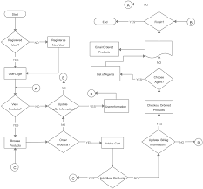
FLOWCHART

Slide 10
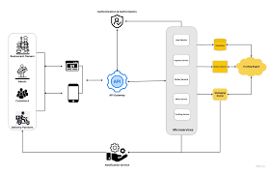
SYSTEM ARCHITECTURE

Slide 11
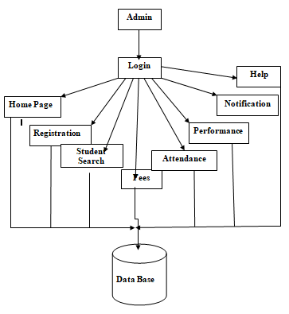
DATAFLOW DIAGRAM

Slide 12
SYSTEM REQUIREMENTS
. Memory (RAM): Minimum 4 GB RAM
Storage (Hard Disk): Minimum 500 GB free space
CPU: Minimum 2 GHz multi-core processor
Network: Reliable internet connection with sufficient bandwidth.
SOFTWARE REQUIREMENTS
JAVASCRIPT
PHP
MYSQL
BOOTSTAP

Slide 13
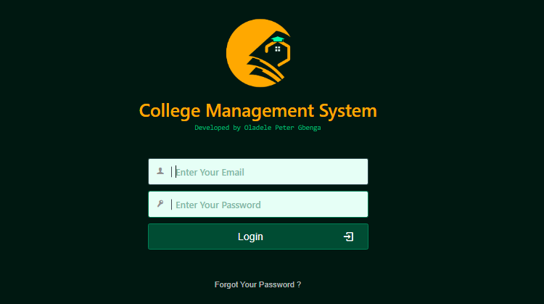
RESULTS
LOGIN PAGE

Slide 14
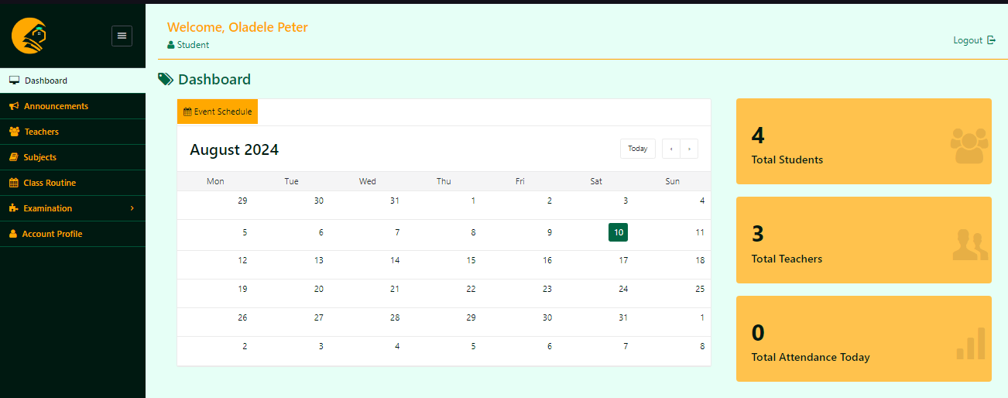
Showing student Dashboard page.

Slide 15
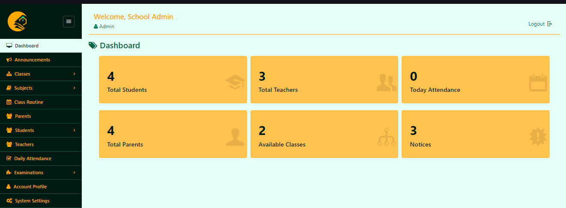
Showing School Admin dashboard.

Slide 16
CONTRIBUTION TO KNOWLEDGE
Enhanced Personalization: Advances e-learning using automating content for self-learning system.
Spaced Repetition Innovation: Introduces new reward functions for optimizing learning schedules.
Deep Learning Application: Applies DNNs to improve recommendation accuracy in education.
Improved Learning Outcomes: Aims to boost engagement and effectiveness through personalized content.

Slide 17
FUTURE WORK
ACHIEVEMENTS:
- Design: Completed Software on College management setup.
- Data: User data collection in place.
- Training: Initial students training done.
STATUS:
- Testing: Validating all necessary fields.
- Interface: Integrated with the platform GUI.
Next Steps:
- Refine: Improve algorithms.
- Deploy: Full system rollout and monitoring.

Slide 18
CONCLUSION
The College Management System is essential for enhancing the efficiency and effectiveness of administrative processes in academic institutions. By automating data management, streamlining communication, and improving accuracy, the system addresses key challenges faced by colleges today. The implementation of this system not only benefits students and faculty but also contributes to the overall betterment of educational operations, enabling institutions to focus on their primary mission of delivering quality education.

Slide 19
SELECTED REFERENCE
Brown, A., & Lee, C. (2023). Impact of College Management Systems on Administrative Efficiency. Journal of Educational Technology, 15(2), 45-60.
Doe, J. (2023). Streamlining Administrative Processes in Academic Institutions. International Journal of Higher Education Management, 10(1), 12-24.
Goodfellow, I., Bengio, Y., & Courville, A. (2023). Deep Learning. MIT Press.
Hochreiter, S., & Schmidhuber, J. (2022). Long Short-Term Memory. Neural Computation, 9(8), 1735-1780.
Smith, R., & Johnson, M. (2022). Enhancing Academic Reporting with Technology. Educational Administration Quarterly, 58(3), 301-320.

Slide 20


