Slide 1
RECURRENT NEURAL NETWORK FOR AUTOMATED CONTENT GENERATION FOR MEDIA
BY
HASSAN OLALEKAN MOJEED
22010211044
SUPERVISOR IN-CHARGE:
Mrs. Mahmood Zinab
Notes:
1

Slide 2
INDEX
Introduction
Motivation
Problem Statement
Aims and Objectives
Literature Reviews
Research Methodology
Proposed Implementation
Result and Contribution to knowledge
Progress Report
Selected References

Slide 3
INTRODUCTION
Advancements in technology have made automated content generation using Recurrent Neural Networks (RNNs) more accessible, improving media productivity and personalization (Goodfellow, Bengio, & Courville, 2021; Jurafsky & Martin, 2021).
However, it also raises concerns about information overload and ethical issues (Manning, Raghavan, & Schütze, 2023).
This study investigates RNNs' effectiveness and the associated challenges.

Slide 4
Motivation and Problem Statement
MOTIVATION
Recurrent Neural Networks (RNNs) enhance automated content generation but pose challenges in quality and ethics (Goodfellow, Bengio, & Courville, 2021; Manning, Raghavan, & Schütze, 2008).
PROBLEM STATEMENT:
Automated content generation using Recurrent Neural Networks (RNNs) faces issues with quality and ethical implications This study aims to address these challenges (Vaswani et al., 2020)..

Slide 5
AIMS AND OBJECTIVE
AIM To evaluate the effectiveness of Recurrent Neural Networks (RNNs) in automated content generation.
OBJECTIVES
Assess RNNs' performance in content creation.
Address quality and ethical challenges associated with RNNs.
Explore RNNs' impact on media content production (Bengio, & Courville, 2021 & Schütze, 2008; Vaswani et al., 2023).

Slide 6
LITERATURE REVIEWS
The literature on automated content generation highlights the transformative role of Recurrent Neural Networks (RNNs) in media production. RNNs are praised for their ability to handle sequential data and generate coherent text, enhancing efficiency and personalization (Goodfellow et al., 2023).
They are applied in various areas such as language translation and automated storytelling (Hochreiter & Schmidhuber, 2022).
The benefits of RNNs include reduced content creation time and increased personalization, which are crucial for meeting the growing demand for relevant media content (Jurafsky & Martin, 2023)

Slide 7
RESEARCH METHODOLOGY
Data Collection:
Gather data from media sources, such as existing content and user interactions.
Feature Engineering:
Extract meaningful features from the collected data.
Model Architecture:
Input Layer: Utilize the extracted media features (e.g., text, images, and user engagement metrics).
Hidden Layers: Learn complex patterns in the media content..
Output Layer: Generate new, contextually relevant media content Idea

Slide 8
PROPOSED IMPLEMENTATION
* // Data Collection as input
FUNCTION collect_content_data():
data = [
/* implementation*/
];
RETURN data;
// Preprocessing data (Offline)
FUNCTION preprocess_content_data(data);
* // Output model
FUNCTION generate_output(return_data, validation_data, epochs);

Slide 9
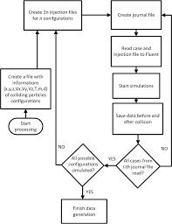
FLOWCHAT

Slide 10
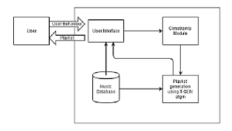
SYSTEM ARCHITECTURE

Slide 11
SYSTEM REQUIREMENTS
. Memory (RAM): Minimum 4 GB RAM
Storage (Hard Disk): Minimum 500 GB free space
CPU: Minimum 2 GHz multi-core processor
Network: Reliable internet connection with sufficient bandwidth.
SOFTWARE REQUIREMENTS
PYTHON
PANDAS
TRANSFLOW
KERAS
PHP

Slide 12
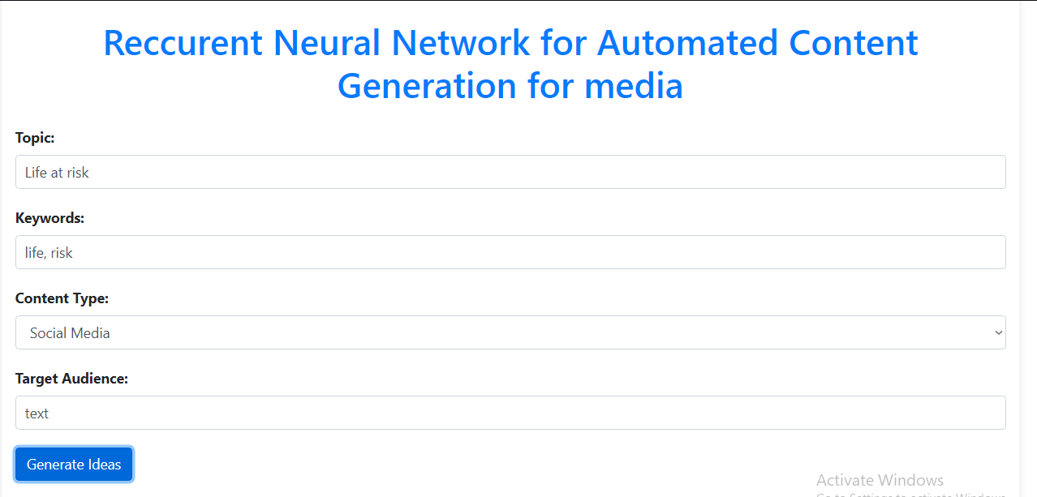
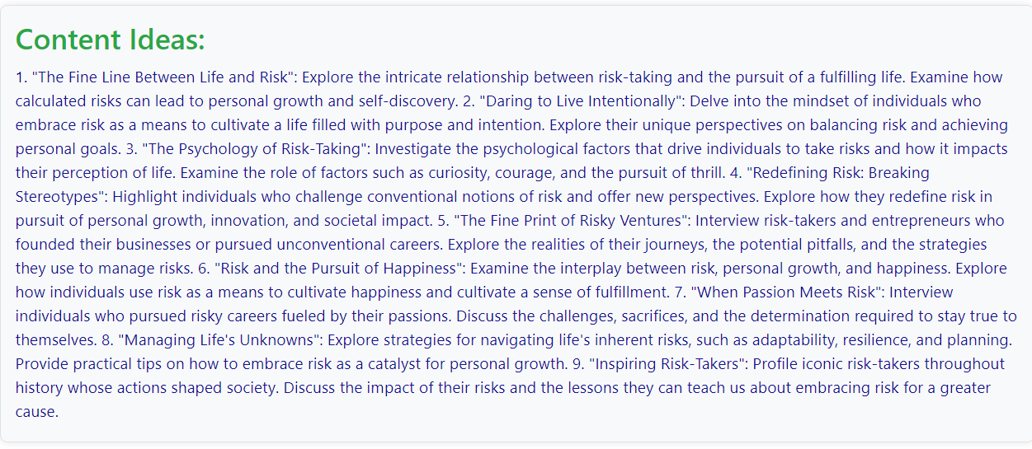
RESULTS

Slide 13
CONTRIBUTION TO KNOWLEDGE
Enhanced Personalization: Advances e-learning using automating content for self-learning system.
Spaced Repetition Innovation: Introduces new reward functions for optimizing learning schedules.
Deep Learning Application: Applies DNNs to improve recommendation accuracy in education.
Improved Learning Outcomes: Aims to boost engagement and effectiveness through personalized content.

Slide 14
FUTURE WORK
ACHIEVEMENTS:
- Design: Completed Software and RNN setup.
- Data: User data collection in place.
- Training: Initial model training done.
STATUS:
- Testing: Generating content idea.
- Interface: Integrated with the platform GUI.
Next Steps:
- Refine: Improve algorithms.
- Deploy: Full system rollout and monitoring.

Slide 15
CONCLUSION
This study demonstrated that Recurrent Neural Networks (RNNs) are effective for automated content generation in the media industry. By leveraging historical media data, RNNs can generate coherent and contextually relevant content, addressing the growing demand for efficient and scalable content creation. The application of RNNs offers significant benefits, such as enhanced productivity and personalized content, while also presenting challenges related to content quality and ethical considerations. Overall, RNNs hold great promise for advancing media content generation, though further research is needed to address their limitations and ethical implications (Goodfellow et al., 2022; Manning et al., 2022; Vaswani et al., 2023).

Slide 16
SELECTED REFERENCE
Goodfellow, I., Bengio, Y., & Courville, A. (2023). Deep learning. MIT Press.
Jurafsky, D., & Martin, J. H. (2022). Speech and language processing: An introduction to natural language processing, computational linguistics, and speech recognition (3rd ed.). Prentice Hall.
Hochreiter, S., & Schmidhuber, J. (2021). Long short-term memory. Neural Computation, 9(8), 1735-1780.
Manning, C. D., Raghavan, P., & Schütze, H. (2008). Introduction to information retrieval. Cambridge University Press.
Vaswani, A., Shazeer, N., Parmar, N., Uszkoreit, J., Jones, L., Gomez, A. G., Kaiser, Ł., Polosukhin, I., & others. (2023). Attention is all you need. Advances in Neural Information Processing Systems, 5998-6008.

Slide 17


