Slide 1
AN ENHANCE MODEL FOR CREDIT CARD FRAUD DETECTION IN BANKS
BY
AJIBOLA ISAAC OLUWASEGUN
MATRIC NUMBER: SUPERVISOR IN-CHARGE:
220102111045 MR. OYEKUNLE
Notes:
1

Slide 2
INDEX
Introduction
Motivation
Problem Statement
Aims and Objectives
Literature Reviews
Research Methodology
Proposed Implementation
Result and Contribution to knowledge
Progress Report
Selected References

Slide 3

INTRODUCTION
As credit card usage rises, security is crucial. In 2019, there were 2.8 billion global users, and U.S. fraud reports jumped 44.7% to 393,207 in 2020. Fraud types include identity theft to open new accounts (up 48%) and using existing accounts (up 9%) (Daly, 2023). These statistics drive my interest in using machine learning to detect fraud.

Slide 4
Motivation
This study addresses the rising threat of credit card fraud as digital payments increase, challenging banks to protect transactions and maintain consumer trust (Chen & Wang, 2023). Current fraud detection systems struggle with evolving tactics, leading to significant losses (Jackson & Green, 2020). The study proposes an enhanced model using advanced technologies to improve detection accuracy and efficiency.

Slide 5
Problem Statement
Credit card fraud remains a costly challenge for banks, with evolving tactics exploiting transaction vulnerabilities. Key issues include:
Regulatory Compliance: Strict regulations complicate the development and implementation of fraud detection systems.
Real-Time Detection: Existing systems struggle with timely transaction analysis, delaying fraud identification.
High False Positive Rates: Rule-based systems produce many false positives, straining resources.
Advanced Technology Integration: There's a need for machine learning and AI to enhance detection accuracy.

Slide 6
Aims and Objectives
To enhance credit card fraud detection methods using advanced technologies to protect financial transactions and customer information.
OBJECTIVES:
To analyze the limitations of current fraud detection systems.
To develop a machine learning-based model for real-time fraud detection.
To reduce false positive rates in fraud detection processes.

Slide 7
Literature Reviews
Credit card fraud is a major threat, with sophisticated tactics like account takeover often evading traditional detection systems (Chen & Wang, 2023). Current rule-based methods struggle with real-time analysis and high false positive rates (Jackson & Green, 2020). Research emphasizes the need for machine learning and AI to improve detection accuracy and ensure regulatory compliance (Zhang et al., 2021; Westerlund, 2019). Enhanced fraud detection methods leveraging advanced technologies are urgently needed.

Slide 8
METHODOLOGY
These include:
Data Collection: Gather a dataset of credit card transactions.
Data Preprocessing: Clean and encode the data.
Feature Selection: Identify relevant features.
Model Development: Implement algorithms (e.g., Random Forest) and split the dataset.
Model Training: Train models and optimize hyperparameters.
Performance Evaluation: Assess using accuracy, precision, recall, and F1-score.
Real-Time Detection: Test fraud detection in real-time.
Compliance Assessment: Ensure regulatory compliance.
Validation: Validate the model against existing systems.

Slide 9
Proposed Implementation
* // Data Collection as input
FUNCTION collect_content_data():
data = [
/* implementation*/
];
RETURN data;
// Preprocessing data (Offline)
FUNCTION preprocess_content_data(data);
* // Output model
FUNCTION generate_output(return_data, validation_data, epochs);
Processing Logic

Slide 10
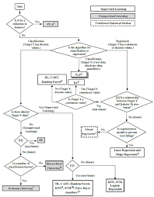
Flowchart

Slide 11
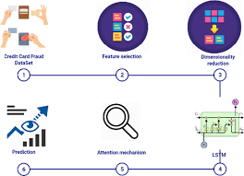
System architecture

Slide 12
SYSTEM REQUIREMENTS
. Memory (RAM): Minimum 4 GB RAM
Storage (Hard Disk): Minimum 500 GB free space
CPU: Minimum 2 GHz multi-core processor
Network: Reliable internet connection with sufficient bandwidth.
SOFTWARE REQUIREMENTS
REACTJS
TYPESCRIPT
PHP
PYTHON
BOOSTRAP

Slide 13

RESULT
Showing sign-in page

Slide 14
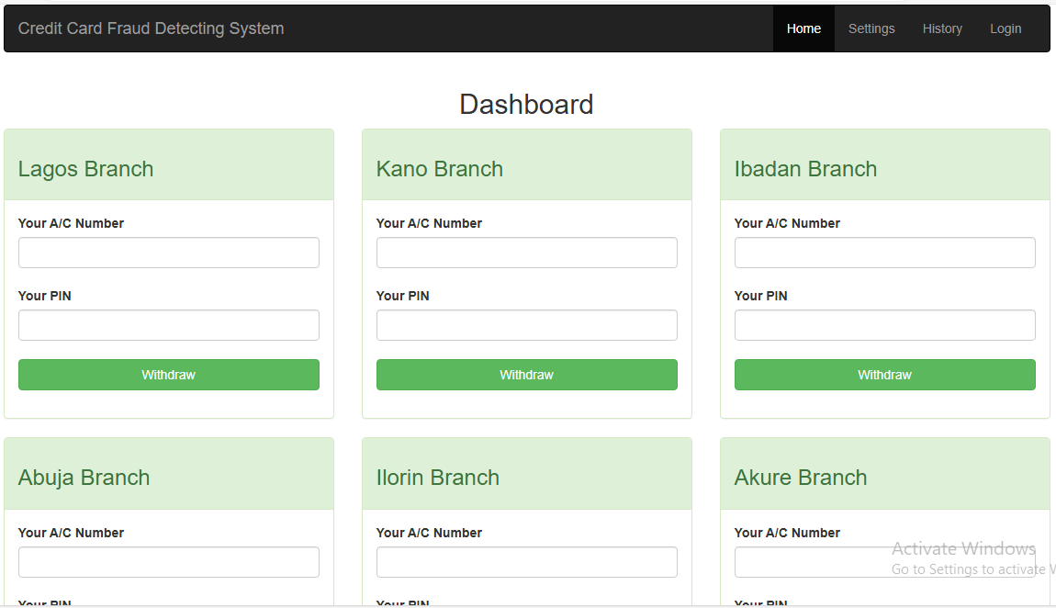
Result
Showing Index page

Slide 15
CONTRIBUTION TO KNOWLEDGE
This study contributes to the existing body of knowledge in several ways:
Advancement of Fraud Detection Techniques:
It introduces an enhanced machine learning model for credit card fraud detection, addressing the limitations of traditional rule-based systems.
Integration of Advanced Technologies:
The research demonstrates the effectiveness of integrating machine learning and AI in real-time fraud detection, providing a framework for future implementations in the financial sector.
Real-Time Processing Insights:
It offers insights into the challenges and solutions for real-time transaction monitoring, contributing to improved operational practices in financial institutions.

Slide 16
RELATED WORKS
The field of credit card fraud detection has evolved significantly, focusing on advanced methodologies to combat sophisticated fraud:
Traditional Rule-Based Systems: Early methods used predefined rules to identify fraud but struggled with complex patterns and had high false positive rates (Dua et al., 2022).
Ensemble Methods: Ensemble methods like Random Forest and Gradient Boosting combine multiple models for improved accuracy in detecting fraud (Xia et al., 2023).

Slide 17
FUTURE WORK
Continued development of new features based on:
1. Develop hybrid models that combine various detection techniques for improved robustness and accuracy.
2. Create real-time detection systems that can be deployed on resource-constrained devices.

Slide 18
CONCLUSION
This study presents an enhanced machine learning model for credit card fraud detection, addressing the inadequacies of traditional systems against sophisticated tactics. By integrating machine learning and identifying key features, the model aims to improve detection accuracy and reduce false positives, ultimately restoring consumer trust. Future research should focus on continuous model enhancements and exploring new technologies to combat evolving fraud patterns.

Slide 19
REFERENCE
Bhasin, M., & Kumari, A. (2020). A survey of credit card fraud detection techniques. International Journal of Computer Applications, 975, 1-6.
Chen, L., & Wang, Q. (2023). Machine learning methods for credit card fraud detection: A review. Journal of Financial Services Research, 63(2), 129-147.
Daly, C. (2023). Credit card fraud statistics: Trends and analysis. Fraud Magazine.
Dua, A., Gupta, S., & Shukla, A. (2019). A comprehensive review of credit card fraud detection methods. Journal of Computer Sciences and Applications, 7(1), 1-11..

Slide 20


