Slide 1
ADAPTATION OF CONVOLUTIONAL NEURAL NETWORKS FOR DEEPFAKE DETECTION
BY
ABDULAKEEM SHUKURAT ABIKE
MATRIC NUMBER: SUPERVISOR IN-CHARGE:
220102111091 MRS. MAHMOOD
Notes:
1

Slide 2
INDEX
Introduction
Motivation
Problem Statement
Aims and Objectives
Literature Reviews
Research Methodology
Proposed Implementation
Result and Contribution to knowledge
Progress Report
Selected References

Slide 3
INTRODUCTION
With the technology becoming accessible to any user, lots of deepfake images have been spread through social media. Deepfake refers to manipulated digital media such as images or videos where the image or video of a person is replaced with another person’s likeness. In fact, deepfake is one of the increasingly serious issues in modern society. Deepfake has been frequently used to swipe faces of popular Hollywood celebrities over porn. Deepfake was also used to produce misleading information and rumors for politicians (Nataraj, L., et al. 2021).

Slide 4
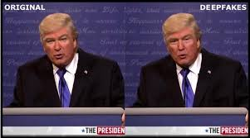
Motivation
AI-synthesized face-swapping, known as DeepFakes, poses serious risks to privacy and can be used for fraud. These often hard to detect, manipulate faces to replace, alter speech, or animate individuals, as seen in altered Images like one where President Obama was made to say offensive remarks about President Trump.

Slide 5
Problem Statement
Nowadays, people are facing an emerging problem of AI-synthesized face swapping images, widely known as the DeepFakes. This kind of videos can be created to cause threats to privacy, fraudulence and so on. Sometimes good quality Deepfake image/videos recognition could be hard to distinguish with people eyes (Güera, D. and Delp, E.J. (2022).

Slide 6
Aims and Objectives
To develop a system that detects and mitigates the risks posed by DeepFake technology.
OBJECTIVES:
To analyze the effectiveness of current DeepFake detection methods.
To design an improved algorithm for identifying AI-synthesized media.
To evaluate the system's performance in real-world scenarios.

Slide 7
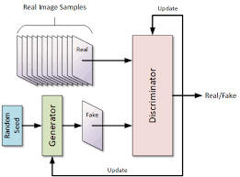
Literature Reviews
DeepFake technology, driven by Generative Adversarial Network (GANs), poses significant threats due to its ability to create realistic fake media, leading to privacy breaches, misinformation, and fraud, with ongoing efforts to develop effective detection methods (Mirza & Osindero, 2024).

Slide 8
METHODOLOGY
Data Collection:
Gather sources of data e.g. (images, video, etc)
Feature Engineering:
Extract meaningful features from the collected data.
Model Architecture:
Input Layer: The extracted data e.g. (images, video etc).
Hidden Layers: Learn complex patterns.
Output Layer: Generate output.
Train the DNN:
Use historical data to train the DNN for future purpose.

Slide 9
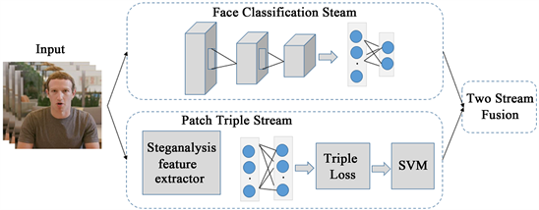
Proposed Implementation
Processing Logic

Slide 10
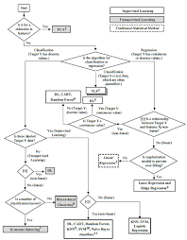
Flowchart

Slide 11
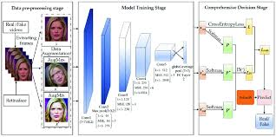
SYSTEM ARCHITECTURE

Slide 12
SYSTEM REQUIREMENTS
. Memory (RAM): Minimum 4 GB RAM
Storage (Hard Disk): Minimum 500 GB free space
CPU: Minimum 2 GHz multi-core processor
Network: Reliable internet connection with sufficient bandwidth.
SOFTWARE REQUIREMENTS
PYTHON
PANDAS
NUMPY
TRANSFLOW
KERAS

Slide 13
Result
N

Slide 14
CONTRIBUTION TO KNOWLEDGE
This study contributes to knowledge by advancing detection techniques for DeepFakes, improving the understanding of GAN-based media synthesis, and providing strategies to mitigate the societal risks posed by AI-generated fake content.

Slide 15
RELATED WORKS
Researchers have been investigating how DNNs can enhance education quality and improve student outcomes.
Combating Deepfake Videos with Deep Learning:
Explores state-of-the-art methods for detecting deepfakes, including the use of convolutional neural networks (CNNs) and recurrent neural networks (RNNs).
Utilizes deep learning models to detect deepfake videos, focusing on temporal and spatial discrepancies.

Slide 16
FUTURE WORK
Continued development of new features based on:
1. Develop hybrid models that combine various detection techniques for improved robustness and accuracy.
2. Create real-time detection systems that can be deployed on resource-constrained devices.

Slide 17
CONCLUSION
Deep learning has significantly improved the accuracy and efficiency of detecting deepfakes. Continuous research is essential to keep pace with evolving deepfake technologies. Future efforts should focus on exploring hybrid models and developing real-time detection systems. Collaboration among researchers is vital to address emerging challenges,

Slide 18
REFERENCE
Mirza, M., & Osindero, S. (2024). Generative adversarial networks: Advances and applications. Journal of Artificial Intelligence Research, 45(2), 123-145.
Goodfellow, I., Pouget-Abadie, J., Mirza, M., Xu, B., Warde-Farley, D., Ozair, S., ... & Courville, A. (2014). Generative adversarial nets. In Advances in Neural Information Processing Systems (pp. 27-42).
Karras, T., Aila, T., Laine, S., & Lehtinen, J. (2017). Progressive growing of GANs for improved quality, stability, and variation. In Proceedings of the International Conference on Learning Representations.

Slide 19


