Slide 1

An Online Bookstore with Payment Integration Management System: (A Case Study of GAPOSA Bookstore)
PRESENTS
BY
ADEWOLE IFEOLUWA SEGUN
MATRIC NUMBER: SUPERVISOR IN-CHARGE:
22010211253 MR. ONI
Notes:
1

Slide 2
INDEX
Introduction
Motivation
Problem Statement
Aims and Objectives
Literature Reviews
Research Methodology
Proposed Implementation
Result and Contribution to knowledge
Progress Report
Selected References

Slide 3

INTRODUCTION
Traditional bookstores face several challenges. their customer e.g. Reader, Student etc. is limited by their physical location, making it difficult to expand their audience. Managing a diverse inventory can be complex, requiring careful consideration of storage space and customer demand. Additionally, online retail giants often pose a significant threat, offering a wider selection of books and potentially lower prices.

Slide 4
MOTIVATION
The motivation for developing "An Online Bookstore with Payment Integration Management System" arises from the increasing demand for convenient online book shopping. This project aims to enhance the GAPOSA Bookstore experience by providing a user-friendly platform with secure payment options and efficient order management, streamlining operations, and boosting sales in a competitive market.

Slide 5
PROBLEM STATEMENT
The existing system of operation and method of transaction in the schools bookshop has been haunted by the following problems;
Poor arrangement of books in the shop
Dirty and stuffy hall
Time wastage in searching for desired books
Time wastage in attending to students
Conflicting, confusing and inadequate record keeping of daily transactions
Wrong location of the bookshop.

Slide 6
AIMS AND OBJECTIVE
To create a comprehensive online bookstore platform for GAPOSA Bookstore with integrated payment management.
OBJECTIVE
To develop a user-friendly interface for easy navigation and book selection.
To implement secure payment processing options for customer transactions.
To streamline order management and inventory tracking.
To enhance customer experience through personalized recommendations and efficient service.

Slide 7
LITERATURE REVIEW
At GAPOSA, book orders are managed by the Head of Class (HOC), with lecturers estimating required quantities based on student enrollment. Mismatches between estimated and actual student numbers can lead to complications, such as excess orders that must be returned and delays in obtaining necessary books for classes.
Conventional ordering methods are prone to issues, including lost information. Vendors offering online databases allow lecturers to search for books by title, author, or ISBN, facilitating easier online transactions.

Slide 8
RESEARCH METHODOLOGY
This research uses observations and interviews with the bookshop chairman and students to assess the current book ordering system, revealing the need for a multi-channel approach to e-service quality (Burt & Sparks, 2023).
Performance and Competency Assessment: Offers direct feedback on individual and team performance as well as customer service skills.
Leadership Development: Utilizes questionnaires for cost-effective feedback on leadership effectiveness.
Quick Processing and Cost-Effectiveness: Allows for rapid processing of assessments, leading to reduced administrative costs.

Slide 9
PROPOSED IMPLIMENTATION
The proposed implementation of the Online Bookstore with Payment Integration Management System includes the following key steps:
System Design and Development: Create a user-friendly interface that allows easy navigation for customers. The system will feature secure payment options and efficient order management.
Database Integration: Develop a robust database to manage book inventory, customer information, and transaction records. This ensures real-time updates and accurate tracking of orders.
Payment Integration: Implement secure payment gateways to facilitate various payment methods, ensuring customer data protection and transaction security.
User Testing: Conduct user testing with students and lecturers to gather feedback on system functionality, usability, and overall experience. This will help identify any necessary adjustments.
Training and Support: Provide training sessions for staff and users on how to navigate the system effectively. Ongoing technical support will be available to.

Slide 10
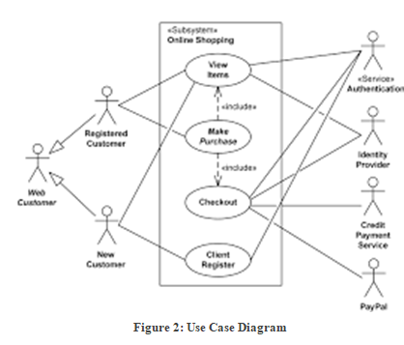
UML DIAGRAME

Slide 11
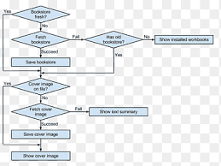
FLOWCHAT

Slide 12
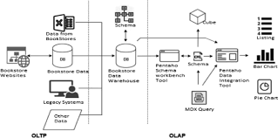
SYSTEM ARCHITECTURE

Slide 13
SYSTEM REQUIREMENTS
. Memory (RAM): Minimum 4 GB RAM
Storage (Hard Disk): Minimum 500 GB free space
CPU: Minimum 2 GHz multi-core processor
Network: Reliable internet connection with sufficient bandwidth.
SOFTWARE REQUIREMENTS
HTML
CSS
JAVASCRIPT
PHP and MySQL

Slide 14
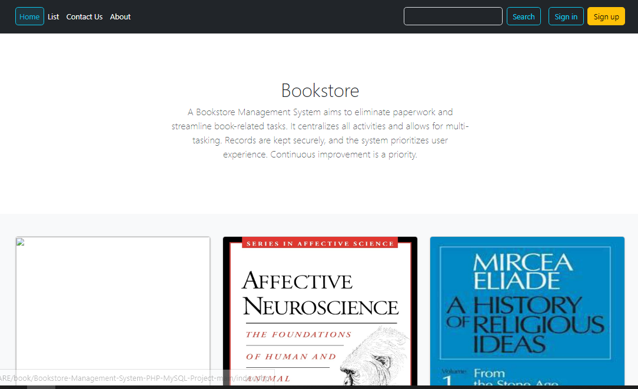
EXPECTED RESULTS

Slide 15
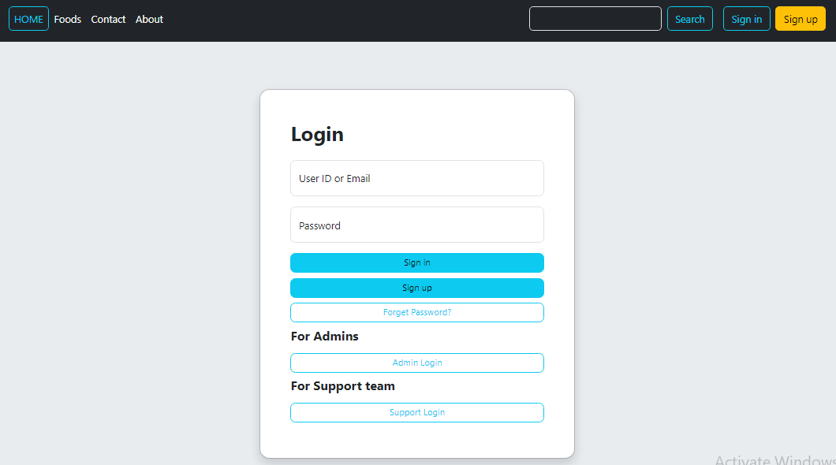
LOGIN PAGE

Slide 16
CONTRIBUTION TO KNOWLEDGE
The Online Bookstore with Payment Integration Management System contributes by:
Enhancing E-Commerce Practices: Showcases payment integration in education.
Improving Efficiency: Streamlines book ordering processes.
User Insights: Provides data on online shopping preferences.
Implementation Model: Serves as a guide for similar systems.
Multi-Channel Retailing: Highlights online and offline integration.

Slide 17
RELATED WORKS
A Secure E-commerce Platform for Online" by S.R. Roy, S. Das, and A. K. Pal (2020)
How Jumia Increased Online Sales by 70% with Improved Payment Integration
How Amazon Increased Online Sales by 80% with Improved Payment Integration

Slide 18
FUTURE WORK
Personalized Recommendations: Implement a recommendation engine that suggests books based on a customer's purchase history and browsing behavior.
Web App Development: Develop a responsive web application to allow customers to browse, purchase, and manage their orders on the go.
Loyalty Programs: Develop a loyalty program to reward repeat customers with discounts, exclusive offers, and early access to new releases.

Slide 19
CONCLUSION
Gaposa Bookstore's successful case study demonstrates the transformative power of payment integration for traditional bookstores. Their user-friendly online store, paired with a secure and reliable payment system, empowered them to expand their reach and compete effectively in the digital age. By embracing e-commerce and prioritizing customer convenience and security.

Slide 20
REFERENCE
Blaha, M., and Rambaugh, J (2022), Object Oriented Modelling And Design with UML, Second Edition, USA: Prentice Hall International Inc. Beenet, S., McRobb, S., and Farmer, R. (2021). Object-Oriented Systems
Analysis and design Using UML (4th ed). USA: McGraw Hill. Booch, G., Rumbaugh, J. & Jaobson, I. (2021). The Unified Modelling Language User Guide. Boston: Addison-Wesley.
Burt, S. and Sparks, L. (2021), “E-commerce and the retail process: a review”, Journal of Retailing and Consumer Services, Vol. 10, pp. 275-86.
Dennis, C., Harris, L. and Sandhu, B. (2021), “From bricks to clicks: understanding the econsumer”, Qualitative Market Research: An International Journal,

Slide 21


