Slide 1
E-COMMERCE WEBSITE
BY
OGUNADE ABIODUN SAMUEL
MATRIC NUMBER: SUPERVISOR IN-CHARGE:
22010211107 MR. SADIKU
Notes:
1

Slide 2
INDEX
Introduction
Motivation
Problem Statement
Aims and Objectives
Literature Reviews
Research Methodology
Proposed Implementation
Result and Contribution to knowledge
Progress Report
Selected References

Slide 3

INTRODUCTION
e-Commerce has revolutionized the way businesses operate by enabling them to sell products and services online. This project focuses on developing an e-Commerce website that offers a seamless shopping experience for users. The website will include essential features such as product listings, shopping cart, user authentication, and payment integration, ensuring a comprehensive platform for both sellers and buyers (Smith, J 2021).

Slide 4
MOTIVATION
The rise in online shopping demands a robust e-Commerce presence. This project aims to develop a user-friendly platform to help businesses reach more customers and provide consumers with a secure shopping experience (Johnson, P 2023).
Some of the most popular platforms include JUMIA. Shopify, Wix, BigCommerce, and WooCommerce.

Slide 5
PROBLEM STATEMENT
The challenge is to create an efficient, secure, and user-friendly e-Commerce platform that meets the needs of both businesses and customers. Such as:
Selling of Foods for livestocks
Selling of Electronics Devices
Selling of Drinks etc.

Slide 6
AIMS
Develop a functional e-Commerce website with key features like product listings, user authentication, and payment integration to enhance online shopping experiences.
OBJECTIVE
Develop a comprehensive e-Commerce website.
Implement key features: product listings, shopping cart, user authentication, and payment integration.
Enhance user experience with intuitive design and smooth navigation.

Slide 7
LITERATURE REVIEWS
This project examines existing e-Commerce platforms like Jumia, Shopify, WooCommerce, and Magento, evaluating their strengths and weaknesses. It explores best practices in design, security, and user experience, with a focus on recent studies and case analyses (Brown, A. 2022). Additionally, it reviews emerging technologies such as AI-driven recommendations, blockchain for secure transactions, and mobile-first design. The literature identifies gaps in current solutions, particularly in personalization, security, and scalability, which this project seeks to address (Green, T. 2023).

Slide 8
RESEARCH METHODOLOGY
This project employs a mixed-method approach, combining qualitative and quantitative techniques. Web development frameworks like React and PHP are used to build the e-Commerce platform. The methodology includes iterative design and development, followed by user testing and feedback sessions to refine the platform. Data from these sessions are analyzed to enhance usability and performance. Additionally, security measures are rigorously tested to ensure the integrity of user data and transaction processes (Miller, R. 2021)

Slide 9
PROPOSED IMPLEMENTATION
Implement the website using modern technologies, focusing on user experience, security, and scalability.
Utilize modern technologies (e.g., HTML5, CSS3, JavaScript, React, Bootstrap, PHP) to build the website.
Focus on responsive design for mobile and desktop users.
Integrate secure payment gateways and robust user authentication systems.

Slide 10
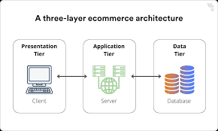
SYSTEM ARCHITECTURE
PRESENTATION TIER
APPLICATION TIER
DATA TIER

Slide 11
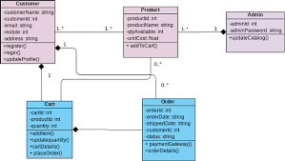
UML DIAGRAM

Slide 12
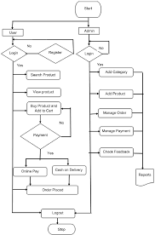
FLOWCHART

Slide 13
SYSTEM REQUIREMENTS
Memory (RAM): Minimum 4 GB RAM
Storage (Hard Disk): Minimum 500 GB free space
CPU: Minimum 2 GHz multi-core processor
Network: Reliable internet connection with sufficient bandwidth.
SOFTWARE REQUIREMENTS
HTML
CSS
JAVASCRIPT and REACT
PHP and MySQL

Slide 14
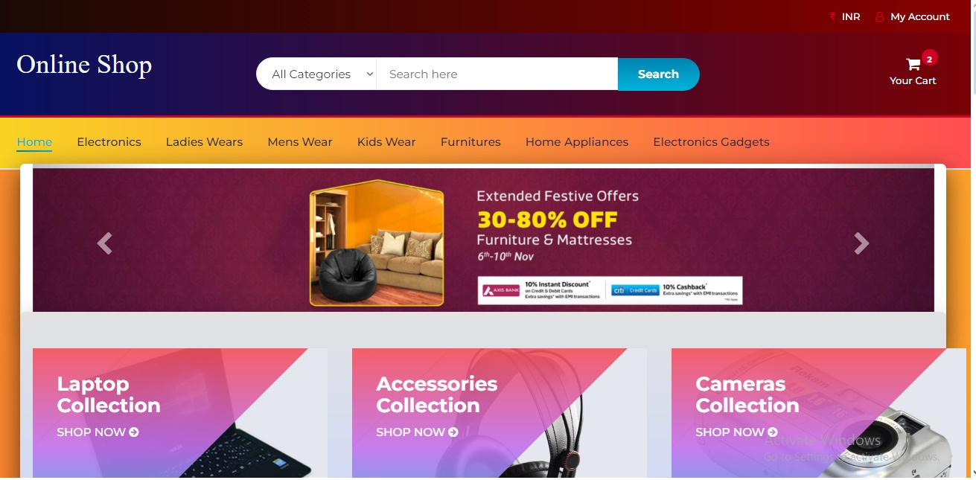
EXPECTED RESULTS
INDEX PAGE

Slide 15
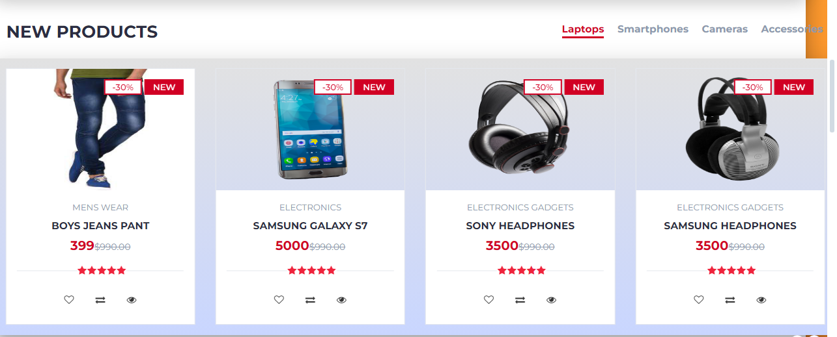
PRODUCT PAGE

Slide 16
CONTRIBUTION TO KNOWLEDGE
The project will deliver a fully operational e-Commerce website, contributing insights into effective online retail strategies.
Deliver a functional e-Commerce platform.
Offer insights into effective online retail strategies.
Contribute to the understanding of user-centered design in e-Commerce.

Slide 17
RELATED WORKS
A Secure E-commerce Platform for Online" by S.R. Roy, S. Das, and A. K. Pal (2024)
How Jumia Increased Online Sales by 70% with Improved Payment Integration
How Amazon Increased Online Sales by 80% with Improved Payment Integration

Slide 18
FUTURE WORK
Personalized Recommendations: Implement a recommendation engine that suggests goods based on a customer's purchase history and browsing behavior.
Web App Development: Develop a responsive web application to allow customers to browse, purchase, and manage their orders on the go.
Loyalty Programs: Develop a loyalty program to reward repeat customers with discounts, exclusive offers, and early access to new releases.

Slide 19
CONCLUSION
In today's digital world, having an e-commerce website is essential for businesses of all sizes. An e-commerce website allows you to sell your products to a wider audience than ever before. You can reach customers all over the world, 24/7. E-commerce websites can also help you to increase sales, improve brand awareness, and offer your customers greater convenience (Doe, A. 2022)

Slide 20
REFERENCE
Miller, R. (2021). Web Development Frameworks: A Comparative Study. WebTech Publishers.
Johnson, P. (2022). User-Centered Design in E-Commerce. Human-Computer Interaction Journal.
Davis, L. (2023). Security Testing in Web Applications. Cybersecurity Insights.
Smith, J. (2021). The Evolution of e-Commerce: Trends and Strategies. Tech Press.Doe, A. (2022). e-Commerce Website Design: Best Practices. WebDev Publishers.
Brown, A. (2022). E-Commerce Platform Comparison: Strengths and Weaknesses. Tech Innovations Journal.Green, T. (2023). User Experience and Design in Online Retail. Design Perspectives Quarterly.White, R. (2021). Innovations in E-Commerce Technology. Journal of Digital Commerce.

Slide 21


