Slide 1

AN ONLINE FOOD ORDERING AND DELIVERY SYSTEM
(A CASE STUDY OF RIKI-MART. FOOD STORE)
BY
OWOLANA TOLUWALOPE
BAMIDELE
MATRIC NUMBER: SUPERVISOR IN-CHARGE:
22010211113 MR. OYEKUNLE
Notes:
1

Slide 2
INDEX
Introduction
Motivation
Problem Statement
Aims and Objectives
Literature Reviews
Research Methodology
Proposed Implementation
Result and Contribution to knowledge
Progress Report
Selected References

Slide 3
INTRODUCTION
Advancements in technology have transformed the food service sector, with online ordering systems revolutionizing customer experiences and operational efficiency. Mukherjee & Nath (2023).
RIKI Mart, a leading food service provider in Saapade, Ogun State, aims to enhance customer convenience through online food ordering.
This presentation introduces our prototype model, designed to simplify ordering processes and elevate customer satisfaction.

Slide 4
MOTIVATION
The motivation for developing "An Online food store with Payment Integration Management System" arises from the increasing demand for convenient online book shopping. This project aims to enhance the GAPOSA Bookstore experience by providing a user-friendly platform with secure payment options and efficient order management, streamlining operations, and boosting sales in a competitive market.

Slide 5
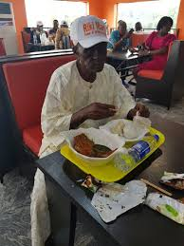
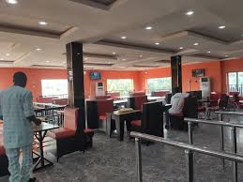
Problem Statement
RIKI Mart's traditional food ordering and delivery processes are manual and inefficient, leading to time delays and errors. Centralized systems still rely on manual inputs, resulting in higher operational costs and lower customer satisfaction (Jones, Comfort, & Hillier, 2021; Mukherjee & Nath, 2021). Therefore, there is a need for an automated online food ordering and delivery system to streamline operations and improve the customer experience.

Slide 6
Aims
To develop an automated online food ordering and delivery system for RIKI Mart that enhances operational efficiency and improves customer satisfaction.
OBJECTIVES
Analyze Current Processes: Evaluate the existing food ordering and delivery methods at RIKI Mart to identify inefficiencies and areas for improvement.
Design a Prototype: Create a user-friendly prototype of the online food ordering system that facilitates easy navigation for customers and staff.
Implement Automation: Integrate automated features that minimize manual input, thereby reducing the likelihood of errors and delays in order processing.

Slide 7
Literature review
RIKI Mart, located in Remo North local government, Ogun State, is a prominent food service provider serving a diverse clientele. Traditionally, the local way of ordering food relies on manual processes, which can lead to inefficiencies. To improve efficiency and customer satisfaction, RIKI Mart has initiated the development of a prototype online food ordering and delivery system.

Slide 8
RESEARCH METHODOLOGY
This research utilizes observations and interviews with RIKI Mart management and customers to evaluate the current food ordering system, highlighting the need for an automated online ordering solution (Burt & Sparks, 2023).
Performance and Efficiency Evaluation: Provides direct feedback on the efficiency of the current manual ordering processes and identifies areas for improvement in service delivery.
User Experience Development: Employs surveys and questionnaires to gather cost-effective feedback from users on their experiences and expectations regarding the online food ordering system.
Streamlined Implementation and Cost Efficiency: Facilitates the rapid development and deployment of the online system, leading to reduced operational costs and enhanced service quality.

Slide 9
Proposed Implementation
The proposed implementation of the Online Food Ordering and Delivery System for RIKI Mart includes the following key steps:
System Design and Development: Create a user-friendly interface that enables easy navigation for customers. The system will incorporate secure payment options and efficient order management features.
Database Integration: Develop a robust database to manage food inventory, customer information, and transaction records. This integration will ensure real-time updates and accurate tracking of orders.
Payment Integration: Implement secure payment gateways to support various payment methods, ensuring the protection of customer data and transaction security.
User Testing: Conduct user testing with customers and staff to gather feedback on system functionality, usability, and overall experience. This process will help identify any necessary adjustments.
Training and Support: Provide training sessions for staff and users on navigating the system effectively. Ongoing technical support will be available to address any issues that arise.

Slide 10
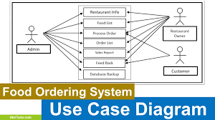
UML Diagrams
Use Case Diagram: This diagram shows the cases (entities) in the system and their relationships.

Slide 11
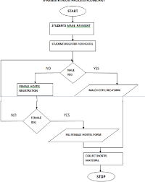
FLOWCHART

Slide 12
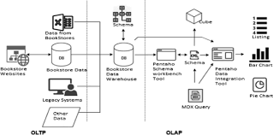
SYSTEM ARCHITECTURE

Slide 13
SYSTEM REQUIREMENTS
. Memory (RAM): Minimum 4 GB RAM
Storage (Hard Disk): Minimum 500 GB free space
CPU: Minimum 2 GHz multi-core processor
Network: Reliable internet connection with sufficient bandwidth.
HTML
CSS
JAVASCRIPT
JQUERY
PHP
MYSQL
SOFTWARE REQUIREMENTS

Slide 14
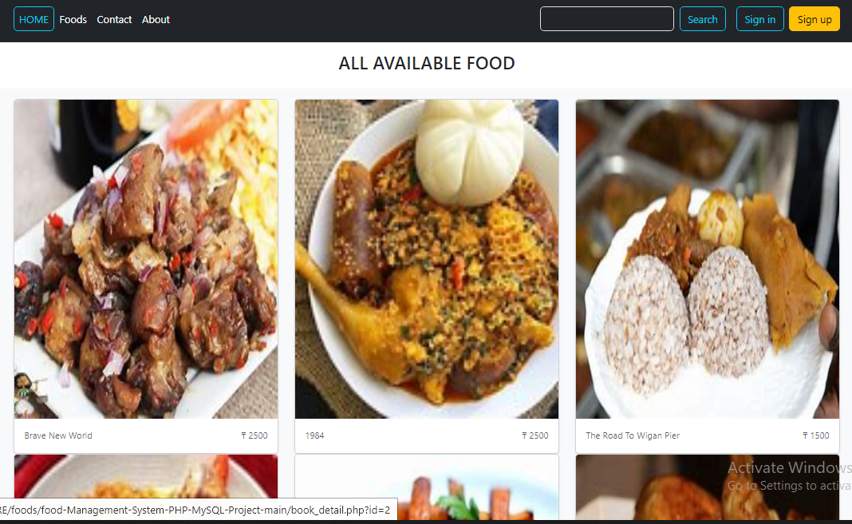
RESULTS

Slide 15
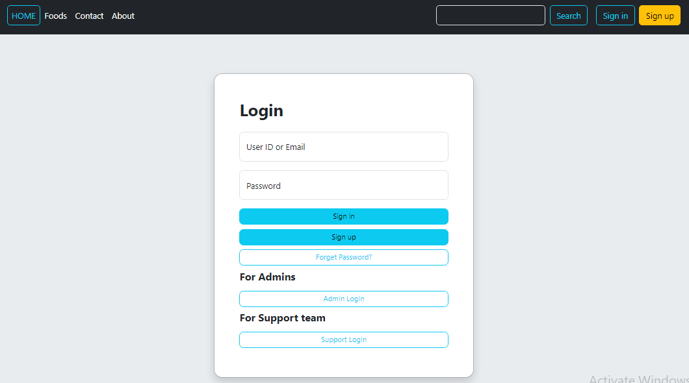
Login page

Slide 16
CONTRIBUTION TO KNOWLEDGE
The Online Food Ordering and Delivery System contributes by:
Enhancing E-Commerce Practices: Showcases add to cart and payment integration.
Improving Efficiency: Streamlines food ordering processes.4
User Insights: Provides data on online shopping preferences.
Implementation Model: Serves as a guide for similar systems.
Multi-Channel Retailing: Highlights online and offline integration.

Slide 17
RELATED WORKS
Industry Trends: Review of current trends in online food ordering and delivery systems.
A Secure E-commerce Platform for Online" by S.R. Roy, S. Das, and A. K. Pal (2023)
Operational Models: Analysis of different operational models for managing online orders and deliveries.
Security Measures: Research on secure payment methods and data protection in e-commerce.

Slide 18
FUTURE WORK
Personalized Recommendations: Implement a recommendation engine that suggests food based on a customer's purchase history and browsing behavior.
Web App Development: Develop a responsive web application to allow customers to browse, purchase, and manage their orders on the go.
Loyalty Programs: Develop a loyalty program to reward repeat customers with discounts, exclusive offers, and early access to new releases.

Slide 19
CONCLUSION
The adoption of online food ordering and delivery systems by Riki Mart marks a significant step towards modernizing its operations and enhancing customer satisfaction. This initiative is expected to bring numerous benefits, including improved convenience, operational efficiency, cost savings, and increased sales. By leveraging data insights and technological advancements, Riki Mart will continue to maintain a competitive edge and drive future growth. The company's commitment to providing an exceptional online ordering experience will ensure it meets evolving customer needs and stays ahead in the food service industry.

Slide 20
REFERENCE
Boyer, K. K., Hallowell, R., & Roth, A. V. (2020). E-services: Operating strategy—a case study and a method for analyzing operational benefits. Journal of Operations Management, 20(2), 175-188. Jones, P., Comfort, D., & Hillier, D. (2021). E-retailing: The last mile. International Journal of Retail & Distribution Management. Kimes, S. E. (2021). Customer perceptions of electronic food ordering. Cornell Hospitality Report, 11(2), 6-15. Lee, Z., Han, H., & Lockee, B. (2023). E-learning and blended learning in the delivery of health services: A systematic review. Studies in Health Technology and Informatics, 113, 201-223. Mukherjee, A., & Nath, P\Security and privacy in

Slide 21


