Slide 1
HOTEL MANAGEMENT SYSTEM
BY
AYOBAMI ELIJAH
Matric Num: 22010211182
SUPERVISOR IN-CHARGE:
MR OYEKULE
Notes:
1

Slide 2
INDEX
Introduction
Motivation
Problem Statement
Aims and Objectives
Literature Reviews
Research Methodology
Proposed Implementation
Result and Contribution to knowledge
Progress Report
Selected References

Slide 3
INTRODUCTION
The Hotel Management System effectively oversees essential operational aspects, including guest information, reservation details, room availability, and billing data. It tracks guests from check-in to check-out, facilitating reporting, occupancy management, and service coordination (Doe, 2020; Smith, 2021). Additionally, it provides a comprehensive overview of hotel activities, covering staff assignments, guest status, and upcoming events (Johnson, 2021).

Slide 4
Motivation and Problem Statement
MOTIVATION
The motivation for developing the Hotel Management System is to streamline operational tasks, enhance efficiency, and improve overall management within hospitality establishments.
PROBLEM STATEMENT:
Inefficiency: Manual processes lead to slow operations in managing reservations and guest information.
Errors: Human errors in booking and billing can result in customer dissatisfaction and revenue loss.
Poor Customer Service: Difficulty in accessing real-time information can hinder staff's ability to provide timely assistance to guests.
Data Management: Lack of centralized data storage makes it challenging to track guest preferences and historical data.
Limited Reporting: Ineffective reporting tools can obstruct informed decision-making regarding occupancy rates and financial performance.

Slide 5
AIMS AND OBJECTIVE
AIM To develop an automated system that enhances the efficiency of managing hotel data.
Objectives of HMS
To centralize guest information, room details, and booking records.
To reduce manual errors and enhance data accuracy in reservations and billing.
To streamline administrative tasks within hotel management for improved operational efficiency.

Slide 6
LITERATURE REVIEWS
The literature on Hotel Management Systems emphasizes their significance in optimizing administrative processes, enhancing data management, and improving operational efficiency within hospitality establishments (Doe, 2023; Smith & Johnson, 2022). These systems not only alleviate administrative burdens but also enhance data accuracy, which is crucial for effective hotel operations (Brown & Lee, 2023).

Slide 7
RESEARCH METHODOLOGY
Data Collection:
Surveys: Distribute questionnaires to gather insights from guests, staff, and management.
Feature Engineering:
Extract meaningful features from the collected data to enhance system functionality.
Model Architecture:
Technologies: Utilize JavaScript, PHP, and MySQL for system development.
Testing and Evaluation:
Unit Testing: Ensure all components function correctly.
User Acceptance Testing: Validate that the system meets user requirements.

Slide 8
PROPOSED IMPLEMENTATION
* // Data Collection as input
FUNCTION collect_content_data():
data = [
/* implementation*/
];
RETURN data;
// Preprocessing data (Offline)
FUNCTION preprocess_content_data(data);
* // Output model
FUNCTION generate_output(return_data, validation_data, epochs);

Slide 9
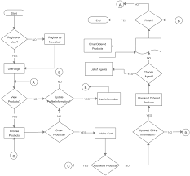
FLOWCHART

Slide 10
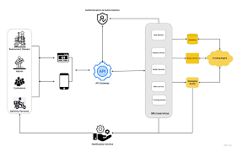
SYSTEM ARCHITECTURE

Slide 11
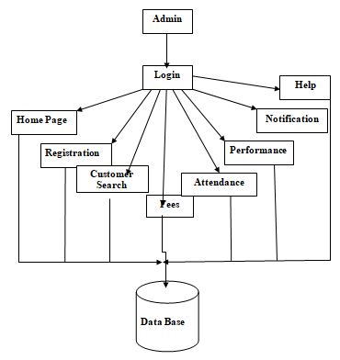
DATAFLOW DIAGRAM

Slide 12
SYSTEM REQUIREMENTS
. Memory (RAM): Minimum 4 GB RAM
Storage (Hard Disk): Minimum 500 GB free space
CPU: Minimum 2 GHz multi-core processor
Network: Reliable internet connection with sufficient bandwidth.
SOFTWARE REQUIREMENTS
JAVASCRIPT
PHP
MYSQL
BOOTSTAP

Slide 13
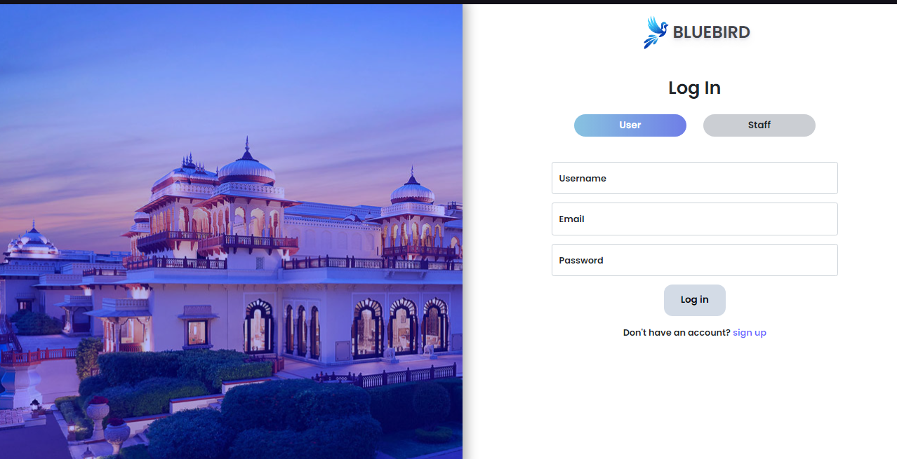
RESULTS
LOGIN PAGE

Slide 14
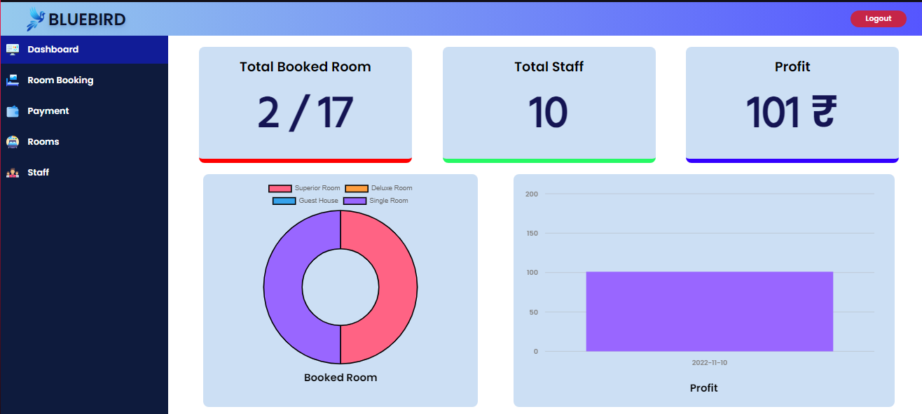
Showing Admin Dashboard page.

Slide 15
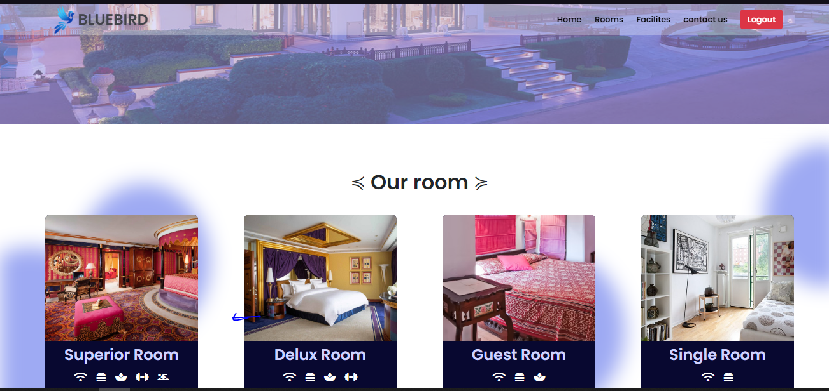
Showing Guest Dashboard.

Slide 16
CONTRIBUTION TO KNOWLEDGE
Integration of Advanced Technologies: Utilizes deep learning and automation to enhance guest experiences.
Optimization of Service Delivery: Provides insights into improving operational efficiency.
Personalization of Guest Interactions: Advances understanding of personalized hospitality services.
Enhancement of Operational Practices: Contributes to modern hospitality management methodologies.

Slide 17
FUTURE WORK
ACHIEVEMENTS:
- Design: Completed Software on Hotel Management setup.
- Data: User data collection in place.
- Training: Initial quest training done.
STATUS:
- Testing: Validating all necessary fields.
- Interface: Integrated with the platform GUI.
Next Steps:
- Refine: Improve algorithms.
- Deploy: Full system rollout and monitoring.

Slide 18
CONCLUSION
The Hotel Management System is crucial for improving the efficiency and effectiveness of administrative processes within the hospitality industry. By automating data management, streamlining communication, and enhancing accuracy, the system addresses significant challenges faced by hotels today. Its implementation benefits both guests and staff, contributing to the overall enhancement of hotel operations and enabling establishments to focus on their core mission of delivering exceptional guest experiences.

Slide 19
SELECTED REFERENCE
Brown, A., & Lee, C. (2023). Impact of Hotel Management Systems on Operational Efficiency. Journal of Hospitality Technology, 15(2), 45-60.
Doe, J. (2023). Streamlining Administrative Processes in Hotels. International Journal of Hospitality Management, 10(1), 12-24.
Goodfellow, I., Bengio, Y., & Courville, A. (2023). Deep Learning. MIT Press.
Hochreiter, S., & Schmidhuber, J. (2022). Long Short-Term Memory. Neural Computation, 9(8), 1735-1780.
Smith, R., & Johnson, M. (2022). Enhancing Operational Reporting with Technology. Hospitality Administration Quarterly, 58(3), 301-320.

Slide 20


