Slide 1
Maali Civil ERP
What every figure means, and how a project moves from quote to closure
All figures as of 04-Oct-2026, calculated by the app from its demo data
Live demo: adetivedesk.github.io/Maali
Notes:
This deck has two parts. Part 1 explains every number you see in the app: what it means and exactly how it is calculated. Part 2 walks through the workflow from quotation to project closure using the demo projects. All figures in the deck come from the live demo data.

Slide 2
Every screen answers four money questions
1
How much was contracted?
2
How much was received?
3
How much was spent?
4
How much profit was made?
CONTRACT VALUE
RECEIVED
ACTUAL COST
ACTUAL PROFIT
₹1.75 Cr
₹60.50 L
₹66.37 L
₹26.14 L
Original contracts + approved change orders across 3 projects
Client payments collected, out of ₹74.50 L billed
Cost booked to phases; ₹16.51 L is on unfinished work
On completed phases (34.4%); forecast ₹59.34 L at completion
And what is still open
Client receivable ₹14.00 L billed but not yet received (₹2.00 L overdue)
Supplier payable ₹15.04 L supplier invoices not yet paid (₹4.96 L overdue)
Notes:
The whole application is built around one objective: know exactly how much money was contracted, received and spent, what is still payable or receivable, and how much profit was actually generated. These are the portfolio totals from the demo data on the Management Dashboard. Profit counts only completed phases, so it is a figure you can audit; forecast profit shows where the portfolio will land.

Slide 3
Eight connected steps take a project from quote to closure
1
2
3
4
5
6
7
8
Quote
Contract
Phases
Cost
Billing
Payment
Profit
Closure
Price the work phase by phase; estimated cost becomes the budget
Upload the signed contract to make the project Active
Set phase budgets, then track status and % progress
Book material, own labour and outsourced work to a phase
Invoice a phase in full, or as running bills
Record client receipts and supplier payments
Revenue − cost, live for every phase and project
Run the checklist and lock the final report
Every number is traceable through linked IDs
QT-2026-001 → PRJ-2026-001 → PH-001 Foundation → EXP-001 cement → SIN-001 supplier bill → CINV-007 invoice → PAY-011 receipt
Click any figure in the app and you can follow it back to the project, phase and record behind it.
Notes:
This is the workflow the whole app is built around. Each step creates records that the next step uses. The project page shows this same 8-step strip and ticks steps off as the project progresses.

Slide 4
Reading the figures
01
What each KPI and chart means, and the formulas behind them

Slide 5
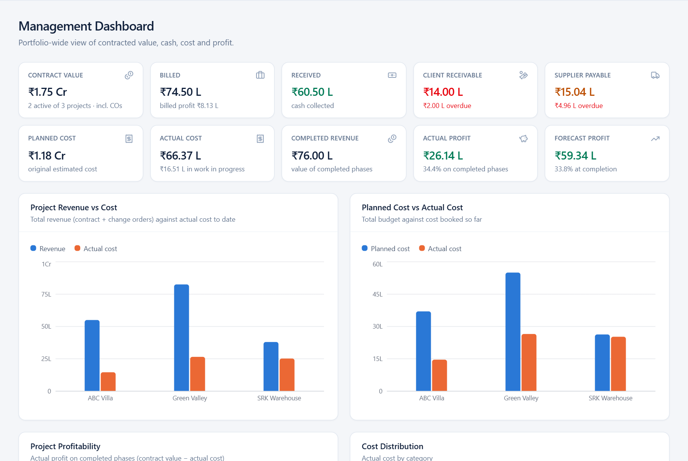
The dashboard opens with ten headline figures
Contract Value
Total approved value, incl. change orders
Billed
Invoices issued (sub-line: billed − actual cost)
Received
Cash actually collected from clients
Client Receivable
Billed − received; overdue part in red
Supplier Payable
Supplier invoices not yet paid
Planned Cost
Original estimated cost (phase budgets)
Actual Cost
Cost incurred so far, incl. work in progress
Completed Revenue
Contract value of completed phases
Actual Profit
Completed revenue − cost of those phases
Forecast Profit
Expected final revenue − expected final cost
Notes:
Every card is clickable and opens the list behind it. Colour carries meaning: green is money in or profit, red is money still owed to us or overdue, amber is money we owe suppliers.

Slide 6
Six formulas produce every profit figure in the app
1
Total revenue
2
Actual cost
3
Actual profit
Original contract + approved change orders
Material + own labour + outsource + other direct
Revenue of completed phases − their actual cost
ABC Villa: ₹50 L + ₹5 L = ₹55 L
Portfolio: ₹66.37 L, of which ₹16.51 L WIP
Foundation: ₹8 L − ₹5.1 L = ₹2.9 L
4
Profit margin
5
Billed profit
6
Forecast profit
Actual profit ÷ completed revenue × 100
Billed − all actual cost (a cash-style check)
Final revenue − expected final cost; unfinished phases at max(budget, cost so far)
Foundation: ₹2.9 L ÷ ₹8 L = 36.25%
Portfolio: ₹74.5 L − ₹66.37 L = ₹8.13 L
Portfolio: ₹1.75 Cr − ₹1.16 Cr = ₹59.34 L
Notes:
Profit is recognised only when a phase is completed, so actual profit is always backed by finished work and real costs. Cost already spent on unfinished phases is work in progress: it is not counted as a loss and not yet as profit. Billed profit is a quick cash-style check, and it reads low whenever work is done before it is invoiced. Forecast profit shows where each project will land if unfinished phases cost at least their budget.

Slide 7
Worked example: Foundation made a 36.25% margin
REVENUE (100% COMPLETE)
₹8,00,000
ACTUAL COST
₹5,10,000
ACTUAL PROFIT
₹2,90,000
PROFIT MARGIN
36.25%
₹40,000 under the ₹5,50,000 budget
Notes:
Foundation is complete, so its full ₹8,00,000 contract value is recognised and its profit counts. Material came in ₹10,000 under budget, own labour ₹10,000 under and outsource ₹20,000 under: ₹40,000 under budget in total. Profit = ₹8,00,000 − ₹5,10,000 = ₹2,90,000; margin = ₹2,90,000 ÷ ₹8,00,000 = 36.25%.

Slide 8
Profit is not cash: ABC Villa shows profit but negative cash
Profit view
Cash view
Completed phases revenue
₹8,00,000
Client receipts
₹9,00,000
− Their actual cost
−₹5,10,000
− Supplier payments
−₹6,94,000
Work in progress (excluded)
₹9,51,400
− Own labour & site payments
−₹2,75,800
Actual profit
₹2,90,000
Cash position
−₹69,800
The fix is collection, not cost-cutting: ₹6.50 L is billed but unpaid (₹2.00 L already overdue). Collecting it turns the project cash-positive.
Notes:
The project page always shows these two cards side by side. Only Foundation is complete at ABC Villa, so actual profit is ₹2,90,000; the ₹9,51,400 spent on Structure and Electrical work is work in progress until those phases complete. The cash position tells you whether you have the money right now: costs are paid as they are incurred, but cash only arrives when the client pays.

Slide 9
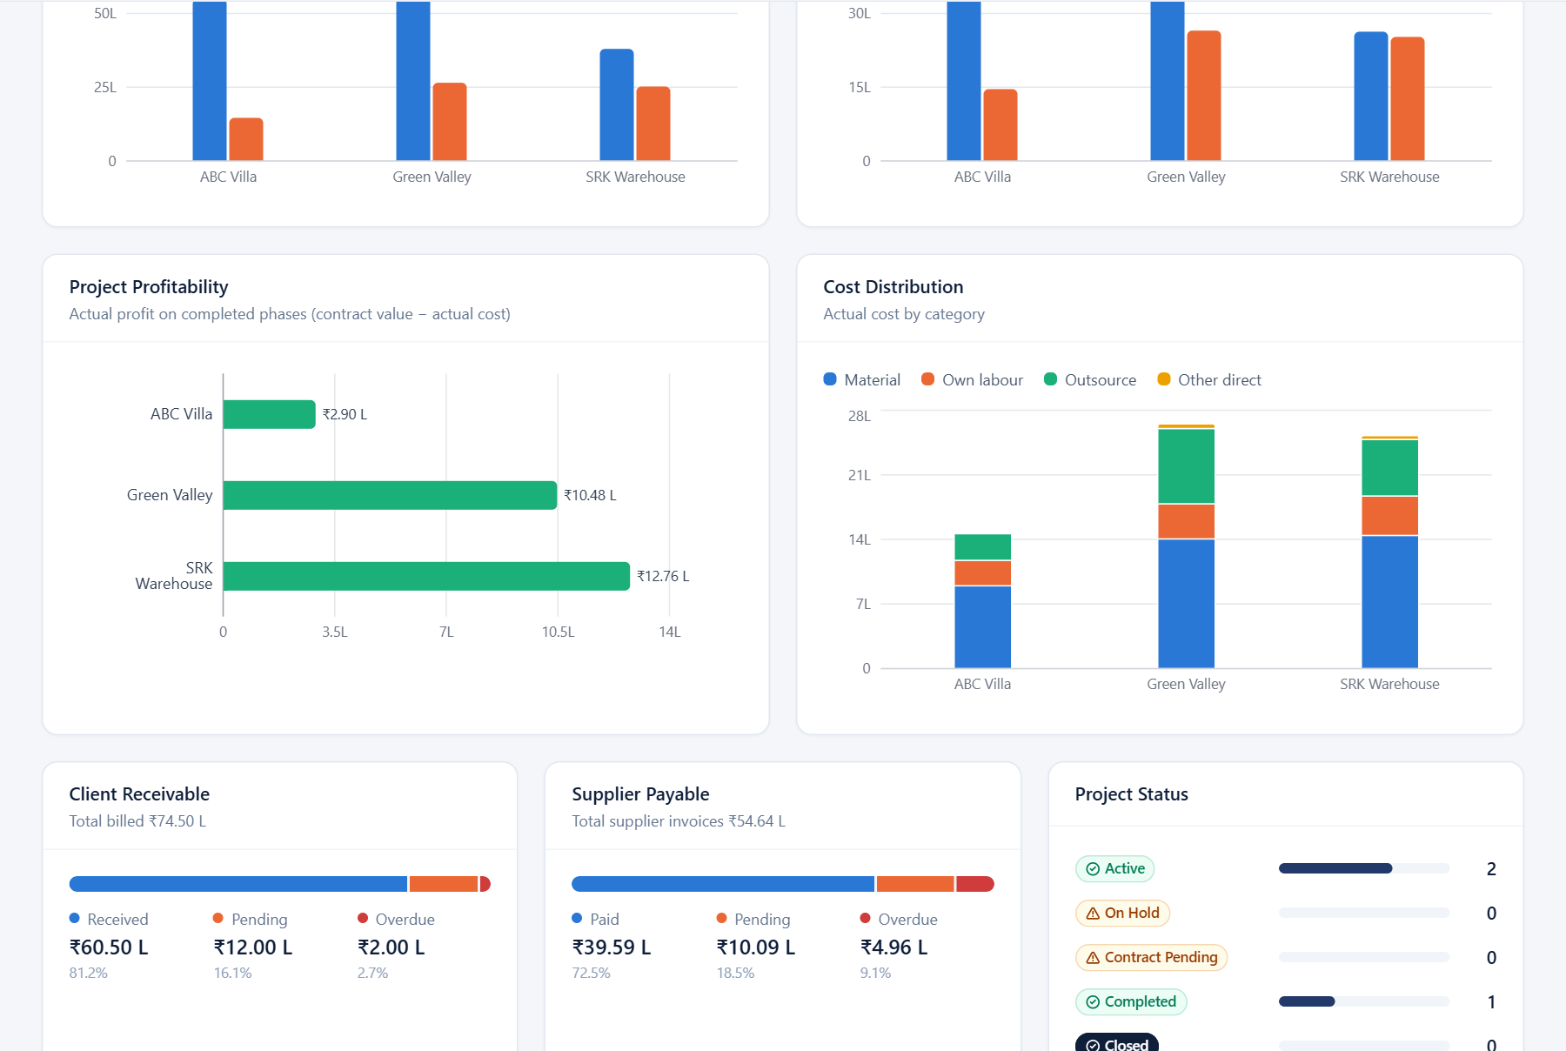
Dashboard charts show where money is made and where it is stuck
1
Revenue vs Cost · Planned vs Actual
Bars per project. A wide blue-over-orange gap means room for margin.
2
Project Profitability
Actual profit on completed phases; red would be a loss.
3
Cost Distribution
Each project's cost split into material, labour, outsource, other.
4
Receivable & Payable meters
Received or paid vs pending vs overdue, as one 100% bar.
5
Project Status
Count of projects in each stage of the lifecycle.
Notes:
Hover any bar in the app for exact figures. The meters at the bottom answer two questions quickly: how much of what we billed has been collected, and how much of what suppliers billed us is still unpaid.

Slide 10
SRK Warehouse closed at 33.6%; Green Valley has the most to bill
✓
SRK Warehouse · 100% done
Final profit ₹12.76 L at 33.6% margin, above the 30.8% planned. Ready to close.
!
Green Valley · 47% done
₹10.48 L profit on two completed phases; Foundation & Basement (₹18 L) is ready to bill.
!
ABC Villa · 36% done
Only Foundation is complete (₹2.90 L). Structure material is 5% over budget.
Notes:
Revenue is the full contract including approved change orders. Actual profit counts completed phases only, so it steps up each time a phase is finished; forecast profit (amber) shows the expected end result. For SRK, which is fully complete, actual and forecast profit are the same.

Slide 11
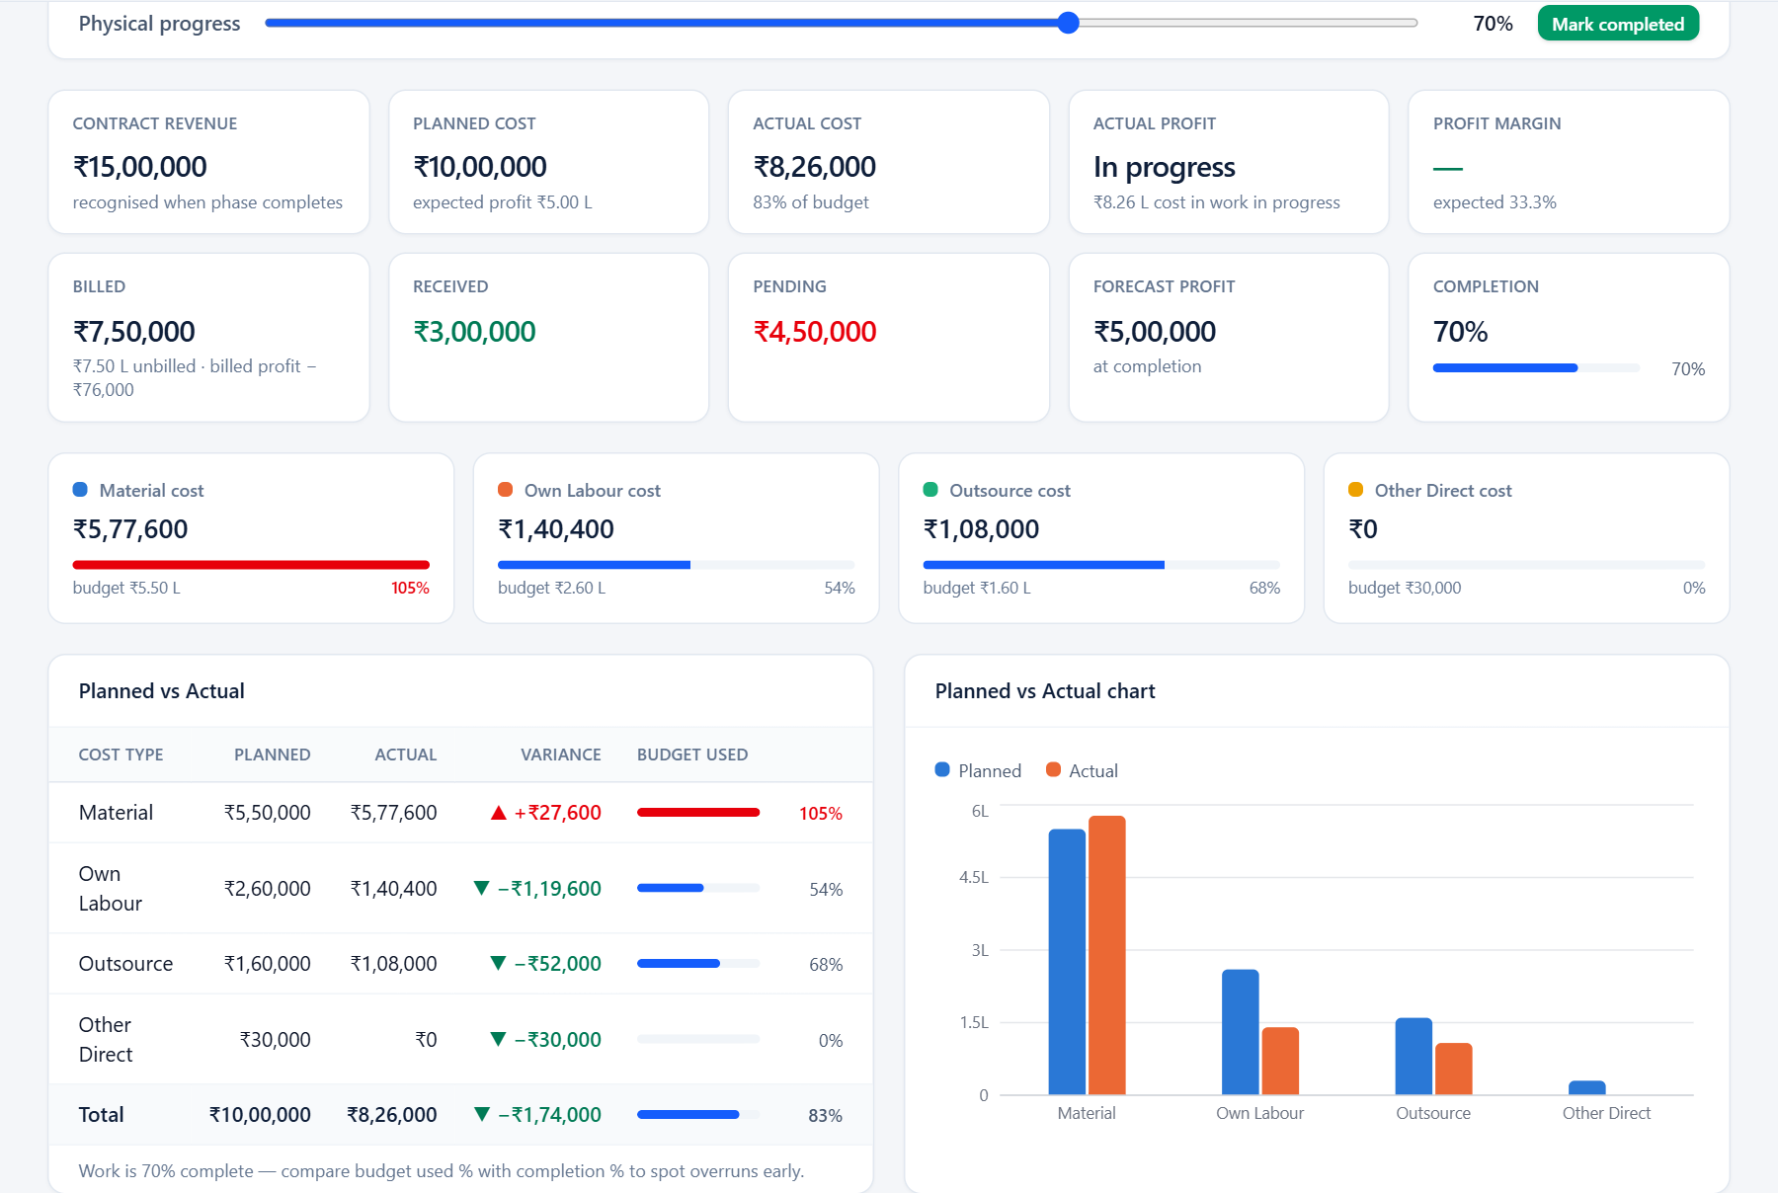
Arrows and colours flag budget overruns before they grow
▲
Red ▲ +₹ = over budget
Structure material: ₹5,77,600 actual vs ₹5,50,000 planned (+₹27,600).
▼
Green ▼ −₹ = under budget
Variance = actual − planned, so a negative number is good.
%
Budget used vs completion
83% of budget spent at 70% complete: compare the two to spot overruns early.
●
Status badges
Green paid/active · blue in progress/billed · amber partly paid or pending · red overdue.
Notes:
Each phase has its own dashboard with the same planned-vs-actual table. Budget bars turn amber above 90% and red above 100%. The expense form also warns you before you save an entry that pushes a category over budget.

Slide 12
Workflow walkthrough
02
Quote → Contract → Phase → Cost → Billing → Payment → Profit → Closure

Slide 13
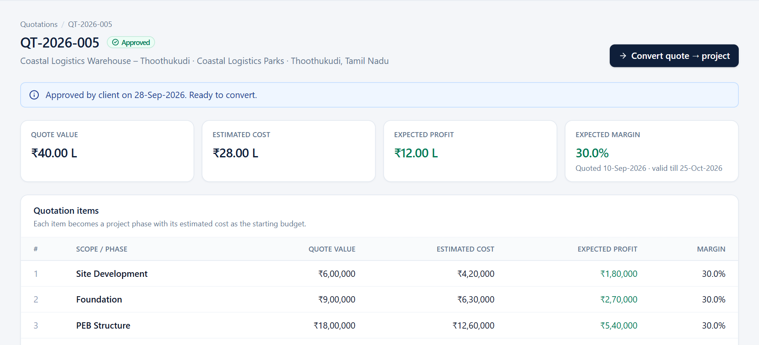
Step 1 · An approved quotation becomes a project in one click
1
Create the quotation
Add each scope line with its quote value and estimated cost.
2
Send and get approval
Draft → Sent → Under Review → Approved (or Rejected / Expired).
3
Convert → Project
Lines become phases; estimated cost becomes each phase budget; a contract is created awaiting signature.
QT-2026-005 · Coastal Logistics: ₹40 L quote, ₹28 L estimated cost, 30% expected margin. Approved on 28-Sep-2026 and ready to convert.
Notes:
Example: QT-2026-005 for Coastal Logistics is approved at ₹40,00,000 with ₹28,00,000 estimated cost, a 30% expected margin. Clicking Convert creates the project in Contract Pending status, four phases, and a contract record awaiting signature.

Slide 14
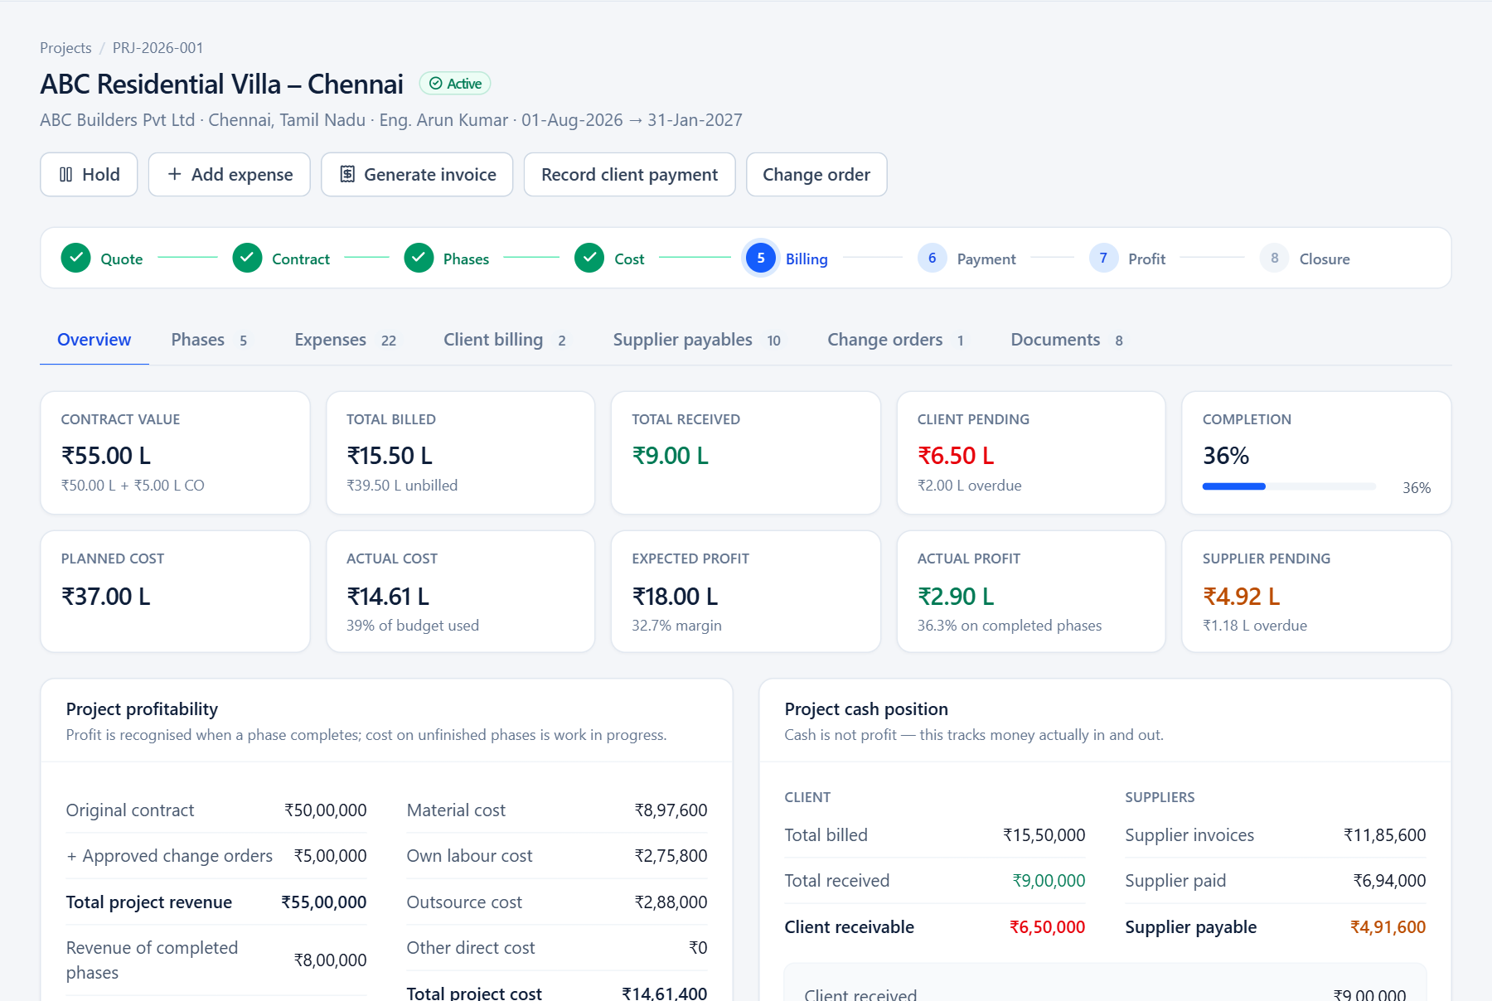
Steps 2–3 · Upload the contract, then set budgets and track progress
1
Upload signed contract
The contract and the project both switch to Active.
2
Set phase budgets
Planned material, own labour, outsource and other cost per phase.
3
Start and progress phases
Planned → In Progress; drag the progress slider as work advances.
4
Completion updates itself
Project % is weighted by phase value: ABC Villa is 36% complete.
Notes:
The workflow strip at the top of every project ticks off each stage. Phase statuses run Planned → In Progress → Completed → Billed → Payment Received → Closed. Billing statuses are set automatically when invoices and receipts are recorded.

Slide 15
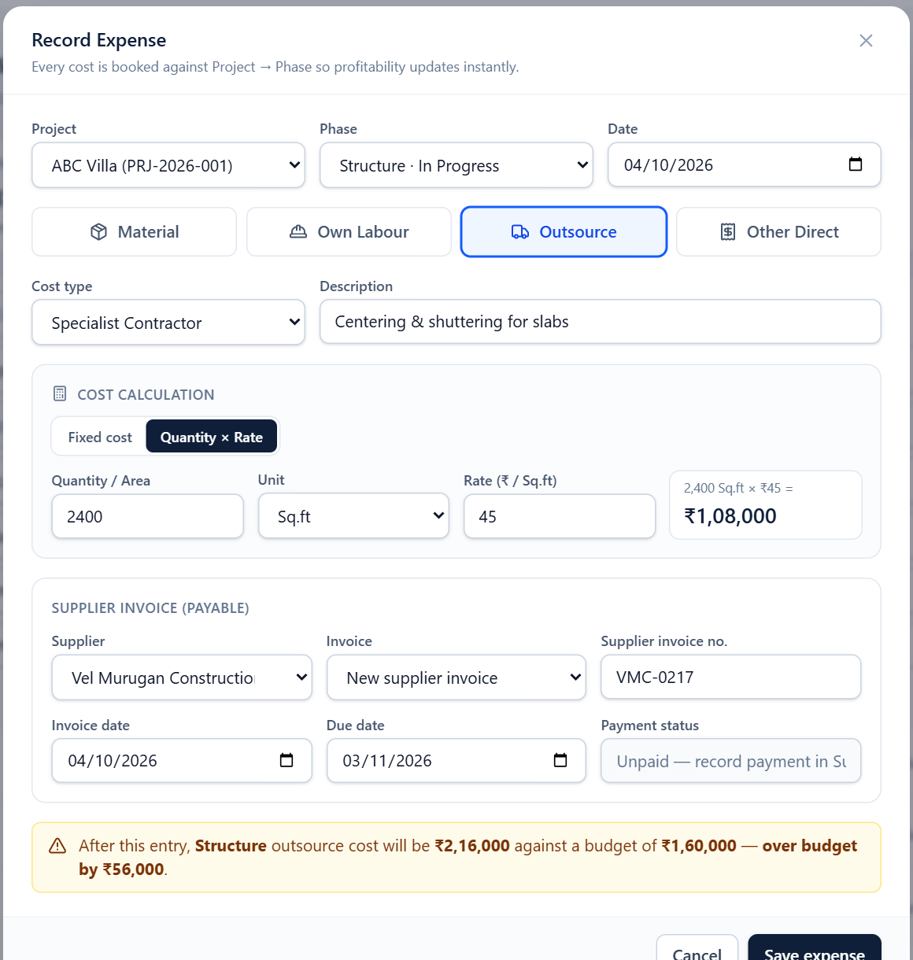
Step 4 · Three ways to cost work, all calculated for you
1
Material
Quantity × unit rate
250 bags × ₹420 = ₹1,05,000
2
Own labour
Daily rate × working days
₹1,200 × 25 days = ₹30,000
3
Outsourced work
Fixed contract, or quantity × rate
2,400 sq.ft × ₹45 = ₹1,08,000
Every expense is booked to Project → Phase. Material and outsource entries also create a supplier invoice, and the form warns you before a category goes over budget.
Notes:
Open Quick add → Expense from anywhere. Pick the project and phase, choose Material, Own Labour, Outsource or Other Direct, and enter quantities. The amount is calculated live, and the yellow warning shows how the entry affects the phase budget. Profitability updates as soon as you save.

Slide 16
Step 5 · Supplier invoices are payables; payments clear them
Example: Kumar Steel Traders · KST-2350 · ABC Villa Structure steel
Paid ₹1,00,000
Pending ₹1,17,600 · overdue since 30-Sep
Invoice amount ₹2,17,600 (3,200 kg × ₹68)
1
Expense ≠ payment
2
Supplier pending
3
Payment status
The expense hits project cost the day it is recorded, and profit when its phase completes. The payment only moves cash.
Invoice amount − payments. Several part payments can be made against one invoice.
Unpaid → Partially Paid → Paid. Anything past its due date with a balance shows Overdue.
Notes:
Go to Suppliers, expand an invoice to see its expense lines and payment history, and click Pay. The pending and overdue totals on the supplier page and the dashboard update immediately.

Slide 17
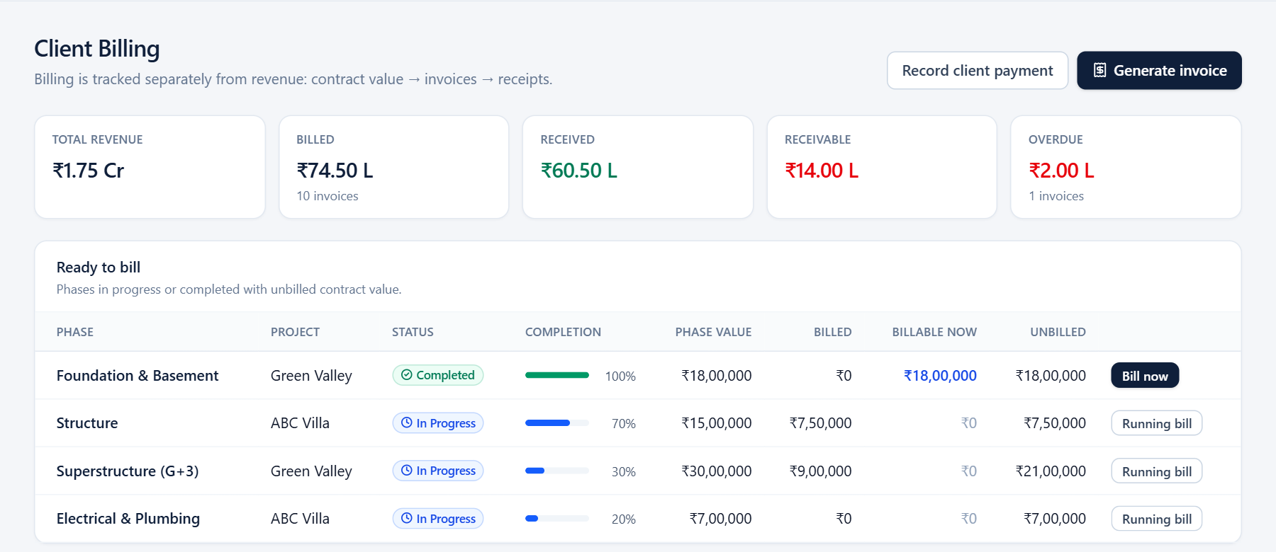
Step 6 · Bill finished work, then record each receipt
Example: Foundation, ABC Villa
Invoice INV-2026-007
₹8,00,000
− Payment 10-Sep
₹4,00,000
− Payment 25-Sep
₹2,00,000
= Pending, overdue
₹2,00,000
"Billable now" shows completed phases not yet invoiced. A fully billed phase moves to Billed automatically; once fully received it moves to Payment Received.
Notes:
The Ready to bill list shows phases with unbilled value. "Billable now" in blue is a completed phase that has not been invoiced yet. Use Bill now for a completed phase, or a running bill (25%, 30%, 50%) for work in progress. Record client payment supports bank transfer, cash, cheque or other, with a reference number.

Slide 18
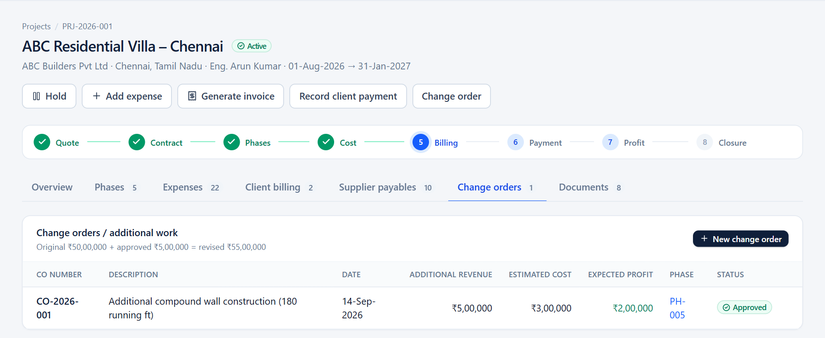
Step 7 · Approved change orders add revenue and their own phase
CO-2026-001 · compound wall
Original contract
₹50,00,000
+ Change order
₹5,00,000
= Revised contract
₹55,00,000
Approval creates phase PH-005 with a ₹3,00,000 budget, so the extra work is costed, billed and profit-recognised like any other phase.
Extra profit (est.)
₹2,00,000
Notes:
Change orders can be saved as Pending Approval and approved later; Green Valley has one waiting (CO-2026-002, ₹2,50,000). Only approved change orders count toward revenue.

Slide 19
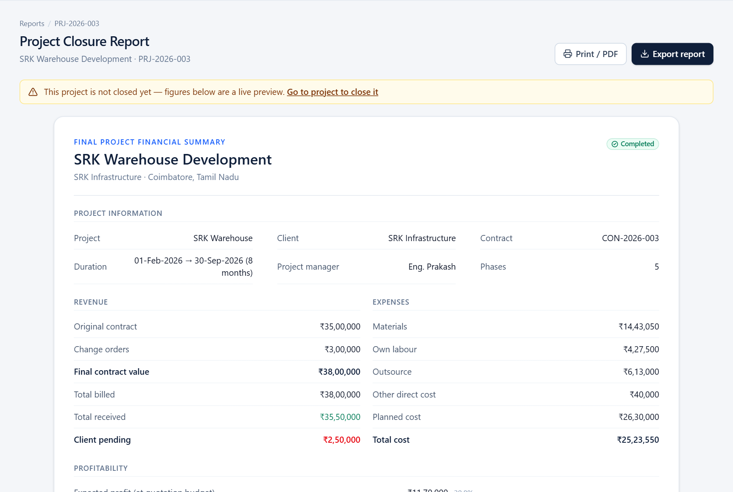
Step 8 · Closure locks the final numbers: SRK made ₹12.76 L
FINAL REVENUE
FINAL COST
₹38.00 L
₹25.24 L
₹35 L contract + ₹3 L change order
₹1.06 L under the ₹26.30 L plan
FINAL PROFIT
STILL OPEN
₹12.76 L
₹3.47 L
33.59% margin (30.8% planned)
₹2.50 L from client · ₹0.97 L to suppliers
Close project runs a 9-point checklist: all phases complete, all invoices raised, costs and payments recorded, pending amounts shown. Then it snapshots the figures and opens the report, ready to export or print.
Notes:
SRK Warehouse is complete with every phase billed, so it is ready to close in the demo. The report covers project information, revenue, expenses, profitability, supplier settlement and a phase summary. Outstanding client and supplier amounts stay visible after closure so they can still be chased and paid.

Slide 20
Try the full walkthrough in 10 minutes
1
Quotations → open QT-2026-005 → Convert quote → project
2
Upload the signed contract → project becomes Active
3
Set a phase to In Progress → Quick add → Expense
4
Suppliers → pay the new invoice
5
Mark the phase Completed → Generate invoice
6
Record client payment → watch pending and profit update
7
Projects → SRK Warehouse → Close project → view report
adetivedesk.github.io/Maali · Demo data lives in your browser; use “Reset demo data” to start over
Notes:
This path covers every step of the workflow in about ten minutes. Each visitor gets their own copy of the demo data, so nothing you change affects anyone else. Next stage: connect a backend and database; the data layer and calculations are already structured to be swapped for API calls.

