Slide 1
Programming Workshop:
GitHub, Vim, and Python Basics
Beginner’s Workshop #3
26 September 2016

Slide 2
Outline
Speed Exercises
“Homework” - Completion
GitHub - Fork Our Repository
Using Vim
Python:
Making a script
I/O
Making a Function

Slide 3
Speed Exercises
# 1:
Make a function that counts to 15 and prints each odd number.
60 seconds

Slide 4
Speed Exercises
# 2:
Make a function that prints all prime numbers between 1 and 100.
180 seconds

Slide 5
Speed Exercises
# 3:
Make a script that takes a string from the user and prints how many characters it contains.
120 seconds

Slide 6
“Homework”
Get Linux and Python running!
Make a GitHub account and fork our repository
Go through the Codecademy Python lesson

Slide 7
Forking our GitHub Repository
Forking our repository:
Open our repo in a web browser
In the upper right side of the interface, click “fork this repository”
In the list of your repositories, select the fork of our repository
Clone your fork of our repository to your computer

Slide 8
VIM!
Open a terminal
Open a file with Vim
Follow along and try each step
Alternative: gedit
sudo apt-get install gedit

Slide 9
VIM commands
Command | Description
vim <file> | Open file <file>
i | Go into insert mode
v | Go into visual mode
Arrow keys | Move up, down, left, or right
y | When in visual mode, select text, and use ‘y’ to copy (yank)
p | When not in any mode, use ‘p’ to paste on the character or row following cursor
:w | Save (write) file
:q | Exit (quit)

Slide 10
VIM!
For more practice, head to:
http://vim-adventures.com/

Slide 11
Python Basics: Scripting
Involves making a file and running the file
Similar operation to interpreter - the Python interpreter still interprets the script - but not an interactive interface
Unlike other languages, DON’T need:
Main()
Functions
Classes

Slide 12
Python Basics: I/O
Many types of input:
input()
open(“filename”, “mode”)
file.read()
with open() as csvfile: …
csv.readrow()

Slide 13
Python Basics: I/O (cont’d)
Command line input collected via:
variable = input(“Print this statement then collect: “)
Sometimes must cast type:
int_variable = int(input(“Give us a number: “))
float_variable = float(input(“Give us a number: “))

Slide 14
Python Basics: I/O (cont’d)
File input collected via:
file_reference = open(“filename”, “mode”)
Then can write to file:
file_reference.write()

Slide 15
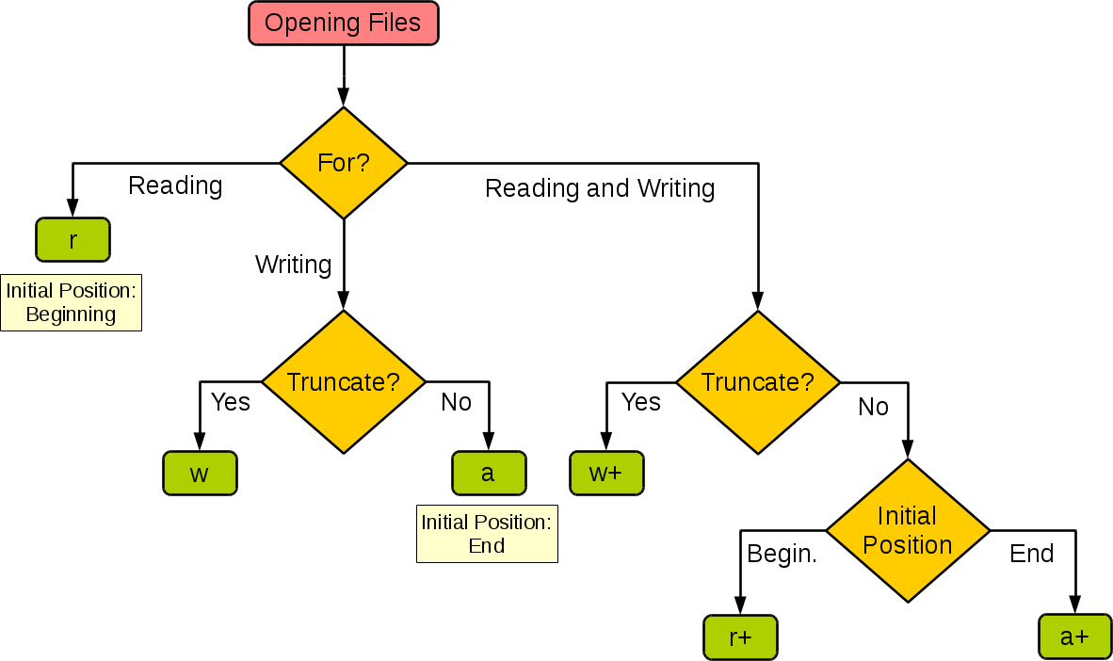
http://stackoverflow.com/questions/1466000/python-open-built-in-function-difference-between-modes-a-a-w-w-and-r

Slide 16
Python Basics: I/O (cont’d)
Many types of output:
print()
open(“filename”, “mode”)
file.write()
with open() as csvfile: …
csv.writerow()

Slide 17
“Homework”
Go through the Codecademy Python lesson
Play Vim Adventures or read Vim tutorials

