Slide 1
PROKARYOTIC CELL
Prokaryotic cells are the simplest of most primitive cells. The records of microfossils suggest that they have evolved 2.5 billion years ago and existed as the only organisms on earth for the next one billion years until eukaryotes evolved about 1.5 billion years ago.

Slide 2
PROKARYOTIC CELL
The ultrastructure of a prokaryotic cell, particularly a typical bacterial cell consists of cell envelope, cytoplasm, nucleoid, plasmids and surface appendage.
1. Cell envelope:
It is the protective covering of bacterial cell that has three basic layers: the outermost glvcocalyx, middle cell wall and innermost cell membrane (plasma membrane),

Slide 3
PROKARYOTIC CELL
2. Cytoplasm:It is granular, crystallo-colloidal complex that fills the whole prokaryotic cell excluding nucleoid. The cytoplasm contains mesosome, chromatophores, ribosomes, inclusion bodies and plasmids.
(i) Mesosome (or chondrioids):
It is a convoluted membranous infolding of the plasma membrane. Mesosome when connected with nucleoid is called septal mesosome and when not connected called lateral mesosome.

Slide 4
PROKARYOTIC CELL
Mesosome can be considered analogous to mitochondria of eukaryotic cells as these are the sites of respiratory enzymes. Hence, mososomes are also called as “mitochondria of prokaryotic cells” or “bacterial mitochondria”.

Slide 5
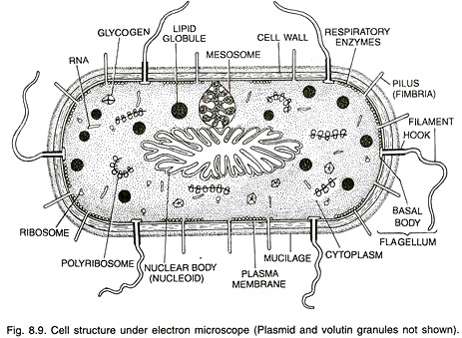

Slide 6
PROKARYOTIC CELL
Ribosomes:
Prokaryotic ribosomes are 70S in nature that consist of larger 5OS and smaller 30S subunits. The "S" stands for svedbergs, a unit used to measure how fast molecules move in a centrifuge.

Slide 7
PROKARYOTIC CELL
Inclusion bodies:These are non-living structures present freely in the cytoplasm. Inclusion bodies may be organic or inorganic. They include mainly food reserve and special prokaryotic organelles like gas vacuoles

Slide 8
PROKARYOTIC CELL
Plasmids:
the term ‘plasmid’ to those ring-like self replicating extra chromosomal DNA that are found in the cytoplasm of prokaryotes. Plasmids are used as in ideal vector for indirect gene transfer in recombinant DNA technology (Genetic Engineering).

Slide 9
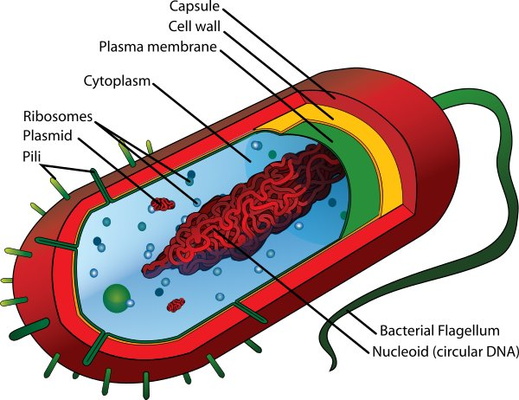

Slide 10
PROKARYOTIC CELL
3. Nucleoid Nucleoid is the genetic material of a prokaryotic cell that occupies up to 1/5 of the interior of the bacterial cell. It is represented by a single circular naked DNA which is highly looped and super coiled. Nucleoid is a compact structure hat nuclear envelope and nucleolus.

Slide 11
PROKARYOTIC CELL
4. Appendages:
The surface appendages present on bacterial cell may be motile flagellum or non-motile pili and fimbriae.

Slide 12
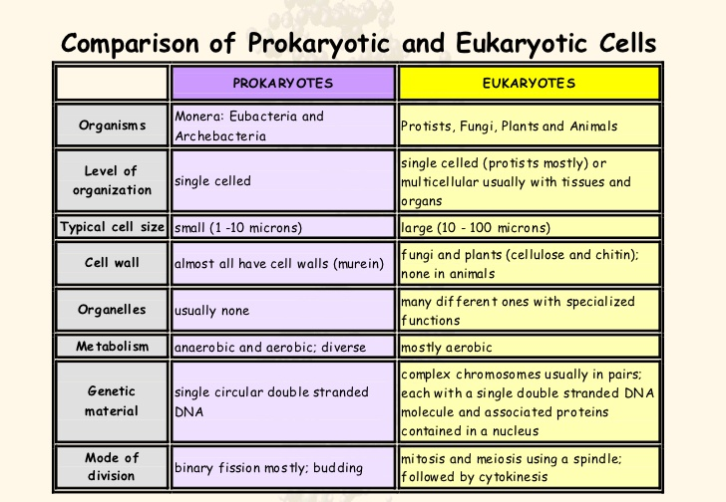

Slide 13
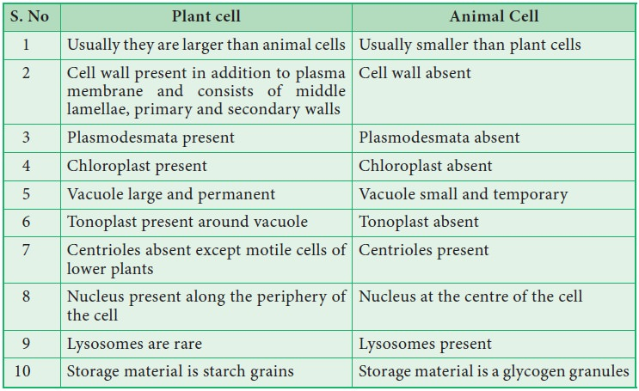

Slide 14
