Slide 1

University Institute of Engineering
Course Name- Professional Communication Skills
Course Code- 20PCT-154
Faculty Name- Mr Vishal Monga
COVER LETTER
DISCOVER . LEARN . EMPOWER

Slide 2
Course Objectives
The Course aims to:
1 | Stress on students awareness of interpersonal communication skills and appropriate usage of verbal and non-verbal expression in social and professional environment.
2 | Prepare the student for discourse in English, using a number of communication strategies.
3 | Introduce them to key concepts of Morality, Diversity & Inclusion
4 | Provide foundations for the placement process of the student.

Slide 3

Course Outcomes
On completion, the students are expected to
CO Number | Title | Level
CO1 | Evaluate facts to write research and short official, technical or social reports. | Evaluate
CO2 | Create communication material for an organization dedicated to a social cause and use electronic/social media to share concepts and ideas. | Create
CO3 | Analyse and summarize information, ideas and opinions on a social issue using grammatically correct English. | Analyse
CO4 | Perform effectively in the placement process. | Apply
CO5 | Display moral values, ethics and sensitivity for diversity and inclusion. | Apply
https://www.pertemps.co.uk/
Notes:
https://www.google.com/url?sa=i&url=https%3A%2F%2Fsloanreview.mit.edu%2Farticle%2Ffive-ways-to-improve-communication-in-virtual-teams%2F&psig=AOvVaw0TTElm7CjMaUyvrnZ7z0V9&ust=1591773620787000&source=images&cd=vfe&ved=0CAIQjRxqFwoTCKi454SZ9OkCFQAAAAAdAAAAABAO

Slide 4
Cover Letter
Sent with applicant’s resume to provide additional information on his/her skills and experience.
The letter typically provides detailed information on why an applicant is qualified for the job.
A cover letter typically accompanies a resume.
Employers use cover letters as a way to screen applicants for available jobs and to determine which candidates they would like to interview.

Slide 5
When is a cover letter necessary?
A cover letter is important and required
If the job offer requires a cover letter,
If the employer, hiring manager, or recruiter requests one,
If you’re applying directly to a person and know their name,
If someone has referred you for the position.
Note: Cover letters aren’t always necessary. For example, you might not need a cover letter if you’re applying online.

Slide 6
Resume Vs Cover Letter
RESUME is about YOU… | COVER LETTER is about THEM and WHY you make a good match!

Slide 7
Purpose of a Cover Letter
It formally introduces you, and can personalize the presentation of your resume.
It highlights specific information from your resume and from your background that applies to a specific field or position. It can also give reader insight to items not addressed in a resume.
It helps to facilitate a meeting between you and the employer.
Provides a sample of your written communication skills.

Slide 8
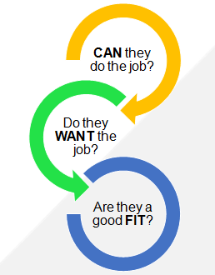
Purpose of a Cover Letter (Cont’d)
Your goal as a job candidate is to prove you are what the employer is looking for.

Slide 9
Tips for Creating a Powerful Cover Letter
Send an original letter
Keep it short, specific and to the point.
State the job title
Explain why you want this job
NOT to “make money”
Describe specific ways you will contribute
Refer to, but don’t repeat, your resume
Reflect your own self-confidence
Proofread, Revise and Edit

Slide 10
Poll Question
Which of the following is not a function of a cover letter?
To inform the employer of the job you are applying for
To show how well you write
To inform the reader of what you expect to get out of the job you're applying for
To entice the reader to want to get to know you better by interviewing you

Slide 11
Poll Question
Which of the following is not a function of a cover letter?
To inform the employer of the job you are applying for
To show how well you write
To inform the reader of what you expect to get out of the job you're applying for
To entice the reader to want to get to know you better by interviewing you

Slide 12
Business Letter Format
Your Contact Information
The Date
Employer’s Name, Position, and Address
The Greeting
Introductory Paragraph
Body of the Letter
Summary Paragraph
Closing
Your Name and Signature

Slide 13
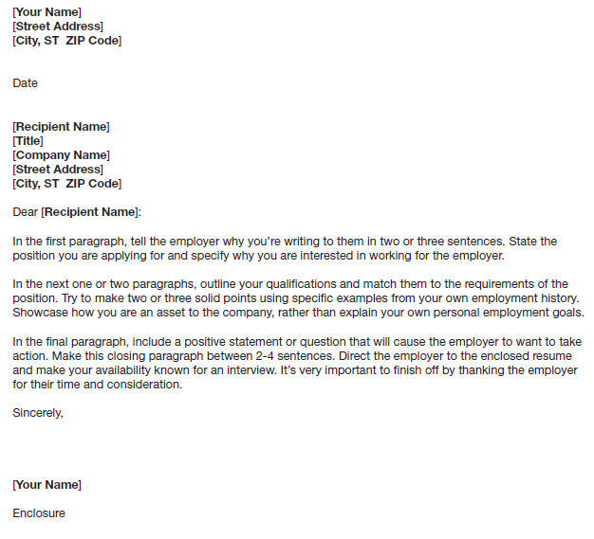
Format of Cover letter

Slide 14
Opening
HOOK!
Is there a link between your skills/experience and the position?
Interest and passion
Matches skills
Shows research in company
NOT random fact-dropping!

Slide 15
Example
Weak opening paragraph:
  I am writing today to apply for the Marketing Manager position you have posted on your company Website.
Good opening paragraph:
  As a current second year Masters student specializing in Marketing and Finance at Chandigarh University, I am excited to apply for Marketing Manager position at Future Group. I believe that my experience and education make me a strong candidate for this position.

Slide 16
Skills Matching
Describe specific skills that are clearly matched to the job description
Reference specific examples from courses, work, volunteer and/or co-curricular experiences
Connect your accomplishments, skills and knowledge directly to the position, organization and/or field
Experiences highlighted should be specific and concise, linking past experiences through transferable skills
Tell the employer how you can directly contribute to the company – don’t make them connect the dots

Slide 17
Example
My experiences demonstrate that I am a dedicated and intelligent worker, willing to take challenges, and excited to learn. Moreover, I have a strong interest in creativity and in the creative process – in developing interesting and elegant solutions to complex problems. The unique perspective provided by living overseas as a scholar/composer/performer has given me a great deal of experience working with and directing groups. I have learned not only how to work effectively within these groups, but also I recognize the reward from doing so.

Slide 18
Conclusion/Closing
Give a final statement of interest/qualifications
Reiterates skills in a different way
Indicate your plans to contact the employer to discuss opportunities or request an interview
Thank the employer for his/her time and consideration
Use appropriate closing line, such as:
      Yours sincerely
  Sign your name and print it underneath.
Enclosure

Slide 19
Example
Thank you for your time and consideration. I will be available starting from the beginning of September. You can contact me at xxxx@gmail.com or +91-98888-88888. I am attaching my resume as well to give you information about my academic background and work experience. Also, you can see a brief overview and snapshots of my work at my online portfolio: http://www.abcde.in.

Slide 20
Cold Cover Letters
Most positions are never advertised
A cold cover letter is an inquire to an employer, recruiter or hiring manager regarding possible job opportunities
Advantages include:
Creating a job that didn’t previously exist
Gaining early consideration for a position that hasn’t yet been advertised and expanding your network of contacts
By sending a letter to an employer who’s not soliciting candidates, your resume will not be buried in a pile of hundreds of others

Slide 21
Use Active Verbs
Verbs have either active or passive voice. The active voice is more powerful.
Active: Pat Smith wrote the report.
Passive: The report was written by Pat Smith.
A passive verb always consists of a form of to be followed by a past participle.
(was seen, had been taught, is guaranteed)

Slide 22
Example
“I have built my career on effective non-profit management, commercial banking, public finance, accounting, and management skills based on hard-won expertise in human resources. I have succeeded by identifying….”
-RATHER THAN THE MORE PASSIVE-
“My career has been built in non-profit management, commercial banking, public finance, accounting, management and human resources. My success has come from identifying….”

Slide 23
Things to Avoid
Assume the employer will connect the dots
Be explicit about your experience and what they need
Overusing “I”
Focus on how you meet an employer’s needs, not on your life story
Minimize the use of the word “I,” especially at the beginning of your sentences
Making it too long
One page maximum
A great cover letter is concise but compelling

Slide 24
Things to Avoid
Repeating your resume word for word
Don’t regurgitate what’s on your resume
Your CL should tell a story about the relevant accomplishments on your resume
Spelling and/or grammar errors
Get several reviews from others
“Here’s what I’m looking for”
Focus your letter on what you can do for them, NOT what they can do for you

Slide 25
Poll Question
Which of the following is necessary for a successful cover letter?
Opening, body and closing paragraphs
Addressing the letter to a specific individual or department
Connecting your skills to the ones profiled in the job advertisement
All of the above

Slide 26
Poll Question
Which of the following is necessary for a successful cover letter?
Opening, body and closing paragraphs
Addressing the letter to a specific individual or department
Connecting your skills to the ones profiled in the job advertisement
All of the above

Slide 27
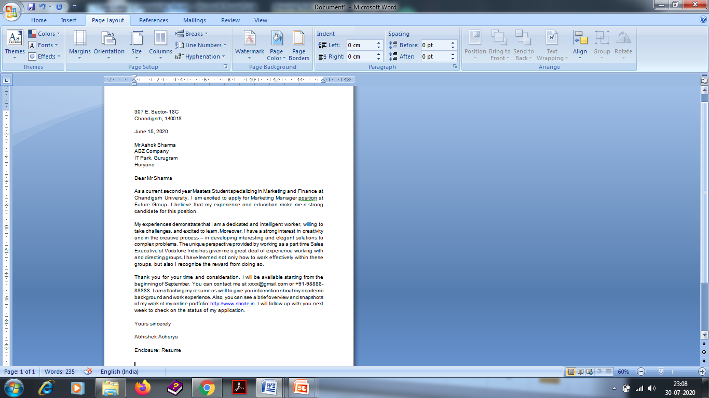
Example of a Cover letter

Slide 28
Action Verbs
Achieved Administered Attained Built Coached Completed Coordinated Delivered Demonstrated Developed | Effected Established Expedited Formulated Generated Headed Implemented Improved Invented Launched | Led Maintained Managed Motivated Negotiated Organized Originated Planned Presented Proposed | Reinforced Reorganized Researched Set up Simplified Solved Tackled Taught Updated

Slide 29
Self-descriptive Words
Adaptable Analytical Assertive Confident Conscientious Creative Disciplined | Efficient Energetic Enterprising Enthusiastic Expressive Extroverted Ingenious | Innovative Manager Personable Persuasive Precise Productive Reliable | Responsible Self-reliant Self-starter Skilled Tactful Team player Technical

Slide 30
Applications
Applicable to professional life
Will strengthen the Cover Letter writing skills of students
Students will be able to write better cover letters as a result they will be able to get more job opportunities.

Slide 31
Assessment Pattern
Students are assessed on the basis of the following parameters:
Hourly Tests - 2
Assignments
Surprise Test
Quiz
Student Engagement
End Semester Exam

Slide 32
References
www.careerplacejobs.com/cbo/CoverLetter.ppt
https://owl.english.purdue.edu/media/ppt/20071017015442_698.ppt
https://www.saultcollege.ca/Services/.../Powerpoints/Cover%20Letter%20Writing.ppsx
users.ipfw.edu/wellerw/cover_letter.ppt
umich.instructure.com

Slide 33
THANK YOU
For queries
Email: communicationskills.uilah@gmail.com

