Slide 1
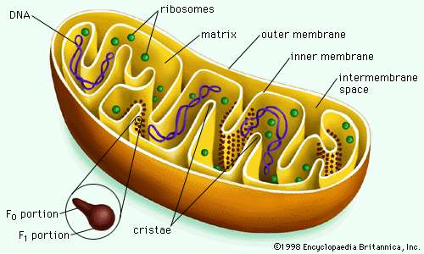
Mitochondria
Mitochondria - Mitochondria are oblong shaped organelles that are found in the cytoplasm of every cell.
In the animal cell, they are the main power generators, converting oxygen and nutrients into energy.
Also known as power house of cell.

Slide 2
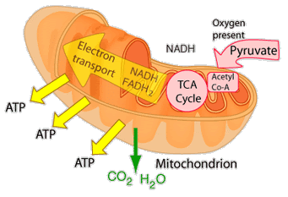
Mitochondria
Mitochondria produce the energy necessary for the cell's survival and functioning.
Through a series of chemical reactions, mitochondria break down glucose into an energy molecule known as adenosine triphosphate (ATP), which is used to fuel various other cellular processes.

Slide 3
Nucleus
Nucleus - The nucleus is a highly specialized organelle that serves as the information processing and administrative center of the cell. This organelle has two major functions: it stores the cell's hereditary material, or DNA, and it coordinates the cell's activities, which include growth, intermediary metabolism, protein synthesis, and reproduction (cell division).

Slide 4
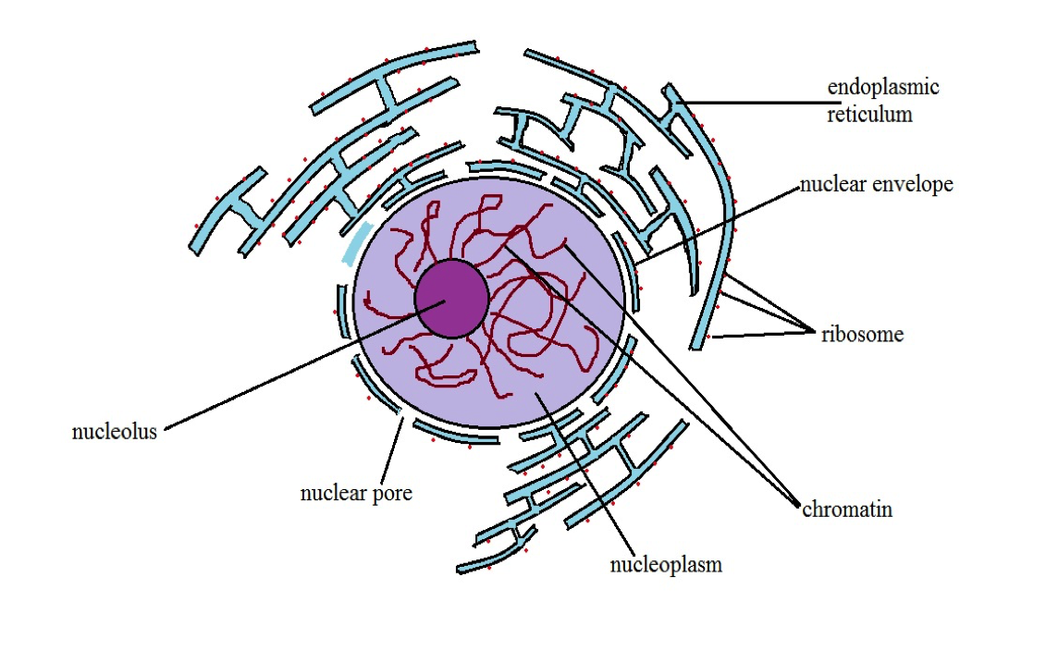

Slide 5
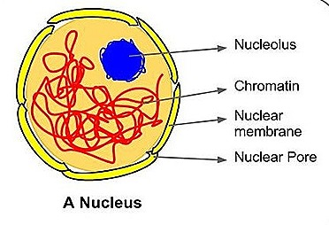
Parts of Nucleus
Nuclear Envelope
It bounds the nucleus on the outside. The nuclear envelope separates the nucleus from the cytoplasm. Nuclear envelope contains a large number of pores or perforations .

Slide 6
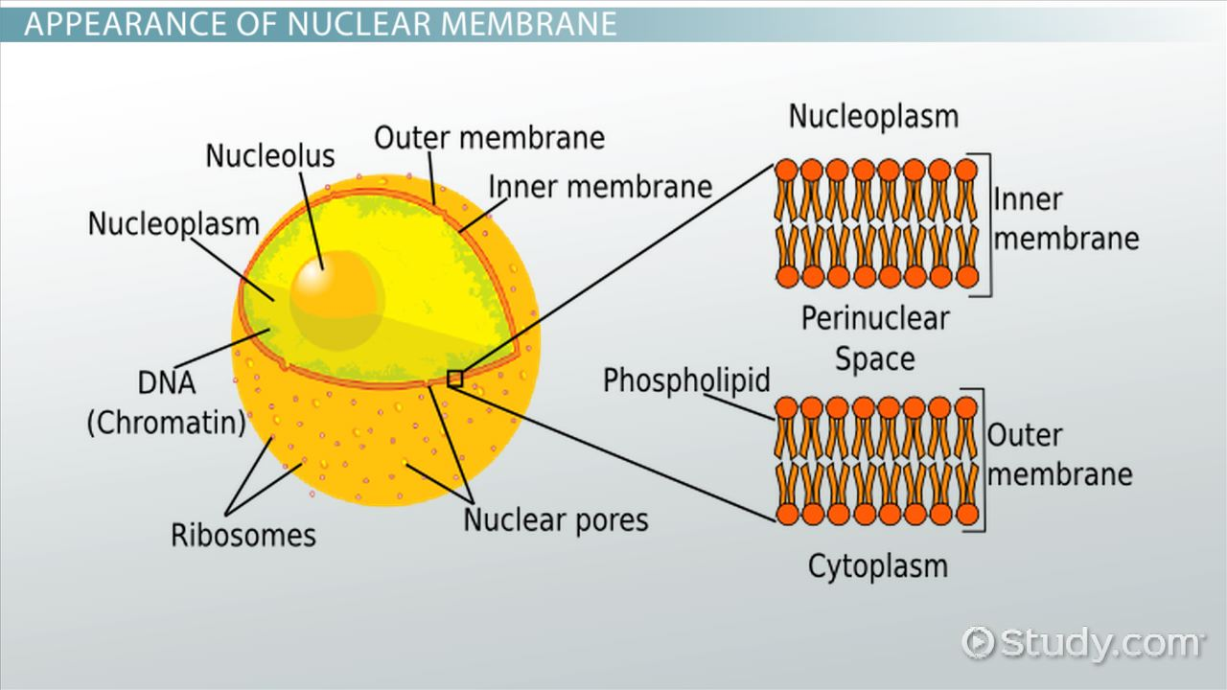

Slide 7
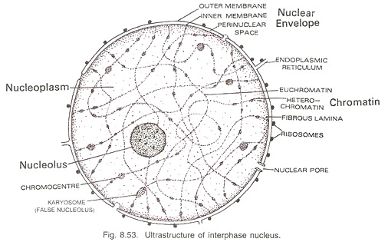

Slide 8
Parts of Nucleus
Nucleoplasm
It is a transparent, semifluid and colloidal substance which fills the nucleus. It contains nucleosides and a number of enzymes (e.g., DNA polymerase, RNA polymerase) which are required for the synthesis and functioning of DNA, RNA, nucleoproteins, etc.

Slide 9
Parts of Nucleus
Chromatin:
It is hereditary DNA-protein fibrillar complex which is named so be­cause of its ability to get stained with certain basic dyes. Chromatin occurs in the form of fine overlapping and coiled fibres which appear to produce a network called chromatin reticulum.
Chromatin fibres are distributed throughout the nucleoplasm.

Slide 10
Parts of Nucleus
They are differentiated into two regions— euchromatin and heterochro­matin.
Euchromatin is narrow lightly stained and diffused fibrous part which forms the bulk of chromatin.
Heterochromatin is wider darkly stained and condensed granular part which is attached here and there on the euchro­matin.

Slide 11
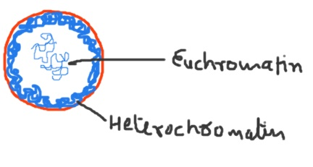

Slide 12
Parts of Nucleus
The whole of chromatin is not functional. Generally only a portion of euchromatin which is associated with acid proteins takes part in transcription or formation of RNAs. During prophase of nuclear division, the chromatin fibres condense to form a definite number of thread-like structures called chromosomes.

Slide 13
Parts of Nucleus
Nucleolus :Nucleolus is a naked, round or slightly irregular structure which is attached to the chromatin at a specific region.
A covering membrane is absent around nucleolus. Calcium seems to be essential for maintaining its configuration. Nucleolus has four components— amorphous matrix, granular part, fibrillar portion and chromatin

Slide 14
Functions of Nucleolus
(i) Nucleolus is the principal site for the development of ribosomal RNAs.
(ii) It is the centre for the formation of ribosome components,
(iii) Nucleolus stores nucleoproteins. The same are synthesised in the cytoplasm (over the ribosomes) and transferred to nucleolus,

Slide 15
FUNCTIONS OF NUCLEUS
Nucleus is an essential and integral part of the eukaryote cell. It stores genetic information in its DNA molecules which can be passed on to daughter cells. It also controls cellular activities.
Nucleus contains hereditary material called chromatin. Chromatin is DNA- protein complex. It is made of a number of fine fibres that condense to form chromosomes. Number of chromosomes is fixed for a species. They bear genes.

Slide 16
FUNCTIONS OF NUCLEUS
Chromatin part of nucleus possesses all the genetic information that is required for growth and development of the organism, its reproduction, metabolism and behaviour.
Nucleus controls cell metabolism and other activities through the formation of RNAs (mRNA, rRNA, tRNA) which control synthesis of particular type of enzymes.

Slide 17
FUNCTIONS OF NUCLEUS
Ribosomes are formed in nucleolus part of the nucleus.

