Slide 1
LYSOSOMES
Lysosomes are ultra structural particles of the cell containing hydrolytic enzymes responsible for digestion. They are formed by golgi bodies.
Particles isolated from tobacco and maize seedlings contain several of the hydrolases found in animal lysosomes. They are so called because they contain lytic or destructive enzymes. The enzymes, if released, can digest the cell and hence lysosomes are sometimes called ‘suicide bags’.

Slide 2
Lysosomes are globular or granu­lar in appearance without any characteristic shape or structure. These are bounded by a single lipoprotein membrane con­taining enzymes in crystalline form. The enzymes present are phosphatase, nuclease, lipase, protease, glycosidase, sulfates, amylase.

Slide 3
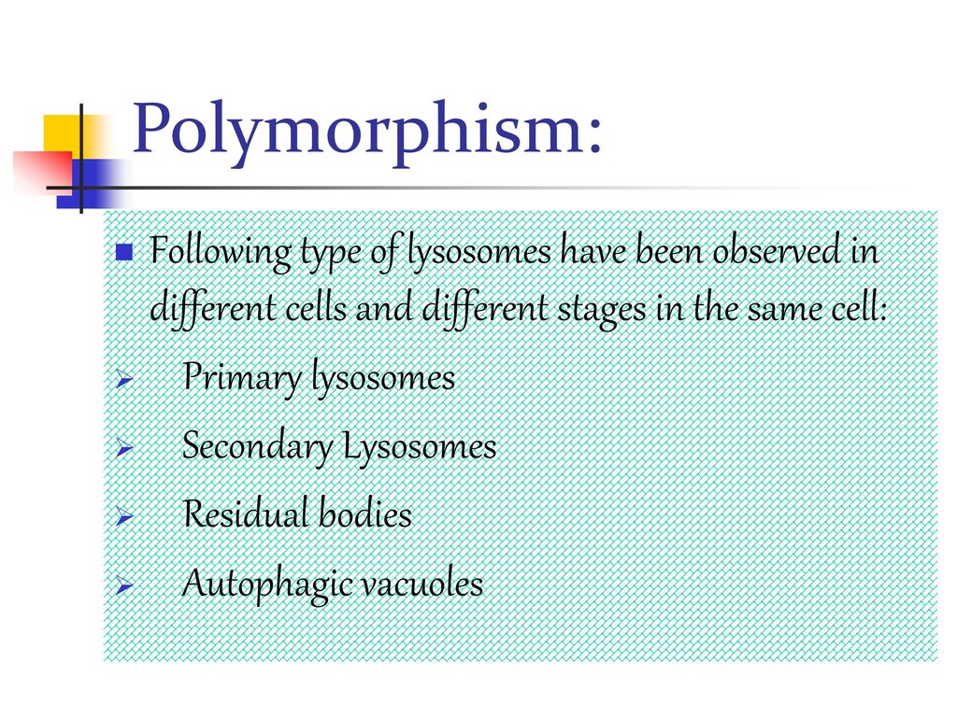

Slide 4
Primary lysosomes are homogeneous, dense, membrane-bound organelles packed with acid hydrolases capable of breaking down polymers of all types. The low pH required for hydrolase activity is maintained by a membrane ATP-dependent hydrogen ion pump.
Secondary:-These ultimately fuse with primary lysosomes, thus forming secondary lysosomes. This body having engulfed material within membrane has also full complements of acid hydrolases .

Slide 5
Residual bodies: lysosomes having undigested material or debris are called residual bodies.
Autophagic vacuoleIt is a special case in which lysosome digests a part of cell (e.g., mitochondria or portions of ER) by the process of autophagy.

Slide 6
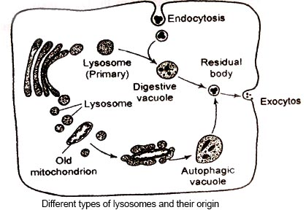

Slide 7
Function of Lysosomes in Cell
Lysosomes are bags containing digestive enzymes involved in digestion of intra­cellular and extracellular particles.
The primary lysosomes secrete hydrolases outside by exocytosis, resulting in degradation of the extracellular material (extracellular digestion).

Slide 8
Function of Lysosomes in Cell
Digestion of substances within the cell is called intracellular digestion. Intracellular digestion may involve heterophagy or autophagy.
Heterophagy is the intake of exogenous material into the cell by endocytosis and the subsequent breakdown of this material by enzymes in secon­dary lysosomes. Autophagy brings about digestion of cell’s own material on the death of a cell, or with cellular injury.

Slide 9
Microfilaments
Microfilaments, also called actin filaments, are polymers of the protein actin that are part of a cell’s cytoskeleton.
Common to all eukaryotic cells, these filaments are primarily structural in function and are an important component of the cytoskeleton, along with microtubules and often the intermediate filaments.
They are the smallest filaments of the cytoskeleton.

Slide 10
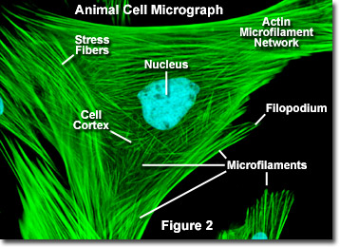
Microfilaments
Microfilament functions include cytokinesis, amoeboid movement, cell motility, changes in cell shape, cell contractility.

Slide 11
Video link
https://www.youtube.com/watch?v=URUJD5NEXC8

