Slide 1
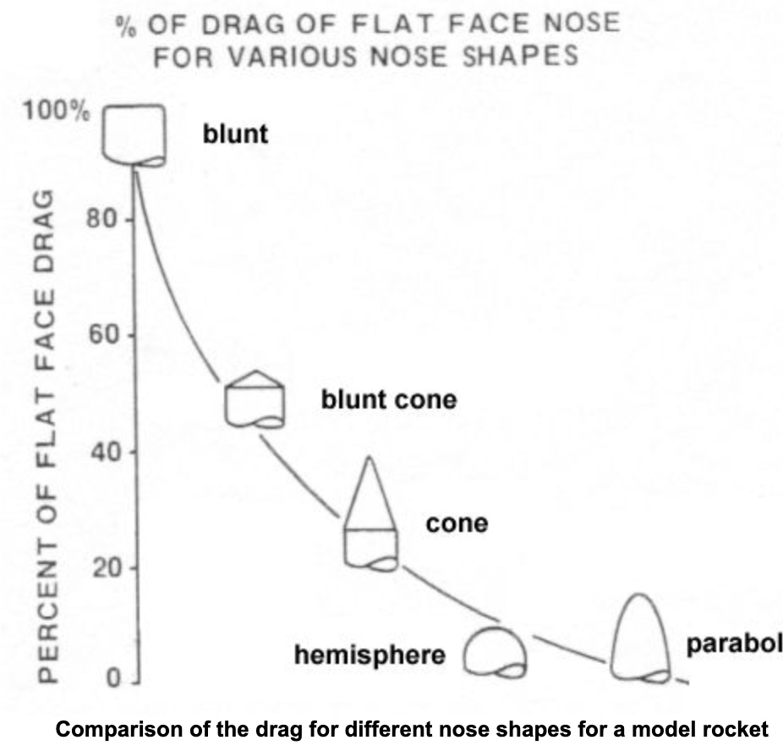
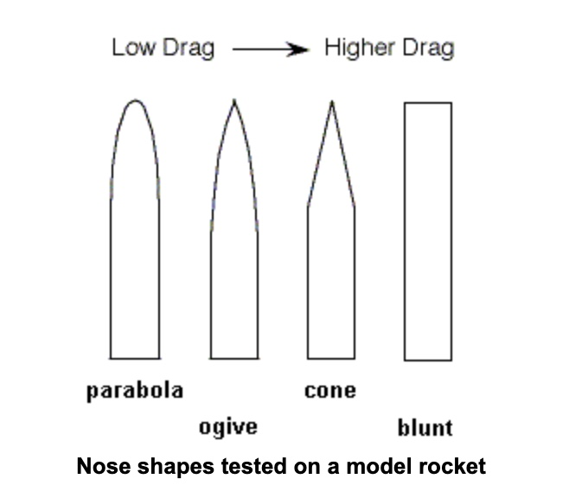
Nose Shape
By: Brandon Henry

Slide 2
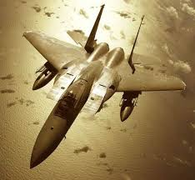
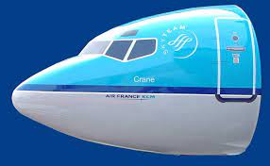
Rounded Nose vs. Pointed Nose
Rounded Nose
Attributes:
Has a higher mass
Effective in Subsonic settings
Emulates a parabolic nose shape
Pushes air in front to allow air to roll over the fuselage
Pointed Nose
Attributes:
Uses more material to make up the length of the nose
Effective in Supersonic settings
Keeps Shockwave away from aircraft
Conic Shape

Slide 3
Rounded Noses
Since we’re worried about lap time, we want the plane to have as little drag as possible. Rounded noses push the air in front of them allowing it to roll over the fuselage with little resistance. In Subsonic speed setting this is extremely useful (this is why commercial airplanes use this nose model)

Slide 4
Pointed Noses
We do want the plane to have as little drag as possible to achieve the best lap time. Pointed noses are most effective at reducing drag in supersonic speed settings, HOWEVER the plane we build is NOT going to be flying at supersonic speeds.

Slide 5
A Rounded Nose should be used for out Plane
We should try to emulate the nose of a Boeing commercial airplane because it takes into account the need for a small window for a pilot to see through.

