Slide 1
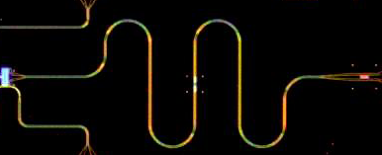
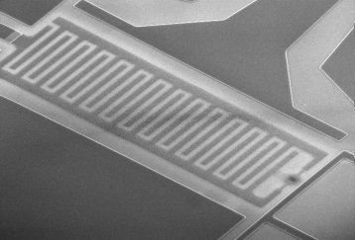
C_{g}
C_{gq}
V_{g}
C_{Σ}
E_{J}

