Slide 1
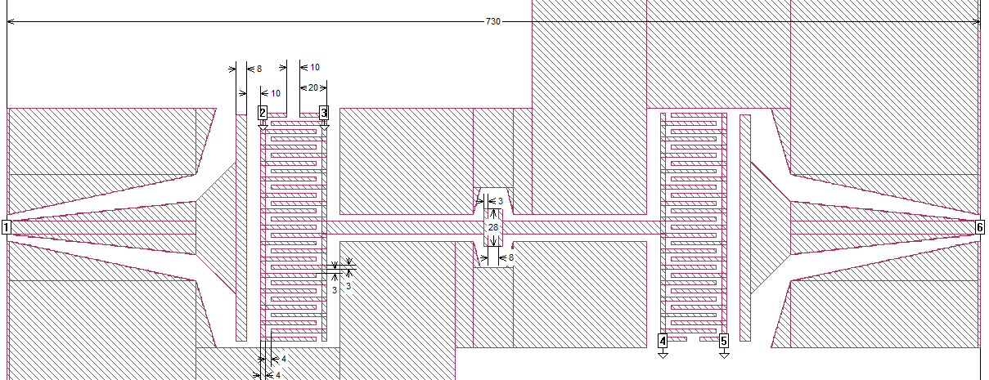
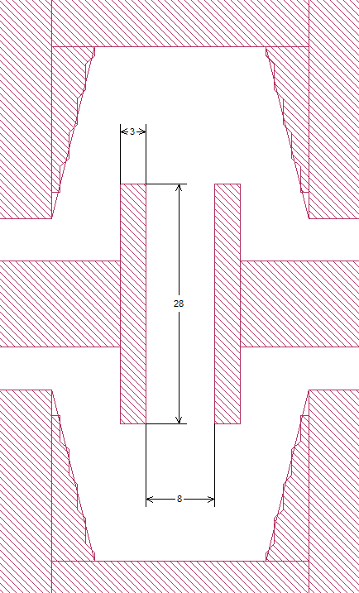
a)
b)
c)
L₂₃
L₄₅
d)
C₁₂
C₃₄
C₅₆
C_{g1}
C_{qq}
C_{g2}
C₂₃
C₄₅
L_{J1}
L_{J2}
Z₀
Z₀
C₁₀
C₂₀
C₃₀
C₄₀
C₅₀
C₆₀
Z₀
Z₀
C_{J1}
C_{J2}

