Slide 1
See file CHI2A3 for additional figures
in A3 format

Slide 2
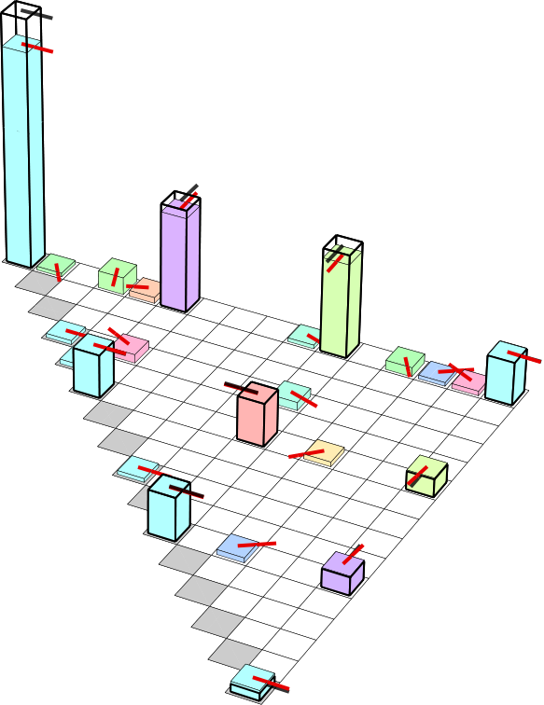
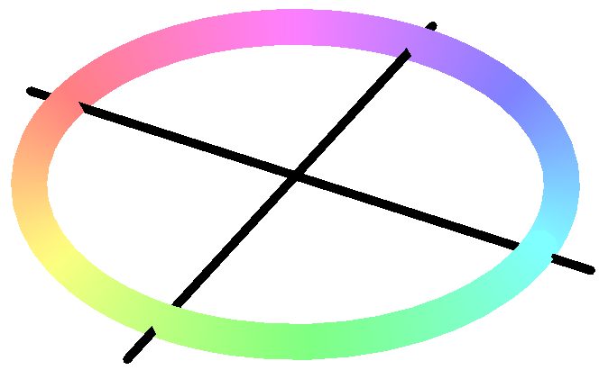
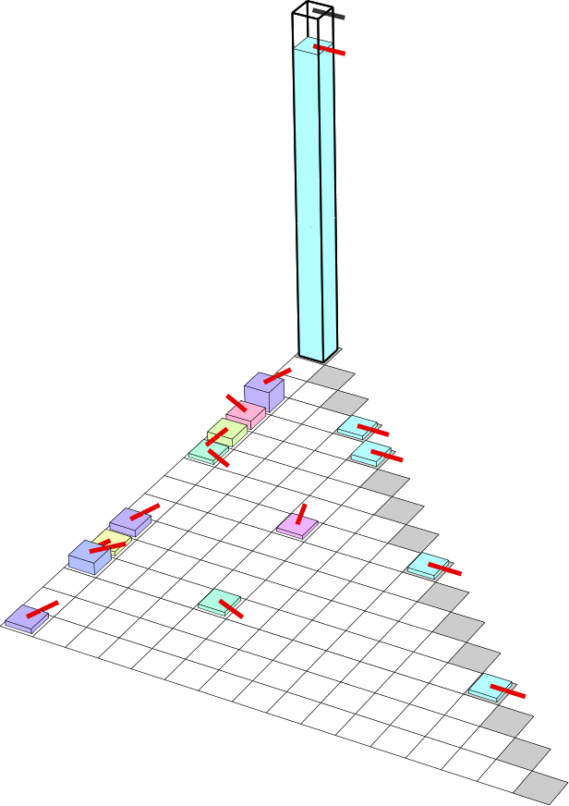
a) χ matrix
0.73
π/2
∗
π
0
−π/2
II
∗
∗
ZZ
∗
∗
∗
II
IX
IY
IZ
∗
XI
~
∗
XX
b) χ matrix
1
XY
XZ
F_{g} = 0.90
YI
∗
YX
∗
YY
YZ
ZI
∗
ZX
ZY
ZZ
II
S
S
S
Z
Z
Z
ZZ
T₁
T₁
T₁
II
IX
IY
IZ
XI
XX
XY
XZ
YI
YX
YY
YZ
ZI
ZX
ZY
ZZ

Slide 3
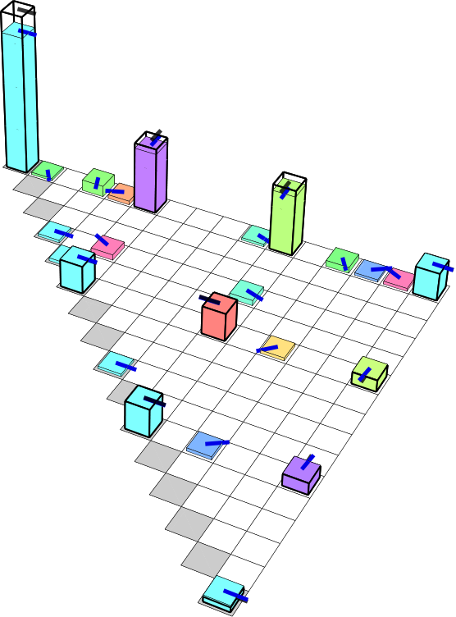
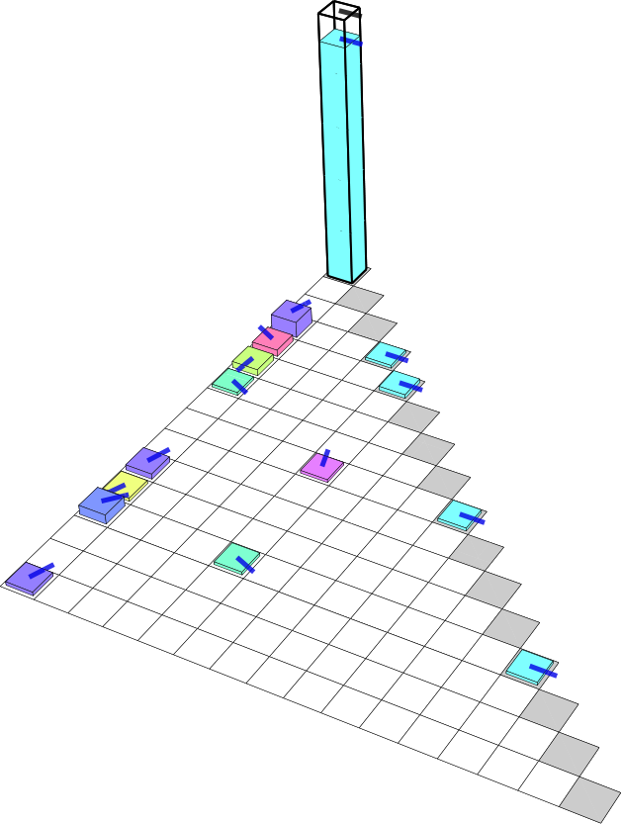
a) χ matrix
0.73
π/2
π
∗
0
II
−π/2
∗
∗
ZZ
∗
∗
II
∗
IX
IY
∗
IZ
XI
XX
∗
XY
XZ
YI
~
1
∗
YX
b) χ matrix
F_{g} = 0.90
YY
YZ
∗
ZI
ZX
∗
ZY
ZZ
II
S
S
S
Z
T₁
Z
T₁
Z
T₁
ZZ
II
IX
IY
IZ
XI
XX
XY
XZ
YI
YX
YY
YZ
ZI
ZX
ZY
ZZ

Slide 4
a) χ matrix
1
π/2
F_{g} = 0.90
π
0.73
0
−π/2
∗
~
b) χ matrix
∗
∗
S
∗
S
S
∗
II
∗
IX
Z
IY
Z
Z
T₁
T₁
T₁
IZ
∗
XI
XX
∗
XY
II
IX
XZ
IY
IZ
YI
XI
XX
∗
YX
XY
XZ
YY
YI
YX
YZ
YY
ZI
YZ
ZI
ZX
ZX
ZY
∗
ZY
ZZ
ZZ

Slide 5
a) χ matrix
1
0.73
π/2
F_{g} = 0.90
π
∗
0
−π/2
~
∗
b) χ matrix
∗
∗
∗
II
∗
IX
IY
∗
IZ
S
XI
S
S
XX
∗
XY
Z
XZ
Z
Z
T₁
T₁
T₁
YI
∗
YX
YY
II
YZ
IX
IY
ZI
IZ
XI
XX
ZX
XY
XZ
∗
ZY
YI
YX
ZZ
YY
YZ
ZI
ZX
ZY
ZZ

Slide 6
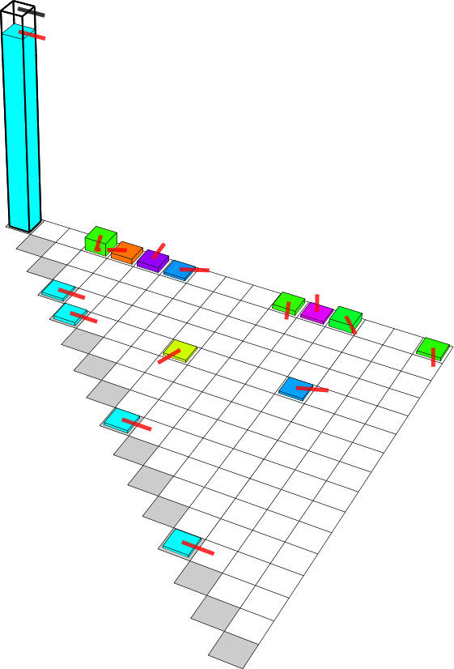
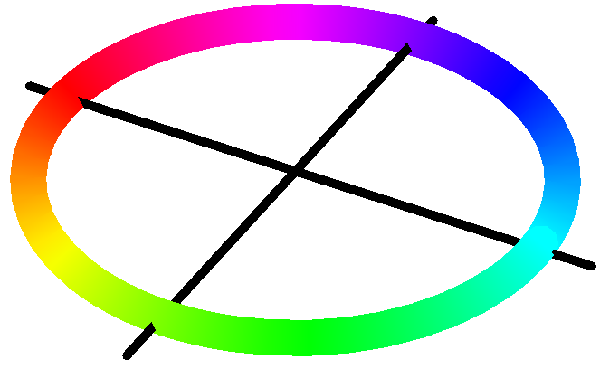
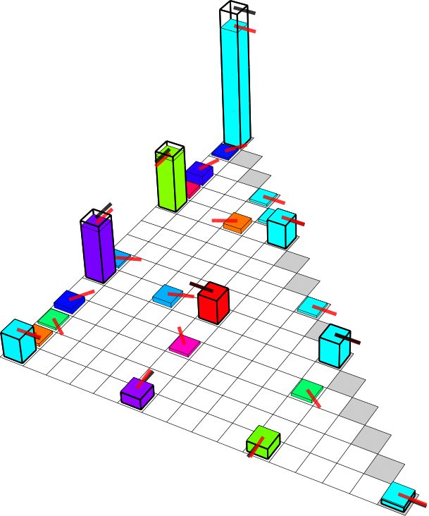
~
a) χ matrix
1
b) χ matrix
F_{g} = 0.90
π/2
0.73
π
∗
0
−π/2
S
S
S
Z
Z
Z
II
∗
IX
T₁
IY
T₁
T₁
IZ
∗
XI
∗
XX
XY
XZ
YI
∗
YX
YY
∗
∗
YZ
ZI
II
IX
ZX
IY
IZ
∗
ZY
XI
XX
∗
ZZ
XY
XZ
YI
YX
YY
YZ
ZI
ZX
∗
ZY
ZZ

Slide 7
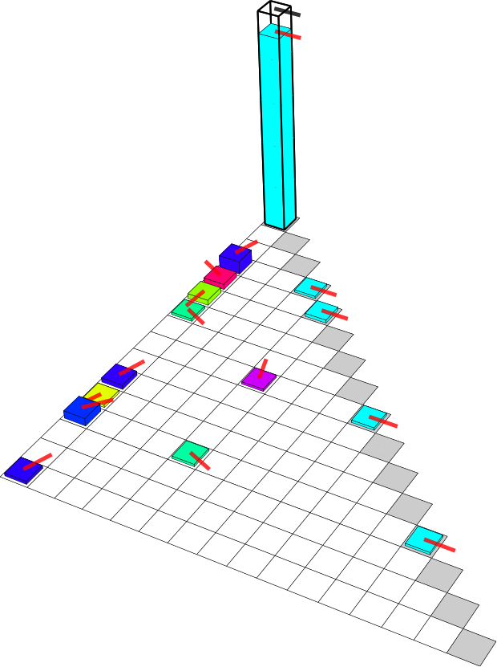
0.73
π/2
∗
π
0
a) χ matrix
1
−π/2
F_{g} = 0.90
∗
∗
∗
~
b) χ matrix
II
∗
IX
IY
∗
∗
IZ
XI
II
XX
IX
IY
XY
IZ
∗
XZ
XI
XX
YI
S
XY
∗
YX
S
YY
S
XZ
YI
Z
YX
Z
YZ
Z
YY
YZ
ZI
ZI
∗
ZX
T₁
ZX
ZY
ZY
T₁
ZZ
T₁
ZZ
II
IX
IY
IZ
XI
XX
XY
XZ
YI
YX
YY
YZ
ZI
ZX
ZY
ZZ

Slide 8
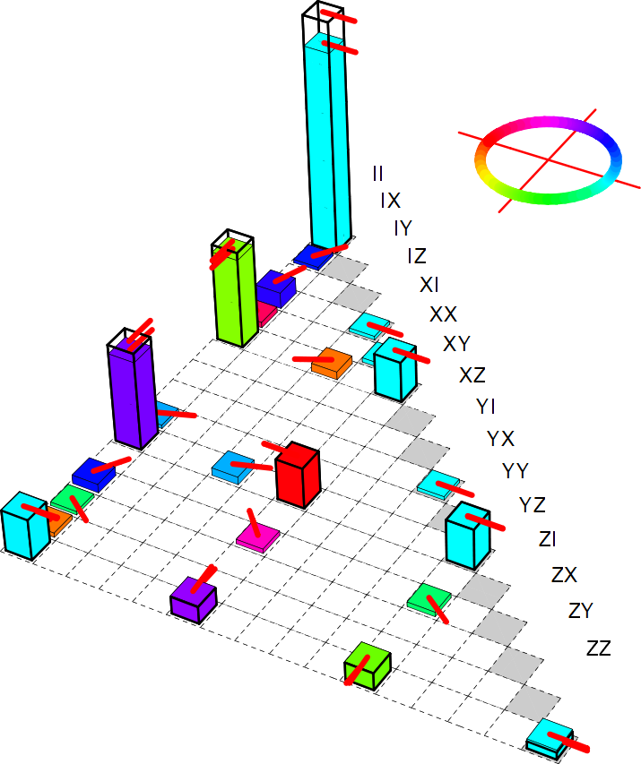
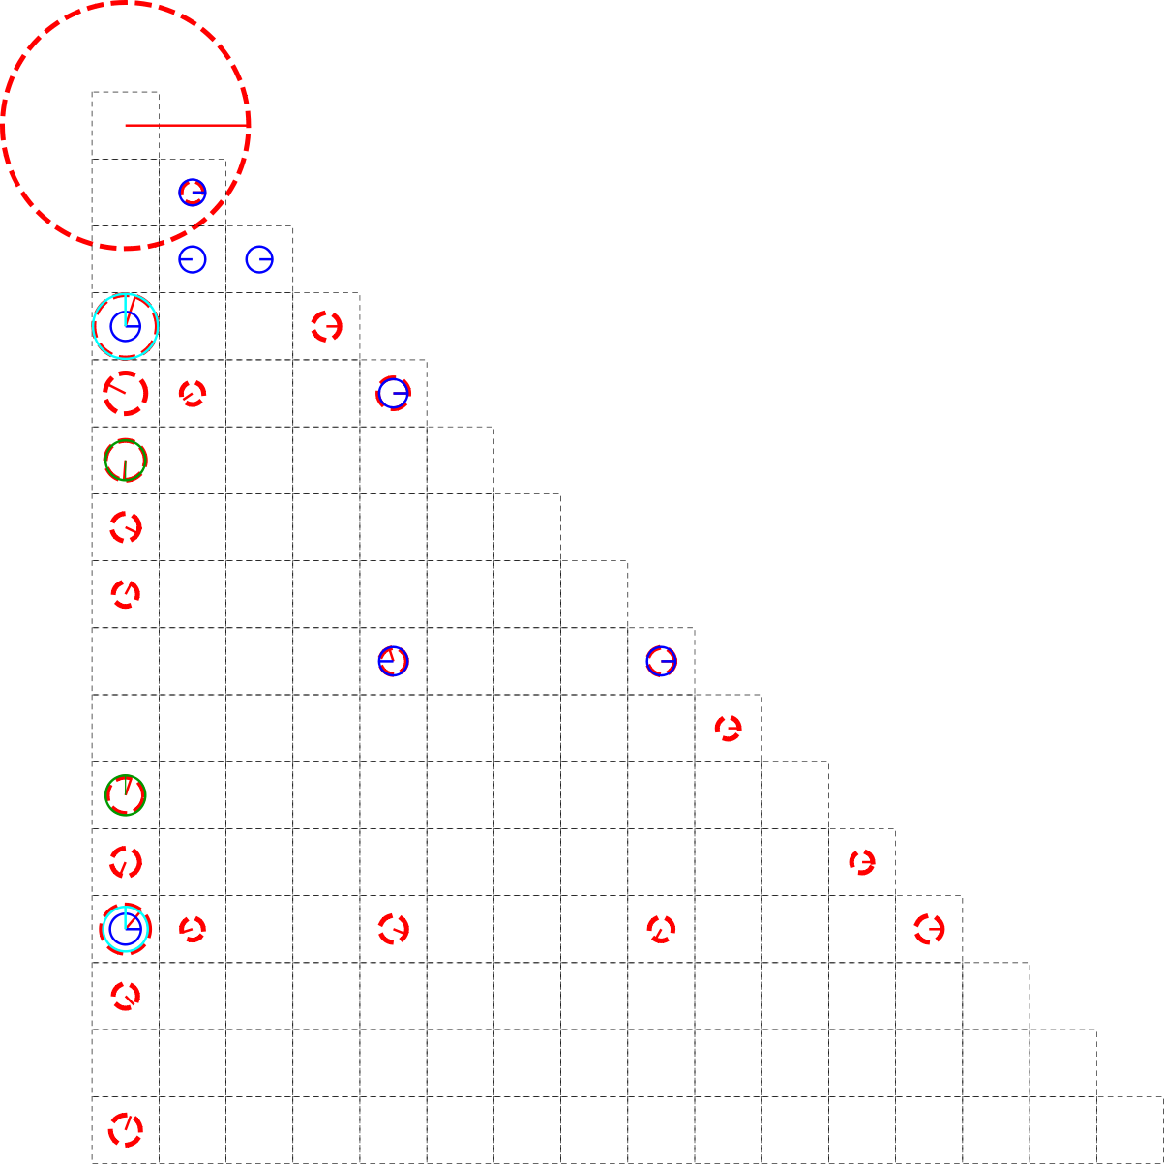
a) χ matrix
0.73
∗
π/2
F_{g} = 0.90
π
0
−π/2
∗
∗
∗
∗
∗
∗
∗
0.90
∗
∗
~
b) χ matrix
experiment
∗
∗
Z errors -3.5°,-7°
overswap +5°
relaxation
T₁=436, 520ns
∗
∗
∗
∗
∗
∗
∗

Slide 9
0.73
∗
π/2
π
0
−π/2
∗
∗
∗
∗
∗
∗
∗
∗
∗

Slide 10
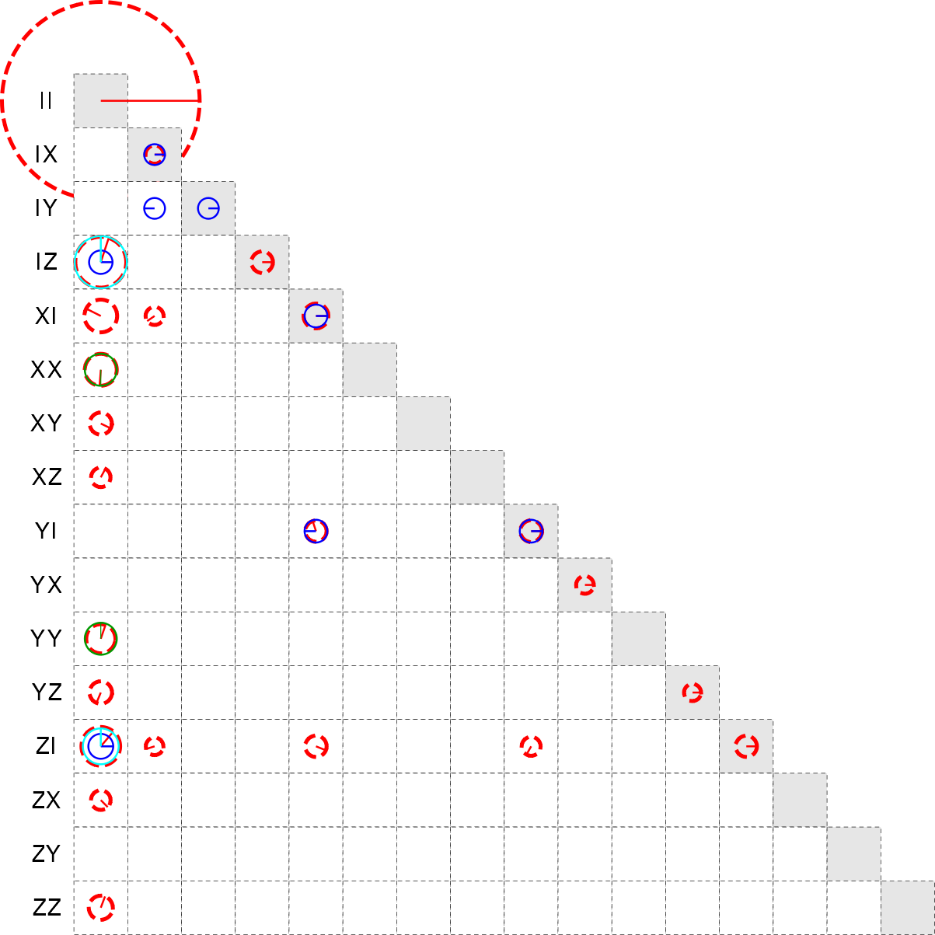

Slide 11
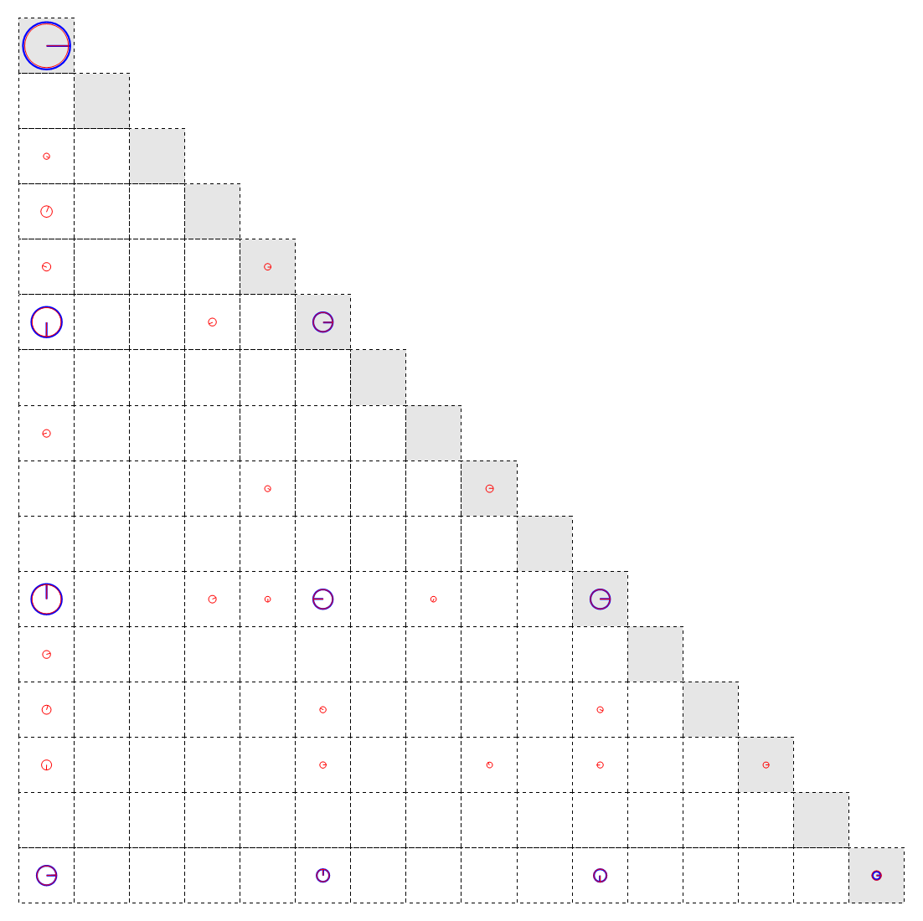

Slide 12
Adobe Illustrator File at: L:\local-expdata\FO-C5\3rd-Run\2011_04_21\matrices - quantum process tomography at 31 ns - 16\chi matrix and kraus operators.ai
A
B
C
D
E
1.0
0.8
0.6
0.4
0.2
0.0
A
B
C
D
E

Slide 13
A
B
C
D
E

