Slide 1
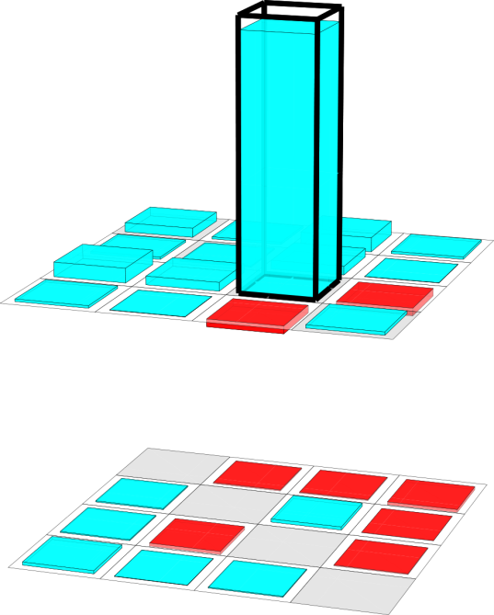
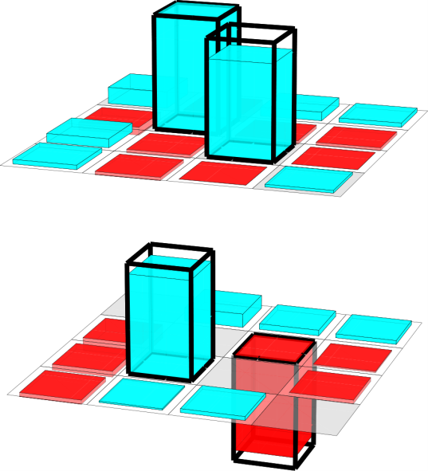

Target: I10>
Target: $\frac{− \text{i} \text{I}\text{01> + }\text{I}\text{10> }}{√2}$
a)
<00I
<01I
<10I
<11I
I00>
Simulation data at L:\local-expdata\FO-C5\3rd-Run\2011_04_13\good_data\simulation of swap 2.par
Data L:\local-expdata\FO-C5\3rd-Run\2011_04_13\good_data\swap.opj
Density matrices from \\ORDERIC\users\Commun\PROJET Cavités\articles\ISWAP\swap.nb
Spins: L:\local-expdata\FO-C5\3rd-Run\2011_04_21\Quantum Process Tomography at 31 ns-16-spins-0.txt
I01>
I10>
I11>
π
0
ideal
measured
b)
1
Re
Re
I00>
I01>
I10>
I11>
<00I
<01I
<10I
<11I
Im
Im
F=95%
F=91%
C=0.85

Slide 2
a)
I10>
I01>
occupation prob.
I00>
I11>
31
Simulation data at L:\local-expdata\FO-C5\3rd-Run\2011_04_13\good_data\simulation of swap 2.par
Data L:\local-expdata\FO-C5\3rd-Run\2011_04_13\good_data\swap.opj
Density matrices from \\ORDERIC\users\Commun\PROJET Cavités\articles\ISWAP\swap.nb
Spins: L:\local-expdata\FO-C5\3rd-Run\2011_04_21\Quantum Process Tomography at 31 ns-16-spins-0.txt
b)
coupling time Δt (ns)
<Pauli operator>
IX
IZ
YI
YX
XY
ZY
YZ
IX
IZ
YI
XX
ZX
YY
XZ
IY
XI
ZI
XX
ZX
YY
XZ
ZZ
IY
XI
ZI
YX
XY
ZY
YZ
c)
ZZ
1
Re
Re
I00>
I01>
I10>
I11>
I00>
I01>
I10>
I11>
Im
Im
ideal
measured
F=95%
F=91%
C=0.85

Slide 3
a)
I10>
I01>
occupation prob.
I00>
I11>
31
Simulation data at L:\local-expdata\FO-C5\3rd-Run\2011_04_13\good_data\simulation of swap 2.par
Data L:\local-expdata\FO-C5\3rd-Run\2011_04_13\good_data\swap.opj
Density matrices from \\ORDERIC\users\Commun\PROJET Cavités\articles\ISWAP\swap.nb
Spins: L:\local-expdata\FO-C5\3rd-Run\2011_04_21\Quantum Process Tomography at 31 ns-16-spins-0.txt
b)
coupling time Δt (ns)
<Pauli operator>
IX
IZ
YI
YX
XY
ZY
YZ
IX
IZ
YI
XX
ZX
YY
XZ
IY
XI
ZI
XX
ZX
YY
XZ
ZZ
IY
XI
ZI
YX
XY
ZY
YZ
c)
ZZ
I00>
I01>
I10>
I11>
π
0
ideal
measured
F=95%
F=91%
C=0.85

Slide 4
a)
I10>
I01>
occupation prob.
I00>
I11>
31
Simulation data at L:\local-expdata\FO-C5\3rd-Run\2011_04_13\good_data\simulation of swap 2.par
Data L:\local-expdata\FO-C5\3rd-Run\2011_04_13\good_data\swap.opj
Density matrices from \\ORDERIC\users\Commun\PROJET Cavités\articles\ISWAP\swap.nb
Spins: L:\local-expdata\FO-C5\3rd-Run\2011_04_21\Quantum Process Tomography at 31 ns-16-spins-0.txt
b)
coupling time Δt (ns)
<Pauli operator>
IX
IZ
YI
YX
XY
ZY
YZ
IX
IZ
YI
XX
ZX
YY
XZ
IY
XI
ZI
XX
ZX
YY
XZ
ZZ
IY
XI
ZI
YX
XY
ZY
YZ
c)
ZZ
I00>
I01>
I10>
I11>
π
0
ideal
measured
F=95%
F=91%
C=0.85

Slide 5
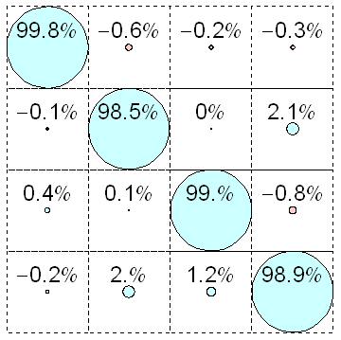
a) raw
d)
10
01
00
11
b) readout error
corrected
e)
|1>
|0>
|1>
|0>
81%
81%
1
93%
88%
0
I10>
c) readout crosstalk
corrected
f)
|00>
|01>
|10>
|11>
00
I01>
01
10
I00>
11
I11>

Slide 6
a)
I10>
I01>
occupation prob.
I00>
I11>
31
Simulation data at L:\local-expdata\FO-C5\3rd-Run\2011_04_13\good_data\simulation of swap 2.par
Data L:\local-expdata\FO-C5\3rd-Run\2011_04_13\good_data\swap.opj
Density matrices from \\ORDERIC\users\Commun\PROJET Cavités\articles\ISWAP\swap.nb
Spins: L:\local-expdata\FO-C5\3rd-Run\2011_04_21\Quantum Process Tomography at 31 ns-16-spins-0.txt
b)
swap duration (ns)
<Pauli operator>
XI
ZI
IY
XY
YX
YZ
ZY
XI
ZI
IY
XX
XZ
YY
ZX
YI
IX
IZ
XX
XZ
YY
ZX
ZZ
YI
IX
IZ
XY
YX
YZ
ZY
c)
ZZ
I00>
I01>
Not corrected for tomo error
I10>
I11>
Square root fidelities
ideal
measured
F=98%
F=94%

Slide 7
Simulation data at L:\local-expdata\FO-C5\3rd-Run\2011_04_13\good_data\simulation of swap 2.par
Data L:\local-expdata\FO-C5\3rd-Run\2011_04_13\good_data\swap.opj
Density matrices from \\ORDERIC\users\Commun\PROJET Cavités\articles\ISWAP\swap.nb
a)
|10>
|01>
switching probability
|00>
|11>
31
swap duration (ns)
ideal
b)
measured
|00>
|01>
|10>
|11>
F=98%
F=94%

Slide 8
a)
I10 >
I 01 >
occupation prob.
I 00 >
I 11 >
31
Simulation data at L:\local-expdata\FO-C5\3rd-Run\2011_04_13\good_data\simulation of swap 2.par
Data L:\local-expdata\FO-C5\3rd-Run\2011_04_13\good_data\swap.opj
Density matrices from \\ORDERIC\users\Commun\PROJET Cavités\articles\ISWAP\swap.nb
Spins: L:\local-expdata\FO-C5\3rd-Run\2011_04_21\Quantum Process Tomography at 31 ns-16-spins-0.txt
b)
swap duration (ns)
1.0
0.5
0.0
-0.5
-1.0
xi
yi
zi
ix
iy
iz
xx
xy
xz
yx
yy
yz
zx
zy
zz
xi
yi
zi
ix
iy
iz
xx
xy
xz
yx
yy
yz
zx
zy
zz
c)
|00>
|01>
|10>
|11>
ideal
measured
F=98%
F=94%

Slide 9
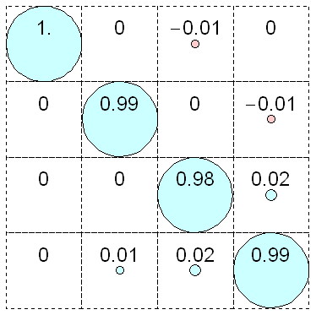

Slide 10
a)
raw data
b)
visibility corrected
c)
visibility and crosstalk corrected

Slide 11
Fig 2 paper iSWAP
measurement
simulation
|00>
|10>
|01>
|11>

Slide 12
Supplementary material for paper iSWAP

Slide 14
Simulation data at L:\local-expdata\FO-C5\3rd-Run\2011_04_13\good_data\simulation of swap 2.par
Data at L:\local-expdata\FO-C5\3rd-Run\2011_04_13\good_data\quantum swap vs. Duration.par
measurement
simulation
|00>
|10>
|01>
|11>
|00>
|10>
|01>
|11>

Slide 15
Data at L:\local-expdata\FO-C5\3rd-Run\2011_04_13\good_data\quantum swap vs. Duration.par

Slide 16
<Pauli operator>
IX
IZ
YI
YX
XY
ZY
YZ
IX
IZ
YI
XX
ZX
YY
XZ
IY
XI
ZI
XX
ZX
YY
XZ
ZZ
IY
XI
ZI
YX
XY
ZY
YZ
ZZ

